Slide 1
JPEG Compression
Mini Project
M A Rama Murthy - 21EC39016
B H S Sagar - 21EC39038

Slide 2
CONTENTS
Objective
Introduction
Related Work
Results
Discussions and Conclusions
References

Slide 3
OBJECTIVE
The objective of this project is to implement and analyze JPEG image compression techniques, focusing on block-based Discrete Cosine Transform (DCT) and quantization.
It aims to evaluate the impact of compression on image quality using metrics like PSNR and compression ratio.
The project also includes visualizing compressed images and generating performance graphs for different compression parameters.

Slide 4
INTRODUCTION
Image compression is the process of reducing the amount of data required to store or transmit an image. It comes in two main types:
Lossless Compression: This method preserves the image quality perfectly, as the recovered image is identical to the original.
Lossy Compression: While achieving high compression, it sacrifices some image quality during recovery, making it suitable for network transmission.
JPEG : Joint Photographic Experts Group

Slide 5
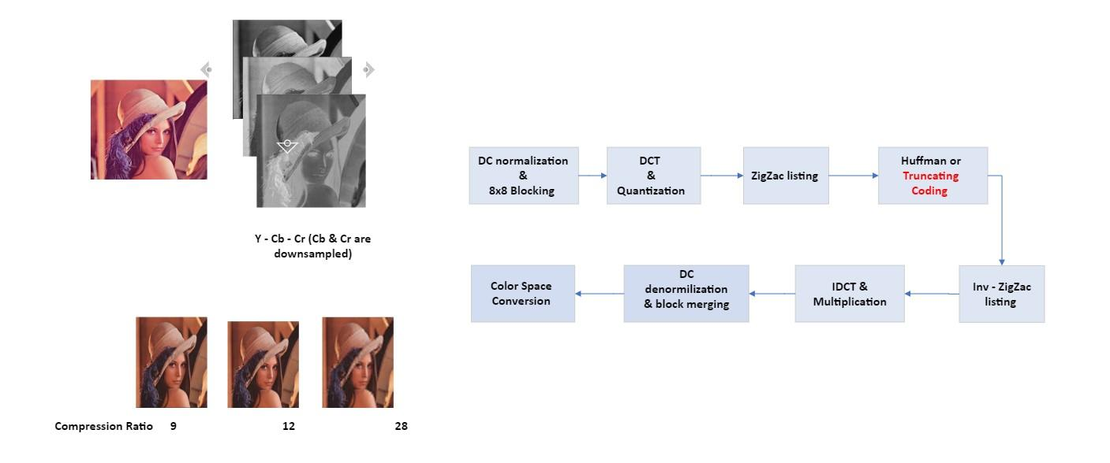
PIPELINE
.

Slide 6
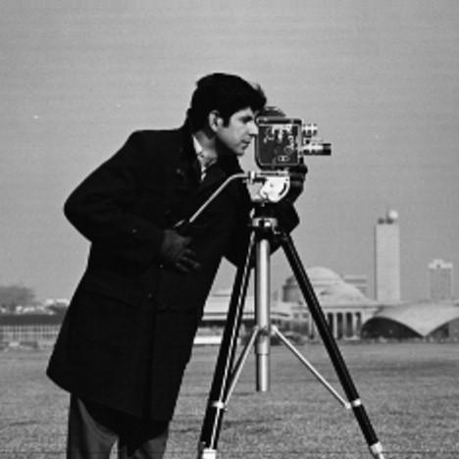

RESULTS
ORIGINAL IMAGE COMPRESSED IMAGE

Slide 7


RESULTS
ORIGINAL IMAGE COMPRESSED IMAGE

Slide 8
Discussions and Conclusion
JPEG compression is lossy, meaning it sacrifices image content during quantization.
Image quality is reduced due to content loss, making it unsuitable for sharp edges or animated graphics.
JPEG relies on the Discrete Cosine Transform (DCT), concentrating energy in the center of the spectrum.
Chroma subsampling further decreases quality by downsampling chrominance, which is less noticeable to the human eye.
So we have successfully designed the entire JPEG Compression pipeline.

Slide 9
References
IEEE Xplore Full-Text PDF:
Discrete cosine transform - Wikipedia
JPEG Data Compression
Huffman Coding

