Slide 1
Social Network
PROJECT

Slide 2
Made By : G31
1.Mohamed Morsy Sec: 3 BN: 33882 2.Shimaa Hassan Sec: 2 BN: 33803 3.Soha Alaa Sec: 2 BN: 33855 4.Maged Mabrouk Sec: 2 BN: 33845

Slide 3
Github link:
https://github.com/M-Morsy/Social-Network

Slide 4
Language used:
Python

Slide 5
Data Base:
Save And Load JSON Format Data From Local .json File

Slide 6
OOP for Social Network
PROJECT

Slide 7
Files
Person.py: class to hold each user's basic information
Post.py: class to hold the comment and post classes to enable users to post and comment on each others' posts
hashing.py: An extra data structure
LoadSave.py: To load and save out Network
Users.py: class to hold users' data structure, a graph. with all the related algorithms
Testing files (some may be removed with time):
Test senarios.py
User_Person_Test.py
posttest.py
Person_Test.py
Relation hints.py

Slide 8
Person.py
Each person has a set of attributes like:
ID: for system identification
name: user name
email
password: used later on in registration
age
location: countries
gender
posts: list of posts IDs
groups: list of group IDs To be done later
admin: list of group IDs where this person is the group admin To be done later

Slide 9
Person.py
requests_sent: dictionary with all other users' ids that this user sent friend requests to
requests_received: dictionary with all other users' ids that this user received friend requests from
setters and getters for all attributes
interface with post class:
add post
remove post
interface with group class: To be done later - check future work

Slide 10
Users.py
This file is divided into sections each section delivers a certain functionality
section one:
class attributes and static data
constructor and destructor
Graph functionality
section two: searching algorithms To Be Done
section three: Posts
One static attribute is Posts, which is a list of Post objects to enable use of all Post methods Also an interface with Comment class through Post class, not directly. But some extra functions are needed here like
add_post(self, post, user_id) to add Post objects to the static Post list in class
get_posts(self, user_id): to view all posts in the network

Slide 11
Users.py
section four: Operation on a group
This section mainly is interested in relations between users, sending requests and accepting them or rejecting them
It's also possible to show all friends of a certain user with show_friends()
It's possible to show all friends' posts of a certain user, his/her timeline, with show_friends_posts()
It's possible to check relation between two users
section five: Extract trees and graphs
This section is interested in finding the shortest path between users and returning sub trees of graphs. This should interface with hashing.py in the future To be Done
section six: Visualization
This section is intersted in visualizing graphs of sub-graphs
show_graph(): to give a draw the whole network
Further work needed
Section Seven: Analysis on the graph To be done later

Slide 12
Post.py
Each post have some attributes:
a string representing the post text
user_id: the unique ID of the user who wrote the post
post_id: a unique post ID to access it
the exact date and time when the post written
a list of comments objects
each comment have the same attributes as the post
Also contains some methods:
setters and getters for the attirbutes
delete post
edit the post text
delete comment
edit comment
post view to show the post and its comment contents

Slide 13
LoadSave.py
The Save function
Our network system relays on a graph containing all the users of the system connected together, this function take all the users data and attributes like name, age, gender, posts, comments,.. etc. and save it in a dictionary within a json file to use it another time.
The Load function
it takes back the saved data from the json file. like all the users and their connections and data. and load it into its suitable data structure to become usable.

Slide 14
Data Structure for Social Network
PROJECT

Slide 15
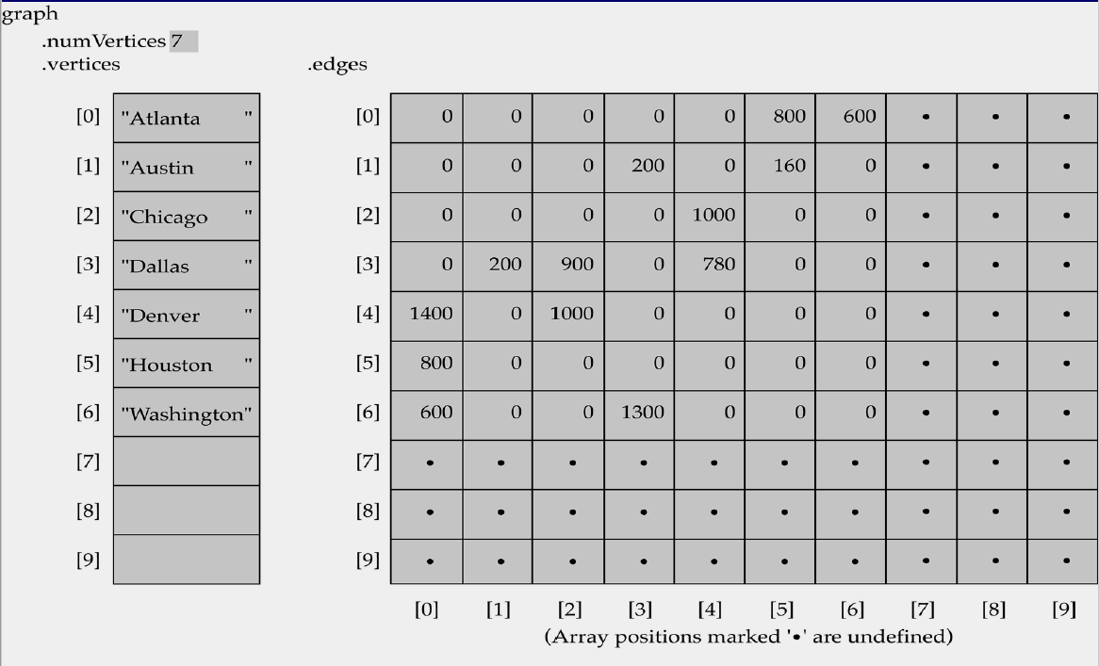
* Speed is O(1): * Uses: - to know if user with id x connected to user with id y - to know the strength or type of relation
Matrix

Slide 16
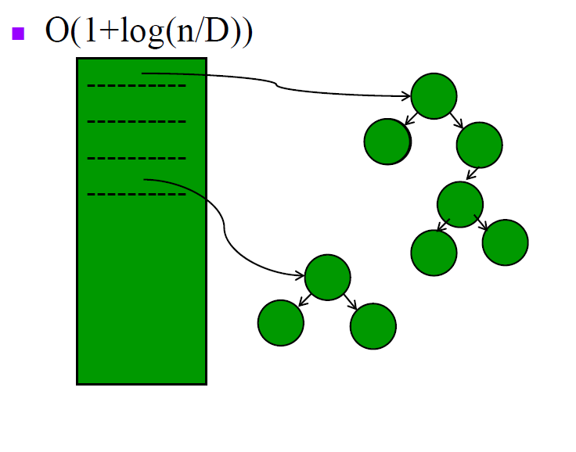
Hash Tables

Slide 17
Age Hash Table
Uses:
To get a binary search tree of users that are in the range of specific age, we can use it in marketing or to classify the posts or advertising.
Our Classification:
12 keys in hash table guide you to 12 binary search trees to find a range of ages that your age is on.
BST:
Age from 0 to 9 - Age from 10 to 19 - Age from 20 to 29
Age from 30 to 39 - Age from 40 to 49 - Age from 50 to 59
Age from 60 to 69 - Age from 70 to 79 - Age from 80 to 89
Age from 90 to 99 - Age from 100 to 109 - Age from 110 or more

Slide 18
Name Hash Table
Uses:
To get a binary search tree of users that have the same name or any equivalent name, by summing the ASCII code of letters and multiply it by 70 to get the key of the hash table.
Our Classification:
12 keys in hash table guide you to 12 binary search trees to find this name or equivalent names to it.
After summation, we take the remainder of divide your number by 12 to get index in the range of [0,12[.

Slide 19
Country Hash Table
Uses:
To get a binary search tree of users that have the same location or any equivalent location by the name of country, by summing the ASCII code of letters and multiply it by 70 to get the key of the hash table.
Our Classification:
12 keys in hash table guide you to 12 binary search trees to find this name or equivalent names to it.
After summation, we take the remainder of divide your number by 12 to get index in the range of [0,12[.

Slide 20
hashing.py
In general, it contains all hash tables and BST class.
Class Node is the BST class contains:
* Attributes:
self.left = left node, self.right = right node, self.data = data, self.id = user id
* Methods:
def __init__(self, data , id): to set the root node with the data and initial user id that’s set to -1 refers to there are no users yet
def insert(self, data , id): to insert a new node or user to BST
def PrintTree(self): print the tree from largest element to lowest one
def delete(self, key): delete the user’s node with the given id

Slide 21
hashing.py
* Objects:
# age binary trees
ageRoot9 = Node(int(9 / 2) + 1, -1), ageRoot19 = Node(int(19 / 2) + 1, -1), ageRoot29 = Node(int(29 / 2) + 1, -1)
ageRoot39 = Node(int(39 / 2) + 1, -1), ageRoot49 = Node(int(49 / 2) + 1, -1), ageRoot59 = Node(int(59 / 2) + 1, -1)
ageRoot69 = Node(int(69 / 2) + 1, -1), ageRoot79 = Node(int(79 / 2) + 1, -1), ageRoot89 = Node(int(89 / 2) + 1, -1)
ageRoot99 = Node(int(99 / 2) + 1, -1), ageRoot109 = Node(int(109 / 2) + 1, -1), ageRoot119 = Node(int(119 / 2) + 1, -1)
# Node(int(9 / 2) + 1, -1) to set the root node to the avg. number between the range of ages and no user will be on it.

Slide 22
hashing.py
* Objects:
# name binary trees
nameRoot0 = Node("l",-1), nameRoot1 = Node("m",-1), nameRoot2 = Node("n",-1)
nameRoot3 = Node("o",-1), nameRoot4 = Node("p",-1), nameRoot5 = Node("q",-1)
nameRoot6 = Node("r",-1), nameRoot7 = Node("s",-1), nameRoot8 = Node("t",-1)
nameRoot9 = Node("u",-1), nameRoot10 = Node("v",-1), nameRoot11 = Node("w",-1)
# Node("l",-1) to set the root node to hash table index number and no user will be on it.

Slide 23
hashing.py
* Objects:
# country binary trees
countryRoot0 = Node("l",-1), countryRoot1 = Node("m",-1), countryRoot2 = Node("n",-1)
countryRoot3 = Node("o",-1), countryRoot4 = Node("p",-1), countryRoot5 = Node("q",-1)
countryRoot6 = Node("r",-1), countryRoot7 = Node("s",-1), countryRoot8 = Node("t",-1)
countryRoot9 = Node("u",-1), countryRoot10 = Node("v",-1), countryRoot11 = Node("w",-1)
# Node("l",-1) to set the root node to hash table index number and no user will be on it.

Slide 24
hashing.py
Hash Tables Methods:
def ageHashFunc(age): you give it your age and it tell you where is your place in age hash table
def nameHashFunc(name): you give it your name/country and it tell you where is your place in name/country hash table

Slide 25
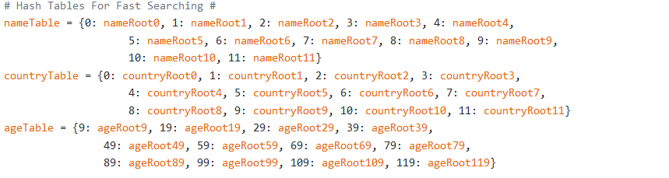
hashing.py
Hash Tables:

Slide 26
Algorithms for Social Network
PROJECT

Slide 27
hashing.py
Search function can search for 3 attributes at max: age, name, country.
Takes that 3 attributes in any order, but the attribute name must be written before the attribute itself.
Returns a list of users IDs, those users share the same searched attributes.
* def search (arg1, arg1Data, arg2=None, arg2Data=None, arg3=None, arg3Data= None):

Slide 28
hashing.py
A traversal algorithm through the a Binary Search Tree
This was used for tree printing in function: def PrintTree ():
It was also used in function: def SearchBTin ():

