Slide 1
PROPOSAL CONTENT INITIATIVE
Less searching.
More storytelling.
THE END OF “I KNOW IVE SEEN THAT SLIDE …” | PROPOSED AI-ASSIT TOOL

Slide 2
M MOSER ASSOCIATES
2026
TABLE OF CONTENTS
Role & current environment
What we own, who we work with, and the tools and content sources we use today.
01
Current proposal production process
The proposal workflow and the three main types of content used
02
03
Where the proposed tool fits today
Where the proposed tool can add value to our current workflow
Success requirements & pain points
Where the current process creates friction and what an effective solution must deliver.
04
What an ideal solution would enable
The future capabilities that would meaningfully improve proposal development.
05

Slide 3


M MOSER ASSOCIATES
2026
Role &
Current
Environment

Slide 4
M MOSER ASSOCIATES
2026
Proposals role
Interpret the RFP to identify requirements, evaluation drivers, risks, client priorities, and the real ask behind the brief.
Understand what leadership wants the client to believe, remember, and do.
Develop the response strategy, win themes, key messages, structure, and narrative.
Facilitate kickoffs and working sessions to align the pursuit team.
Identify the most relevant projects, people, capabilities, and proof points, and explain why they matter.
Gather existing content and determine what should be reused, adapted, updated, or created.
Translate technical and multidisciplinary input into clear, concise, client-facing language.
Turn different inputs into one cohesive story and visual approach.
Shape page hierarchy, layouts, diagrams, presentations, and other visual storytelling.
Coordinate directors, marketing, local teams, and subject-matter experts; assign responsibilities and follow up on missing information.
Challenge generic claims, weak logic, repetition, unsupported statements, and content that does not advance the response.
Adapt the approach to different clients, opportunities, leadership styles, and team preferences.
Manage compliance, including requirements, attachments, page limits, forms, deadlines, and submission instructions.
Protect the schedule and maintain momentum from kickoff through final delivery.
Lead editing, quality control, proofreading, production, and submission.
Identify outdated, duplicated, missing, or underdeveloped content within the library.
Improve reusable content, templates, processes, and proposal best practices.
Ensure the proposal meets RFP requirements and quality standards.
Work with directors, marketing, subject-matter experts, and local teams.
Understand what leadership wants the client to believe, remember, or do.
Gather existing content and identify what is relevant
Decide what to reuse, adapt, or create.
Coordinate contributors and follow up on missing content.
Turn different inputs into one clear story and visual approach.
Adapt to different leadership, team, and client preferences.
Protect the schedule and deliver on time.
Manage final production, review, and submission.
Quality control of document
Our role is to translate team's pursuit strategy into a clear, compelling, client-facing proposal or presentation.
We do not simply retrieve content. We evaluate, contextualize, connect, tailor and transform it into compelling responses for each opportunity
Admin tasks

Slide 5
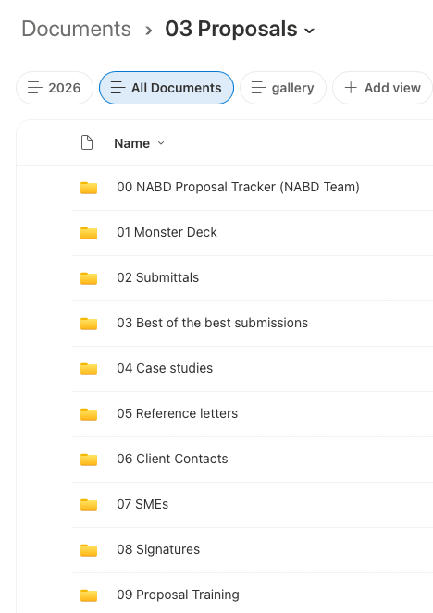
tools and content sources I use today
M MOSER ASSOCIATES
2026
Tools & content sources we use
RFP/RFQ Name:
MMA Project No.:
MILESTONE | DATE | COMMENT
Issue Date:
Site Meeting:
Questions Deadline:
Addendum Deadline:
Deadline:
Interviews:
Award:
PROJECT DETAILS | INFORMATION
Size:
Value, cost:
Services required:
Project schedule:
Sustainability:
Sub-Consultants Required:
Email – Request comes in. We also gather client info, intel and track correspondence.
Proposal Tracker - Excel
Intake Form
Project Folder/Channel (RFP Docs, Draft presentation & Final Response)
Share point
  Submittal Per Year
  Best of the Best (IDD, MSA, DESIGN)
Monster Deck (library)
Post RFP De-Brief
Case studies
KC
Website
ChatGPT & Claude
SUBMISSION REQUIREMENTS
Requirement | Lead | Notes | Status
 |  |  | complete
 |  |  | in progress
 |  |  | off target / challenge
The opportunity is to make that content easier to find, trust, reuse and maintain.
Notes:
What it contains. How you use it. What is working well. What is difficult about using it.

Slide 6
M MOSER ASSOCIATES
2026
Current proposal production process

Slide 7
M MOSER ASSOCIATES
Our current process
Use the intake brief & analyze the RFP and client context to identify requirements, decision drivers, risks, responsibilities, deadlines, and the real ask, creating a clear, client-specific (not just compliant) response plan for kickoff.
Take first pass at storyline
*For complex responses, proposals may take the first pass or co-develop the storyline with leaders and directors, translating strategic input into a clear narrative, key messages, and response structure for team review and refinement.
1 · RECEIVE & ASSES
PROPOSAL DROPS
The group receives the RFP and deadline
2 · ASSIGN
PROPOSAL SPECIALIST ASSIGNED
A team member takes ownership of the response and get involved with rest of team members
3 · PREPARE
Proposal Specialist analyzes the RFP Intake brief: size, location, requirements, SMEs deadline, etc
4 · ALIGN
Kickoff and strategy
The team confirms the win strategy. priorities and roles are assigned
5 · FRAME
Define the central narrative, win themes, key messages, differentiators, proof points, section structure, and desired client takeaways.
Analyze the RFP and establish the response plan:
Requirements and evaluation criteria
Mandatory forms and attachments
Page limits and submission instructions
Questions and ambiguities
Deadlines
Review milestones
Risks and missing information
Establish level of effort
MATCH EACH CONTENT NEED TO THE RIGHT PATH
Test the draft against the client priorities, RFP requirements, narrative strategy, evidence, tone, visual hierarchy, and readability. Resolve gaps, repetition, contradictions, and unsupported claims.
Canonical M Moser content
Proposal specialist retrieves approved source-of-truth slides
6 · TRANSLATE
our team builds the storyline.
Narrative, slide plan, visual structure and content needs
7 · BUILD
Assemble the proposal
Coordinate contributors and bring every slide into one story, clean it up visually
Reusable high-quality content
Proposal specialist surfaces options; she then find, selects and adapts
Questions we ask ourselves
Is it relevant to this client?
Is it current and accurate?
Is it approved for use?
Is there evidence behind the claim?
Does it need to be rewritten, combined, shortened, or replaced?
Does it advance the win strategy?
One-off proposal content
Proposal specialist creates the client-specific visual story
9 · ARCHIVE
Save in Share point submittals. Decide if it belongs in any other folder and/or monster deck.
8 · DELIVER
Review, refine and submit
Confirm relevance and tone, revise, quality-check and deliver
Archive the submission, record the outcome and lessons learned (debrief), identify reusable content, update project and team information (as needed), and address gaps uncovered during the pursuit.

Slide 8
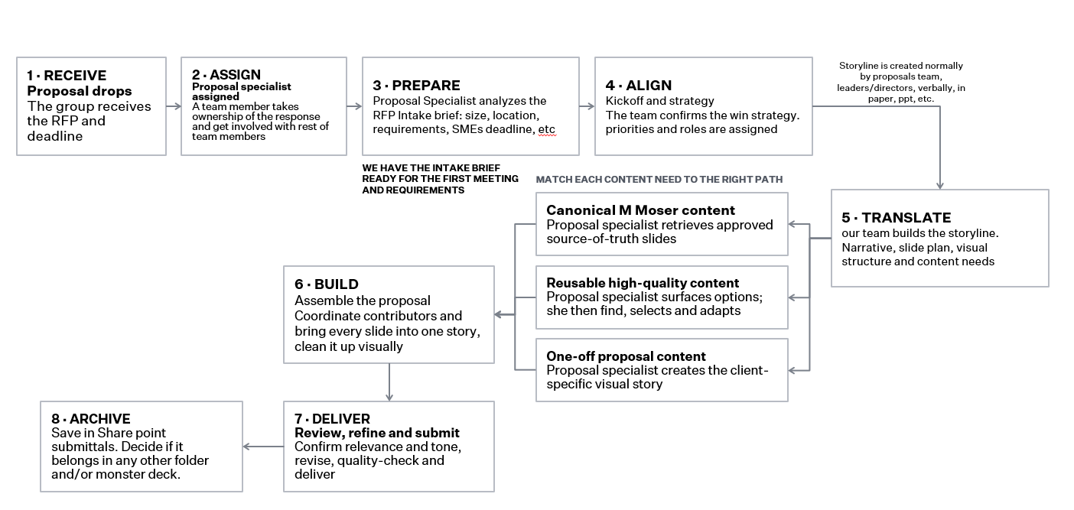

Slide 9
M MOSER ASSOCIATES
2026
CONTENT TYPE | EXAMPLES | BEST ROLE FOR THE TOOL | OUR TEAM’S ROLE
Canonical M Moser content | About Us, services, Global Capabilities, Resumes | Retrieve the approved source-of-truth material | Confirm relevance and place it in the story
Reusable high-quality content | MSA Slides, the banner, diagrams, experience slides, strong submissions | Easy and fast access, Surface relevant options | Evaluate, select, adapt and contextualize
One-off proposal content | Win themes, client-specific story, custom diagrams | Limited support with discovery and assembly | Translate strategy into the client-specific visual story

Slide 10
Where the proposed tool fits
Notes:
This means every office can move faster and perform better because the behavioural understanding already exists.
Vancouver became the foundation for many of the ideas later stretched across the broader portfolio.

Slide 11
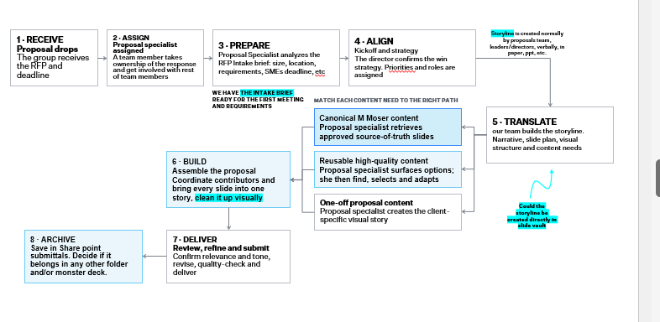
Ai-assisted process
AI accelerates the process. The proposals team determines what is relevant, credible, differentiated, and right for the client.
3 · PREPARE
TOOL: Extracts & stores requirements, deadlines, evaluation criteria, attachments, and potential gaps.
PROPOSALS: Interprets the RFP, validates requirements, identifies risks, and establishes the response plan.
5 · FRAME
TOOL: Surfaces relevant precedents, themes, evidence, and potential narrative directions.
PROPOSALS: Defines the win themes, key messages, differentiators, and final storyline with pursuit leadership.
1 · RECEIVE & ASSES
PROPOSAL DROPS
The group receives the RFP and deadline
2 · ASSIGN
PROPOSAL SPECIALIST ASSIGNED
A team member takes ownership of the response and get involved with rest of team members
4 · ALIGN
Kickoff and strategy
The team confirms the win strategy. priorities and roles are assigned
The tool can also help at Deliver, not only Build:
Compare the draft against RFP requirements
Flag missing sections or attachments
Identify repetition and inconsistencies
Check names, titles, project data, and terminology
Confirm that approved content was used
Surface potential outdated or unsupported claims
Final validation and approval should remain with the proposals team.
MATCH EACH CONTENT NEED TO THE RIGHT PATH
Canonical M Moser content
TOOL : Retrieves approved source-of-truth material.
PROPOSALS: Confirms relevance and placement.
6 · TRANSLATE
TOOL: Retrieves approved content and recommends relevant projects, people, capabilities, and proof points.
PROPOSALS: Evaluates, selects, adapts, and structures the content around the client and strategy.
7 · BUILD
TOOL: Supports content assembly, page planning, gap identification, and consistency checks.
PROPOSALS: Coordinates contributors and develops one cohesive, visually compelling client story.
Reusable high-quality content
TOOL: surfaces relevant options.
PROPOSALS : evaluates, selects, adapts, and contextualizes.
One-off proposal content
TOOL: May support discovery, outlining, or assembly.
PROPOSALS: Translates the strategy into original client-specific content and visual storytelling.
9 · ARCHIVE
TOOL: Recommends tags, identifies reusable content, and flags outdated or missing material.
PROPOSALS: Approves what is retained, records lessons learned, and maintains the quality of the library.
8 · DELIVER
TOOL: Checks compliance, completeness, repetition, terminology, and potential inconsistencies.
PROPOSALS: Reviews, refines, validates, approves, and submits the final response.
This area needs more team support than tool.
IF WE THINK THIS IS IMPORTANT.
The tool can potentially support storyline development by surfacing relevant content, precedent, proof points, and potential narrative directions. Proposalist and pursuit leadership define and refine the final story.
Questions we ask ourselves
Is it relevant to this client?
Is it current and accurate?
Is it approved for use?
Is there evidence behind the claim?
Does it need to be rewritten, combined, shortened, or replaced?
Does it advance the win strategy?

Slide 12
1 · RECEIVE
Proposal drops
The group receives the RFP and deadline
2 · ASSIGN
Proposal specialist assigned
A team member takes ownership of the response and get involved with rest of team members
3 · PREPARE
Proposal Specialist analyzes the RFP Intake brief: size, location, requirements, SMEs deadline, etc
4 · ALIGN
Kickoff and strategy
The director confirms the win strategy. Priorities and roles are assigned
Storyline is created normally by proposals team, leaders/directors, verbally, in paper, ppt, etc.
WE HAVE THE INTAKE BRIEF READY FOR THE FIRST MEETING AND REQUIREMENTS
MATCH EACH CONTENT NEED TO THE RIGHT PATH
Canonical M Moser content
Proposal specialist retrieves approved source-of-truth slides
5 · TRANSLATE
our team builds the storyline.
Narrative, slide plan, visual structure and content needs
6 · BUILD
Assemble the proposal
Coordinate contributors and bring every slide into one story, clean it up visually
Reusable high-quality content
Proposal specialist surfaces options; she then find, selects and adapts
One-off proposal content
Proposal specialist creates the client-specific visual story
Could the storyline be created directly in slide vault
8 · ARCHIVE
Save in Share point submittals. Decide if it belongs in any other folder and/or monster deck.
7 · DELIVER
Review, refine and submit
Confirm relevance and tone, revise, quality-check and deliver
Notes:
[Sources]
- User-provided workflow context and M Moser proposal-process deck; no external sources.

Slide 13
M MOSER ASSOCIATES
2026
SUCCESS REQUIREMENTS & PAIN POINTS
Notes:
This means every office can move faster and perform better because the behavioural understanding already exists.
Vancouver became the foundation for many of the ideas later stretched across the broader portfolio.

Slide 14
M MOSER ASSOCIATES
2026
Success requirements
Reduce the time spent searching for content.
Export in PPT for to allow people to copy and adapt content without changing the original.
Make approved canonical content easy to identify (have 1 or 2 versions max)
Show where content came from and when it was last updated.
Surface relevant content based on the proposal’s attributes and strategy. (maybe by using tags or even the input form)
Help with basic visual clean design when exporting
Support filtering
Provide useful previews before opening or downloading files.
Make it easy to compare several possible slides.
Preserve our team’s control over selection, adaptation and storytelling.
Fit into the existing proposal workflow rather than creating another disconnected repository.
Make post-proposal archiving and curation easier.
Help promote exceptional one-off and latest material into the reusable library.
POTENTIAL SUCCESS MEASURES:
Time required to find suitable content.
Percentage of retrieved results that are genuinely relevant.
Reduction in recreated or duplicated slides.
Confidence that canonical content is current. (no extra versions)
Amount of newly curated reusable content.
Time our team can redirect toward the proposal’s story and visual quality.
A successful solution should:

Slide 15
M MOSER ASSOCIATES
2026
CURRENT PROCESS PAIN POINTS
Strong content exists, but it can be difficult to find quickly.
Search depends too heavily on folder structures, naming conventions and personal memory.
It is not always clear which version is current, approved or highest quality.
Our current library contains both excellent and average material.
Good one-off content can disappear inside a proposal.
The same content may be recreated because an existing version cannot be located.
Contributors provide material in different formats and at different levels of completeness.
Our team must spend time fixing page by page layout to make it all cohesive
Source material may be accidentally changed when it should have been copied. (not often but can happen)
Proposal timelines are compressed, leaving little time for searching and experimentation.
Different directors and offices may prefer different content.
The quality of reusable content depends on someone continually curating the library.
Archiving happens after a deadline, when the team has already moved to the next pursuit.
During the proposal process, valuable client research and insights are gathered but can easily be lost or forgotten.
There is currently a gap in different team’s visibility into what has been submitted and which version is the latest and greatest.
POTENTIAL CHALLENGES WITH PROPOSED TOOL
FIND
Too much content, too many similar or duplicate slides
TRUST
Outdated, unapproved or just not the best option
MAINTAIN
Ongoing tagging, approvals, curation and user adoption - Someone must approve, update and retire content
ADOPT
The tool must be intuitive, fit the existing workflow, and provide enough value that teams consistently use it.
PROTECT
Permissions, confidentiality, attribution, and client restrictions must carry through search, preview, export, and reuse.
The program must improve access without sacrificing quality, control or human judgment afterward.
Pain points

Slide 16
What an Ideal Solution Would Enable
Notes:
This means every office can move faster and perform better because the behavioural understanding already exists.
Vancouver became the foundation for many of the ideas later stretched across the broader portfolio.

Slide 17
M MOSER ASSOCIATES
2026
Our ideal tool would help us find better content faster!
DISCOVER
Search across approved SharePoint locations and curated libraries.
Understand opportunity attributes, client priorities, and content meaning, not just filenames and keywords.
Surface canonical, reusable, and precedent content separately.
Recommend relevant projects, people, capabilities, proof points, and slides.
TRUST
Show each item’s source, owner, approval status, confidentiality, and last review date.
Clearly identify approved source-of-truth content.
Protect original files and prevent inappropriate reuse or alteration.
COMPARE + DECIDE
Preview, filter, and compare multiple options before opening or downloading them.
Show why each result is relevant to the opportunity.
Preserve the proposals team’s control over selection, adaptation, and storytelling.
BUILD
Export editable PowerPoint content while preserving the original source.
Support visual consistency and reduce page-by-page clean-up.
Incorporate new client-specific content without overwriting reusable material.
LEARN + IMPROVE
Learn from what teams select, adapt, submit, and promote.
Surface recently approved and frequently used content without defaulting only to popularity.
Recommend exceptional new material for review and inclusion in the reusable library.
Make archiving, tagging, updating, and retiring content easier.
Let’s identify the right content, understand why it matters, and use it with confidence.

Slide 18
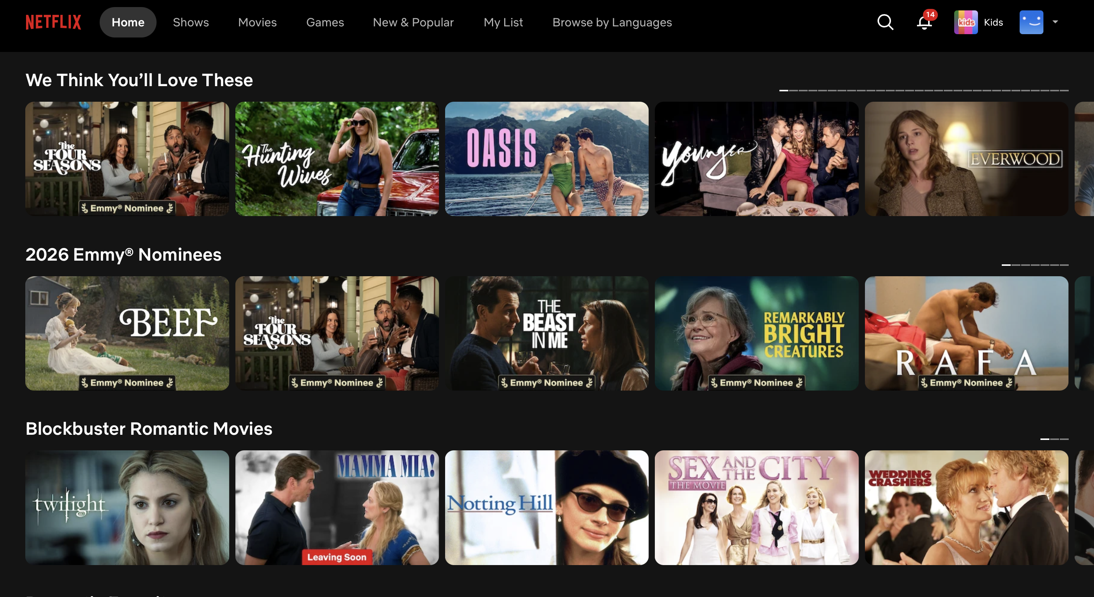
Mock up idea to come..
M MOSER ASSOCIATES
2026
Mock up
Something big during our marketing call was that there is currently a gap in different team’s visibility into what has been submitted and which version is the latest and greatest
Top 10 slides in the last month
New Releases
Maybe create something that says you haven’t used this page in 3 months do we want to keep? To try to keep content relevant
Most used IDD slides

