Slide 2
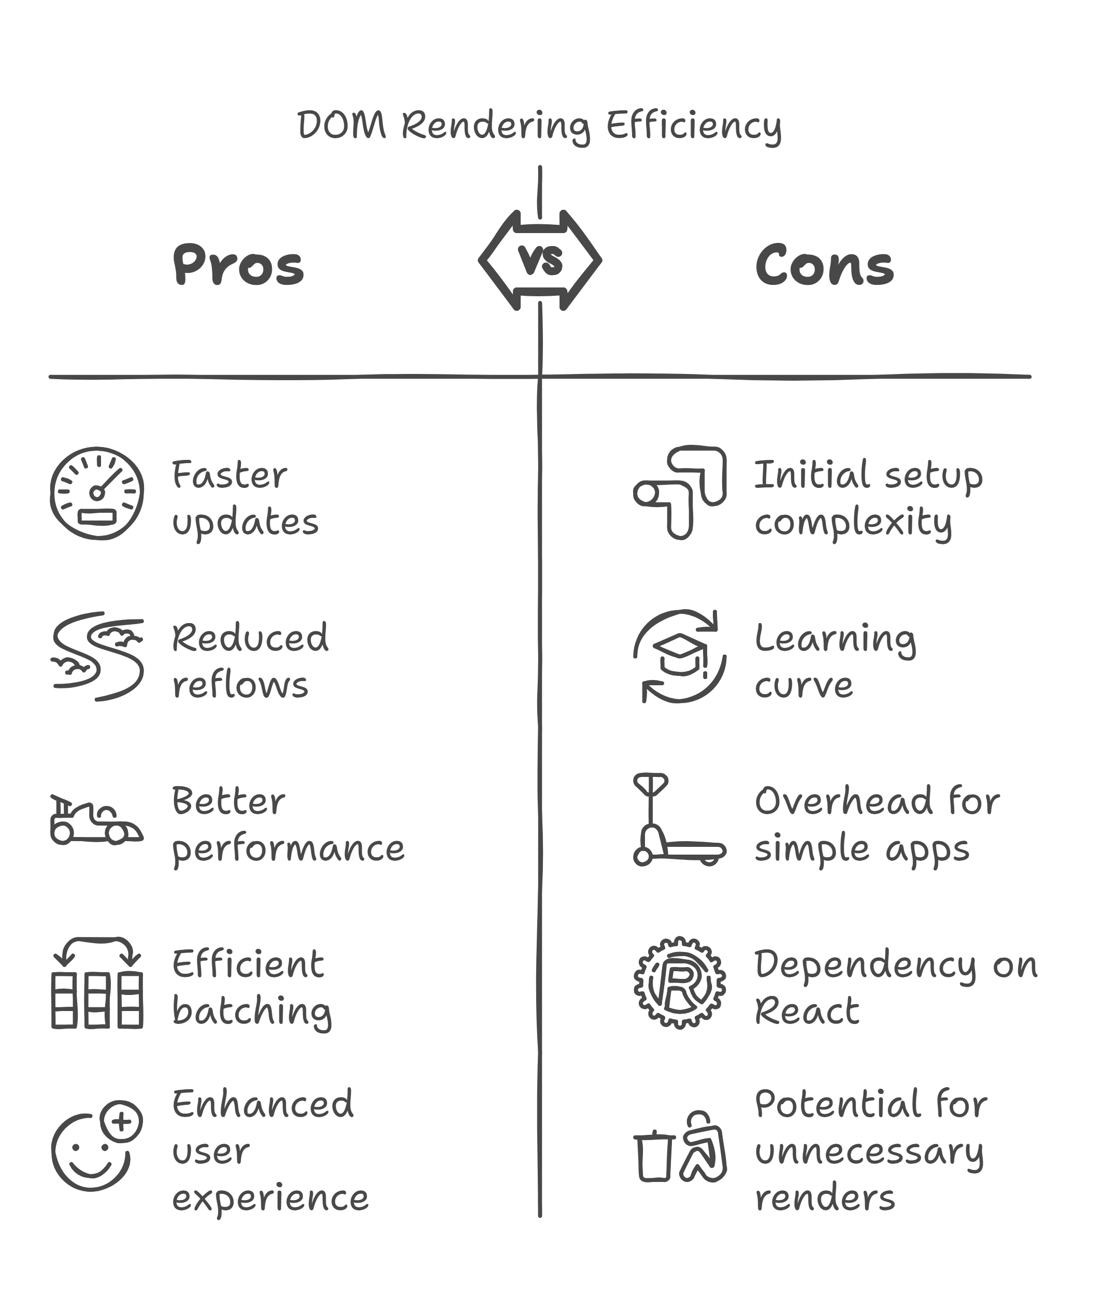
What is React.js?
A JavaScript library for building user interfaces, particularly for single-page applications (SPAs).
Developed by Facebook and open-sourced.
Focuses on creating reusable UI components.
Key Features and Benefits
Component-Based Architecture: UI is built using independent, reusable components.
Declarative UI: React automatically updates the UI when data changes.
Virtual DOM: Efficient way of updating the actual DOM, improving performance.

Slide 3
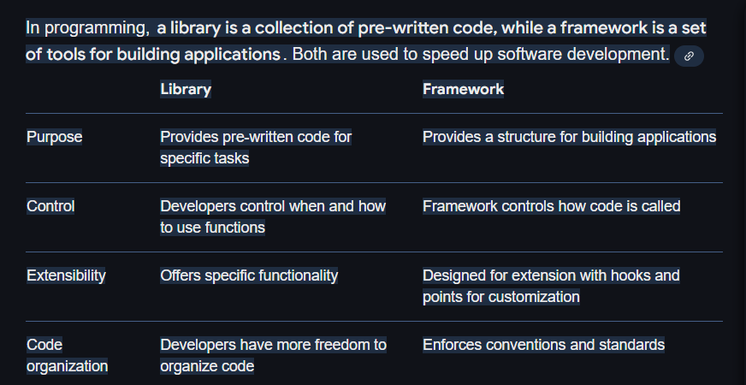

Slide 4
Why Use React?
Fast Performance: React updates only the changed parts of the UI using the Virtual DOM.
Reusable Components: Build once, reuse anywhere to save development time.
Strong Ecosystem: Supported by a large community and various third-party libraries.
Used by Big Companies: Facebook, Instagram, Airbnb, Uber, Netflix, etc.
Example:
Instead of manually updating the UI, React does it efficiently behind the scenes.

Slide 5
Installing React Using Vite
Why Vite?
Vite is a modern build tool that is faster than Create React App.
It provides instant Hot Module Replacement (HMR) for quick updates.
Steps to Install React with Vite
Install Node.js (https://nodejs.org/)
Run the following command in the terminal:
npm create vite@latest myFirstApp
cd myFirstApp
npm install
npm run dev
Now, React is installed with Vite, and you can access the project in your browser.

Slide 6
Understanding React Folder Structure
After creating a project with Vite, the folder structure looks like this:
myFirstApp/
│-- node_modules/ # Installed dependencies
│-- public/ # Static files
│-- src/ # Main source code
│ │-- App.jsx # Main component
│ │-- main.jsx # Renders App component
│ │-- components/ # Custom components
│-- package.json # Project dependencies
│-- vite.config.js # Configuration file
Key Files Explained:
App.jsx – Main component where most of the UI logic exists.
main.jsx – Entry point that renders the App component.
components/ – Folder to store reusable React components.

Slide 7
Understanding React Components
A component in React is a reusable, independent piece of the UI. It allows us to divide the UI into smaller, manageable parts.
Types of Components
Functional Components – Simple JavaScript functions that return JSX.
Class Components – ES6 classes that extend React.Component (rarely used in modern React).
Example of a Functional Component
function Welcome() {
return <h1>Hello, React!</h1>;
}
export default Welcome;
Easy to read and maintain.
Uses ES6 functions.
Supports hooks like useState and useEffect.

Slide 8
JSX (JavaScript XML)
What is JSX?
JSX is a syntax extension of JavaScript that allows writing HTML inside JavaScript.
Why Use JSX?
Easier to read and write UI code.
Helps detect errors during compilation.
Optimized by Babel for browser compatibility.
const element = <h1>Hello, World!</h1>;
This looks like HTML, but it’s actually JavaScript!
JSX must be wrapped inside a single parent element (e.g., a <div>).

Slide 9
Why Use JSX?
Improves Readability – Looks similar to HTML, making it easier to understand.
Detects Errors Early – Helps catch syntax errors before running the code.
Optimized for Browsers – Babel compiles JSX to JavaScript that browsers can understand.
Prevents Security Risks – Helps protect against XSS attacks (Cross-Site Scripting).
What are Props in React?
Props (short for properties) are used to pass data from a parent to a child component/element.
Props help make components reusable and dynamic.
Props are read-only and cannot be modified inside the child component.

Slide 10
Code:
function Greeting(props) {
return <h1>Hello, {props.name}!</h1>;
}
export default function App() {
return <Greeting name="John" />;
}
Here, name="John" is a prop being passed to the Greeting component.
The Greeting component receives the name prop and displays "Hello, John!".

Slide 11
React State – useState Hook
What is State in React?
State is used to store and update data within a component.
Unlike props, state can be changed inside a component.
The useState hook allows a component to remember values between renders.

Slide 12
Code:
import { useState } from 'react';
function Counter() {
const [count, setCount] = useState(0);
return (
<div>
<p>Count: {count}</p>
<button onClick={() => setCount(count + 1)}>Increase</button>
</div>
);
}
export default Counter;
useState(0) initializes count to 0.
setCount updates the state when the button is clicked.

Slide 13
How it Works:
useState(0) initializes count with 0.
setCount(count + 1) updates count when the button is clicked.
The component re-renders to display the new value.

Slide 14
Changing Text with a Button
import { useState } from 'react';
function Message() {
const [text, setText] = useState("Hello!");
return (
<div>
<p>{text}</p>
<button onClick={() => setText("Welcome to React!")}>Change Text</button>
</div>
);
}
export default Message;
useState("Hello!") initializes the state with "Hello!".
Clicking the button updates text to "Welcome to React!".

Slide 15
React Effects – useEffect Hook
What is useEffect?
The useEffect hook allows us to run code when a component mounts, updates, or unmounts.
Often used for:
API calls
Timers (e.g., countdowns, clocks, etc.)
Event listeners
Can be controlled with dependencies to run at specific times.
Example: Auto Updating Timer

Slide 16
Mounting → When the component appears on the screen for the first time.
Updating → When something inside the component changes (like state or props).
Unmounting → When the component is removed from the screen.

Slide 17
import { useState, useEffect } from 'react';
function Timer() {
const [time, setTime] = useState(0);
useEffect(() => {
const interval = setInterval(() => setTime(t => t + 1), 1000);
return () => clearInterval(interval);
}, []);
return <p>Timer: {time} sec</p>;
}
export default Timer;
Runs when the component mounts (empty dependency array []).
Cleans up the interval when the component unmounts.

Slide 18
How it Works:
When the component mounts, useEffect starts an interval.
Every 1 second, it updates seconds.
When the component unmounts, clearInterval(interval) stops the timer.

Slide 19
Showing an Alert When Component Loads
import { useEffect } from 'react';
function WelcomeMessage() {
useEffect(() => {
alert("Component Loaded!");
}, []);
return <h2>Welcome to my App</h2>;
}
export default WelcomeMessage;
useEffect(() => { alert("Component Loaded!"); }, []); runs only once when the component loads.
An alert pops up when the page loads.

Slide 20
How to Learn More About React?
Official React Documentation
Visit react.dev for the latest React guides and tutorials.
Includes beginner to advanced topics with interactive examples.
Video Tutorials & Courses
FreeCodeCamp – Beginner-friendly YouTube tutorials.
Traversy Media – Quick and clear explanations.
Academind – Deep dives into React concepts.
Practice with Hands-On Projects
Build small projects like:
To-Do List (State management), usestate
Weather App (API calls)

Slide 21
Join React Communities
Stack Overflow – Ask & answer React-related questions.
React Discord & Reddit – Learn from developers worldwide.
GitHub Repositories – Explore open-source React projects.
Next Steps After Learning React
Learn React Router for navigation.(react router dom)
Use Redux or Context API for state management. (after 2 months)
Explore Next.js for server-side rendering & performance boosts.

Slide 22
Assignments
1. Create a React App with Vite
Install React using Vite.
Explore the folder structure.
2. Create a Functional Component
Make a UserProfile component that displays a name and email.
3. Use JSX to Render Elements
Create an unordered list <ul> inside a component.
4. Work with Props
Create a Message component that receives text via props.

Slide 23
5. Implement useState
Build a counter app with increment, decrement, and reset buttons.
6. Implement useEffect
Fetch and display API data inside useEffect.
7. Create a To-Do App
Add, remove, and display tasks using state.
8. Style Components
Use CSS to style your components beautifully.

Slide 24
Submission Notes
Capture Evidence:
Take screenshots or record a short video for each task.
Ensure your evidence clearly shows the completed task.
Upload Tasks:
Upload each task as a separate folder or file in your GitHub repository.
LinkedIn Post:
Create a short post summarizing what you learned and how you completed the tasks.
Highlight your key takeaways.
Mention the following account in your post:
Muhammad Munim

Slide 25
Thank You

