Slide 1
NTSB Aviation Analysis for Sky High Corp
By Nesphory Mwakale

Slide 2
Project Analysis Overview
Descriptive Analysis of the National Transport and Safety Board’s Aviation Accident Dataset. This analysis can be used to:
Identify the causes of most aviation accidents and,
Implement methods to curb aviation calamities.

Slide 3
Business Understanding
Sky High Corp wants to purchase and operate planes for commercial and personal use.
Key Points to consider:
Potential risks of aircraft.
Aircraft with the lowest risk to start with.

Slide 4

Data Understanding
NTSB Aviation Accident Dataset for over 85,000 aviation accidents from the year 1962 to 2023.

Slide 5
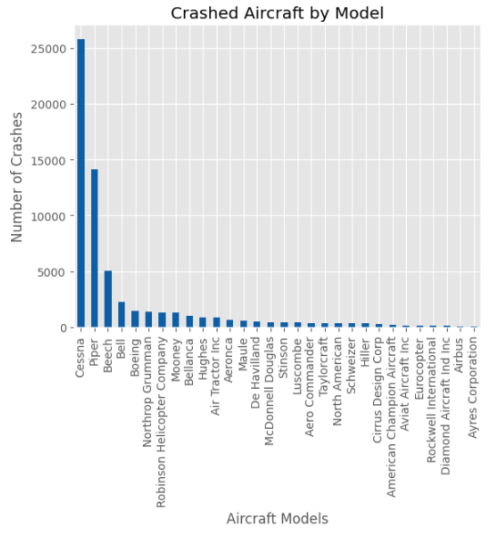
Data Analysis
Top 5 crashed planes are:
Cessna
Piper
Beech
Bell
Boeing

Slide 6
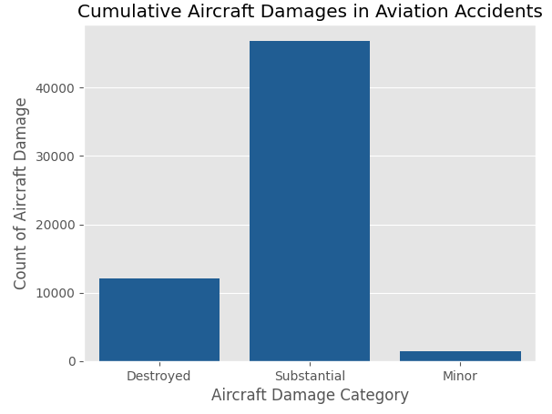
Data Analysis
Most crashes cause significant and expensive damage to the aircraft

Slide 7
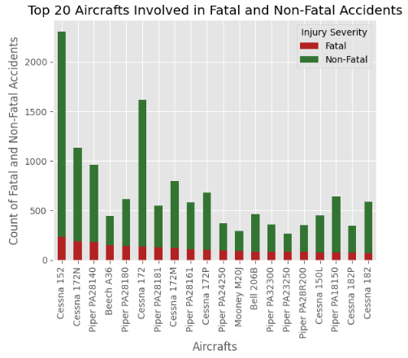
Data Analysis
Most plane crashes are non-fatal (No loss of human life)
Cessna and Piper are safest due to high survival rate

Slide 8
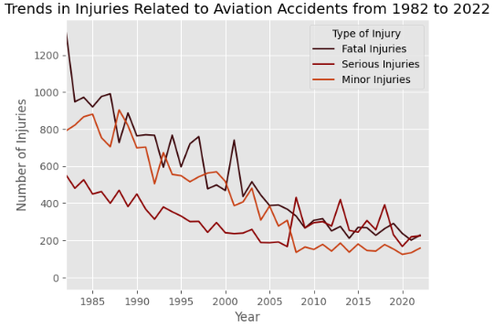
Data Analysis
Casualties from plane crashes have been declining.
Reasons
Technology Advancements.
Implementation of aviation laws to promote safety.

Slide 9
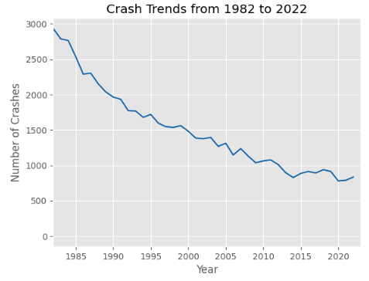
Data Analysis
Frequency of plane crash per year have been reducing.

Slide 10
Conclusion
Airplane crashes become rarer every year.
Aviation casualties reduce every year.
Most accidents cause significant damages to the aircraft.
Most accidents are non-fatal.

Slide 11
Recommendations
Cessna is the most preferred small aircraft.
Cessna 172 and Piper PA-28 lineup preferred for personal use.
Focus on hiring experienced pilots to reduce pilot error
Routine service and maintenance for aircraft for longer lifespan

Slide 12
Questions

Slide 13
Thank You!
Nesphory Mwakale
LinkedIn: https://www.linkedin.com/in/nesphory-mwakale/
GitHub link: https://github.com/M-Nesphory/Aviation_Accident_Project

