Slide 1
Week-1
Introduction to Computing
COMPUTER SCIENCE
Computer Science is the study of computers and computational systems.
0-<number>

Slide 2
Terminology
Algorithm: A set of steps that defines how a task is performed
Program: A representation of an algorithm. In computing, a program is a specific set of ordered operations for a computer to perform.
Programming: The process of developing a program
Software: Programs and algorithms
Hardware: Equipment
0-<number>

Slide 3
History of Algorithms
The study of algorithms was originally a subject in mathematics.
Early examples of algorithms
  Euclidean Algorithm
  Syntax refers to the rules that define the structure of a language. Syntax in computer programming means the rules that control the structure of the symbols, punctuation, and words of a programming language.
  Without syntax, the meaning or semantics of a language is nearly impossible to understand.
0-<number>

Slide 4
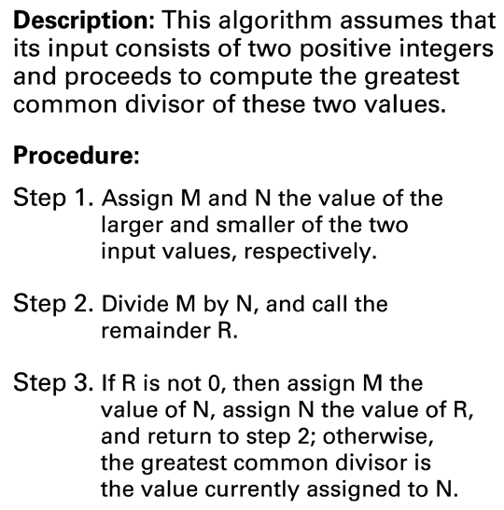
The Euclidean algorithm
0-<number>

Slide 5
Computer Science
The science of algorithms
Draws from other subjects, including
  Mathematics
  Engineering
  Psychology
  Business Administration
0-<number>

Slide 6
Central Questions of Computer Science
Which problems can be solved by algorithmic processes? By discovering patterns in them.
How can algorithm discovery be made easier? Most important tool for algorithm discovery is common sense.
How can techniques of representing and communicating algorithms be improved? Natural language, flowcharts, pseudocode and programming language.
How can characteristics of different algorithms be analyzed and compared? via Efficiency of algorithm.
0-<number>

Slide 7
Central Questions of Computer Science (continued)
How can algorithms be used to manipulate information? Chrome, YT, TikTok.
How can algorithms be applied to produce intelligent behavior? By implementing them to AI.
How does the application of algorithms affect society? Makes life easier.
0-<number>

Slide 8
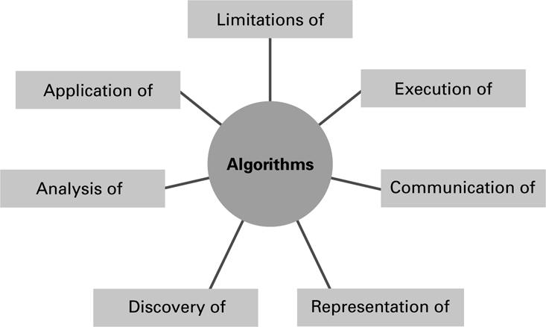
The central role of algorithms in computer science
0-<number>

Slide 9
Abstraction
Abstraction: The distinction between the external properties of an entity and the details of the entity’s internal composition
Abstract tool: A “component” that can be used without concern for the component’s internal properties
0-<number>

Slide 10
Definition of Algorithm
An algorithm is an ordered set of unambiguous, executable steps that define a terminating process.
5-<number>

Slide 11
Algorithm Representation
Requires well-defined primitives
The most basic building blocks of a language are called Primitives.
A collection of primitives constitutes a programming language.
5-<number>

Slide 12
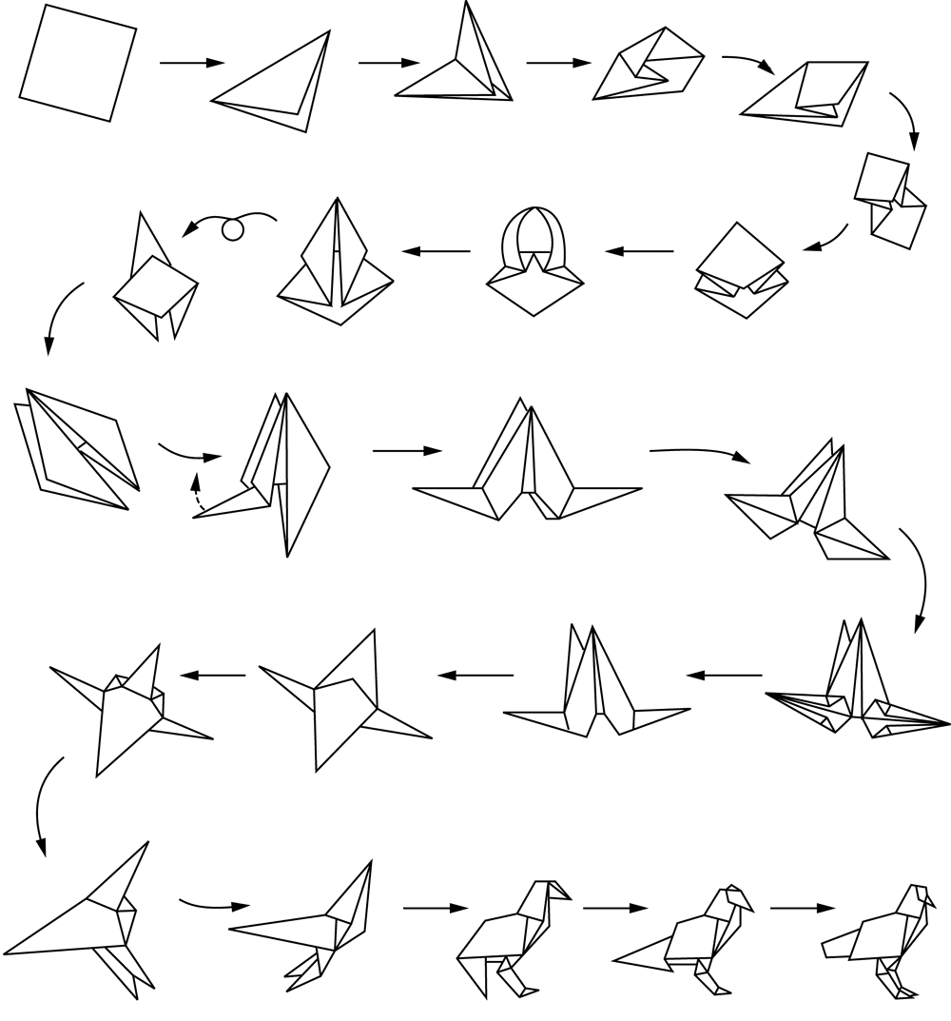
Folding a bird from a square piece of paper
5-<number>

Slide 13
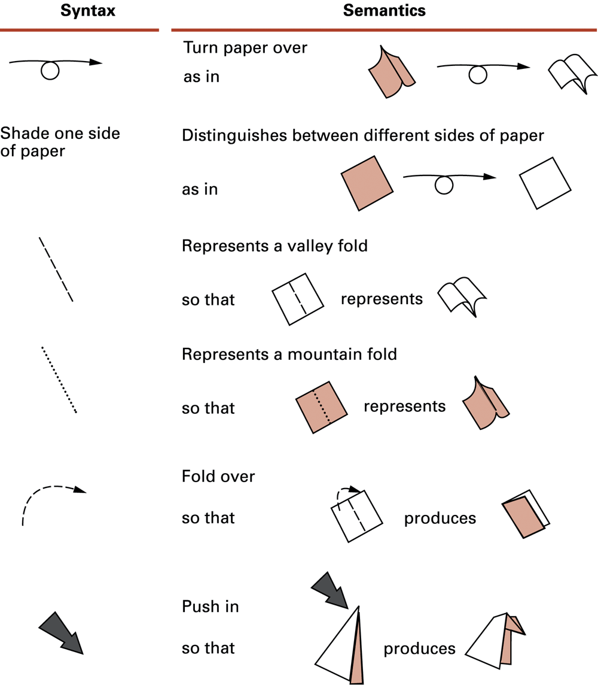
Origami primitives
5-<number>

Slide 14
Polya’s Problem Solving Steps
1. Understand the problem.
2. Devise a plan for solving the problem.
3. Carry out the plan.
4. Evaluate the solution for accuracy and its potential as a tool for solving other problems.
5-<number>

Slide 15
Polya’s Steps in the Context of Program Development
1. Understand the problem.
2. Get an idea of how an algorithmic function might solve the problem.
3. Formulate the algorithm and represent it as a program.
4. Evaluate the solution for accuracy and its potential as a tool for solving other problems.
5-<number>

Slide 16
Getting a Foot in the Door
Try working the problem backwards
Solve an easier related problem
  Relax some of the problem constraints
  Solve pieces of the problem first (bottom up methodology)
Stepwise refinement: Divide the problem into smaller problems (top-down methodology)
5-<number>

Slide 17
Ages of Children Problem
Person A is charged with the task of determining the ages of B’s three children.
  B tells A that the product of the children’s ages is 36.
  A replies that another clue is required.
  B tells A the sum of the children’s ages.
  A replies that another clue is needed.
  B tells A that the oldest child plays the piano.
  A tells B the ages of the three children.
How old are the three children?
5-<number>

Slide 18
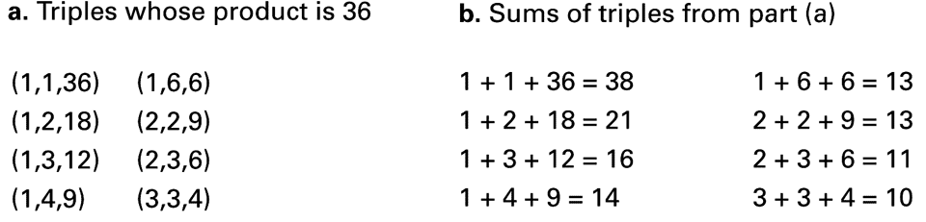
Figure 5.5
5-<number>

