Slide 1



WEEK-2 INTRODUCTION TO COMPUTER SYSTEM: STRUCTURE & PROCESSES

Slide 2
What is A Computer System ?
A functional unit, consisting of one or more computers and associated software, that uses common storage for the execution of the program. They input, output, process, and store data and information.
Consists of three components
People
Computer programmer
Users/End-user
Software
– Hardware

Slide 3
Components of a computer
Software
System Software
Application Software
Hardware
I/O Devices
Central Processing Unit
Memory
Secondary Storage

Slide 4
Software
Software : It is a set of instruction which tells the computer to perform a specific task like arithmetic/logic operations, opening a program etc. It has two types
System Software : It is the type of software developed to run a computer’s hardware and application programs. It provides a platform for other softwares to run. Eg Windows, Linux, MacOS, Android, etc.
Application Software : It is the type of software which is developed to meet the specific needs of a user. Eg MS Word, Visual Studio, etc.

Slide 5
Hardware
Hardware : Any part of the computer system that has a physical existence is called Hardware. They are of two types :
Internal Hardware : The hardware which resides inside of the computer system. Eg Processor, RAM, ROM, etc.
External Hardware : The hardware which resides outside of the computer system. Eg speakers, monitor, printer, etc.

Slide 6
I/O Devices
Alternatively referred to as an IO device, an input/output device is any hardware used by a human operator or other systems to communicate with a computer. As the name suggests, input/output devices are capable of sending data to a computer (input) and displaying processed data to the user (output).

Slide 7
CPU
A central processing unit (CPU), also called a central processor, main processor or just processor, is the electronic circuitry that executes instructions comprising a computer program. The CPU performs basic arithmetic, logic, controlling, and input/output (I/O) operations specified by the instructions in the program.

Slide 8
MEMORY (MAIN MEMORY OR RAM)
Memory is the electronic holding place for the instructions and data a computer needs to reach quickly. It's where information is stored for immediate use. Memory is one of the basic functions of a computer, because without it, a computer would not be able to function properly. It is temporary memory (volatile). Eg RAM, PROM, EPROM, ROM, Cache, Register, etc.

Slide 9
SECONDARY STORAGE DEVICES
Secondary storage is commonly used to store backup data that comes from primary storage. It is permanent storage (non – volatile). The data is copied from the primary storage system to the secondary storage system through the use of replication or other data protection and recovery techniques. Eg Harddisk, Solid State Drive (SSD), etc.

Slide 10

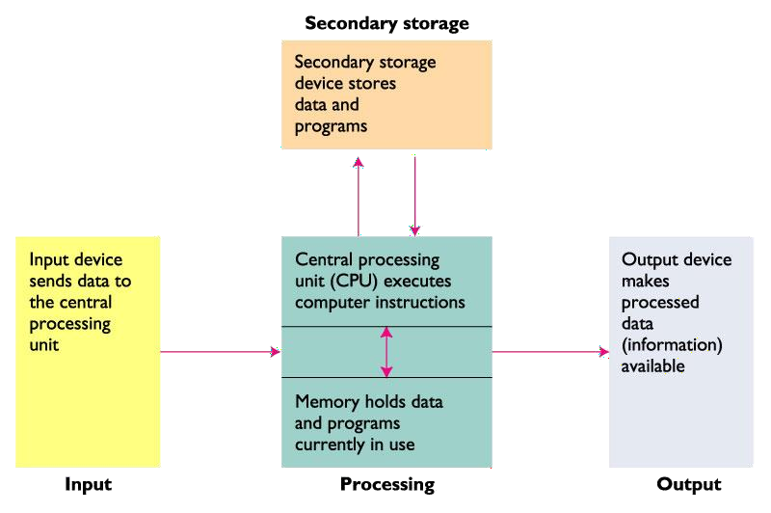
Components of a Computer System

Slide 11




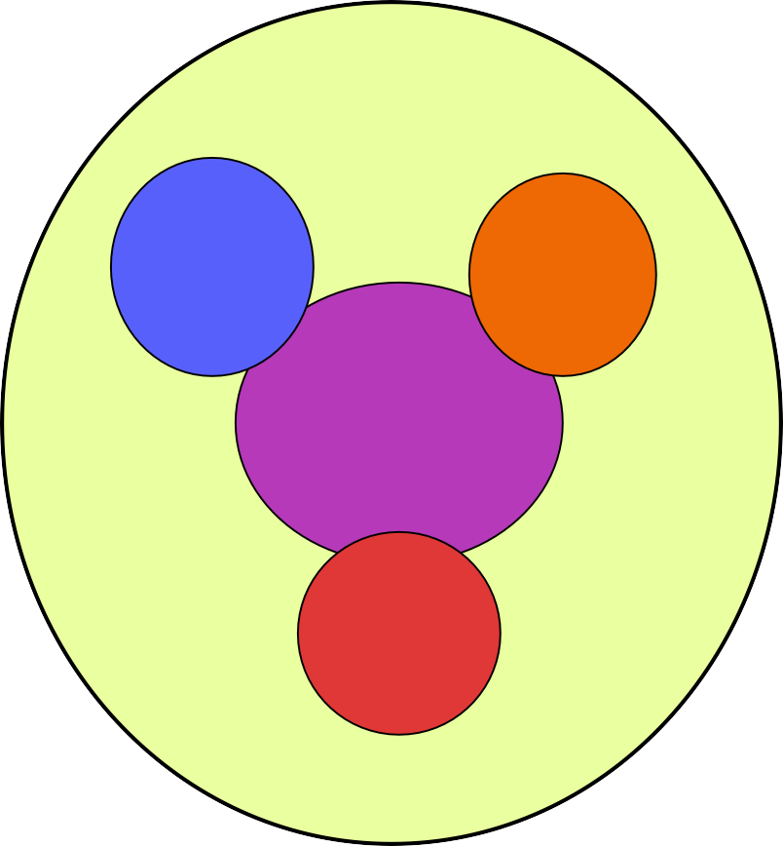


Components Of A Computer
Peripherals
Computer
CPU
Input / Output
Systems Interconnection
i.e. bus
Main Memory
Communication Lines

Slide 12
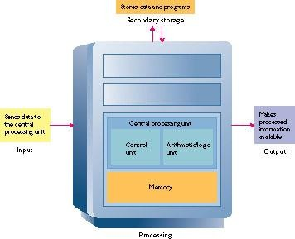
Central Processing Unit
Stores data and programs
Complex set of electronic circuitry
Executes stored program instructions
Two parts
Control unit
Arithmetic/logic unit (ALU)
Secondary storage
Sends data to the CPU
Makes processed info available
Central Processing Unit
Control Unit
ALU
Unit
Input
Output
Registers
UNIVERSITI TENAGA NASIO
Processing

Slide 13
Control Unit
It is a part of CPU which directs the computer system to execute stored program instructions. It sends data and instructions from secondary storage to memory as needed
Must communicate with memory and ALU

Slide 14
Arithmetic Logic Unit
Executes all arithmetic and logical operations
Arithmetic operations
Addition, subtraction, multiplication, division
Logical operations
Compare numbers, letters, or special characters
Tests for one of three conditions
Equal-to condition
Less-than condition
Greater-than condition

Slide 15
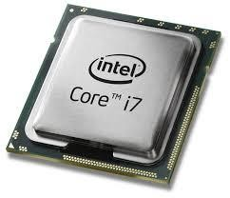
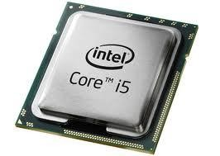
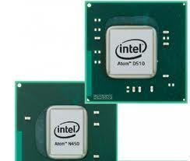
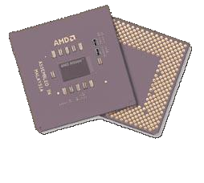
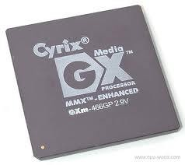
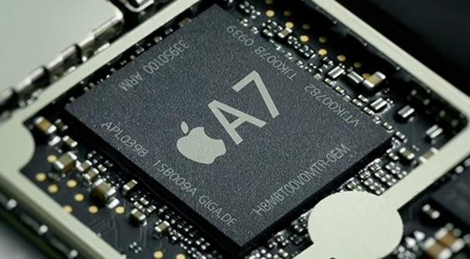
Popular CPUs
Advanced Micro Devices (AMD)
Intel
Core i7
Atom
Core i5
Cyrix
Apple

Slide 16
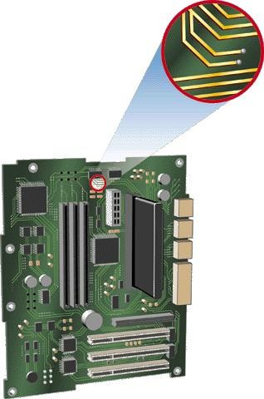
Systems Interconnection (Bus)
shared communication link
set of wires used to connect multiple subsystems
A Bus is also a fundamental tool for composing large, complex systems
The input/output bus provides a pathway so that the microprocessor can communicate with input/output
devices
Processor
Memory
Input
Control
Data path
Output

Slide 17
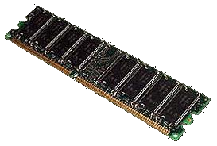
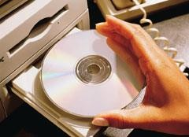
Data Storage and the CPU
Two types of storage:
Primary storage (memory)
Stores data temporarily / volatile
CPU refers to it for both program instructions and data
Holds input to be processed or
holds results of processing
Secondary storage
Long-term storage / non-volatile
Stored on external medium, such as a disk

Slide 18
The CPU and Memory
CPU cannot process data from disk or input device
It must first reside in memory
Control unit retrieves data from disk and moves it into
memory
Items sent to ALU for processing
Control unit sends items to ALU, then sends back to
memory after processing
Data and instructions held in memory until sent to an output or storage device or program is shut down

Slide 19
Temporary Storage Areas
Registers
Memory
High-speed temporary storage areas
located within the CPU
Work under direction of control unit
Accept, hold, and transfer instructions or data
Keep track of where the next instruction to be executed or needed data is stored
Also known as primary storage / main memory
Often expressed as random- access memory (RAM)
Not part of the CPU
Holds data and instructions
for processing
Stores information only as long as the program is in operation
UNIVERSITI TENAGA NASIONA
“Generates Professional

Slide 20
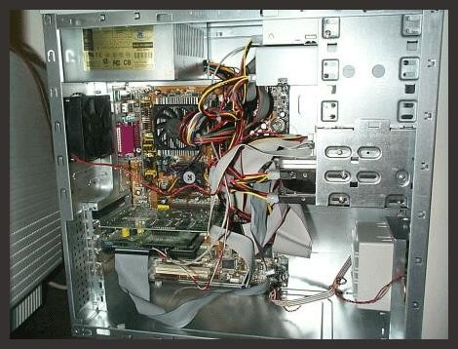
Inside the System Unit / Casing
Motherboard (mainboard) – Large printed circuit board with thousands of electrical circuits
Power supply – Transforms alternating current (AC) from wall outlets to direct current (DC) needed by the computer
Cooling fan – Keeps the system unit
cool
Internal Speaker – Used for beeps
when errors are encountered
Drive bays – Housing for the
computer’s hard drive, floppy drive, and CD-ROM / DVD-ROM drives

Slide 21
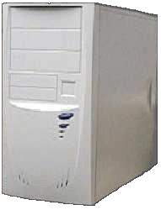
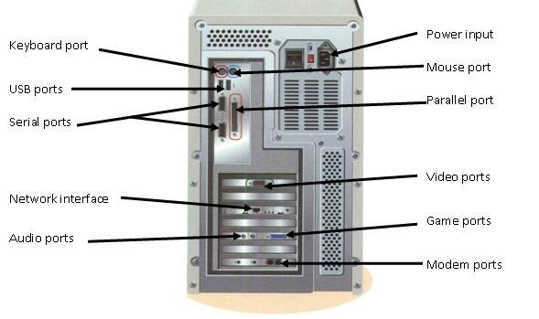
Outside the System Unit
Drive bays
On/off switch
Indicator lights
FRONT
BACK
The front panel contains drive bays, various buttons, and
indicator lights
Connectors and ports are physical receptacles located on
the back to connect peripheral devices to t

Slide 22


How Computers Represent Data
ON
OFF
ON
OFF
OR
= 1 bit
0
1
= 1 Byte
OR
0
0
1
1
0
1
0
0
= 1 Byte
0 1 0 0 0 0 0 1
Bit (Binary digit) – On or off state of electric current; considered the basic unit of information; represented by 1s and 0s (binary numbers)
Byte – Eight bits grouped together to represent a character (an alphabetical letter, a number, or a punctuation symbol); 256 different combinations

Slide 23

Bits
1000 bits = 1 kilobit (kb)
1,000,000 bits = 1 megabit (mb)
1,000,000,000 bits = 1 gigabit (gb)
Kilobits per second (Kbps), Megabits per second (Mbps), and Gigabits per second (Gbps) are terms that describe units of data used in measuring data transfer rates
– Example: 56 Kbps modem

Slide 24

Bytes
8 bits = 1 Byte
1024 Bytes = 1 Kilobyte (KB)
1,048,576 Bytes = 1 Megabyte (MB)
1,043,741,824 Bytes = 1 Gigabyte (GB)
1,099,511,627,776 Bytes = 1 Terabyte (TB)
Kilobyte, megabyte, gigabyte, and terabyte are terms that describe large units of data used in measuring data storage
–Example: 20 GB hard drive
Each byte has 256 (2⁸) possible values

Slide 25
Storage Sizes
Kilobyte: 1024 (2¹⁰) bytes
Memory capacity of older personal computers
Megabyte: roughly one million (2²⁰) bytes
Personal computer memory
Portable storage devices (diskette, CD-ROM)
Gigabyte: roughly one billion (2³⁰) bytes
Storage devices (hard drives)
Mainframe and network server memory
Terabyte: roughly one trillion (2⁴⁰) bytes
Storage devices on very large systems

Slide 26
Storage Sizes
Petabyte (PB): (2⁵⁰) byte = 1024 TB
Exabyte (EB) : (2⁶⁰) byte = 1024 (PB)
Zettabyte (Zb): (2⁷⁰) bytes = 1024 (EB)
Yottabyte (YP) : (2⁸⁰) bytes = 1024 (ZB)

Slide 27
Coding Schemes
Provide a common way of representing a character of data
Needed so computers can exchange data
Common Schemes
ASCII
Unicode

Slide 28


Representing Characters: Character Codes
Character codes translate numerical data into characters readable by humans
American Standard Code for Information Interchange
The most widespread coding scheme used.
Developed by the American National Standards Institute
It has definitions for 128 characters, each character is represented by 7 bits.
Character | Decimal | Hexa-D.
0-9 | 48-57 | 30-39
A-Z | 65-90 | 41-5A
a-z | 97-122 | 61-7A
ASCII
= 4
0
0
1
1
0
1
0
0

Slide 29
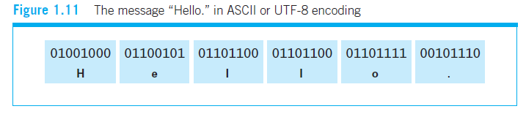
ASCII Coding Example

Slide 30
Unicode
Developed through the cooperation of several of the leading manufacturers of
hardware and software and has rapidly gained the support of the computing community.
This code uses a unique pattern of up to 21 bits to represent each symbol.
When the Unicode character set is combined with the Unicode Transformation
Format 8-bit (UTF-8) encoding standard, the original ASCII characters can still
be represented with 8 bits, while the thousands of additional characters from
such languages as Chinese, Japanese, and Hebrew can be represented by 16 bits.
Beyond the characters required for all of the world’s commonly used languages,
UTF-8 uses 24- or 32-bit patterns to represent more obscure Unicode symbols,
leaving ample room for future expansion.

Slide 31
Representation of images
A pixel is the smallest unit of a digital image or graphic that can be displayed and represented on a digital display device.
A pixel is the basic logical unit in digital graphics. Pixels are combined to form a complete image, video, text, or any visible thing on a computer display.
A pixel is also known as a picture element (pix = picture, el = element).
In the case of a simple black-and-white image, each pixel can be represented by single bit whose value depends on whether the corresponding pixel is black or White
For more elaborate black-and-white photographs, each pixel can be represented by a collection of bits (usually eight), which allows a variety of shades of grayness to be represented.
In the case of color images, RGB encoding scheme is used
Each pixel is represented as three color components—a red component, a green component, and a blue component—corresponding to the three primary colors of light. One byte is normally used to represent the intensity of each color component. In turn, three bytes of storage are required to represent a single pixel in the original image

Slide 32
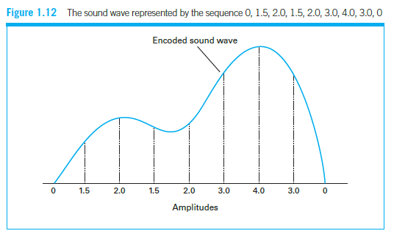
Representation of Sounds
A bitmap is a mapping from one system such as integers to bits. It is also known as bitmap index or a bit array.
The memory is divided into units for bitmap. These units may range from a few bytes to several kilobytes. Each memory unit is associated with a bit in the bitmap. If the unit is occupied, the bit is 1 and if it is empty, the bit is zero.
The most generic method of encoding audio information for computer storage and manipulation is to sample the amplitude of the sound wave at regular intervals
and record the series of values obtained. For instance, the series 0, 1.5, 2.0, 1.5, 2.0, 3.0, 4.0, 3.0, 0 would represent a sound wave that rises in amplitude, falls briefly, rises to a higher level, and then drops back to 0

Slide 33
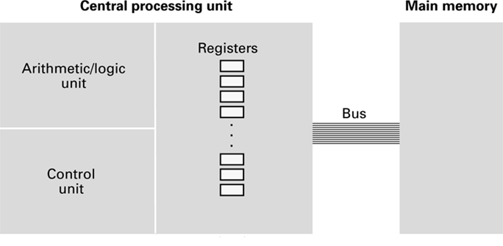
CPU and main memory connected via a bus

Slide 34
Stored Program Concept
A program can be encoded as bit patterns and stored in main memory (bitmap;goto sound slide). From there, the CPU can then extract the instructions and execute them. In turn, the program to be executed can be altered easily.

Slide 35
Terminology
Machine instruction: An instruction (or command) encoded as a bit pattern recognizable by the CPU. It is usually given by a person. Eg A programmer writing a code.
Machine language: The set of all instructions recognized by a machine. It only composes of 1’s and 0’s. It is because machine/computer only understands ON/OFF or High/Low Voltage (pulses).
0 = OFF/Low Voltage 1 = ON/High Voltage

Slide 36
Machine Instruction Types
Data Transfer: copy data from one location to another
Arithmetic/Logic: use existing bit patterns to compute a new bit patterns. These include addition, subtraction, etc and >,<,>=, etc. and AND, OR, NOT, etc.
Control: direct the execution of the program. It tells where the instruction to be executed should go. It directs traffic of instructions.

Slide 37
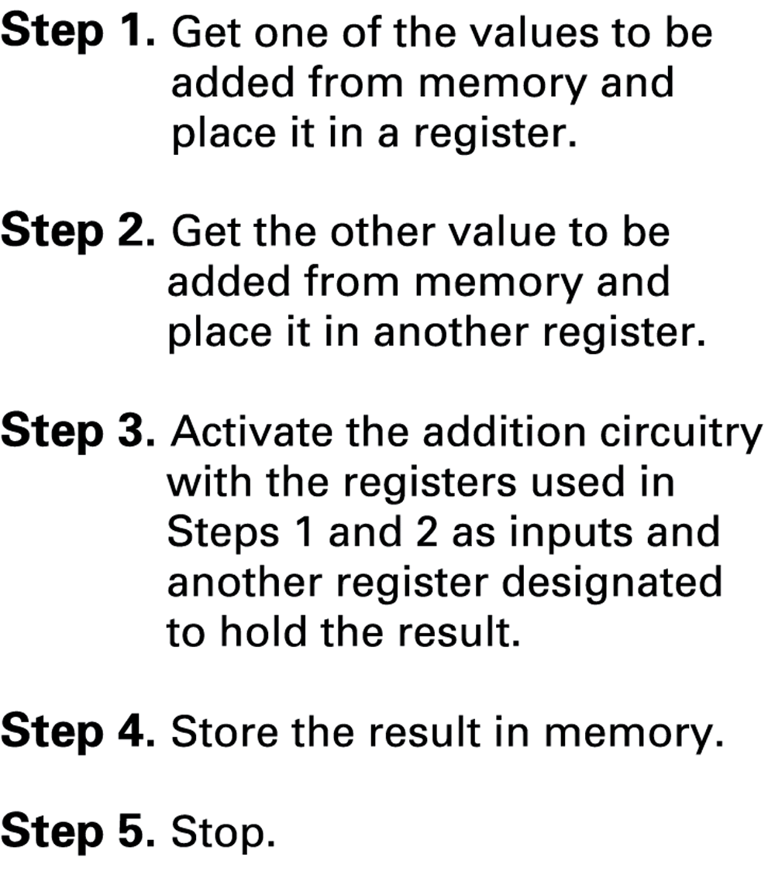
Adding values stored in memory

Slide 38
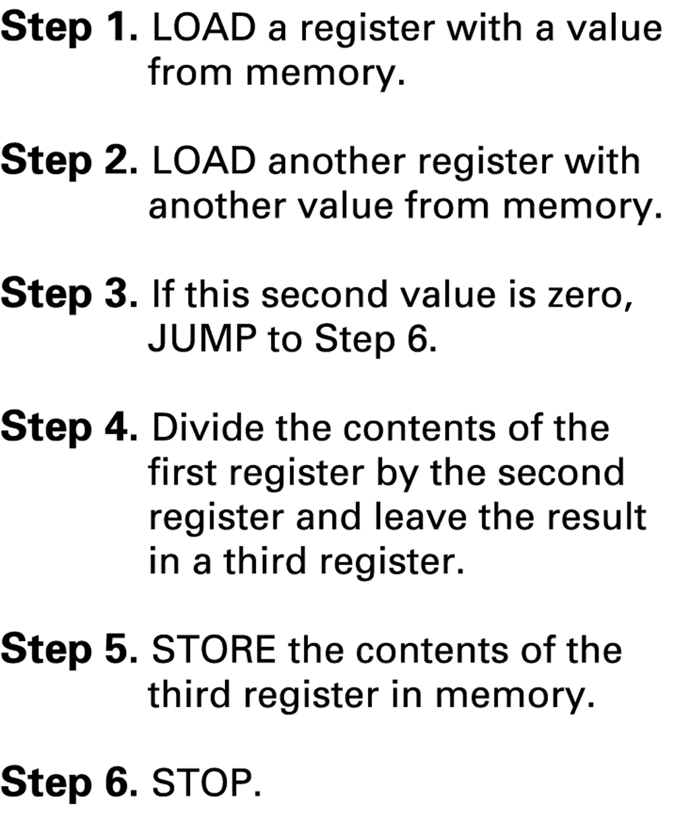
Dividing values stored in memory

Slide 39
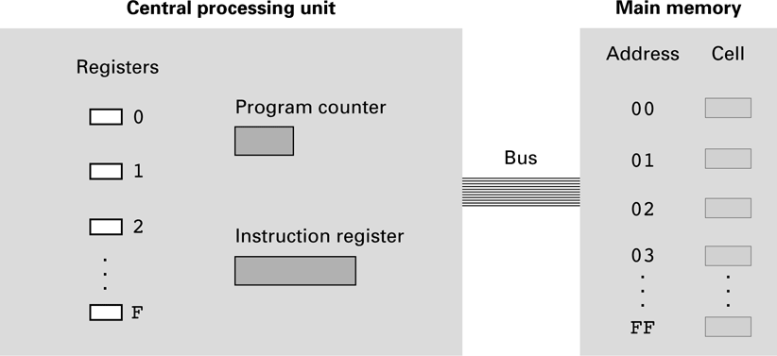
The architecture of the machine described in Appendix C A program counter (PC) is a CPU register in the computer processor which has the address of the next instruction to be executed from memory. It is a digital counter needed for faster execution of tasks as well as for tracking the current execution point. Instruction register : A hardware element that receives and holds an instruction as it is extracted from memory; the register either contains or is connected to circuits that interpret the instruction

Slide 40
Parts of a Machine Instruction
Op-code: Specifies which operation to execute
Operand: Gives more detailed information about the operation
A+B
A & B = Operand
+ = Opcode
Interpretation of operand varies depending on op-code

Slide 41
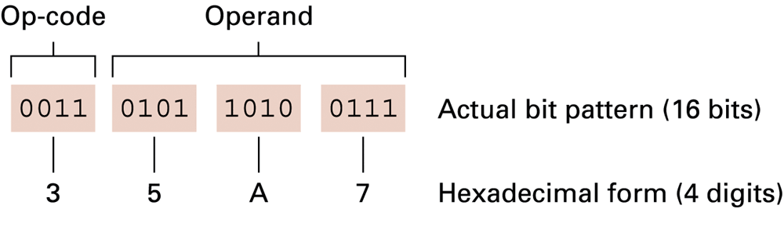
The composition of an instruction for the machine in Appendix C

Slide 42
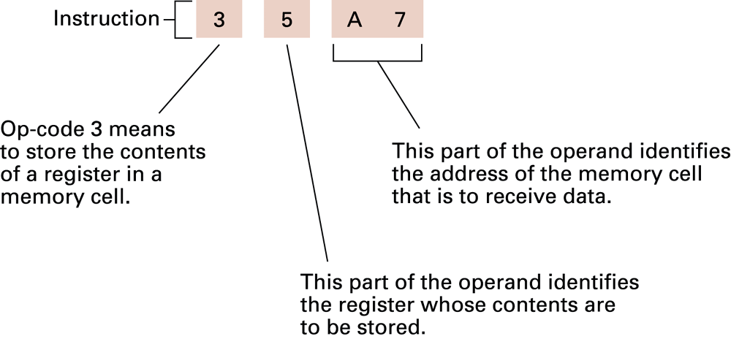
Decoding the instruction 35A7

Slide 43
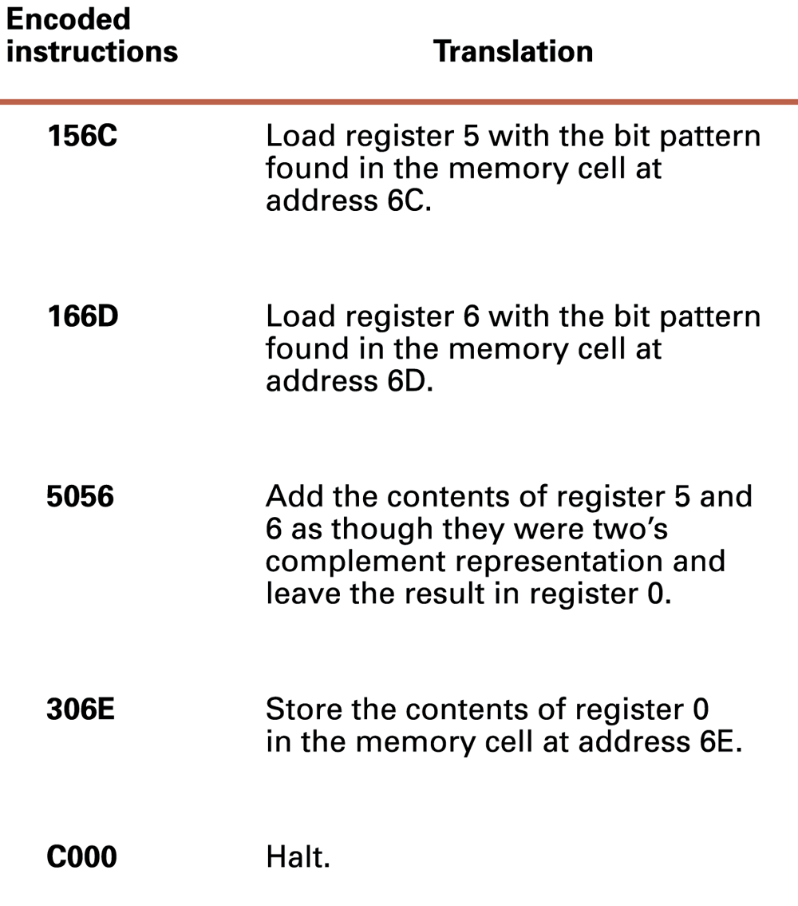
An encoded version of the instructions

Slide 44
Program Execution
Controlled by two special-purpose registers
Program counter: address of next instruction
Instruction register: current instruction
Machine Cycle
Fetch
Decode
Execute

Slide 45
Coding and decoding
Coding : The process of assigning a code to something for identification or classification is called Coding.
Decoding : The process of convert a coded message into intelligible (humanly readable) form is called Decoding

Slide 46
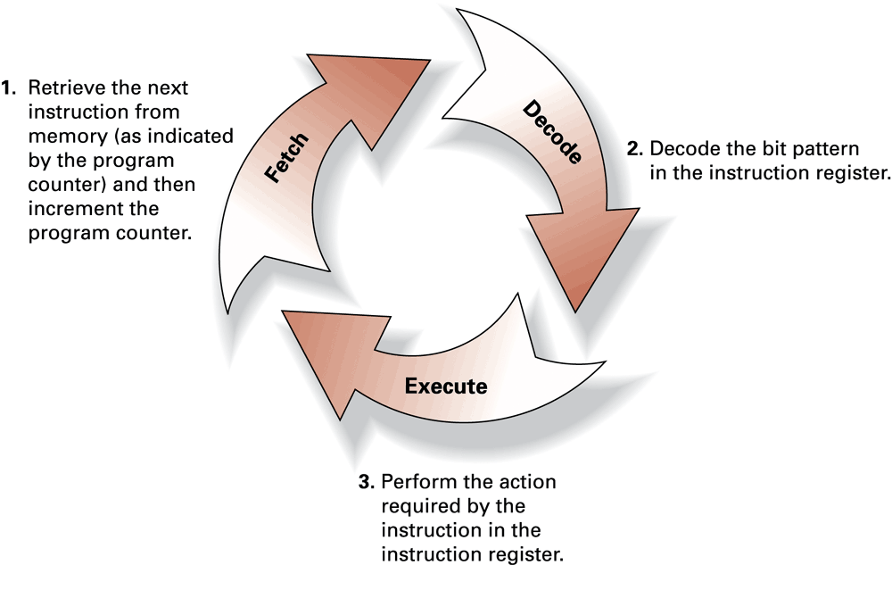
The machine cycle

Slide 47
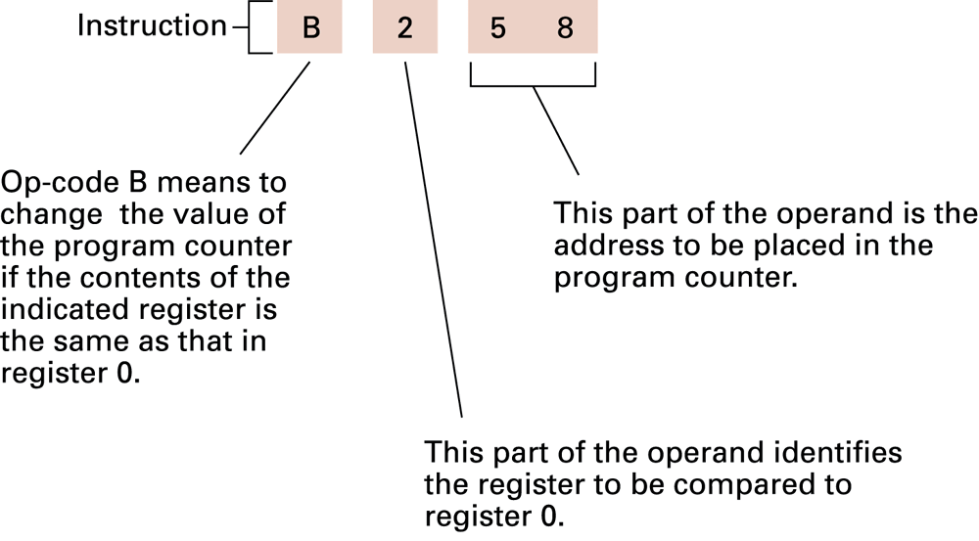
Decoding the instruction B258

Slide 48
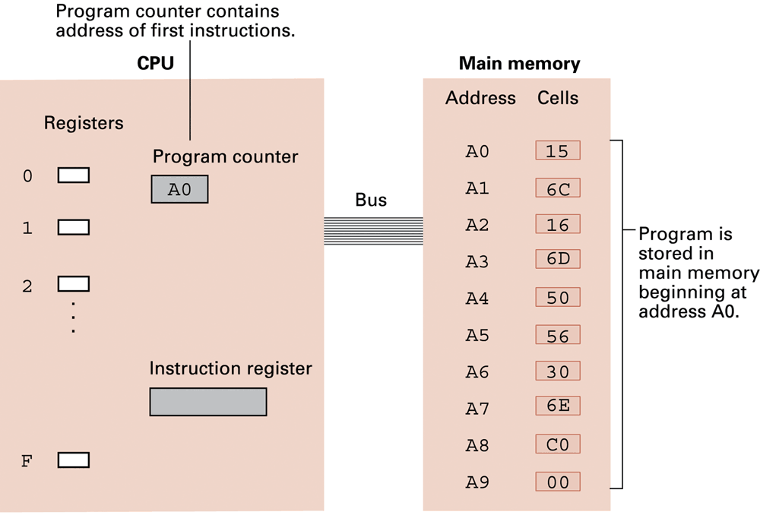
The program from Figure 2.7 stored in main memory ready for execution

Slide 49
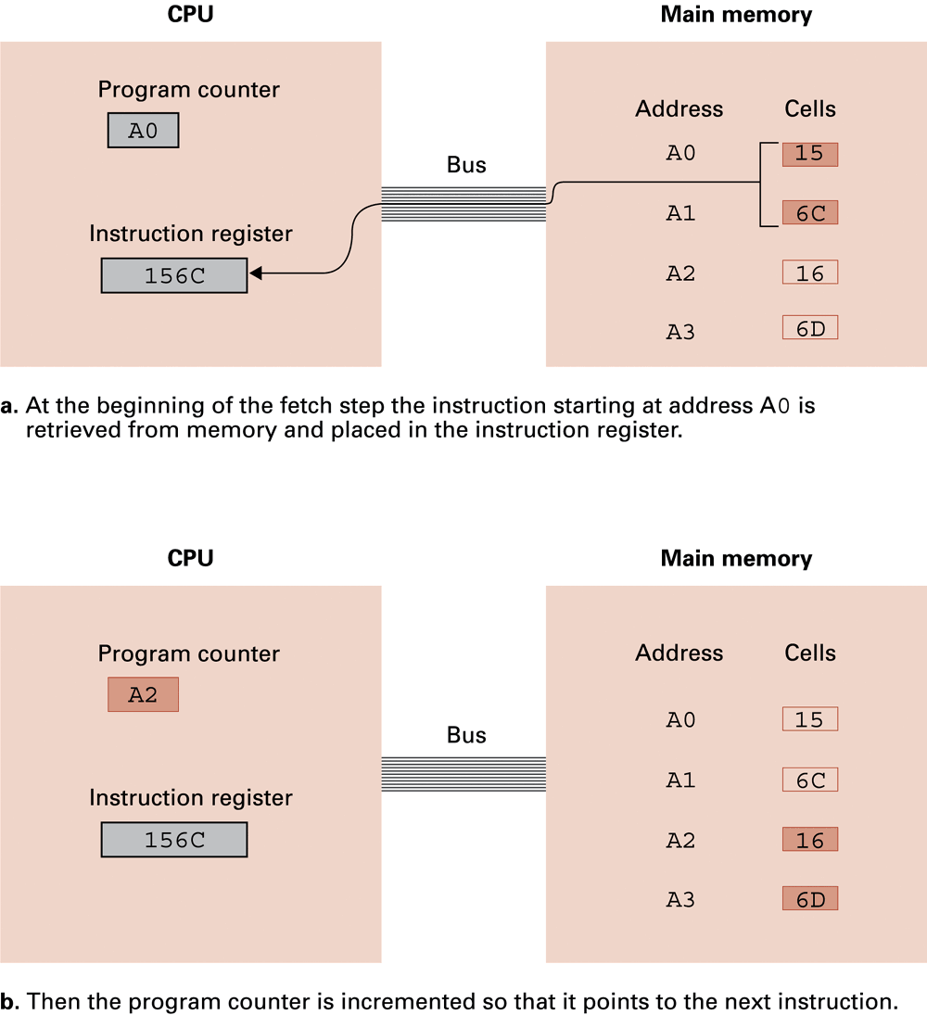
Performing the fetch step of the machine cycle

Slide 50
Performing the fetch step of the machine cycle (continued)

Slide 51
Communicating with Other Devices
Controller: An intermediary apparatus that handles communication between the computer and a device
Specialized controllers for each type of device
General purpose controllers (USB and FireWire)
Port: The point at which a device connects to a computer
Memory-mapped I/O: CPU communicates with peripheral devices as though they were memory cells

Slide 52
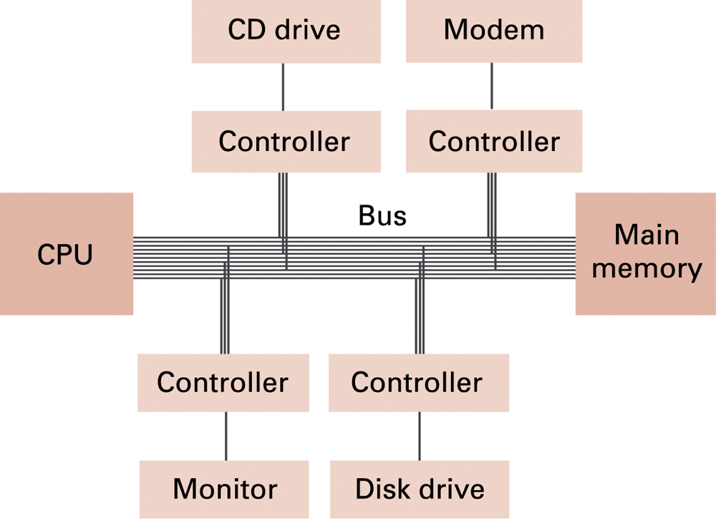
Controllers attached to a machine’s bus

Slide 53
Communicating with Other Devices (continued)
Direct memory access (DMA): Main memory access by a controller over the bus. Direct Memory Access (DMA) is a capability provided by some computer bus architectures that allows data to be sent directly from an attached device (such as a disk drive) to the memory on the computer's motherboard.
Handshaking: The process of coordinating the transfer of data between components. Handshaking is a I/O control method to synchronize I/O devices with the microprocessor. As many I/O devices accepts or release information at a much slower rate than the microprocessor, this method is used to control the microprocessor to work with a I/O device at the I/O devices data transfer rate.

Slide 54
Communicating with Other Devices (continued)
Parallel Communication: The transfer of multiple bits on multiple communication path is called Parallel Communication.
Serial Communication: The transfer of a single bit per time on a single communication path is called Serial Communication.

Slide 55
Parallel Processing
Running two or more processors (CPUs) to handle separate parts of an overall task.
Breaking up different parts of a task among multiple processors will help reduce the amount of time to run a program.
Any system that has more than one CPU can perform parallel processing, as well as multi-core processors which are commonly found on computers today.

