Slide 1
Way-point passing through a Reeds-Shepp trajectory
Podeanu Matei-Alexandru - 462
Schmidt Robert Eduard - 464

Slide 2
Dubins
Primitives:
L - Left Turn
S - Straight
R - Right turn
Paths:
CSC Type (Curve - Straight - Curve):
LSL: Left turn, then Straight, then Left turn.
RSR: Right turn, then Straight, then Right turn.
LSR: Left turn, then Straight, then Right turn.
RSL: Right turn, then Straight, then Left turn.
CCC Type (Curve - Curve - Curve):
LRL: Left turn, then Right turn, then Left turn.
RLR: Right turn, then Left turn, then Right turn.

Slide 3
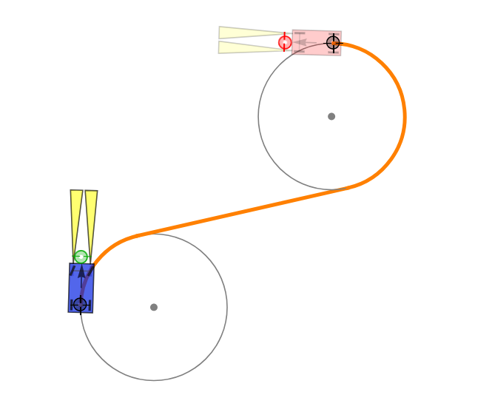
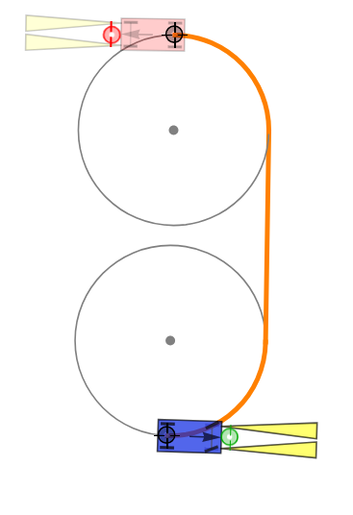
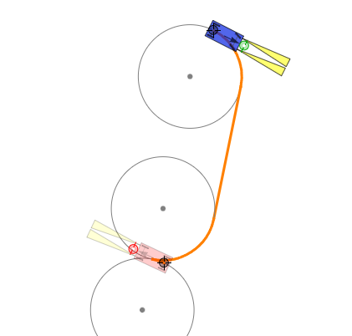
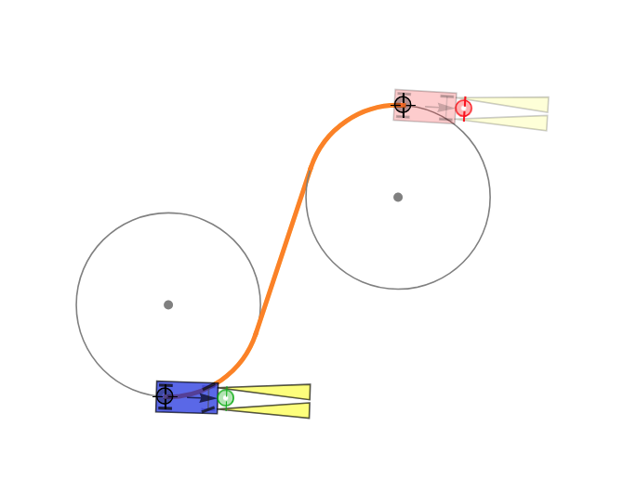
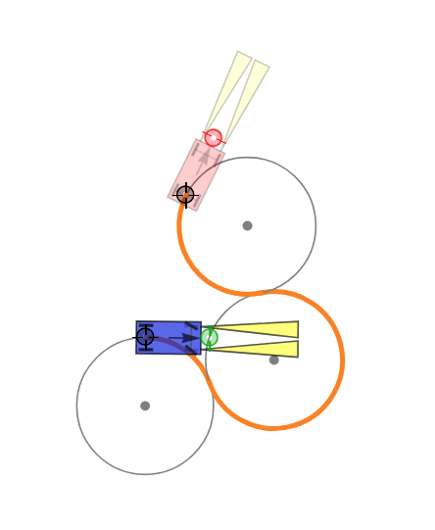
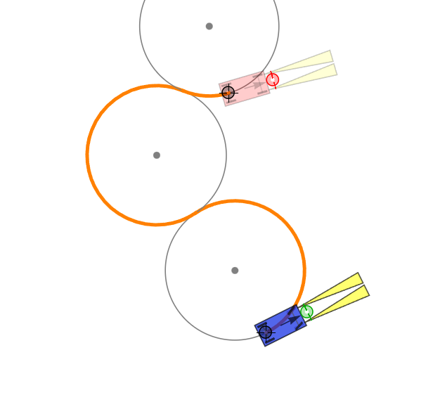
RSL
RSR
LSL
LSR
RLR
LRL

Slide 4
But what are Reeds Sheep Paths?

Slide 5
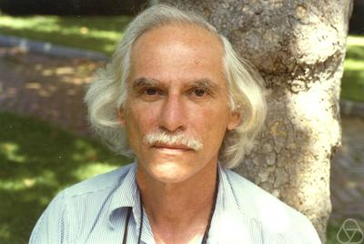
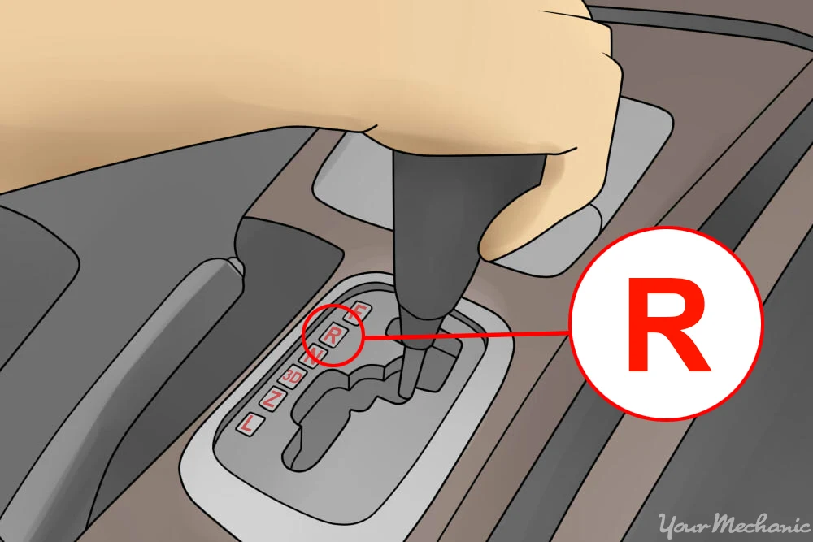
What are Reeds-Shepp paths?
+
=
Reeds-Shepp paths

Slide 6
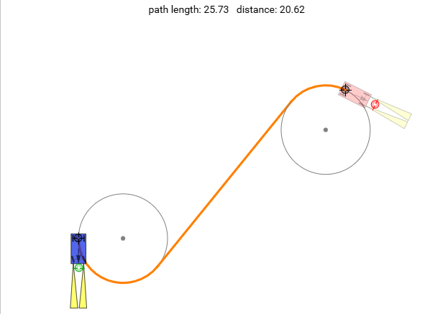
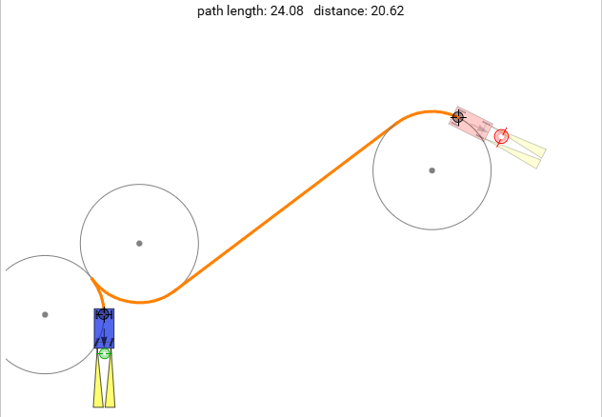
Why Reeds-Shepp?
Dubins
Reeds-Shepp

Slide 7
Travelling Salesman Problem
Goal – Shortest possible loop that hits every point once and returns to the start.
Data – Complete distance/cost matrix (symmetric or asymmetric).
Complexity – NP-hard; exact solvers blow up exponentially, so large instances rely on heuristics.
Uses – Vehicle/robot routing, tool-path planning, genome assembly, ordering Reeds-Shepp way-points.

Slide 8
Travelling Salesman Problem
Goal – Shortest possible loop that hits every point once and returns to the start.
Data – Complete distance/cost matrix (symmetric or asymmetric).
Complexity – NP-hard; exact solvers blow up exponentially, so large instances rely on heuristics.
Uses – Vehicle/robot routing, tool-path planning, genome assembly, ordering Reeds-Shepp way-points.

Slide 9
Time Complexity:
O(n )
!

Slide 10
Implementation
Defining Target Points / Waypoints
Order Optimization (TSP)
Trajectory Generation (Reeds-Shepp)
Simulation of Variable Turning Radii
Visualization & Animation (Turtle)

Slide 11
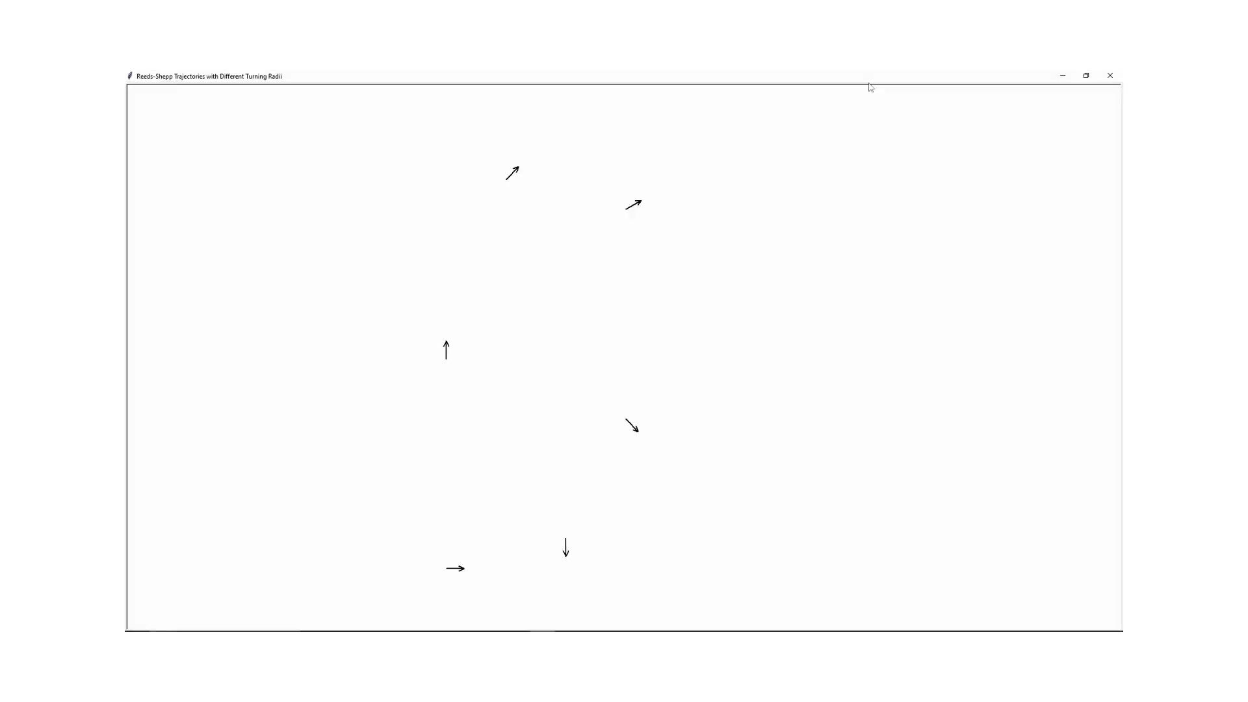

Slide 12
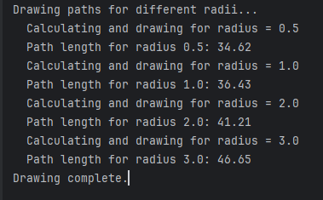
Output

Slide 13
Utilized in (but not limited to):
Autonomous cars nail tight parallel and alley parking.
Warehouse robots reverse efficiently through narrow aisles.
Heavy AGVs back containers through port lanes.
Planetary rovers plan constrained paths on Mars.
Unmanned surface vessels dock using RS planners.
Construction loaders navigate confined sites with reversals.
Airport tug planners optimise aircraft taxi pushbacks.
Autonomous forklifts plan reverse shunts inside warehouses.
Last-mile delivery bots maneuver precisely around pedestrians.

Slide 14
Thank you for your patience!
Oprea marry me

Slide 15
References
Reeds, J. A.; Shepp, L. A. Optimal paths for a car that goes both forwards and backwards. Pacific J. Math. 145 (1990), no. 2, 367-393:
https://projecteuclid.org/euclid.pjm/1102645450
Simulator:
https://demonstrations.wolfram.com/ShortestPathForForwardAndReverseMotionOfACar/
Original Repo: https://github.com/nathanlct/reeds-shepp-curves
Video used for understanding the concepts:
https://www.youtube.com/watch?v=fAqh_cy7ePI&t=55s

