Slide 1


Development of an Educational Game called “Ferid Factory”
For the attainment of the:
National Diploma of Computer Engineering
By Yassine Aloui
Defended on 04/07/2025 before the jury:
President: Dr. KANZARI Dalel
Examiner: Dr. KHEMAJA Maha
Supervisor: Dr. NAOUAR Fatiha
Industrial Supervisor: Mr. MKADMI Mouadh
Academic Year: 2024 / 2025

Slide 2
Plan
1.
General Context
6.
Implementation
2.
Problem Statement
7.
Conclusion & Future Perspectives
3.
Proposed Solution
4.
Requirements Specification
5.
System Design

Slide 3
General Context

Slide 4


1.1 Host Company
Tunisian startup named Horizon Education
Founded in 2020
In Sousse, Tunisia,
specializing in the development of Educational Games
Main Product : Mobile App called Ferid around the world
Chap: General Context
1

Slide 5
1.2 Project’s Domain
Games
Serious Games
Implicit Learning
Games
Chap: General Context
2

Slide 6
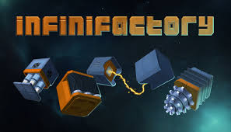
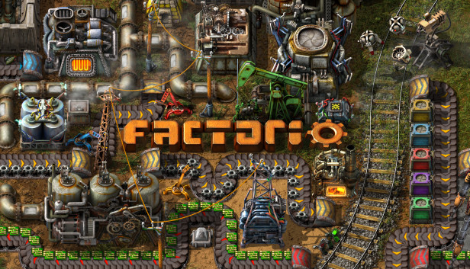
1.3 Existent Solutions
Infinifactory Game
Factorio Game
Chap: General Context
3

Slide 7
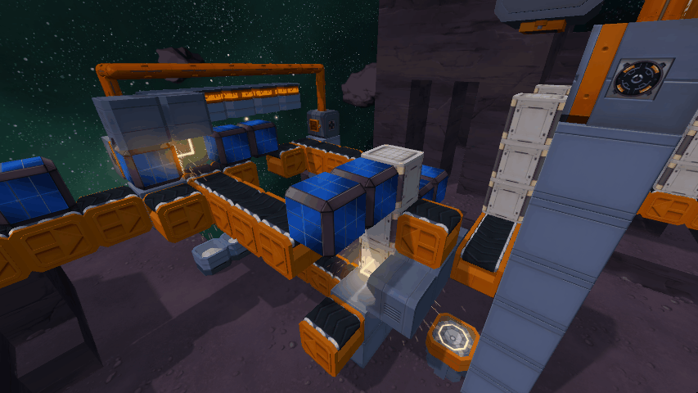
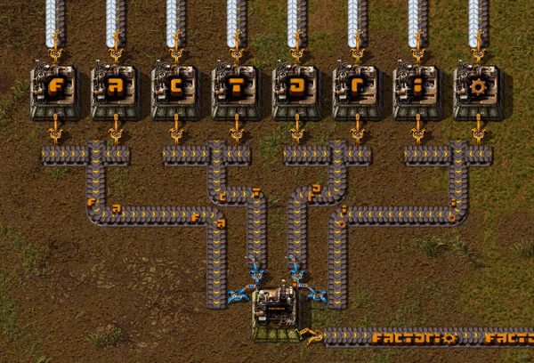
1.4 Advantages of Existent solutions
Those Games Teaches the following Skills :
Decomposition of a problem
Trial-and-error approach
Iterative problem solving
Spatial reasoning
Reverse engineering
Chap: General Context
4

Slide 8

1.5 Limitations of Existent solutions
Those Games Limitations are the following :
Not kid-friendly
  High complexity
  Lack of proper tutorials
  Industrial theme with low emotional engagement
Language barrier (no arabic support)
Chap: General Context
5

Slide 9
Problem Statement

Slide 10
2. Problem Statement
Existing solutions are not kid-friendly due to their complexity, lack of proper tutorials, and absence of Arabic language support.
Chap: Problem Statement
6

Slide 11
Proposed Solution

Slide 12

3. Proposed Solution
Development of a serious game destined for kids:
The kid player creates a Factory using Gadgets (machines) in order to assemble a Target Shape
Age : 4 - 12
Chap: Proposed Solution
7

Slide 13
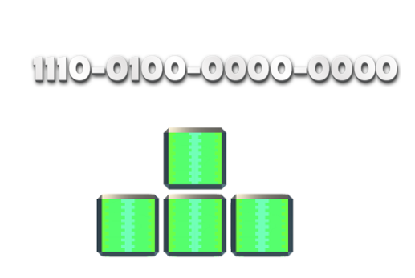
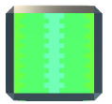

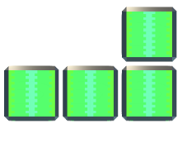
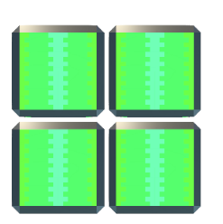
3.1 What is a Target shape ?
A Shape is object that is composed of blocks
Shape 1
Shape 2
Shape 3
Multiple blocks
Factory
Chap: Proposed Solution
8

Slide 14

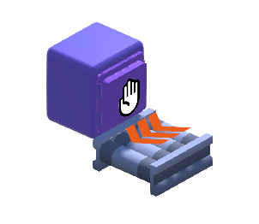
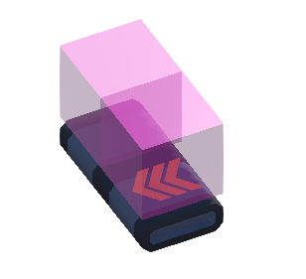
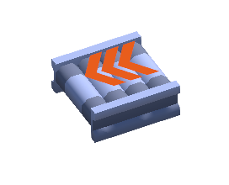
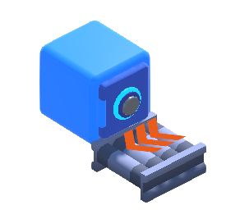

3.2 What is a Factory ?
A Factory is a collection of Gadgets(machines) organised by the kid player in placed on a Grid
+
=
Factory
4x4 Grid
Gadgets
Chap: Proposed Solution
9

Slide 15

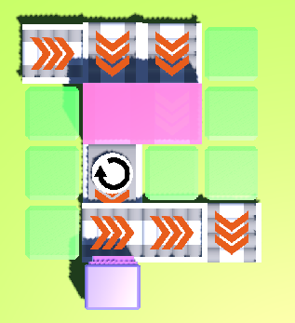

Target Shape
Gadgets(machines)
+
=
Empty Grid
Kid player
Factory
Chap: Proposed Solution
10

Slide 16
Requirements Specification

Slide 17
4.1 Actors Identification
Actor : Kid player aged between 4 and 12
Chap: Requirements Specification
11

Slide 18
4.2 Functional Requirements
Desired Shape Display
Gadget Management: Create, rotate, move, and delete gadgets)
Camera System
Feedback System
Tutorial System
Simulation Handling
Infinite Level Randomization System
Chap: Requirements Specification
12

Slide 19
System Design

Slide 20
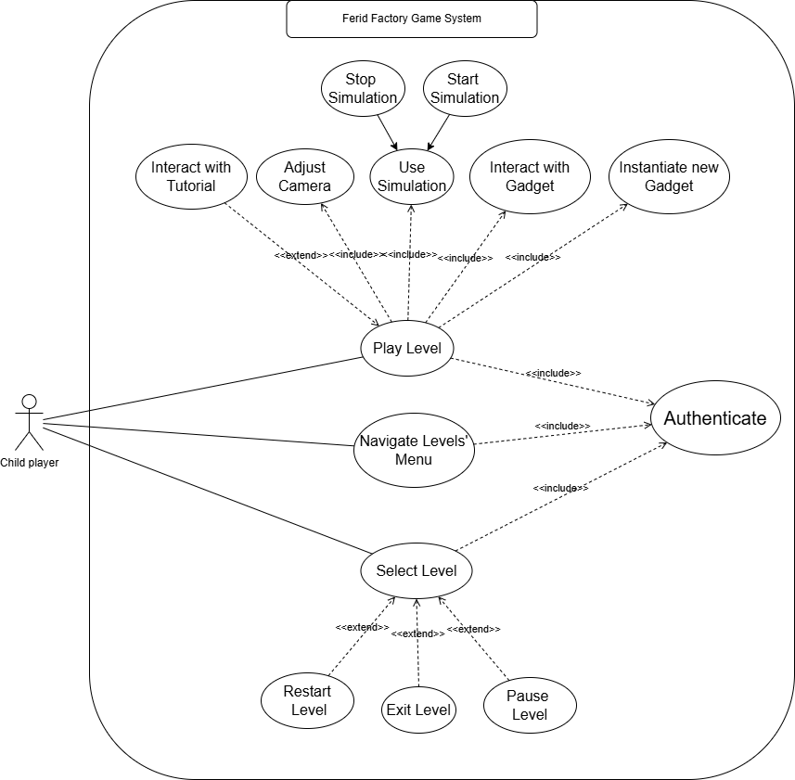
5.1 General Use Case Diagram
Chap: System Design
13

Slide 21
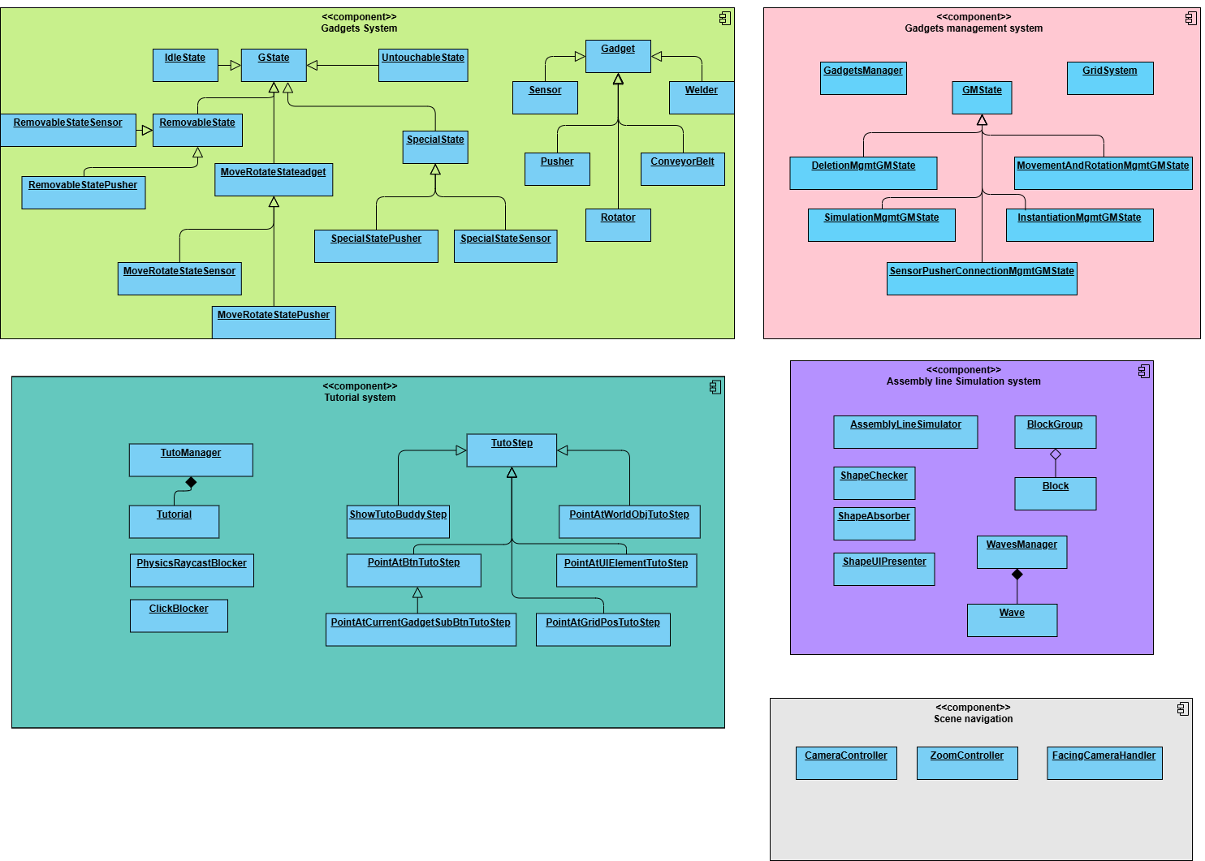
5.2 Components Diagram
Chap: System Design
14

Slide 22
Implementation

Slide 23
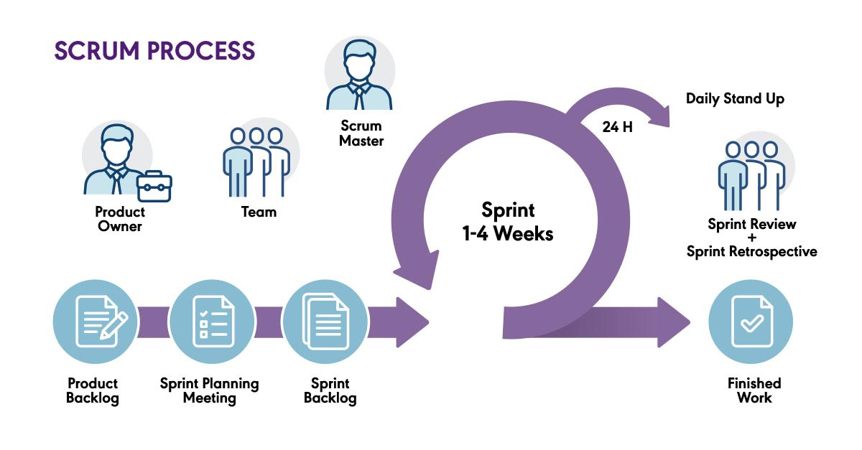
6.1 Development process
Chap: Implementation
15

Slide 24



6.2 Technologies Used
Game development Framework
Programming Language
IDE
Chap: Implementation
16

Slide 25
6.3 Types of Gadgets
How to move from point A to B ?
Conveyor Belt
Chap: Implementation
17

Slide 26
6.3 Types of Gadgets
How to combine 2 blocks ?
Welder
Chap: Implementation
18

Slide 27
6.3 Types of Gadgets
How to rotate blocks ?
Rotator
Chap: Implementation
19

Slide 28
6.4 Demo : Scenario Study
Objective: create the following shape
Target Shape
Chap: Implementation
20

Slide 29
Conclusion

Slide 30
7.1 Conclusion
Since existing solutions are not targeted for kids, this project introduces a serious game where kids use Gadgets (machines) to build a factory that assembles a Target Shape, implicitly teaching valuable skills.
Chap: Conclusion and Perspectives
21

Slide 31
Future Perspectives

Slide 32
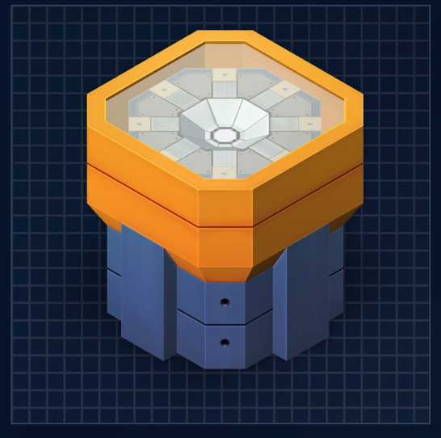
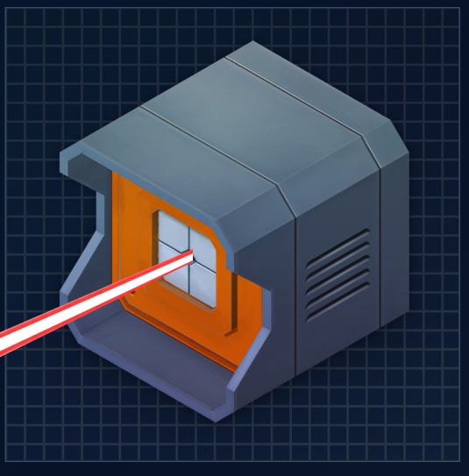
7.2 Perspectives
The introduction of new Gadgets(machines)
Elevator
Laser
Chap: Conclusion and Perspectives
22

Slide 33


7.2 Perspectives
Tracking child progress
Level Creation and sharing system
Chap: Conclusion and Perspectives
23

Slide 34


