Slide 1

CUSTOMER PURCHASE BEHAVIOUR ANALYSIS
LAKSHMI HARSHITHA - 2023BCS0069
ROSHITHA - 2023BCS0105
VINUTHNA - 2023BCS0150

Slide 2

Introduction
Customer purchase behaviour analysis helps businesses understand how customers shop, what products they prefer, and how much they spend.
A data warehouse allows large volumes of customer data to be stored, cleaned, and analyzed for decision making.
This project uses customer shopping data to identify patterns, trends, and business insights using analytical techniques.
Why this project is important Improves business decision making
Identifies customer trends
Helps increase sales
Supports strategic planning

Slide 3
Objectives
The main objectives of this project are:
To analyze customer purchase behaviour using shopping data
To clean and prepare data for analysis
To perform exploratory data analysis
To segment customers using clustering
To predict product category using decision tree
To generate business insights using OLAP operations

Slide 4
Dataset Description
The dataset used in this project is shopping_trends.csv.
It contains customer shopping details such as:
Age
Gender
Product Category
Purchase Amount (USD)
Season
Previous Purchases
Subscription Status
Dataset Features
Structured tabular data
Numerical and categorical variables
Suitable for warehouse analysis

Slide 5
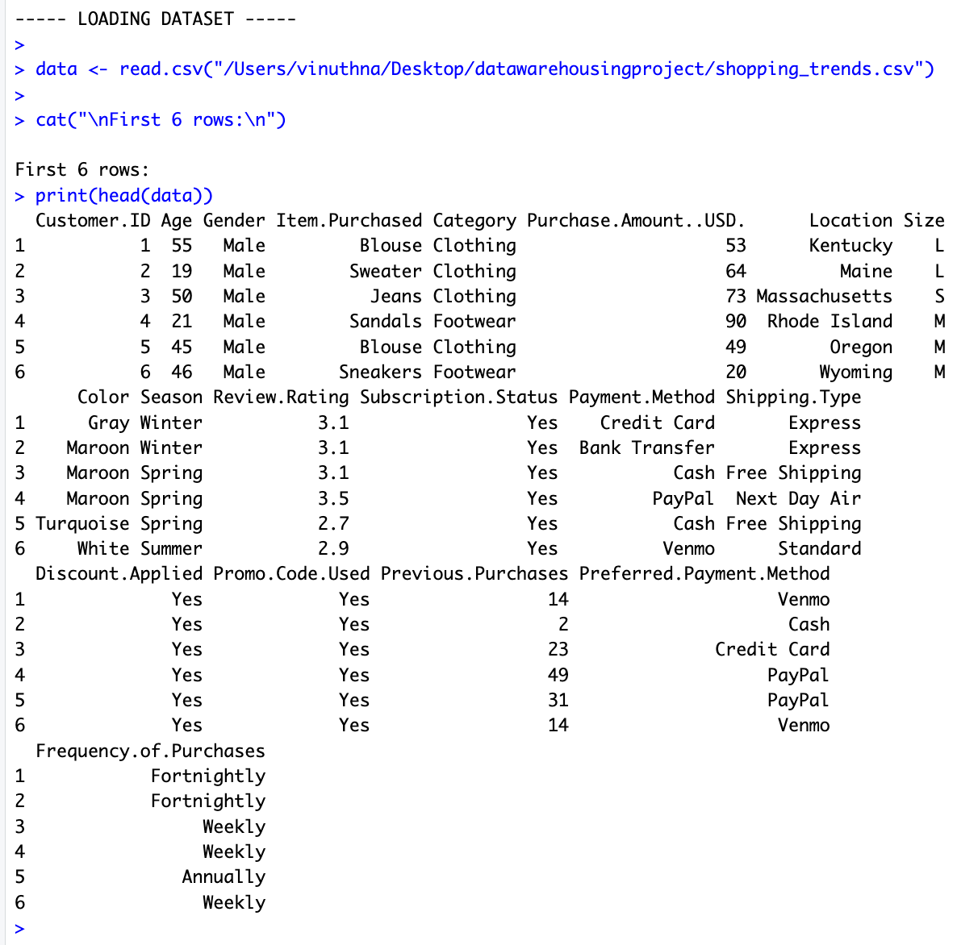

Slide 6
Data Preprocessing
Before analysis, the dataset was cleaned and transformed.
Data Cleaning Steps:
Checked missing values
Removed null records
Removed duplicate rows
Data Transformation:
Converted categorical columns into factors
Selected numerical columns for statistical analysis
Clean and ready dataset for further processing.
Raw Data → Cleaning → Transformation → Analysis

Slide 7
Exploratory Data Analysis
Exploratory analysis was performed to understand customer patterns.
Visualizations Used
Age Distribution
Gender Distribution
Purchase Amount Distribution
Sales by Product Category
Sales by Season
Observations
Certain age groups purchase more frequently
Spending varies across product categories
Seasonal differences affect sales
=

Slide 8
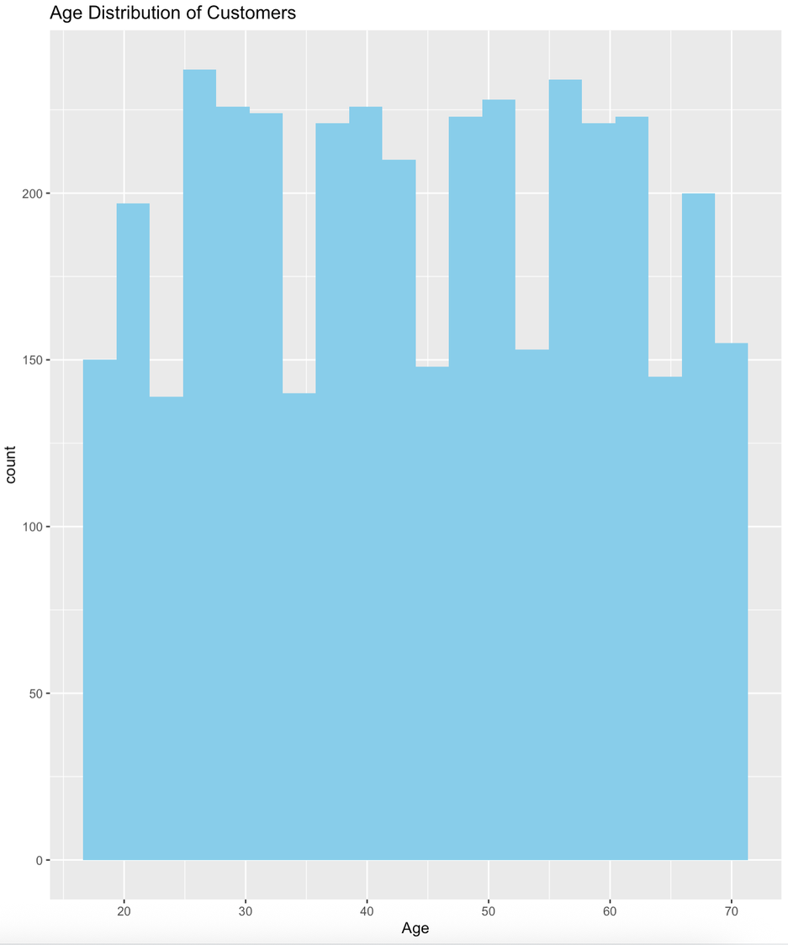
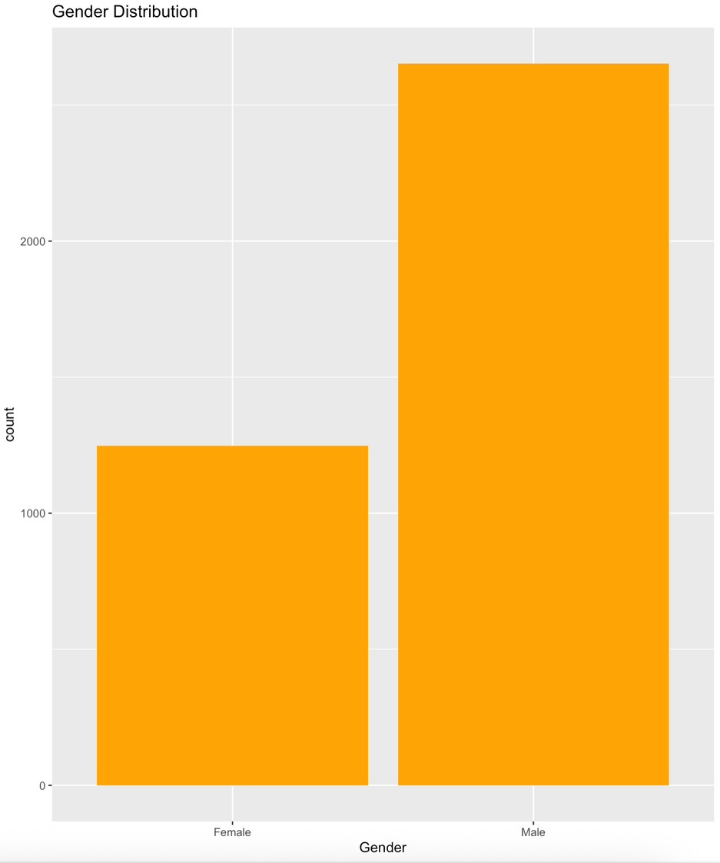

Slide 9
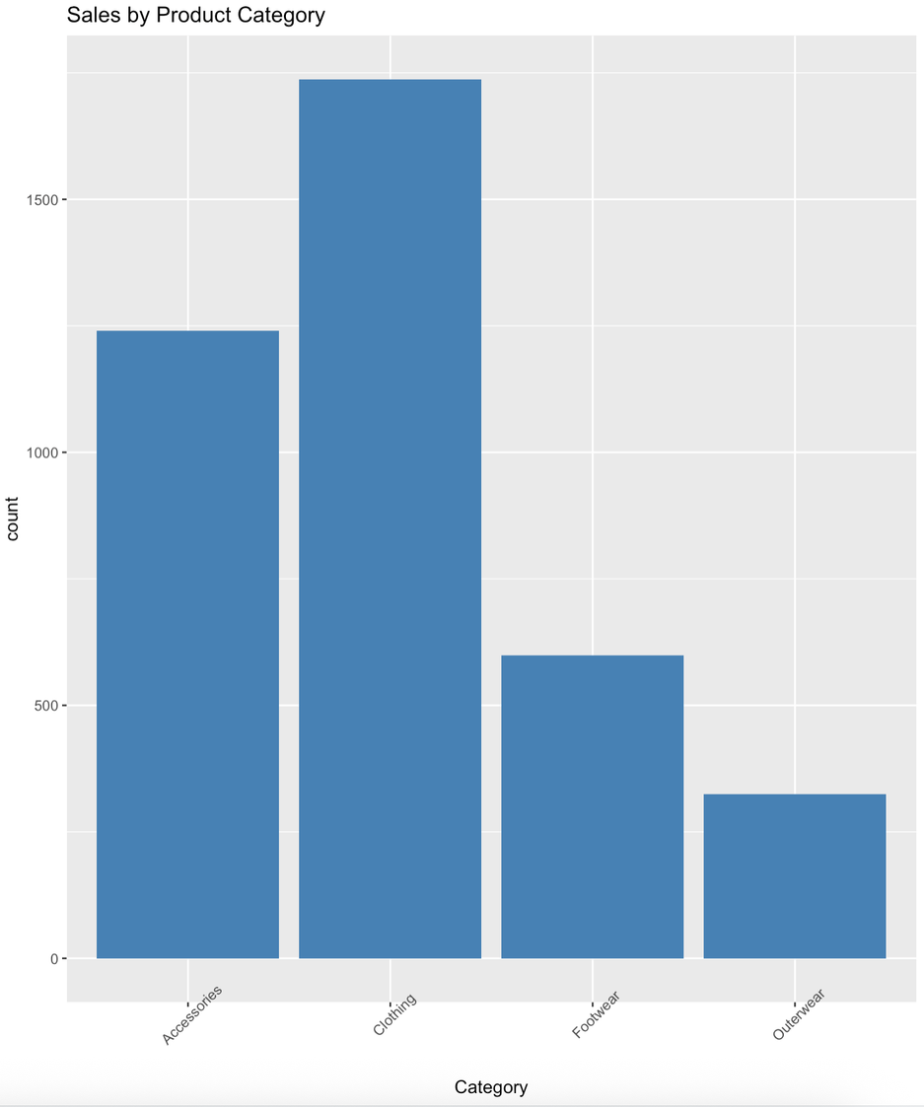
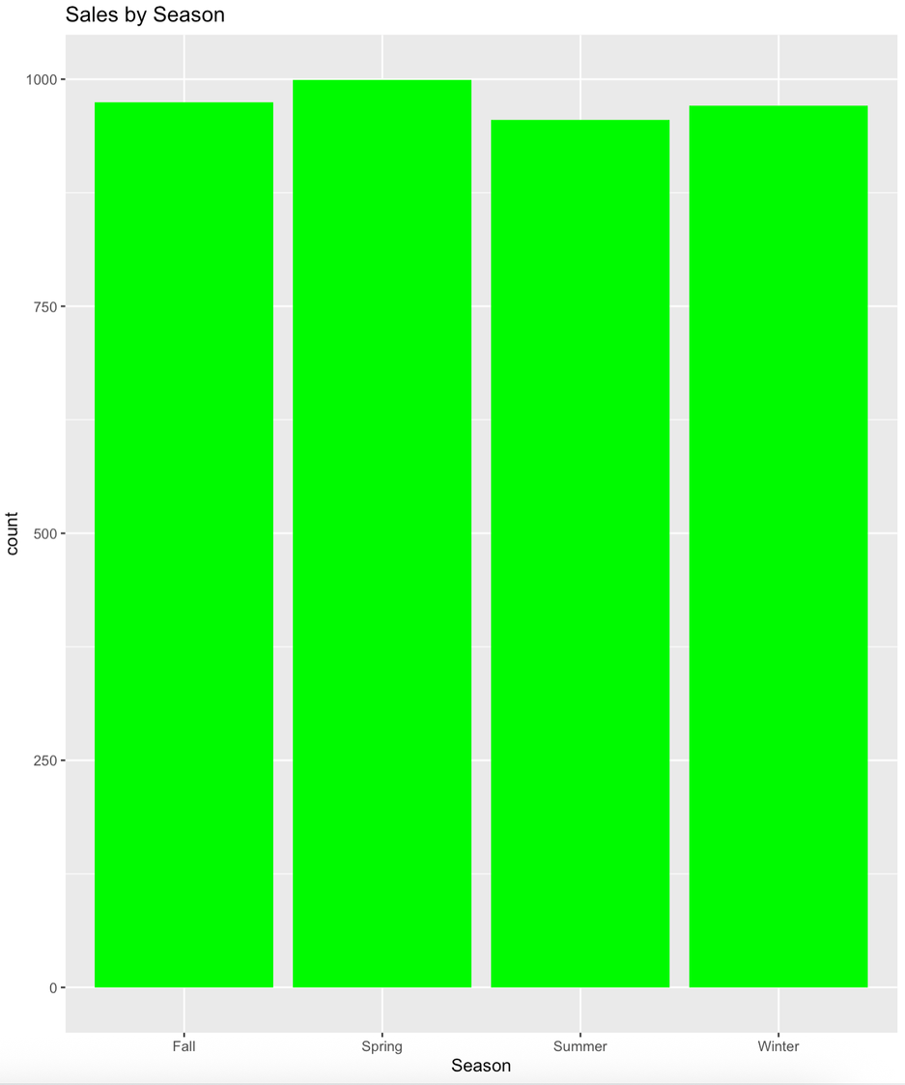

Slide 10
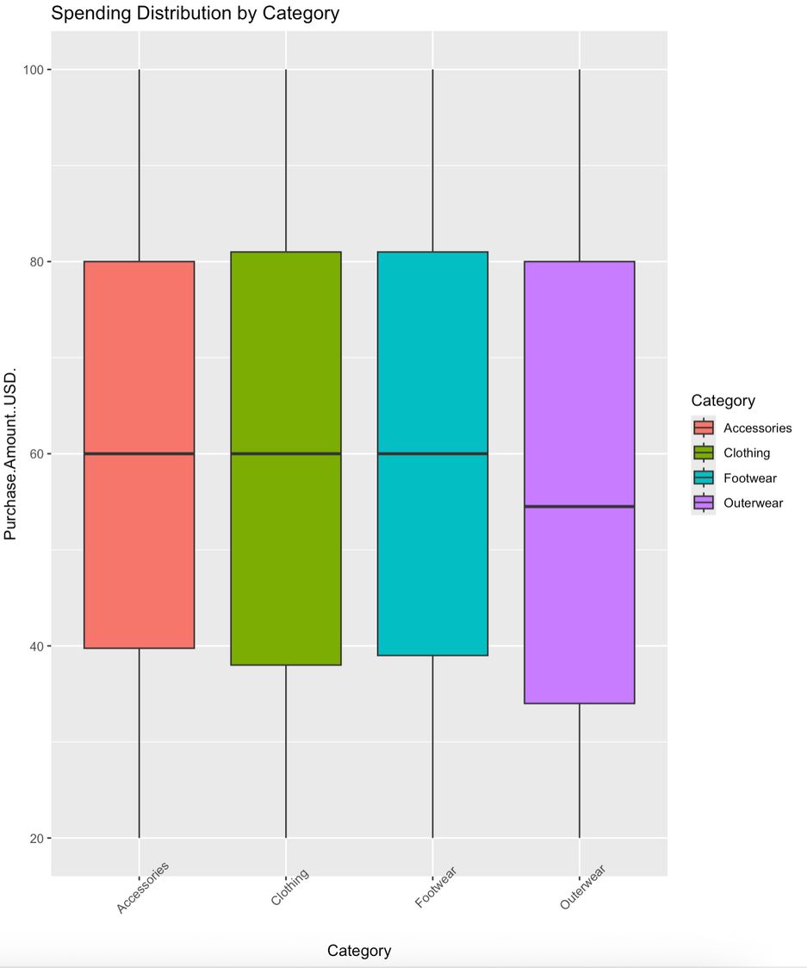
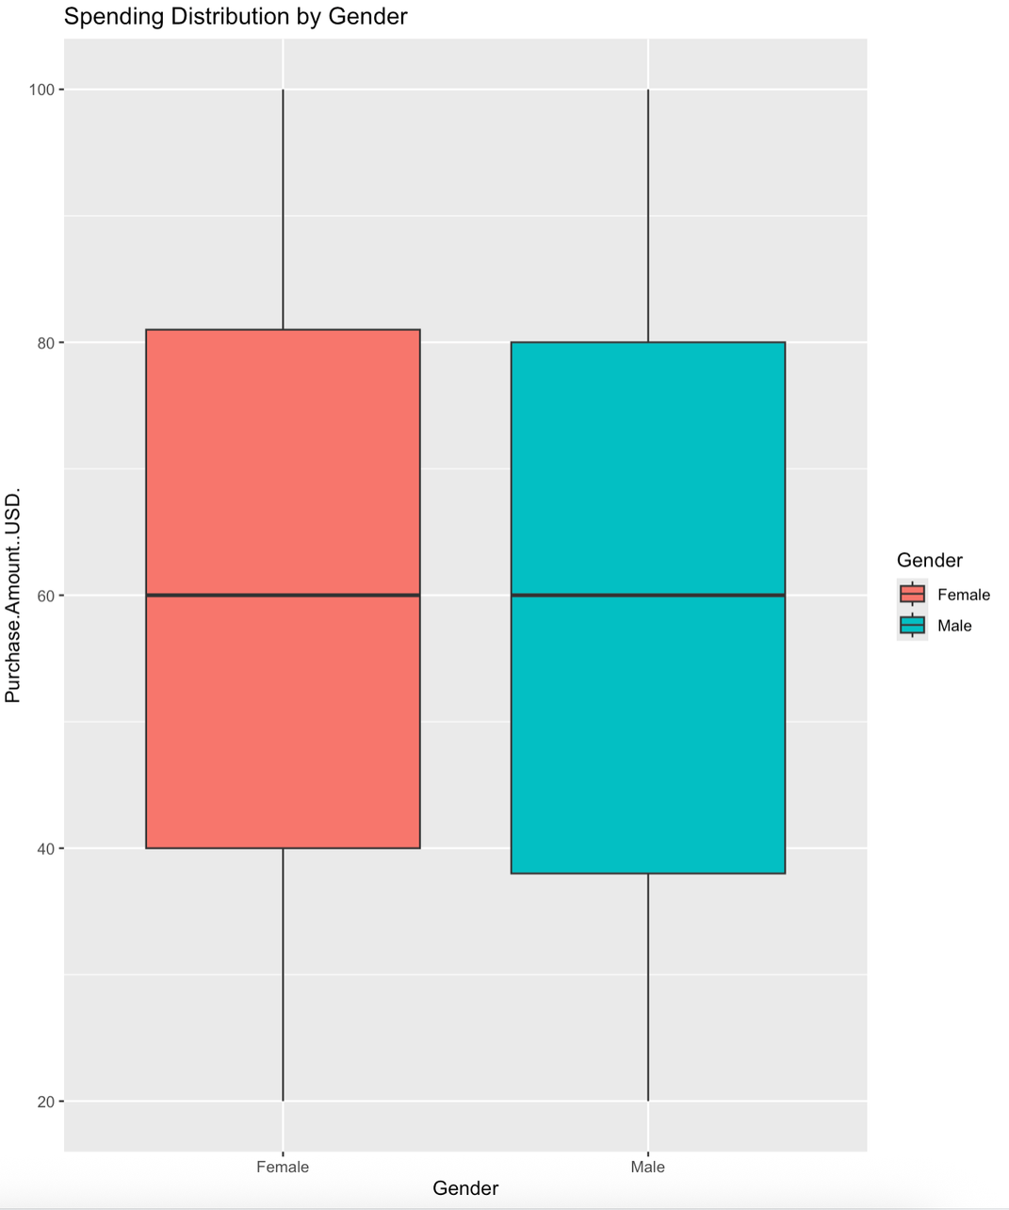

Slide 11
Correlation Analysis
Correlation analysis was used to identify relationships between numerical variables.
Purpose
Measure dependency between variables
Reduce unnecessary features
Method Used
Correlation Matrix
Corrplot Visualization
Outcome
Numerical features showed weak to moderate correlation.

Slide 12
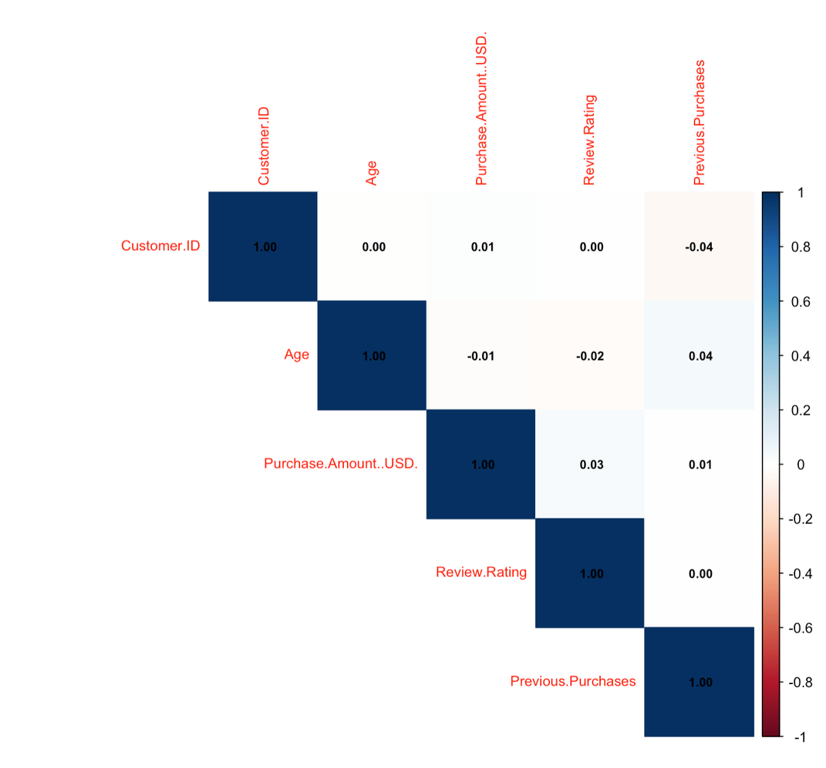
Correlation Heatmap

Slide 13
Customer Segmentation using K-Means Clustering
Customer segmentation helps divide customers into groups based on similar behaviour.
Features Used Age
Purchase Amount
Method K-Means Clustering with 3 clusters
Result Three major customer groups identified:
Low spenders
Medium spenders
High spenders
This helps businesses target customers effectively.

Slide 14
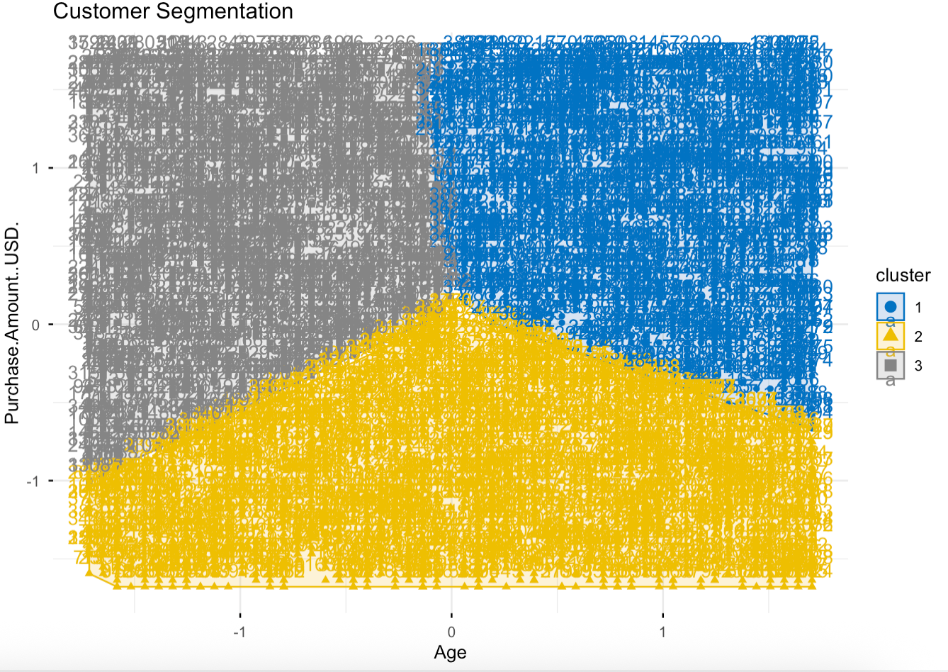
Customer Clustering

Slide 15
Decision Tree and OLAP
Analysis
Decision Tree Classification
A decision tree model was built to predict product category using:
Age
Gender
Previous Purchases
Purchase Amount
OLAP Analysis Performed
Total sales by category
Average spending by gender
Total sales by season
Top performing product categories
This supports multidimensional business analysis.

Slide 16
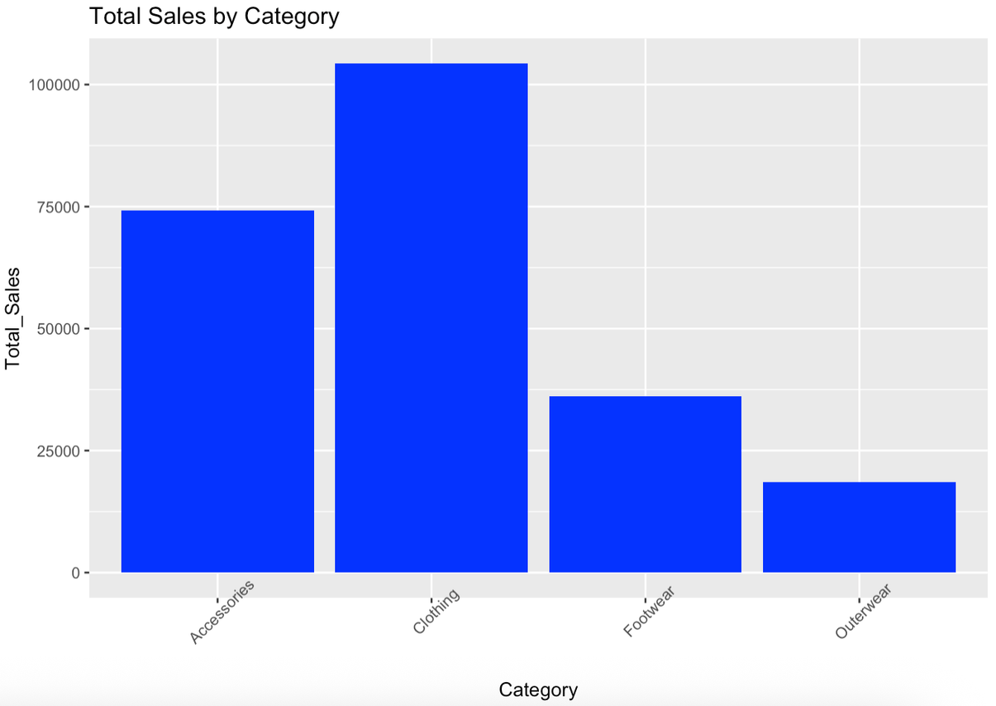
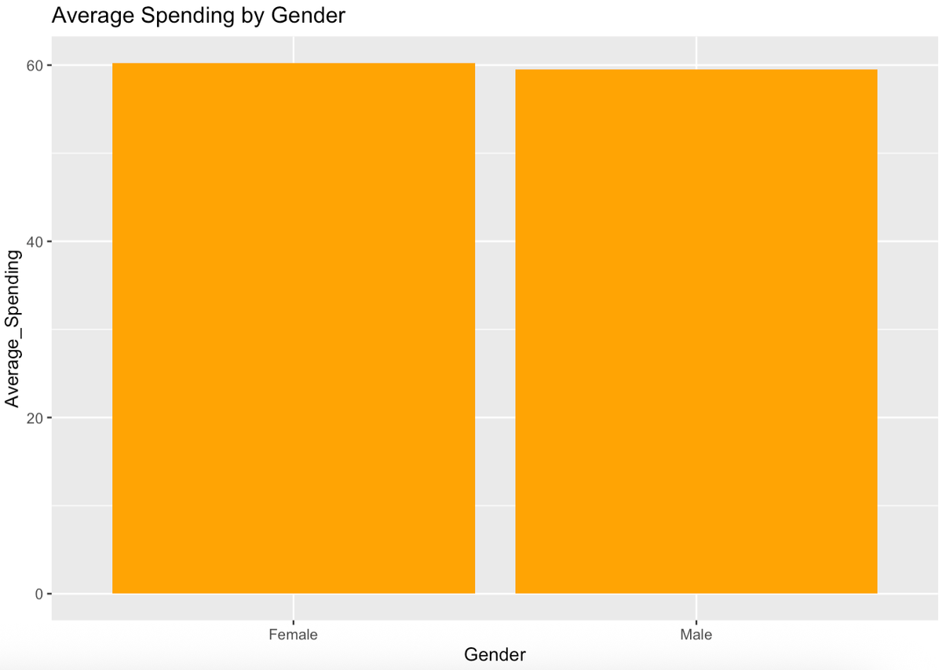

Slide 17
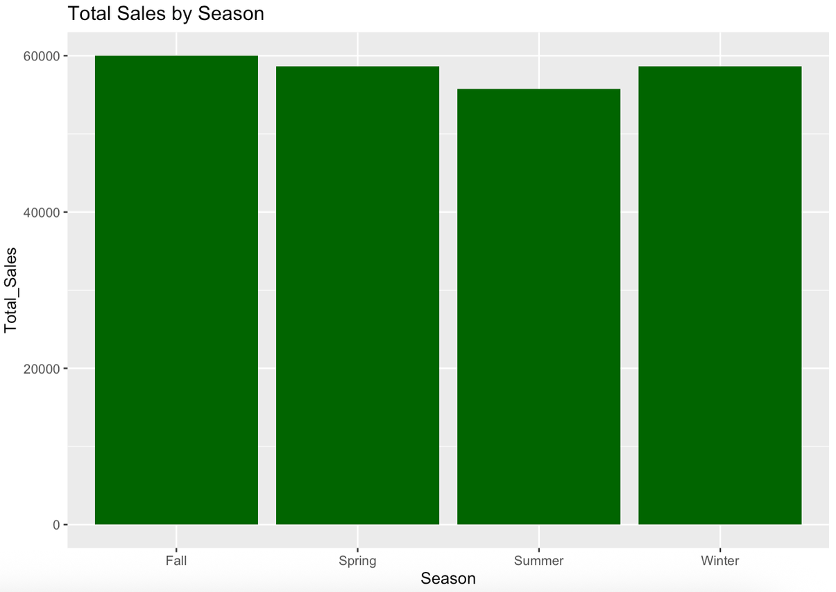
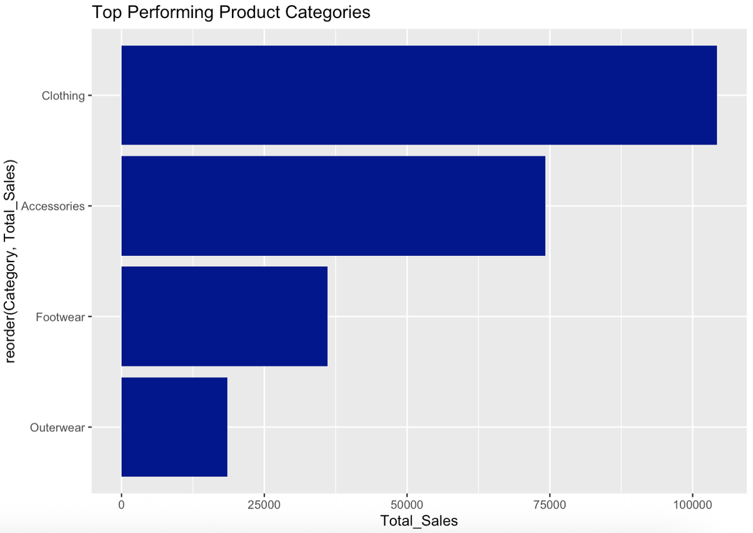

Slide 18
CONCLUSION
Business Insights Average customer spending identified
Highest revenue generating category detected
Best performing season identified
Gender spending trend analyzed
This project shows how data warehouse techniques help convert raw customer data into useful business knowledge.
Future Scope Real-time dashboards
Customer recommendation systems
Advanced predictive analytics

