Slide 1
Development of a Curriculum Analysis and Simulation Library with Applications in Curricular Analytics
Michael Hickman

Slide 2
Outline
Background & Motivation
Previous Work
Library Design & Implementation
Simulation Details
Applications in Curricular Analytics
Future Work

Slide 3
Background & Motivation

Slide 4
Background & Motivation
One of the primary goals of higher-education institutions is to prepare students for the workforce efficiently – student success.
Methods for improving success:
Tutoring Programs
Intervention Programs
Financial Support
Improving Instruction Quality
Classroom Structures (hybrid, flipped)
Etc.
What about curriculum structure?

Slide 5
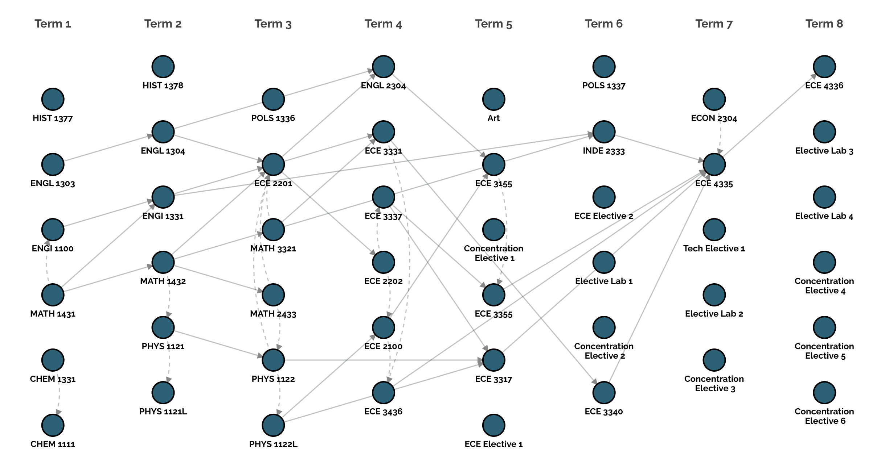
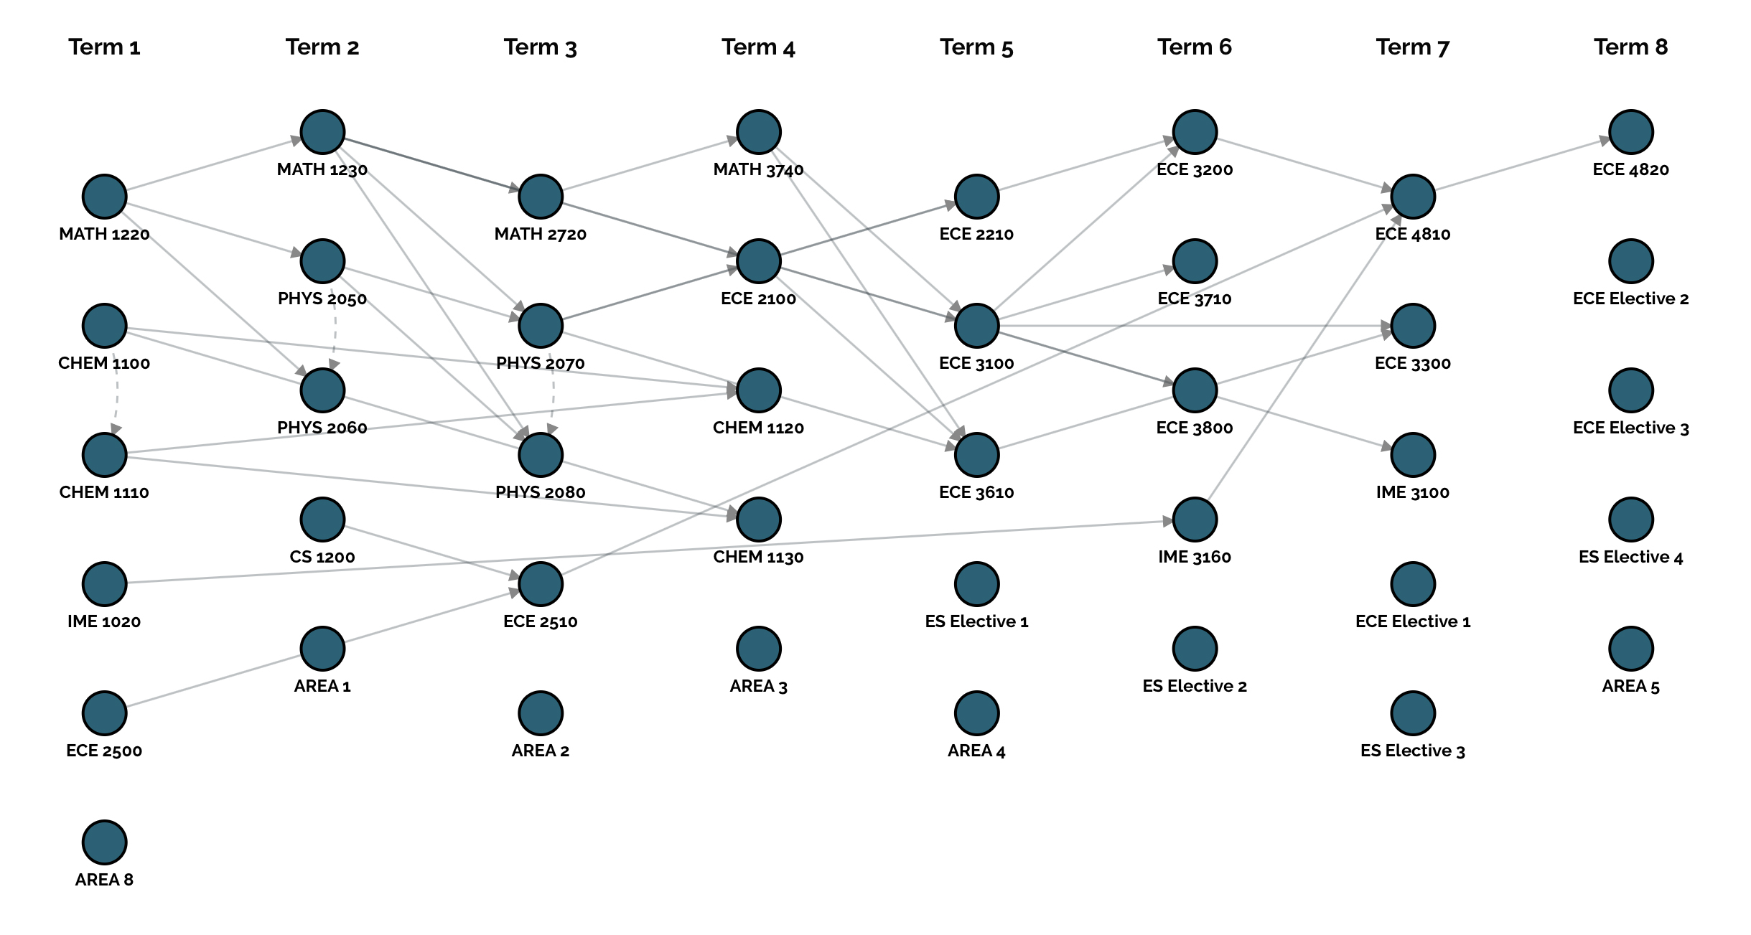
Two Curricula:
Same Major
Four year programs
Within four total credits of each other.
Their structures look very different – one appears much more complex than the other.
Does this structural complexity influence student success?

Slide 6
Background & Motivation
Seeing a curriculum as data (a graph) allows for analytics and correlating structure to student success – given the right tools.
Providing these tools was the motivation behind the development of the Curriculum Analysis and Simulation Library (CASL).
CASL:
Represents curricula in a programming environment.
Defines a JSON-based standard for representing curricula.
Provides metrics for characterizing the structural properties of curricula.
Provides an interface and framework for simulating students moving through a curriculum.

Slide 7
Previous Work

Slide 8
Previous Work
Slim et al., at UNM developed metrics for quantifying the structural complexity of a curriculum with two factors:
Delay Factor: characterized by long paths in a curriculum.
Blocking Factor: the number of courses that a student cannot take until a certain class has been passed.

Slide 9
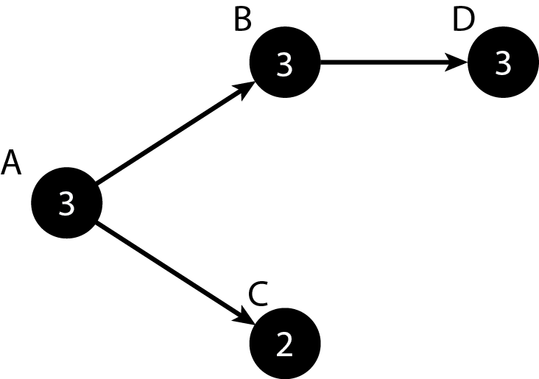

Previous Work
The delay factor of course $v_{i}$, denoted $d\left(v_{i}\right)$, is defined as the number of nodes in the longest path that passes through $v_{i}.$
Ex:

Slide 10
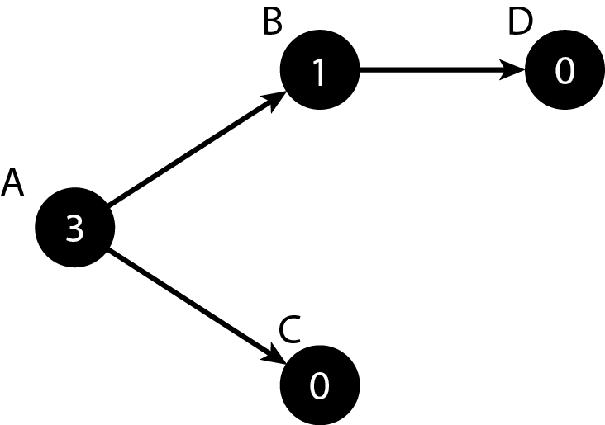

Previous Work
The blocking factor of course $v_{i}$, denoted b$\left(v_{i}\right)$, is defined as the number of courses it blocks until it is completed.
Ex:

Slide 11

Previous Work
The delay and blocking factor, together, define the overall complexity of a curriculum $G_{C}=(V,E)$:
$α_{C}=\sum_{v_{i}∈V}{b\left(v_{i}\right)+d(v_{i})}$

Slide 12
Previous Work
Saltzman and Roeder developed simulations to observe how changes to the business curriculum at SFSU affected graduation rates.
Every semester an influx of students is added.
Students would enroll in classes based on historic course-demand data.
Students would be determined to pass/fail based on course passrates.

Slide 13
Previous Work
Limitations of their model:
Implemented in expensive propriety software.
Designed only for the single curriculum.
Student performance was based solely on course passrates with no support for more sophisticated models.
Did not support grad assignments.
Strictly simulations.

Slide 14
Library Design & Implementation

Slide 15
Library Design & Implementation
CASL is developed as a free, open-source Julia package.
Julia is a free, open-source computational language designed for scientific computing as well as general-purpose use.
Reasons for using Julia:
Performance – close to C with parallelism support
Type system
Great package system with a wide selection of machine-learning and statistical analysis libraries.

Slide 16
Library Design & Implementation
CASL is comprised of three main components:
Curricula-related data types:
Courses
Terms
Curricula
Students
Simulations
Course performance predictions modules
Simulation method

Slide 17
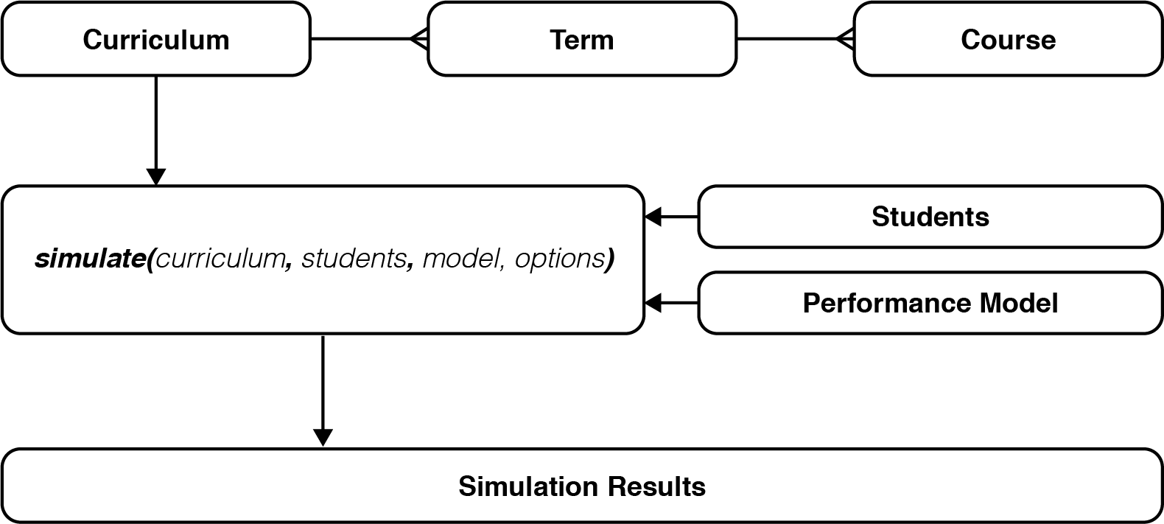
Library Design & Implementation

Slide 18
Library Design & Implementation
Custom Data Types, while note true objects, are entities similar to structures in C in that they encapsulate a set of attributes.
Course – credit hours, prereqs, coreqs, passrate, complexity measures, simulation statistics, etc.
Term – a set of courses, simulation statistics, etc.
Curriculum – set of terms, credit hours, complexity measures, etc.
Students – attempted credit hours, status, user-defined characteristics (ACT), received grades, GPA, etc.
Simulation – simulation results and statistics.
Notes:
Mabe remove?

Slide 19
Library Design & Implementation
Performance Models are Julia modules that are used in simulations to determine how student’s perform in their courses. This gives users flexibility in designing their own simulations.
train(curriculum) – called before the simulation and is used to train any models to predict grades for each course.
predict_grade(course, student) – predicts the received grade for a student in the enrolled course using trained models.
predict_stopout(student, current_term, model) – predicts whether the student will drop out at the end of each term.
Notes:
Maybe Remove

Slide 20
Library Design & Implementation
Finally, everything comes together to simulate students through CASL’s simulate() method which requires the following arguments:
Curriculum
A set of students
Performance Module (optional) – if not supplied a built in model that uses course passrates is used.
Parameters:
duration – the number of semesters to run the simulatio for.
max-credits – the maximum number of credit hours a student can take in one semester
stopouts – a boolean, that when set to false, will not simulate students stopping out.
Notes:
Maybe Remove

Slide 21
Simulation Details

Slide 22
Simulation Details
CASL’s simulations are Discrete-Event Simulations (DES)
Events occur instantaneously at a given point in time.
Events occur sequentially.
Time isn’t continuous, but jumps ahead once certain events take place.
Has the following components:
Starting and Ending states
Clock
List of events
Statistics

Slide 23
Simulation Details
Discrete Event Simulations provide a good fit for simulating students through a curriculum:
Events
Student enrolls in the university.
Student enrolls in courses.
Student receive grades.
Students stop out.
Students graduate.
Students remained enrolled.
Clock – keeps track of semester and is incremented one semester at a time.
Notes:
Combine with Next

Slide 24
Simulation Details
Starting Condition – All students enrolled.
Ending Condition – All students graduate, or duration is reached.
Statistics
Graduation rates at each term
Stopout rates at each term
Student performance (course grades, GPA, etc)
Course enrollment by term.
Simulated course pass rates.
Etc.

Slide 25
Simulation Details
Simulation Assumptions
All students are first-time, full-time students.
A new class of students is not added each semester.
Students register for as many courses as they can.
Students can only register for courses defined within the curriculum.
The order in which students is enrolled is defined by the order they appear in the curriculum.
Course enrollment requirements are strictly enforced.
All courses are offered every semester.
Courses have infinite capacity.

Slide 26
Applications in Curricular Analytics

Slide 27
Applications in Curricular Analytics
The primary motivation behind developing CASL and it’s simulation capabilities is to correlate a curriculum’s complexity with student success:
The higher the complexity, the harder it is for students to move through it and therefore is inversely correlated with student success.

Slide 28
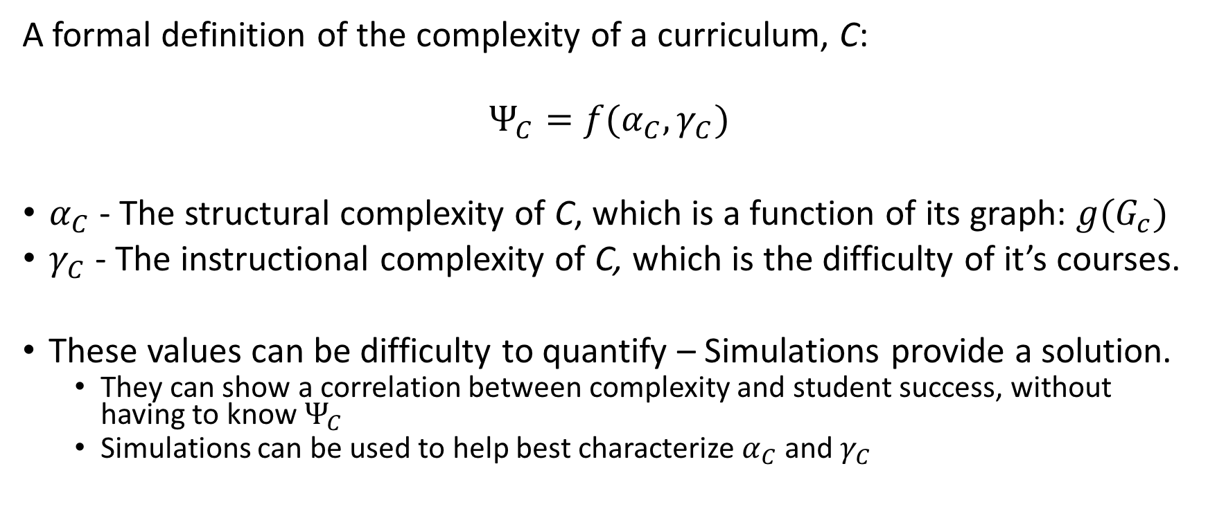
Applications in Curricular Analytics
A formal definition of the complexity of a curriculum, C:
$$Ψ_{C}=f(α_{C}, γ_{C})$$
$α_{C}$ - The structural complexity of C, which is a function of its graph: $g(G_{c})$
$γ_{C}$ - The instructional complexity of C, which is the difficulty of it’s courses.
These values can be difficulty to quantify – Simulations provide a solution.
They can show a correlation between complexity and student success, without having to know $Ψ_{C}$
Simulations can be used to help best characterize $α_{C}$ and $γ_{C}$

Slide 29
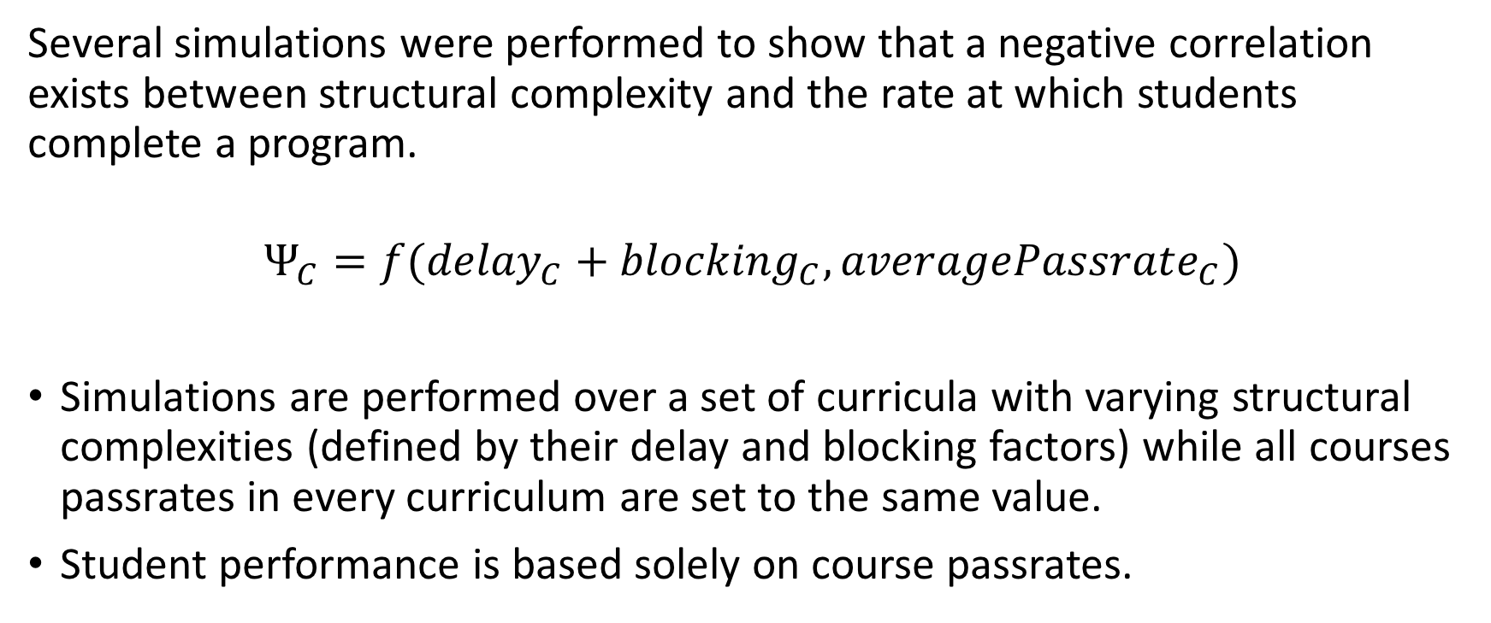
Applications in Curricular Analytics
Several simulations were performed to show that a negative correlation exists between structural complexity and the rate at which students complete a program.
$$Ψ_{C}=f({delay}_{C}+{blocking}_{C}, {averagePassrate}_{C})$$
Simulations are performed over a set of curricula with varying structural complexities (defined by their delay and blocking factors) while all courses passrates in every curriculum are set to the same value.
Student performance is based solely on course passrates.

Slide 30
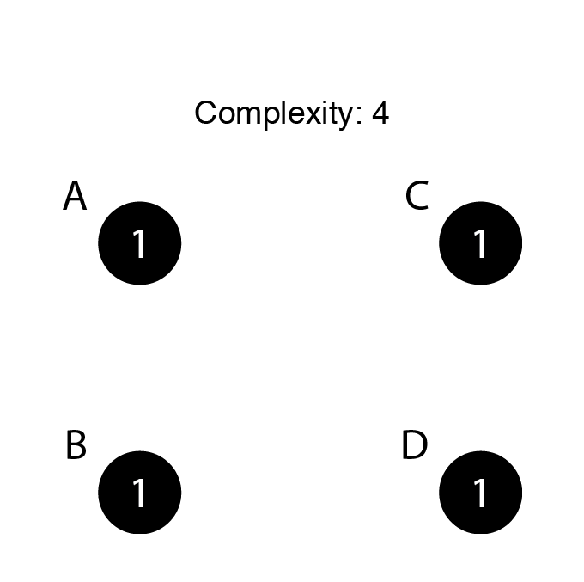
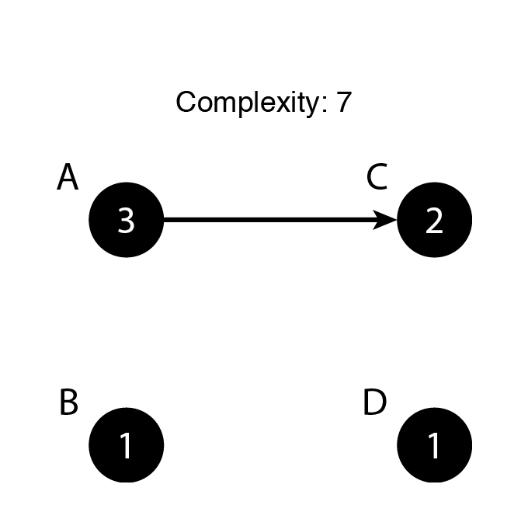
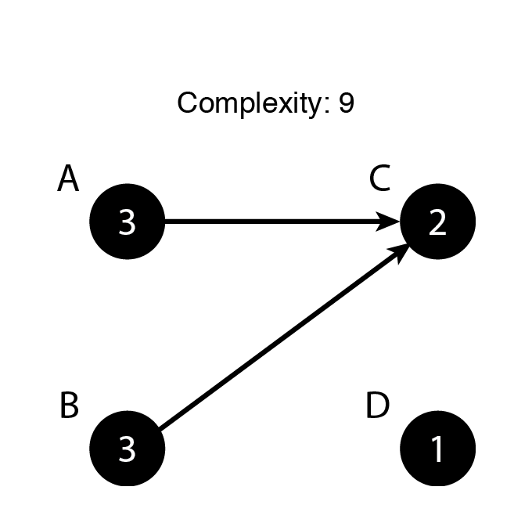
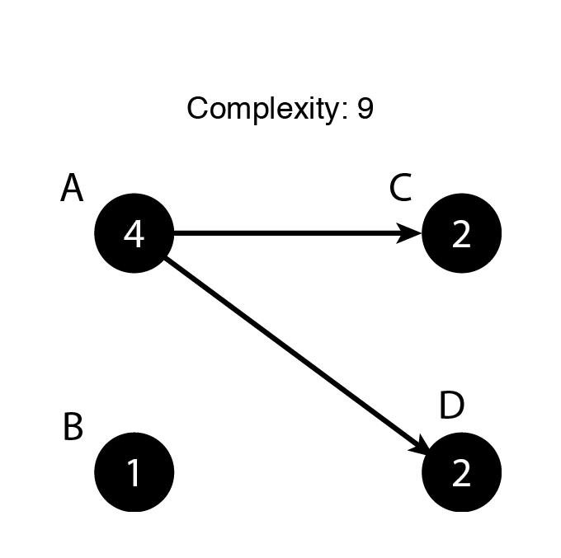
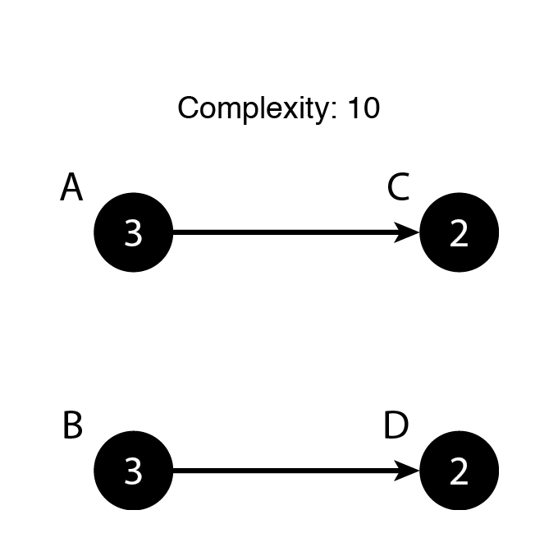
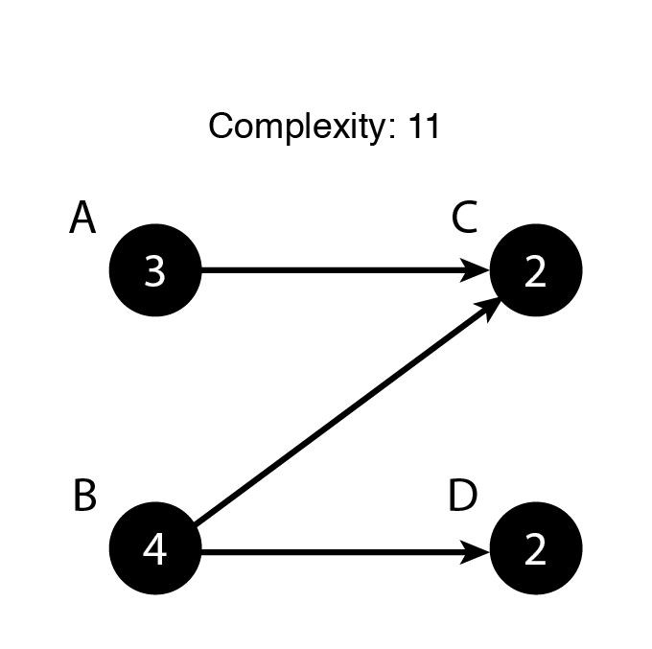
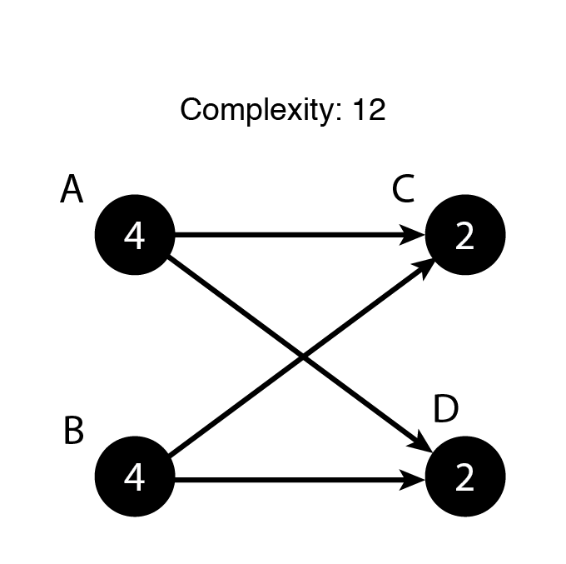
Applications in Curricular Analytics
First, simple four-course, two-term curricula were simulated.

Slide 31
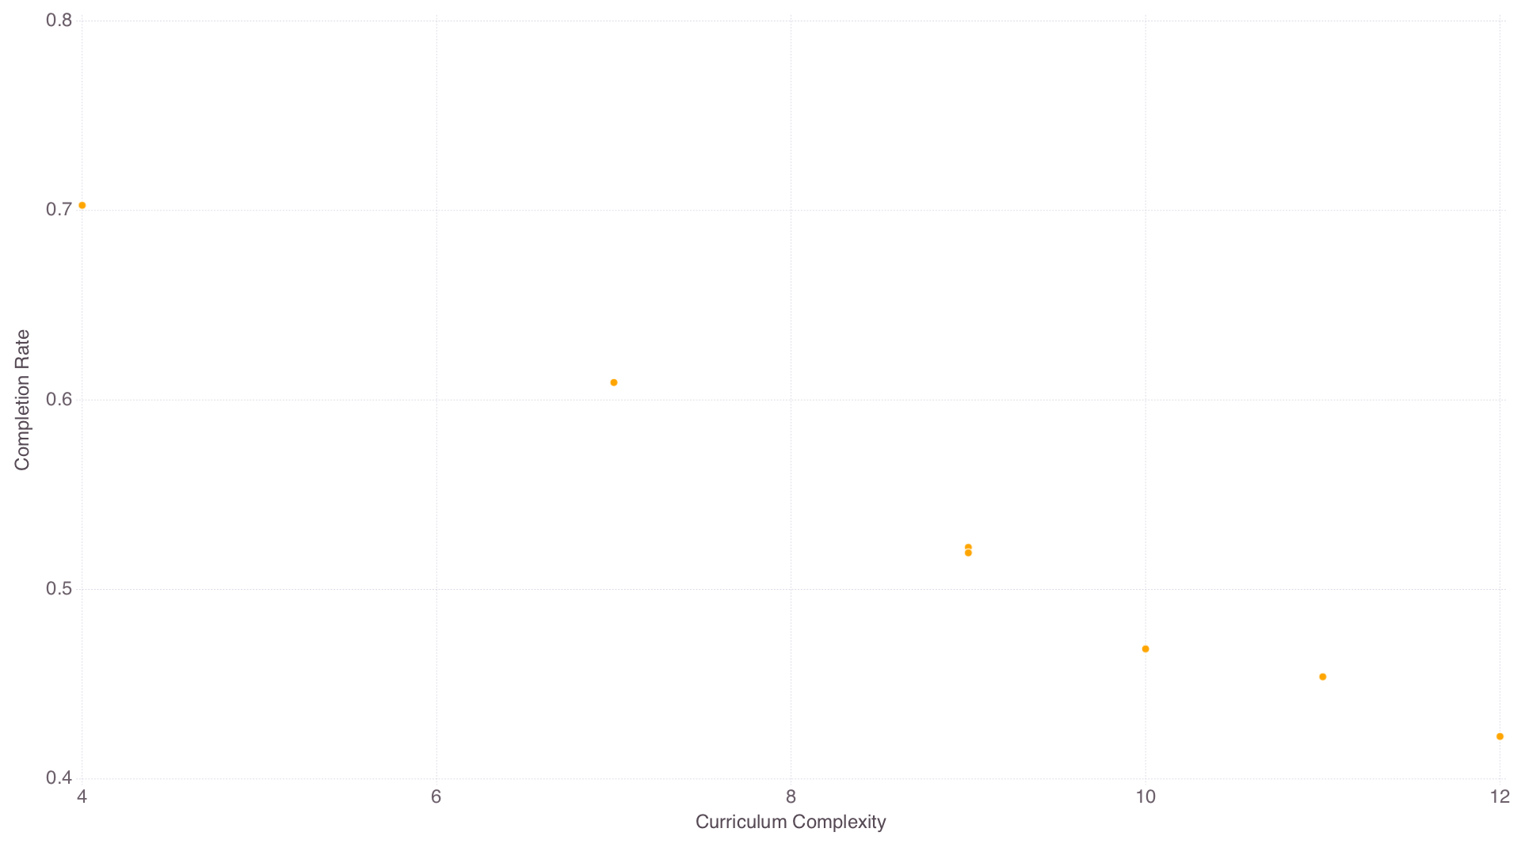
Applications in Curricular Analytics
50% course pass rate
4 terms
Students can take up to three courses a term.

Slide 32
Applications in Curricular Analytics
To introduce more variance in complexity, next simulations were done over three term curricula with two courses in each term.
Every permutation was created.
256 in total.
Ex

Slide 33
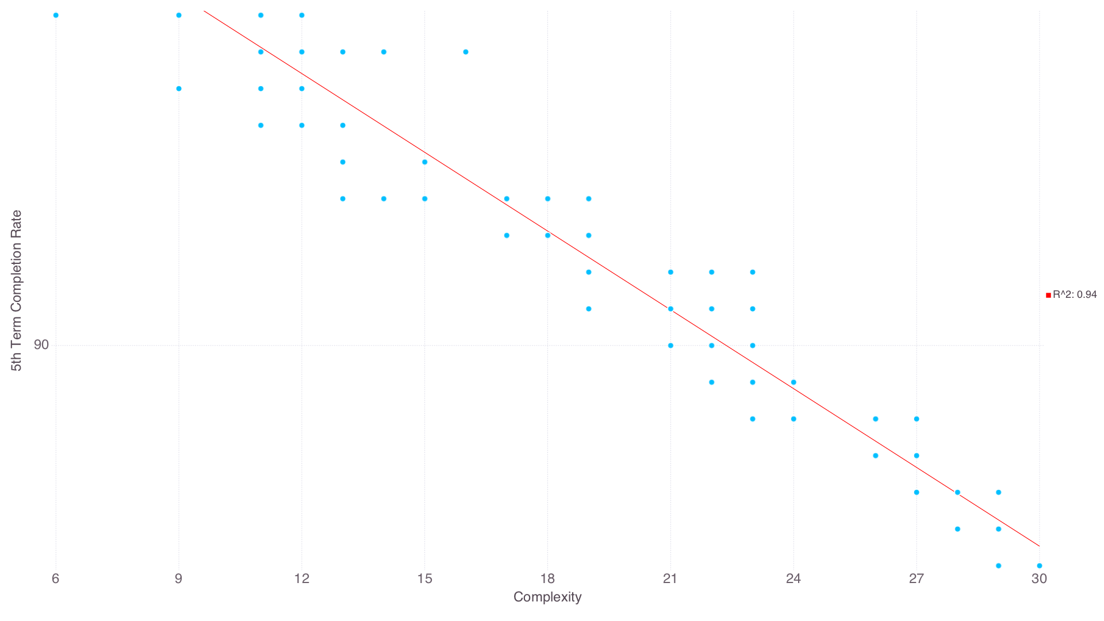
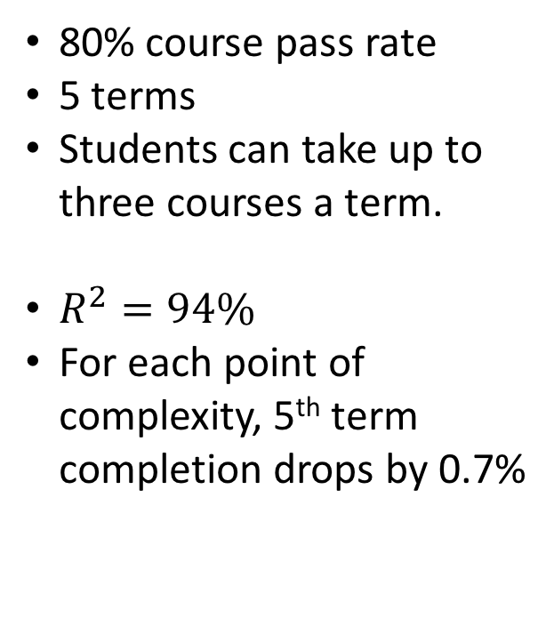
Applications in Curricular Analytics
80% course pass rate
5 terms
Students can take up to three courses a term.
$R^{2}=94\%$
For each point of complexity, 5th term completion drops by 0.7%

Slide 34
Applications in Curricular Analytics
Finally, simulations over real-world curricula were performed.
Curricula came from analytics.academicdashboards.org where universities uploaded their own curricula.
In all, 32 curricula were selected.
All eight term with between 120 and 150 credit hours.

Slide 35
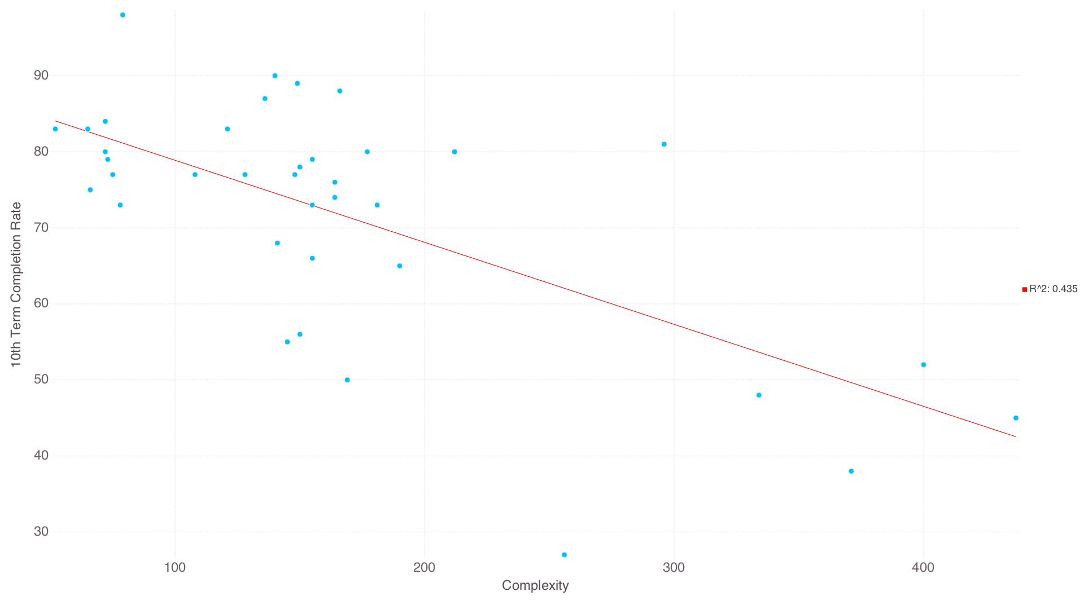
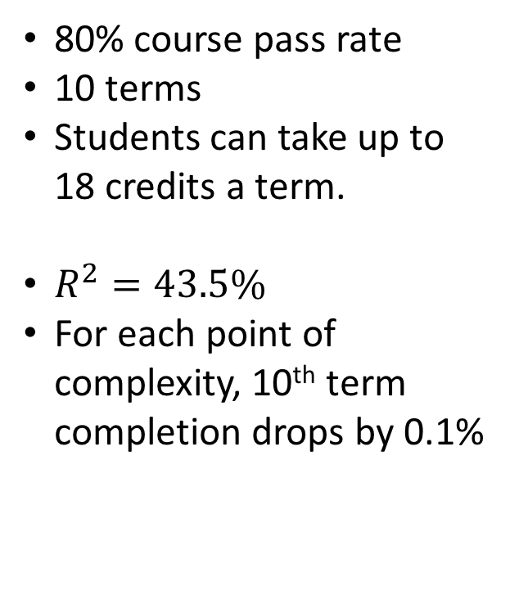
Applications in Curricular Analytics
80% course pass rate
10 terms
Students can take up to 18 credits a term.
$R^{2}=43.5\%$
For each point of complexity, 10th term completion drops by 0.1%

Slide 36
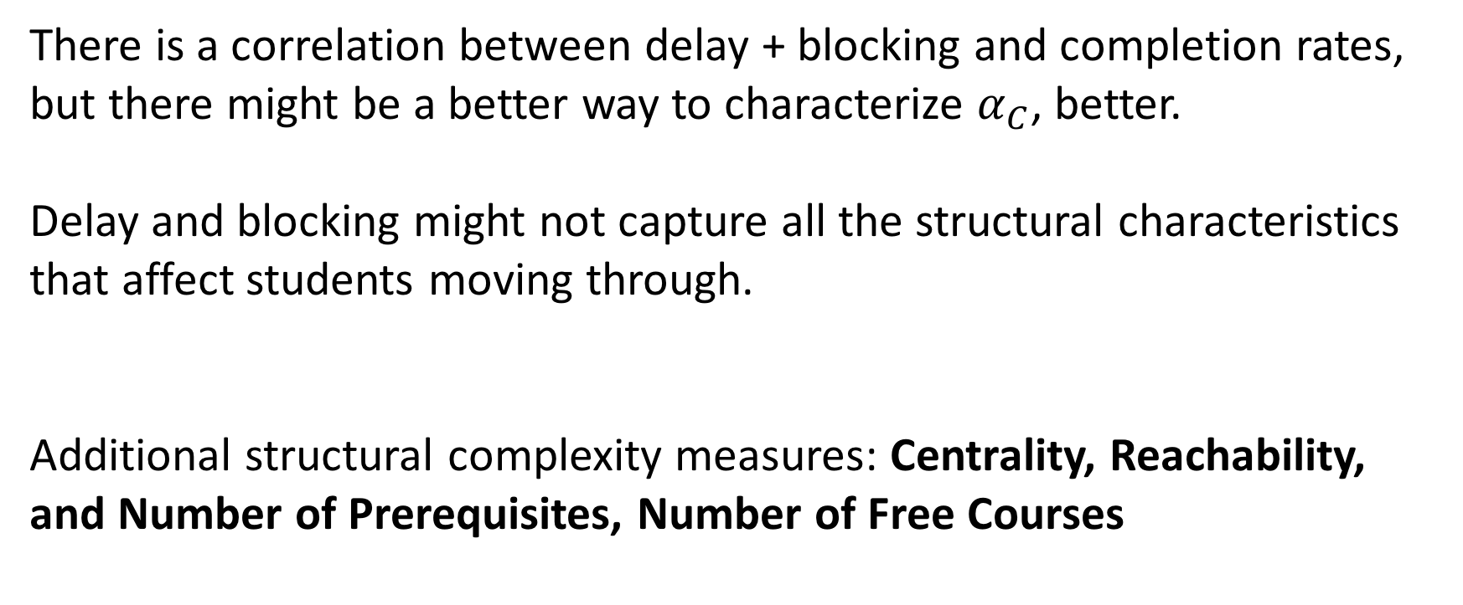
Applications in Curricular Analytics
There is a correlation between delay + blocking and completion rates, but there might be a better way to characterize $α_{C}$, better.
Delay and blocking might not capture all the structural characteristics that affect students moving through.
Additional structural complexity measures: Centrality, Reachability, and Number of Prerequisites, Number of Free Courses

Slide 37
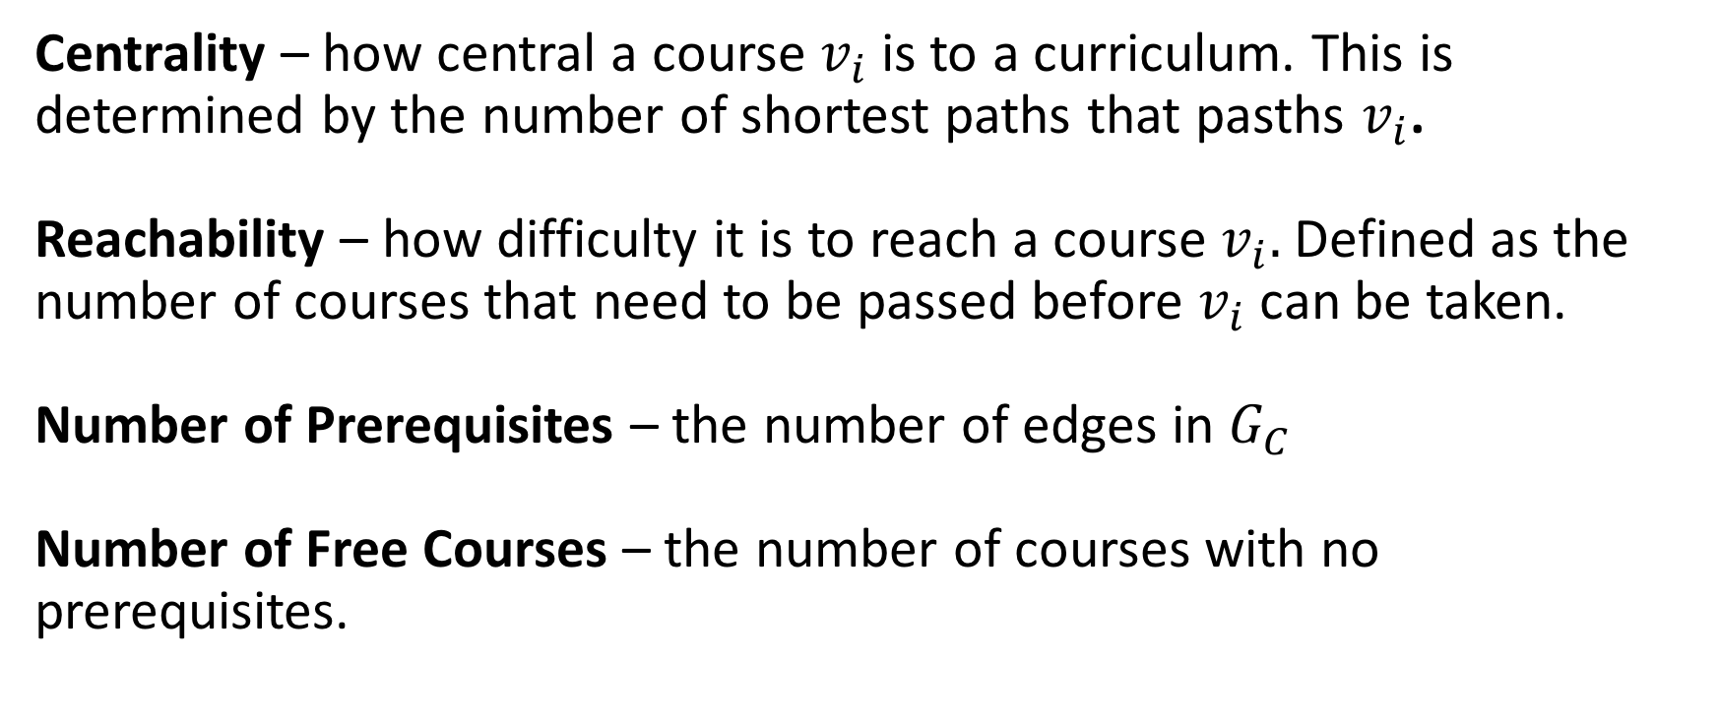
Applications in Curricular Analytics
Centrality – how central a course $v_{i}$ is to a curriculum. This is determined by the number of shortest paths that pasths $v_{i}$.
Reachability – how difficulty it is to reach a course $v_{i}.$ Defined as the number of courses that need to be passed before $v_{i}$ can be taken.
Number of Prerequisites – the number of edges in $G_{C}$
Number of Free Courses – the number of courses with no prerequisites.

Slide 38
Applications in Curricular Analytics
So which of these measures or combination of measures is best?
This can be determined by finding the combination that provides the best fit to completion rates.
Simulations were done over the real-world curricula (80% pass rate, 18 credit limit, 10 terms)
For every possible combination of structural complexity measures, linear regression was performed.
Notes:
Remove – summerrze in next

Slide 39

Applications in Curricular Analytics
The best fit: credit hours, delay+blocking, centrality, reachability:
$$α_{C}=f(credits, \left({delay}_{C}+{blocking}_{C}\right), {centrality}_{C},{reachability}_{C}, prereqs)$$

Slide 40
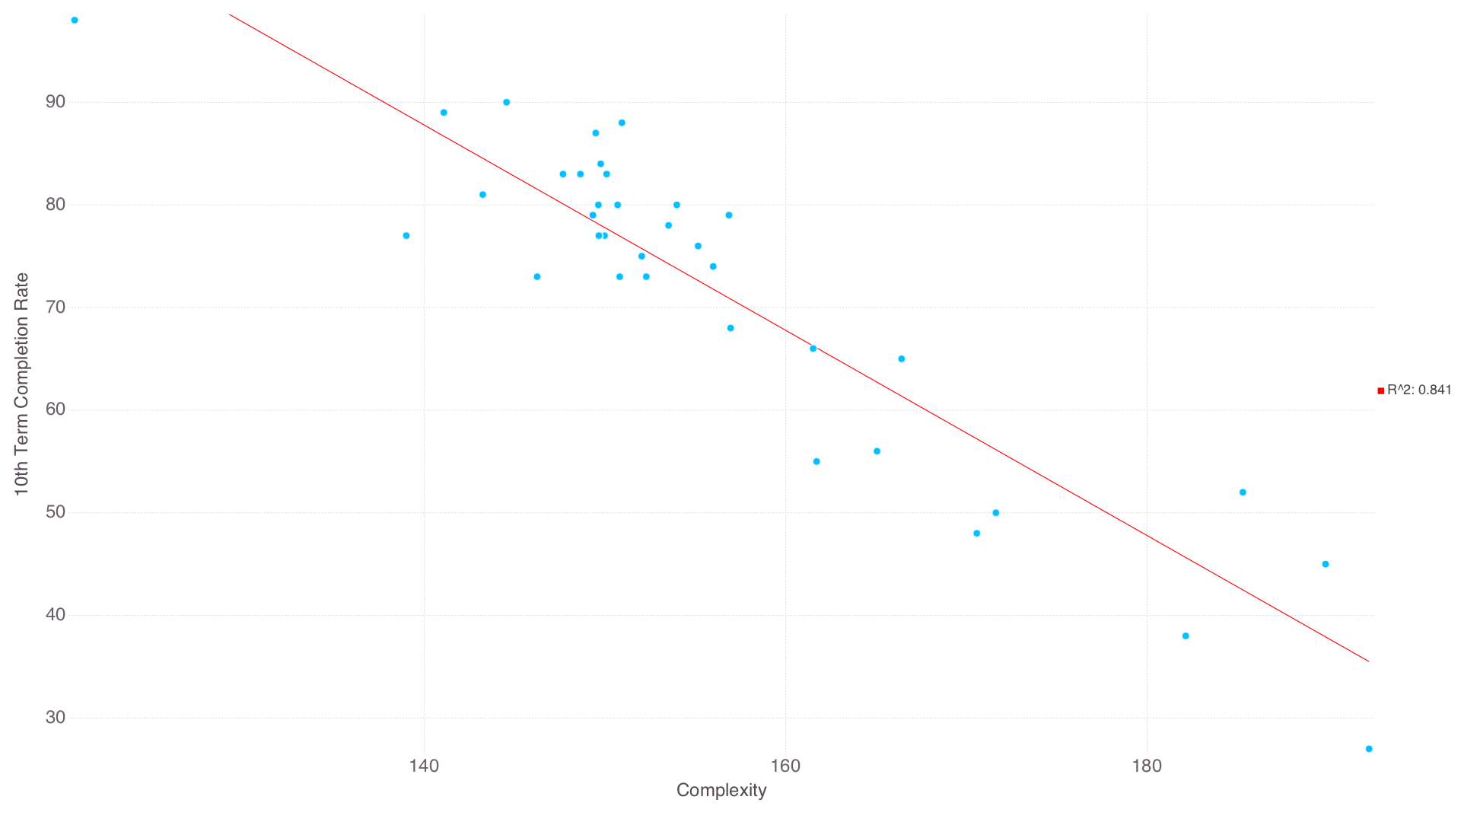
Applications in Curricular Analytics

Slide 41
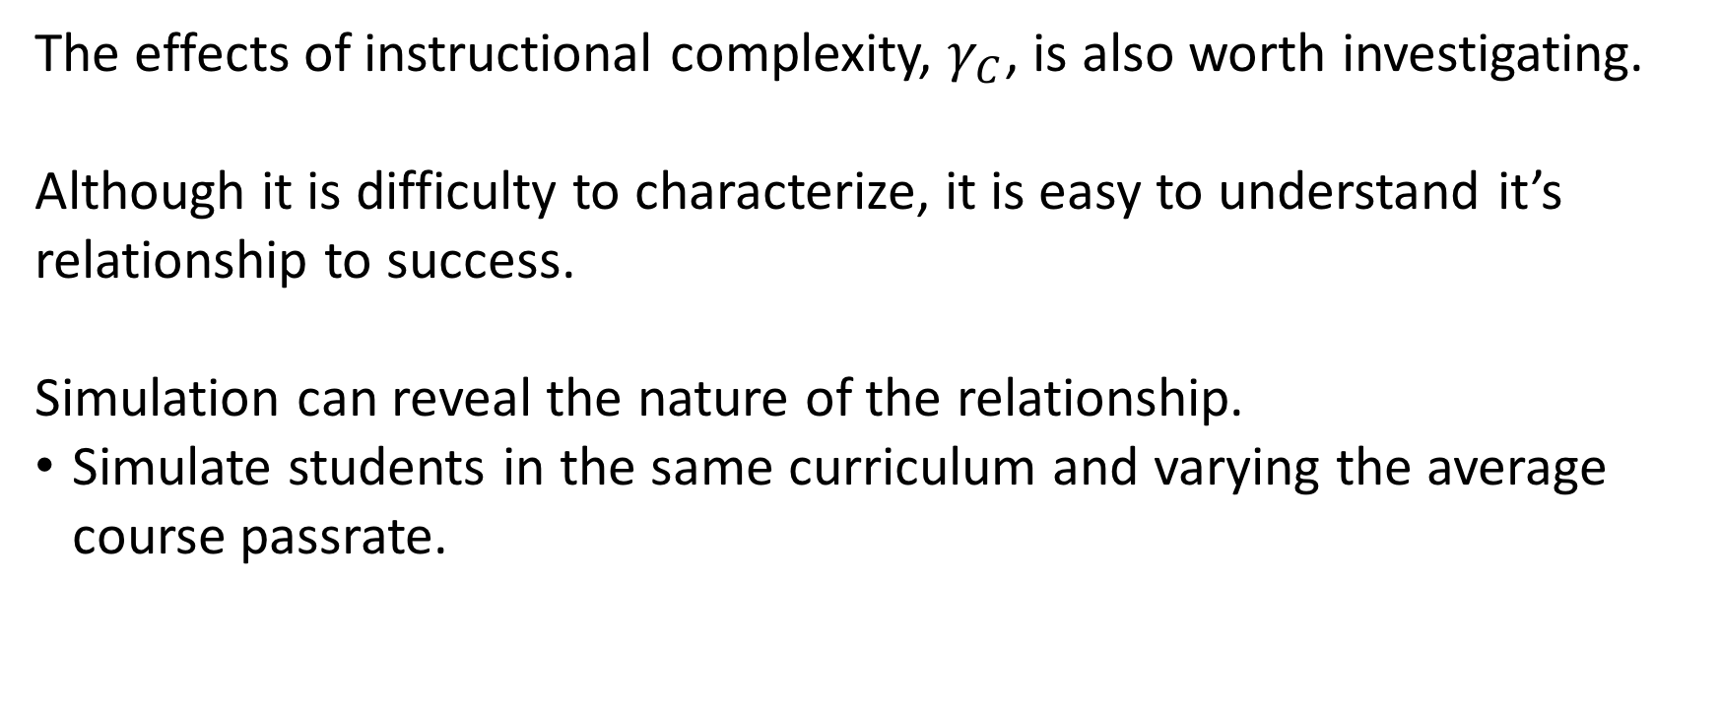
Applications in Curricular Analytics
The effects of instructional complexity, $γ_{C}$, is also worth investigating.
Although it is difficulty to characterize, it is easy to understand it’s relationship to success.
Simulation can reveal the nature of the relationship.
Simulate students in the same curriculum and varying the average course passrate.

Slide 42
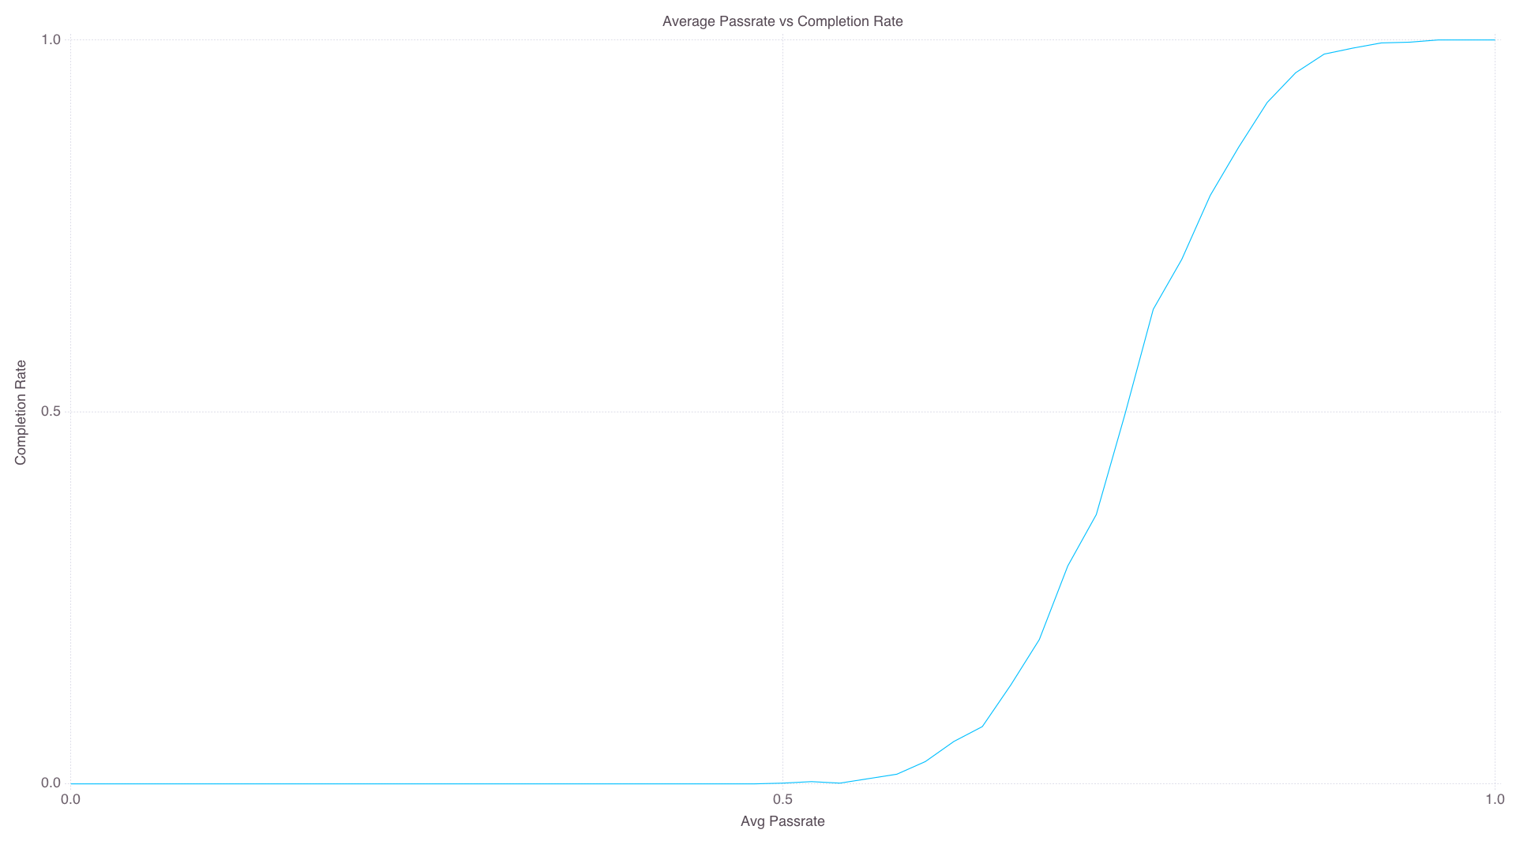
Applications in Curricular Analytics
Computer Engineering at UNM
10 terms
Students can take up to 18 credits a term.

Slide 43
Applications in Curricular Analytics
Increasing pass-rates increases success.
However, it’s not realistic to simply increase course passrates.
Which courses would have the largest effect on overall graduations rates with an increase in passrate?
Notes:
Move into next

Slide 44
Applications in Curricular Analytics
To answer this question, sensitivity analysis was performed over all courses in UNM’s accounting, mechanical engineering, and computer engineering programs.
Students could take up to 18 credits/term
Actual course pass rates were used.
A baseline simulation is carried out. Then, one at a time, each courses pass rate is increased by 30% and is simulated.
The change in 10th term completion rate is recorded.

Slide 45
Applications in Curricular Analytics
Accounting
Computer Eng.
Mechanical Eng.
MATH 180: 2.8%
MGMT 202: 2.8%
MATH 121: 2.7%
ECON 105: 2.2%
ECON 106: 2.2%
MATH 162: 6.1%
MATH 163: 5.5%
PHYC 160: 2.8%
MATH 264: 2.5%
ECON 105: 2.4%
MATH 162: 4.1%
MATH 163: 4.0%
MATH 264: 2.7%
PHYC 160: 2.1%
ECON 105: 2.1%

Slide 46
Future Work

Slide 47
Future Work
CASL
Development of more course performance modules (probit, NN, etc.)
More flexibility in how students are enrolled.
Integration with curricula.academicdashboards.org
Visualizations
Analytics
Simulations using student characteristics
Predictive simulations
Continue to develop better characterizations for curricular complexity

Slide 48
Questions?
Do I need to go back a previous slide?

