Slide 1
Development of a Curriculum Analysis and Simulation Library with Applications in Curricular Analytics
Michael Hickman

Slide 2
Outline
Background & Motivation
Previous Work
Library Design & Implementation
Simulation Details
Applications in Curricular Analytics
Future Work

Slide 3
Background & Motivation

Slide 4
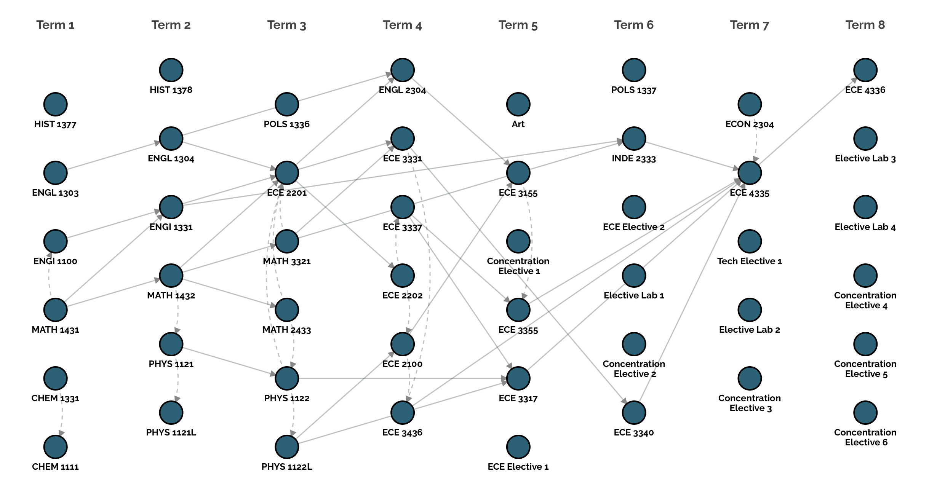
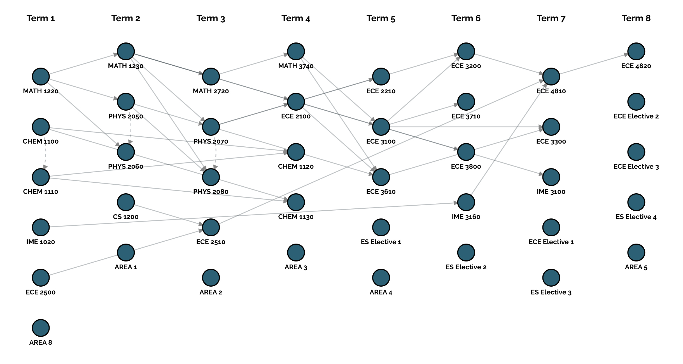
Two Curricula:
Same Major
Four year programs
Within four total credits of each other.
Their structures look very different – one appears much more complex than the other.
Does this structural complexity influence student success?

Slide 5
Background & Motivation
Seeing a curriculum as data (a graph) allows for analytics – given the right tools.
Providing these tools was the motivation behind the development of the Curriculum Analysis and Simulation Library (CASL).
CASL:
Represents curricula in a programming environment.
Defines a JSON-based standard for representing curricula.
Provides metrics for characterizing the structural properties of curricula.
Provides an interface and framework for simulating students moving through a curriculum.

Slide 6
Previous Work

Slide 7
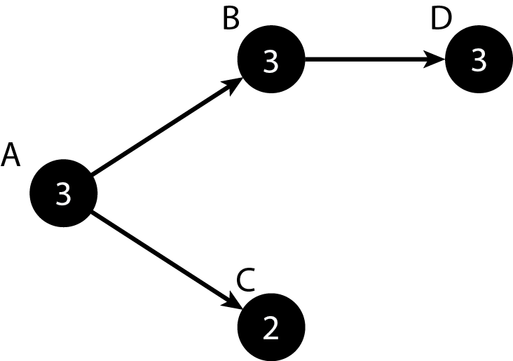
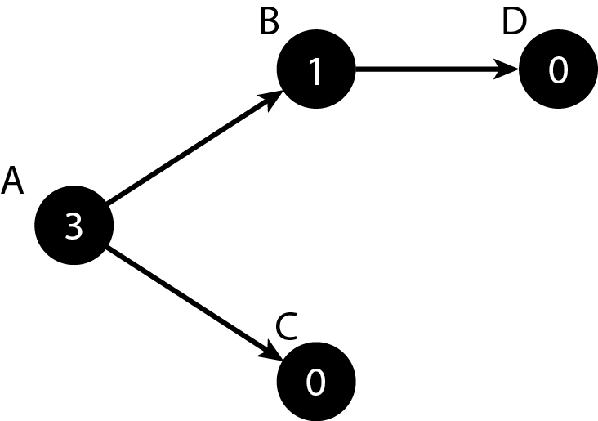


Previous Work
Slim et al., at UNM developed metrics for quantifying the structural complexity of a curriculum with two factors:
The delay factor of course $v_{i}$, denoted $d\left(v_{i}\right)$, is defined as the number of nodes in the longest path that passes through $v_{i}.$
Ex:
The blocking factor of course $v_{i}$, denoted b$\left(v_{i}\right)$, is defined as the number of courses it blocks until it is completed.
Ex:

Slide 8
Library Design & Implementation

Slide 9
Library Design & Implementation
CASL is comprised of three main components:
Data Types – curricula, terms, courses, students, and simulations
Course Performance Modules – instruct the simulation in how to predict student grades.
Simulation Method – curriculum, students, options(duration, max credits, whether to include stop-out behavior)

Slide 10
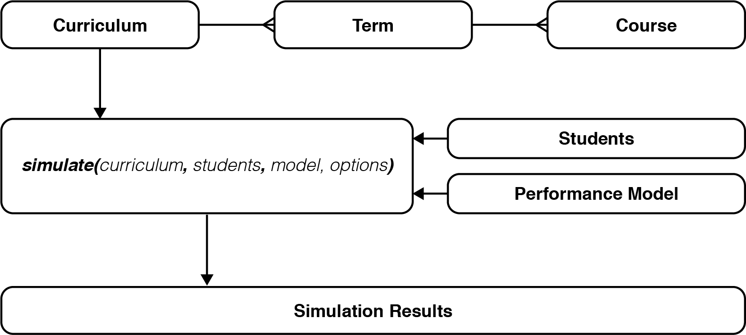
Library Design & Implementation

Slide 11
Simulation Details

Slide 12
Simulation Details
CASL’s simulations are Discrete-Event Simulations (DES)
Events occur instantaneously at a given point in time.
Events occur sequentially.
Time isn’t continuous, but increases incrementally once certain events take place.
Has the following components:
Starting and Ending states
Clock
List of events
Statistics

Slide 13
Simulation Details
Discrete Event Simulations provide a good fit for simulating students through a curriculum:
Events – Students enroll in courses, receive grades, stop out, graduate or remain enrolled.
Clock – keeps track of semester and is incremented one semester at a time.
Starting Condition – all students enrolled.
Ending Condition – no enrolled students or semester limit is reached.
Statistcs – graduation rates, time-to-degree, course enrollment, simulated course passrates, etc.
Notes:
Combine with Next

Slide 14
Simulation Details
Simulation Assumptions
All students are first-time, full-time students.
A new class of students is not added each semester.
Students register for as many courses as they can.
Students can only register for courses defined within the curriculum.
The order in which students is enrolled is defined by the order they appear in the curriculum.
Course enrollment requirements are strictly enforced.
All courses are offered every semester.
Courses have infinite capacity.

Slide 15
Applications in Curricular Analytics

Slide 16
Applications in Curricular Analytics
The primary motivation behind developing CASL and it’s simulation capabilities is determine a correlation between a curriculum’s complexity, and student success.
Lower complexity leads to greater student success.

Slide 17
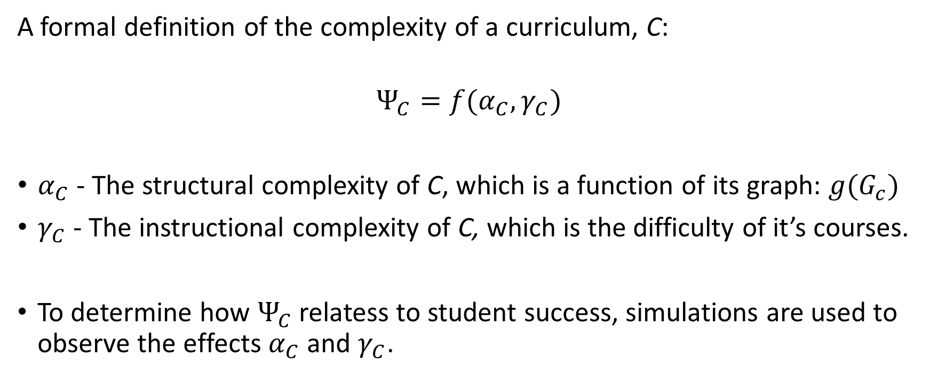
Applications in Curricular Analytics
A formal definition of the complexity of a curriculum, C:
$$Ψ_{C}=f(α_{C}, γ_{C})$$
$α_{C}$ - The structural complexity of C, which is a function of its graph: $g(G_{c})$
$γ_{C}$ - The instructional complexity of C, which is the difficulty of it’s courses.
To determine how $Ψ_{C}$ relatess to student success, simulations are used to observe the effects $α_{C}$ and $γ_{C}$.

Slide 18
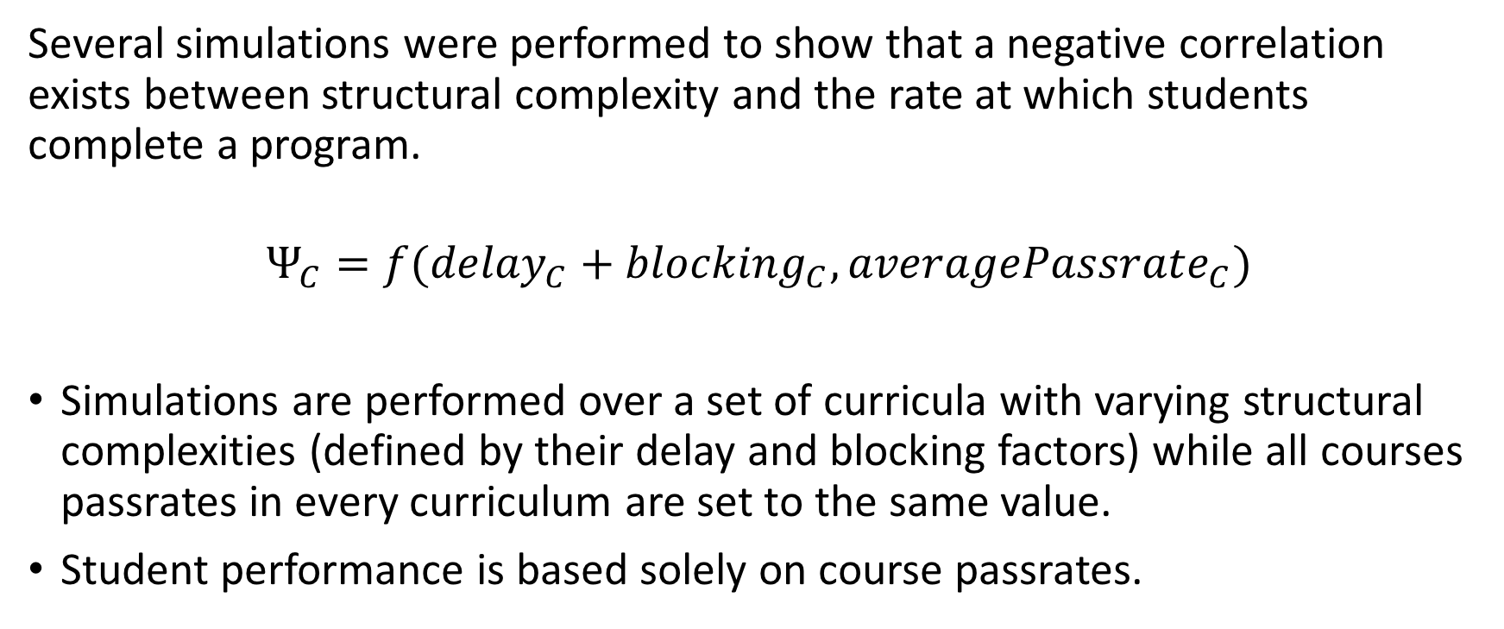
Applications in Curricular Analytics
Several simulations were performed to show that a negative correlation exists between structural complexity and the rate at which students complete a program.
$$Ψ_{C}=f({delay}_{C}+{blocking}_{C}, {averagePassrate}_{C})$$
Simulations are performed over a set of curricula with varying structural complexities (defined by their delay and blocking factors) while all courses passrates in every curriculum are set to the same value.
Student performance is based solely on course passrates.

Slide 19
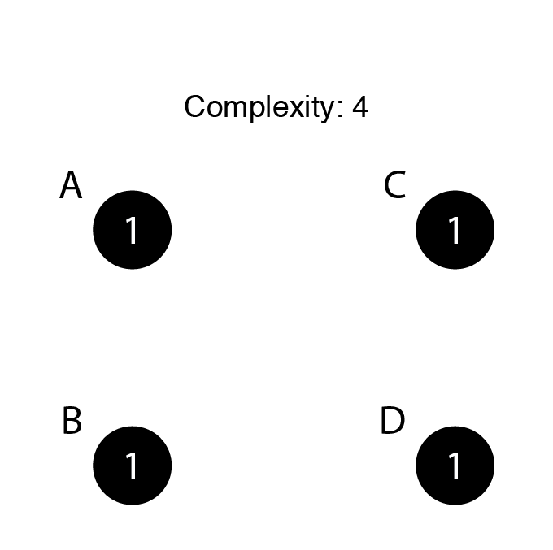
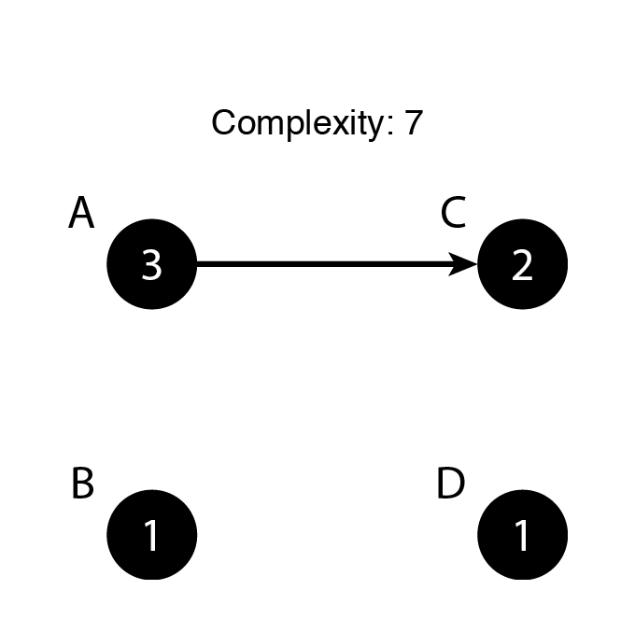
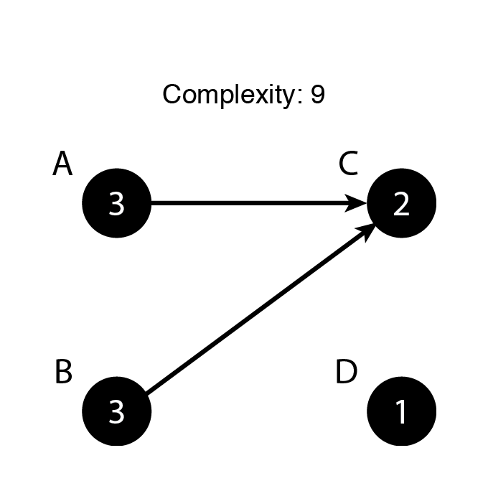
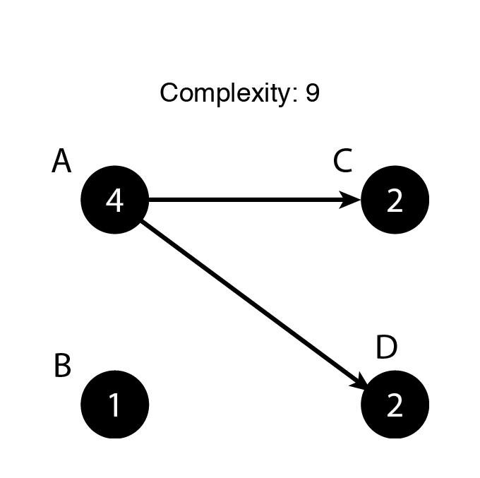
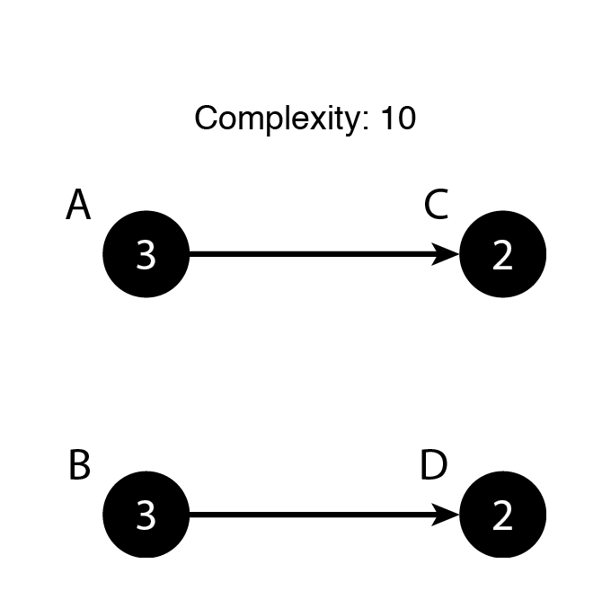
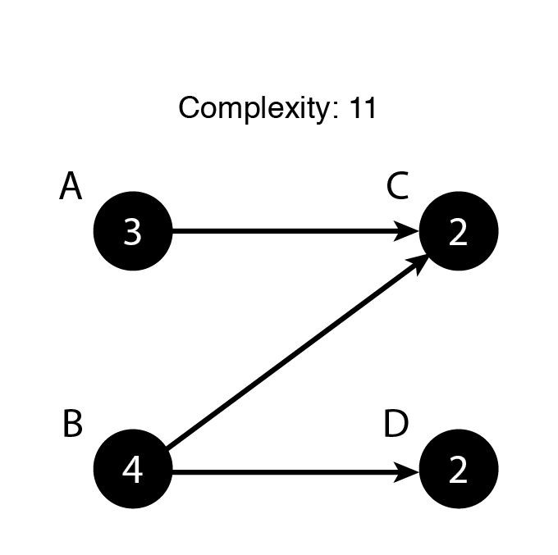
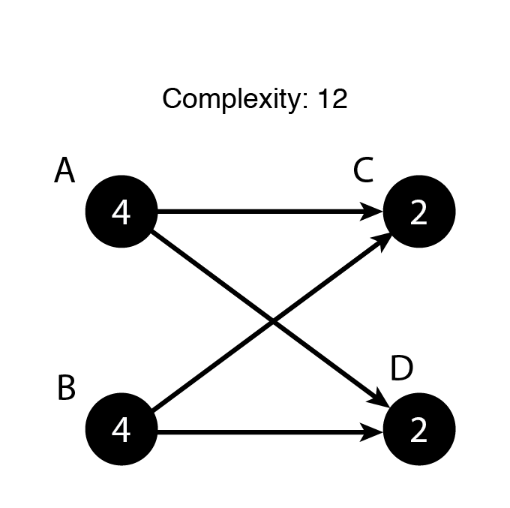
Applications in Curricular Analytics
First, simple four-course, two-term curricula were simulated.

Slide 20
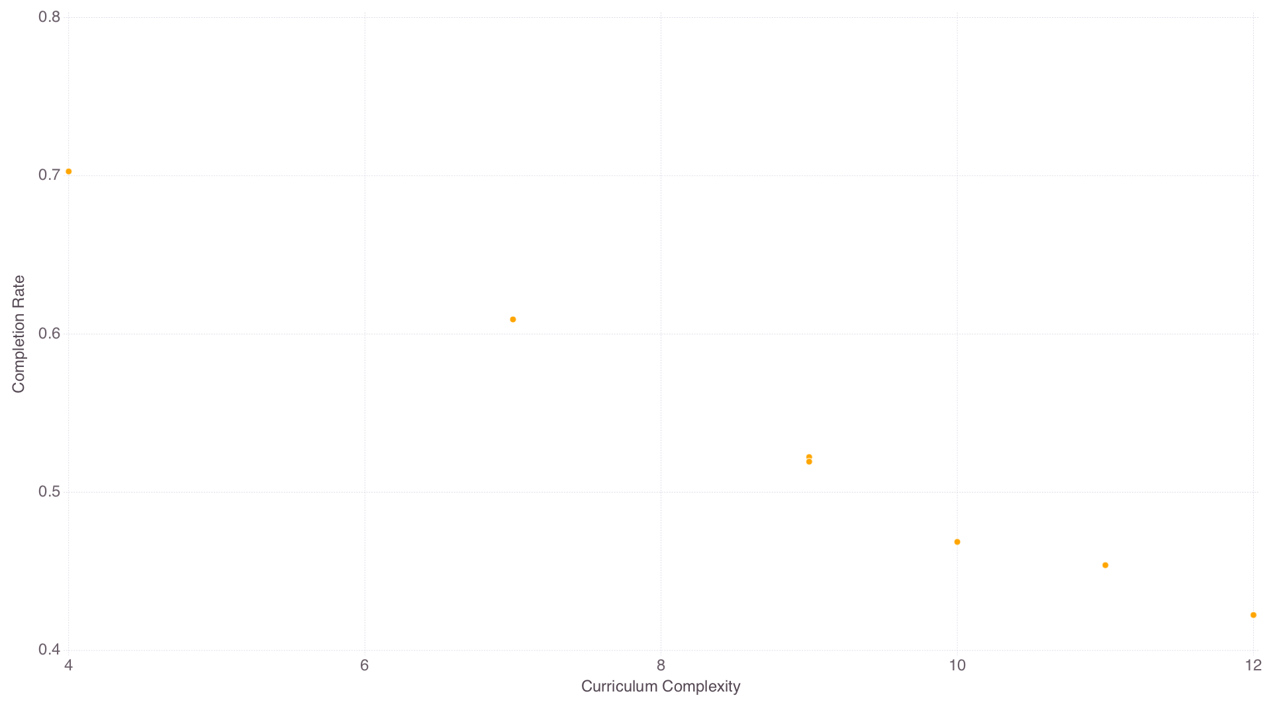
Applications in Curricular Analytics
50% course pass rate
4 terms
Students can take up to three courses a term.

Slide 21
Applications in Curricular Analytics
To introduce more variance in complexity, next simulations were done over three term curricula with two courses in each term.
Every permutation was created.
256 in total.

Slide 22
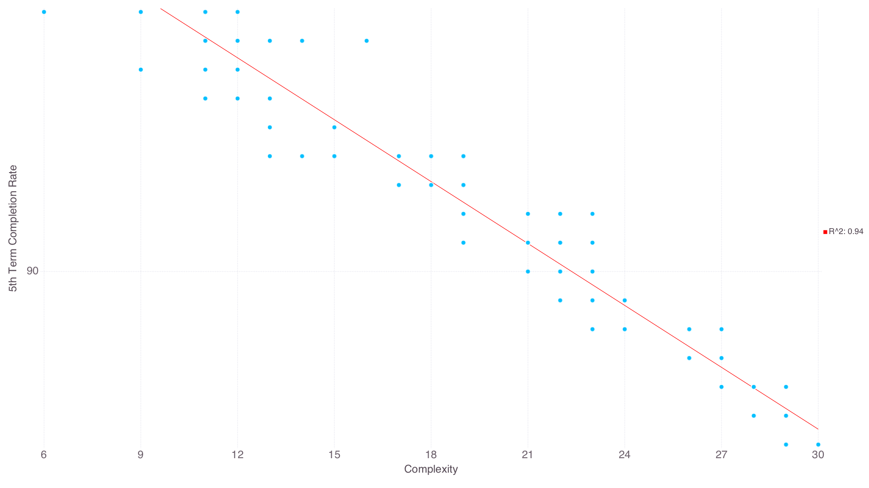
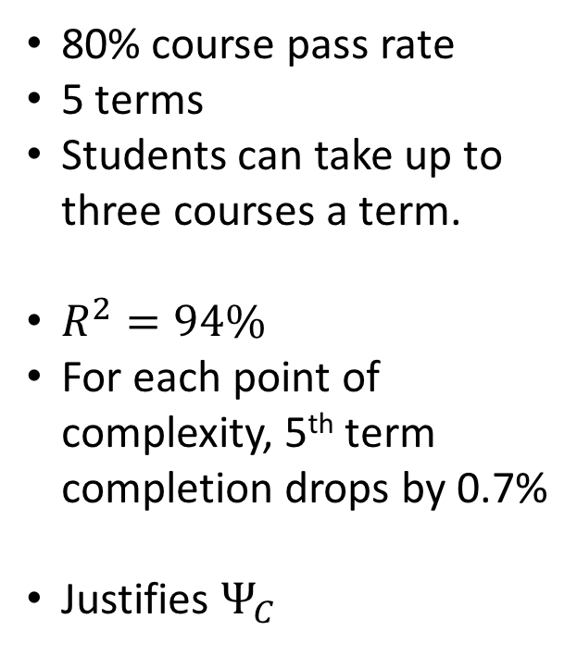
Applications in Curricular Analytics
80% course pass rate
5 terms
Students can take up to three courses a term.
$R^{2}=94\%$
For each point of complexity, 5th term completion drops by 0.7%
Justifies $Ψ_{C}$

Slide 23
Applications in Curricular Analytics
Finally, simulations over real-world curricula were performed.
Curricula came from curricula.academicdashboards.org where universities uploaded their own curricula.
In all, 32 curricula were selected.
All eight terms with between 120 and 150 credit hours.

Slide 24
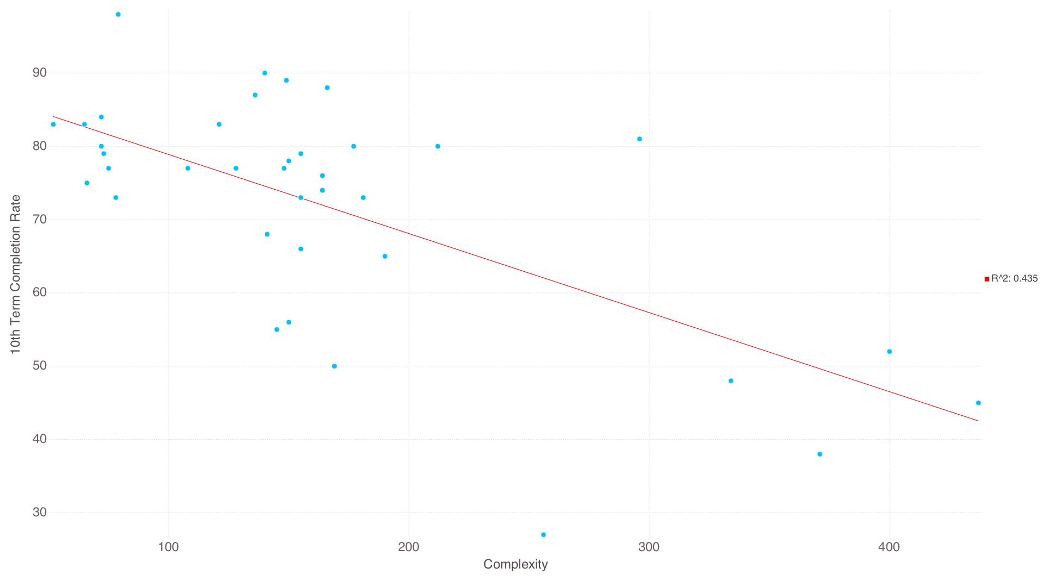
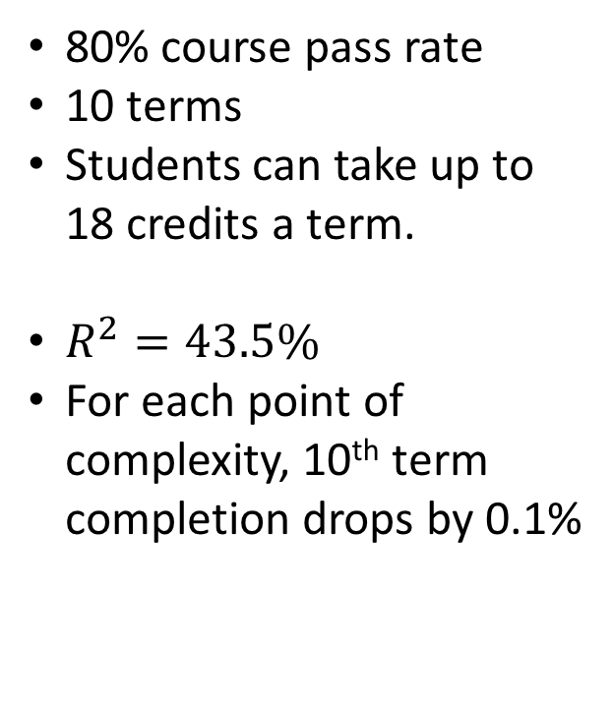
Applications in Curricular Analytics
80% course pass rate
10 terms
Students can take up to 18 credits a term.
$R^{2}=43.5\%$
For each point of complexity, 10th term completion drops by 0.1%

Slide 25
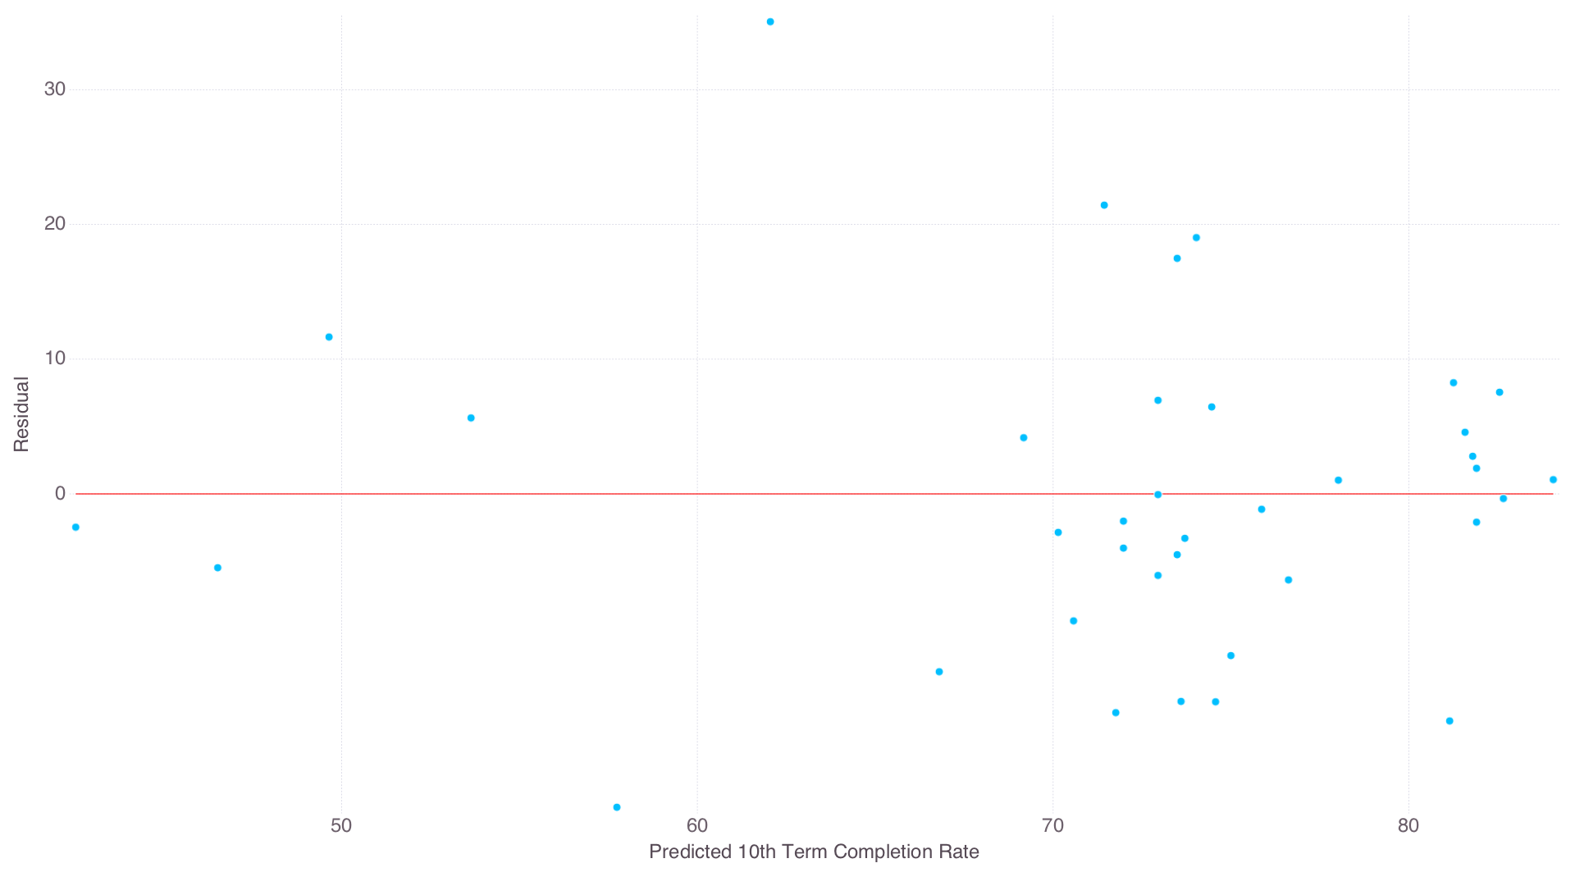
Applications in Curricular Analytics

Slide 26
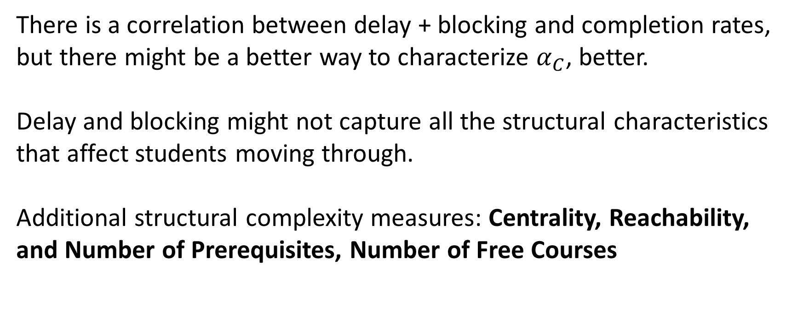
Applications in Curricular Analytics
There is a correlation between delay + blocking and completion rates, but there might be a better way to characterize $α_{C}$, better.
Delay and blocking might not capture all the structural characteristics that affect students moving through.
Additional structural complexity measures: Centrality, Reachability, and Number of Prerequisites, Number of Free Courses

Slide 27
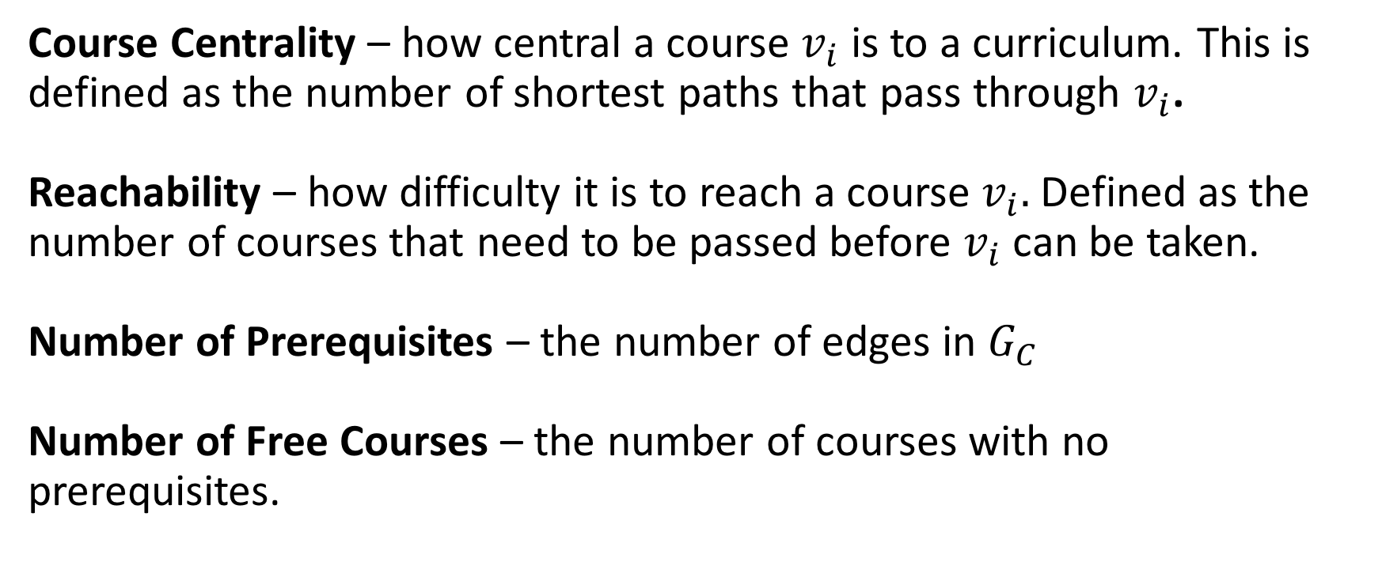
Applications in Curricular Analytics
Course Centrality – how central a course $v_{i}$ is to a curriculum. This is defined as the number of shortest paths that pass through $v_{i}$.
Reachability – how difficulty it is to reach a course $v_{i}.$ Defined as the number of courses that need to be passed before $v_{i}$ can be taken.
Number of Prerequisites – the number of edges in $G_{C}$
Number of Free Courses – the number of courses with no prerequisites.

Slide 28
Applications in Curricular Analytics
So which of these measures or combination of measures is best?
This can be determined by finding the combination that provides the best fit to completion rates using linear regression.
Simulations were done over the real-world curricula (80% pass rate, 18 credit limit, 10 terms)
For every possible combination of structural complexity measures, linear regression was performed.
Notes:
Remove – summerrze in next

Slide 29
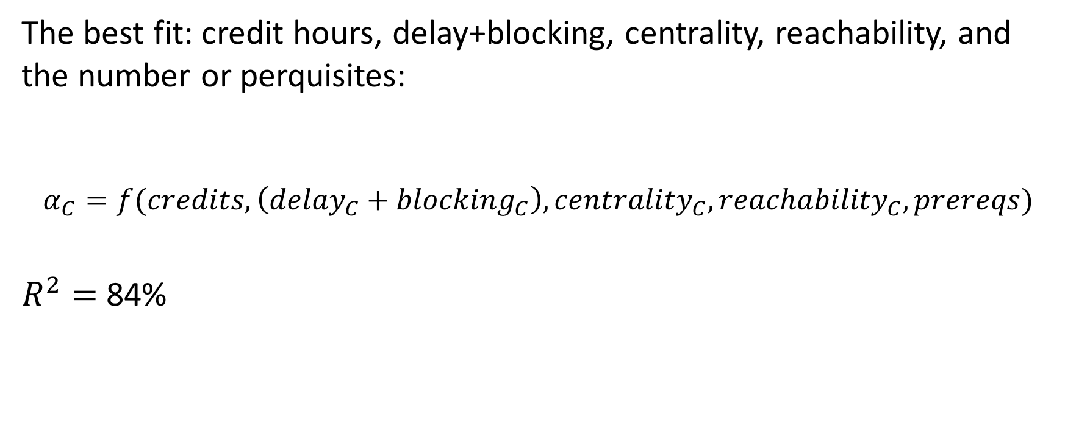
Applications in Curricular Analytics
The best fit: credit hours, delay+blocking, centrality, reachability, and the number or perquisites:
$$α_{C}=f(credits, \left({delay}_{C}+{blocking}_{C}\right), {centrality}_{C},{reachability}_{C}, prereqs)$$
$R^{2}=$ 84%

Slide 30
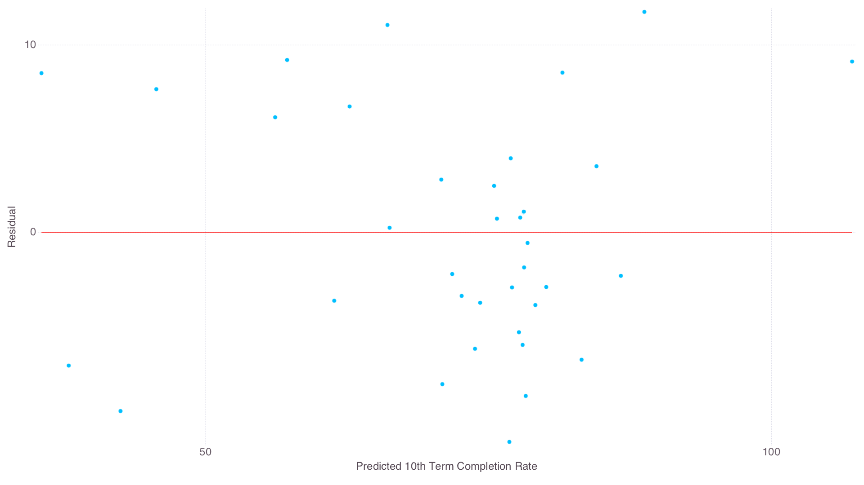
Applications in Curricular Analytics

Slide 31
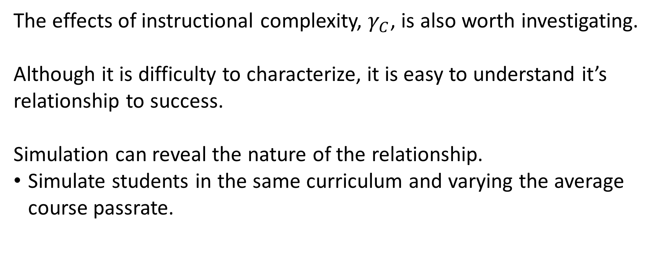
Applications in Curricular Analytics
The effects of instructional complexity, $γ_{C}$, is also worth investigating.
Although it is difficulty to characterize, it is easy to understand it’s relationship to success.
Simulation can reveal the nature of the relationship.
Simulate students in the same curriculum and varying the average course passrate.

Slide 32
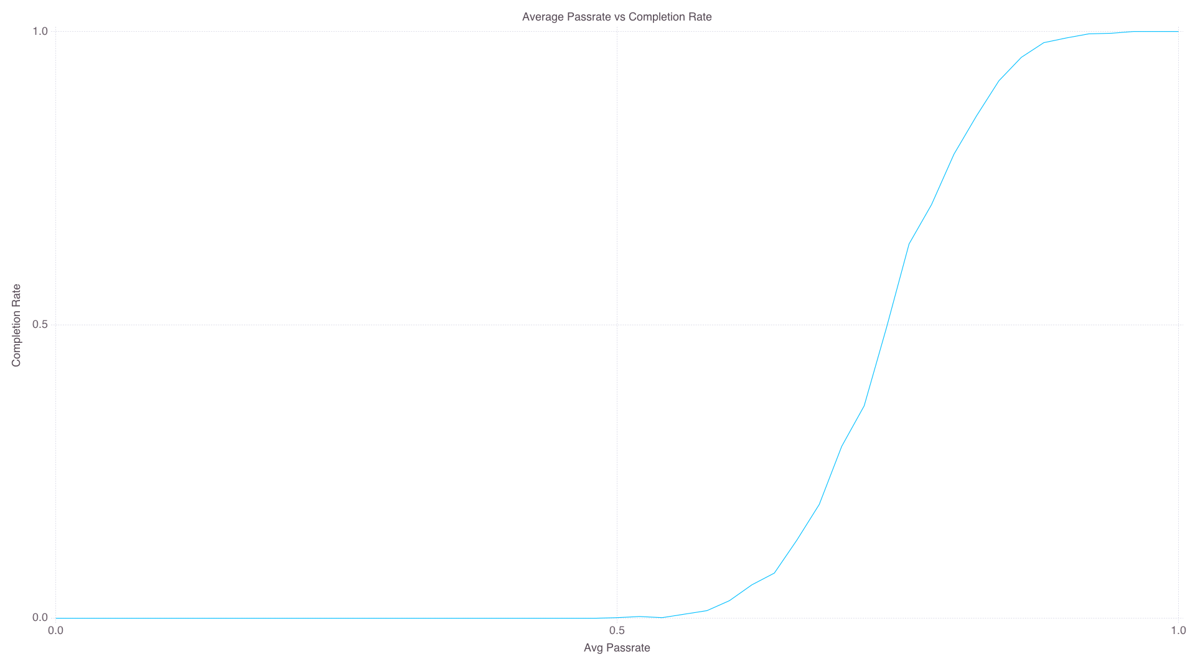
Applications in Curricular Analytics
Computer Engineering at UNM
10 terms
Students can take up to 18 credits a term.

Slide 33
Applications in Curricular Analytics
Decreasing instructional complexity can be achieved through increase course passrates. But which courses should receive the most attention?
Sensitivity Analysis via Simulation
Students could take up to 18 credits/term
Actual course pass rates were used.
A baseline simulation is carried out. Then, one at a time, each courses pass rate is increased by 30% and is simulated.
The change in 8th term completion rate is recorded.

Slide 34
Applications in Curricular Analytics
Accounting
Computer Eng.
Mechanical Eng.
MATH 180: 2.8%
MGMT 202: 2.8%
MATH 121: 2.7%
ECON 105: 2.2%
ECON 106: 2.2%
MATH 162: 6.1%
MATH 163: 5.5%
PHYC 160: 2.8%
MATH 264: 2.5%
ECON 105: 2.4%
MATH 162: 4.1%
MATH 163: 4.0%
MATH 264: 2.7%
PHYC 160: 2.1%
ECON 105: 2.1%

Slide 35
Future Work

Slide 36
Future Work
CASL
Development of more course performance modules (probit, NN, etc.)
More flexibility in how students are enrolled.
Integration with curricula.academicdashboards.org
Visualizations
Analytics
Simulations using student characteristics
Predictive simulations
Continue to develop better characterizations for curricular complexity, especially instructional.

Slide 37
Questions?
Do I need to go back to a previous slide?

