Slide 1
Development of a Curriculum Analysis and Simulation Library with Applications in Curricular Analytics
Michael Hickman

Slide 2
Outline
Background & Motivation
Previous Work
Library Design & Implementation
Simulation Details
Applications in Curricular Analytics
Future Work

Slide 3
Background & Motivation

Slide 4
Background & Motivation
The goal of higher-ed institutions is to prepare students for the workforce efficiently – student success.
Methods for improving success:
Tutoring Programs
Intervention Programs
Financial Support
Improving Instruction Quality
Classroom Structures (hybrid, flipped)
Etc.
What about curriculum structure?

Slide 5
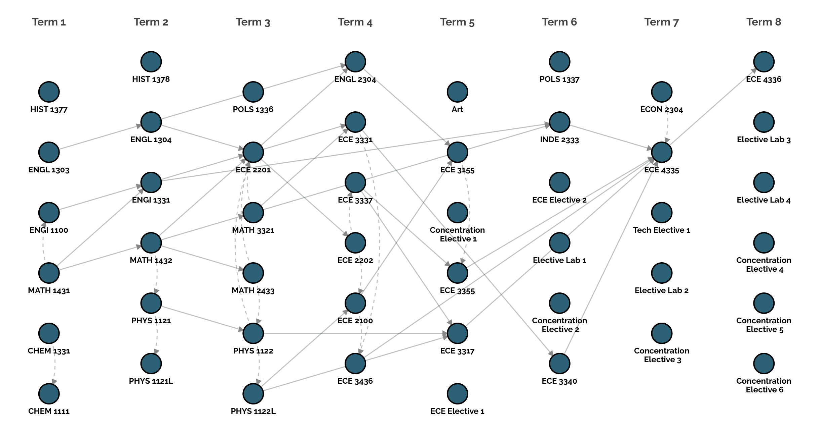
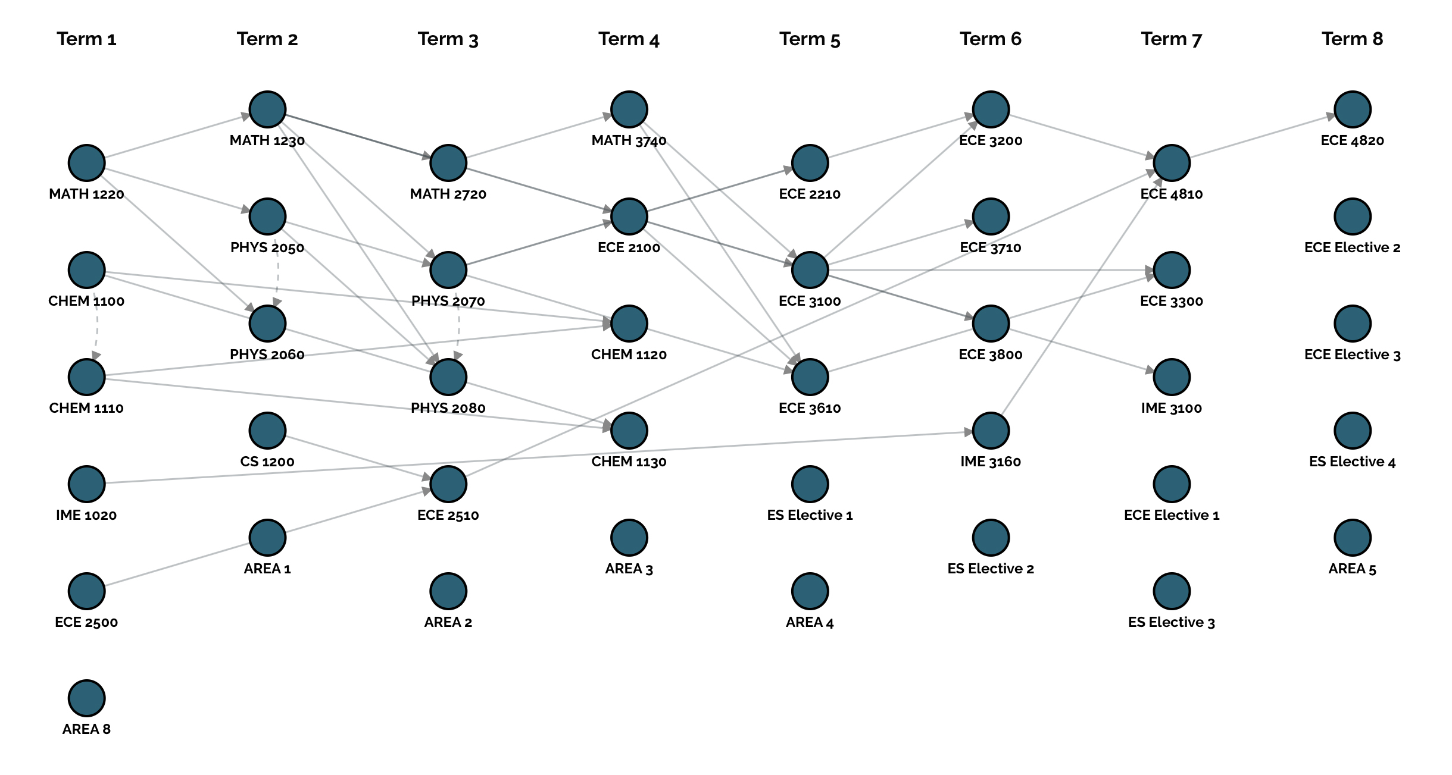
Two Curricula:
Same Major
Four year programs
Within four credits of each other.
Their structures look very different – one appears much more complex than the other.
Does this structural complexity influence student success?

Slide 6
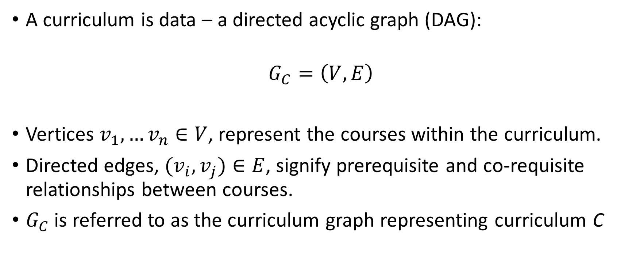
Background & Motivation
A curriculum is data – a directed acyclic graph (DAG):
$$G_{C}=\left(V,E\right)$$
Vertices $v_{1},…v_{n}∈V$, represent the courses within the curriculum.
Directed edges, ${(v}_{i},v_{j})∈E$, signify prerequisite and co-requisite relationships between courses.
$G_{C}$ is referred to as the curriculum graph representing curriculum C

Slide 7
Background & Motivation
Representing a curriculum in this way allows for analytics and correlating structure to student success – given the right tools.
Providing these tools was the motivation behind the development of the Curriculum Analysis and Simulation Library (CASL).
CASL:
Represents curricula in a programming environment.
Defines a JSON-based standard for representing curricula.
Provides metrics for characterizing the structural complexity of curricula.
Provides an interface and framework for simulating students moving through a curriculum.

Slide 8
Previous Work

Slide 9
Previous Work
Two main areas of work that influenced the feature set and implementation of CASL:
Characterizing a curriculum’s structural complexity: Slim, et al. at UNM.
Simulating students within a curriculum: Saltzman and Roeder at SFSU.

Slide 10
Previous Work
Doctor Slim developed metrics for quantifying the structural complexity of a curriculum with two factors:
Delay Factor: characterized by long paths in a curriculum.
Blocking Factor: the number of courses that a student cannot take until a certain class has been passed.

Slide 11
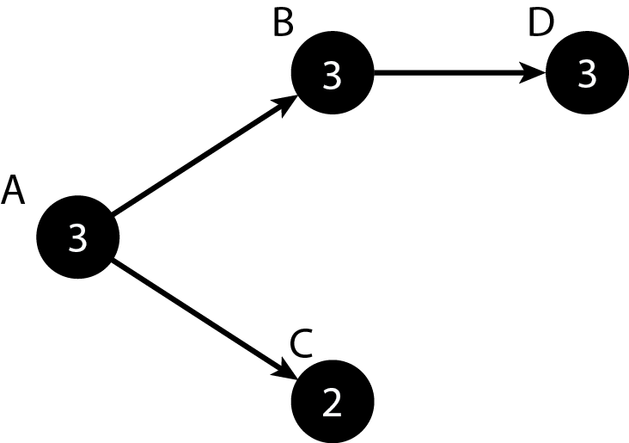

Previous Work
The delay factor of course $v_{i}$, denoted $d\left(v_{i}\right)$, is defined as the number of nodes in the longest path that passes through $v_{i}.$
Ex:

Slide 12
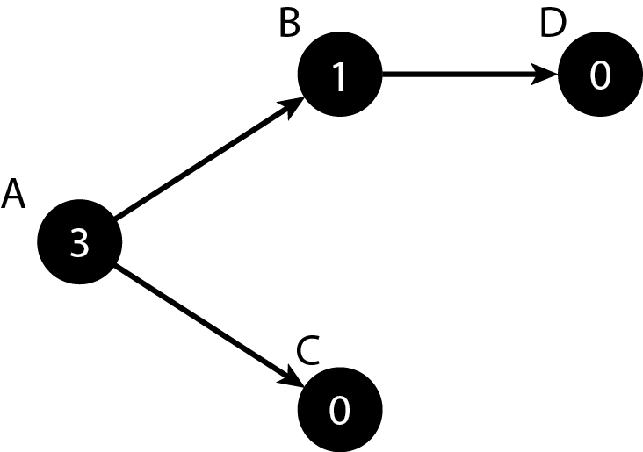

Previous Work
The blocking factor of course $v_{i}$, denoted b$\left(v_{i}\right)$, is defined as the number of courses blocked until $v_{i}$ is completed.
Ex:

Slide 13

Previous Work
The delay and blocking factor, together, define the overall complexity of a curriculum $G_{C}=(V,E)$:
$α_{C}=\sum_{v_{i}∈V}{b\left(v_{i}\right)+d(v_{i})}$

Slide 14
Previous Work
Saltzman and Roeder developed simulations to observe how changes to the business curriculum affected graduation rates.
Every semester an influx of students is added.
Students would enroll in classes based on historic course-demand data.
Students would be determined to pass/fail based on course passrates.

Slide 15
Previous Work
Limitations of their model:
Implemented in expensive propriety software.
Designed only for the business curriculum.
Student performance was based solely on pass rates with no support for more sophisticated models.
Did not support grad assignments.

Slide 16
Library Design & Implementation

Slide 17
Library Design & Implementation
CASL is developed as a free, open-source Julia module.
Julia is a free, open-source computational language designed for scientific computing as well as general-purpose use.
Reasons for using Julia:
Performance – close to C with parallelism support
Better scripting capabilities than other languages such as MATLAB
Support for handling various data formats such as CSV and JSON
Type system
Great package system with a wide selection of machine-learning and statistical analysis libraries.

Slide 18
Library Design & Implementation
CASL is comprised of three main components:
Curricula-related data types:
Courses
Terms
Curricula
Students
Simulations
Course performance predictions modules
Simulation method

Slide 19
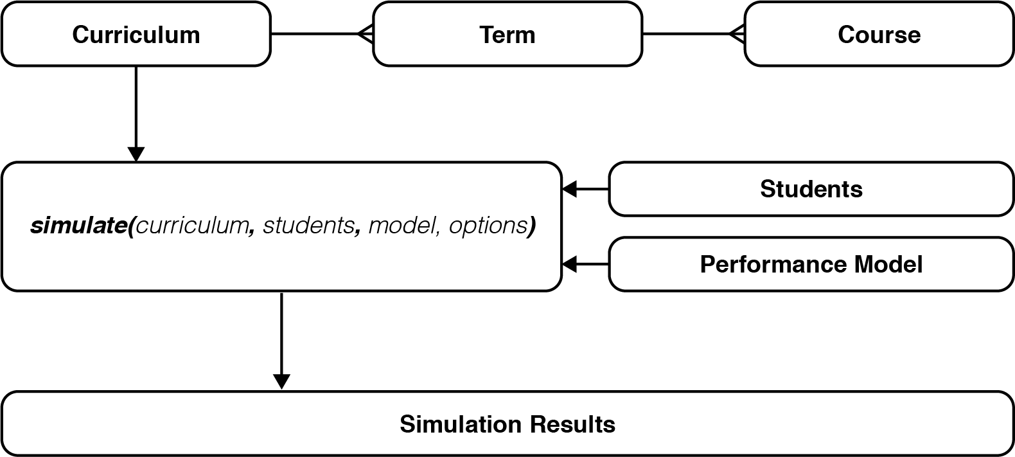
Library Design & Implementation

Slide 20
Library Design & Implementation
Custom Data Types, while note true objects, are entities similar to structures in C in that they encapsulate a set of attributes.
Course – credit hours, prereqs, coreqs, passrate, complexity measures, simulation statistics, etc.
Term – a set of courses, simulation statistics, etc.
Curriculum – set of terms, credit hours, complexity measures, etc.
Students – attempted credit hours, status, user-defined characteristics (ACT), received grades, GPA, etc.
Simulation – simulation results and statistics.

Slide 21
Library Design & Implementation
Performance Models are Julia modules that are used in simulations to determine how student’s perform in their courses. This gives users flexibility in designing their own simulations.
train(curriculum) – called before the simulation and is used to train any models to predict grades for each course.
predict_grade(course, student) – predicts the received grade for a student in the enrolled course using trained models.
predict_stopout(student, current_term, model) – predicts whether the student will drop out at the end of each term.

Slide 22
Library Design & Implementation
Performance Model ex.

Slide 23
Library Design & Implementation
Finally, everything comes together to simulate students through CASL’s simulate() method which requires the following arguments:
Curriculum
A set of students
Performance Module (optional) – if not supplied a built in model that uses course passrates is used.
Parameters:
duration – the number of semesters to run the simulatio for.
max-credits – the maximum number of credit hours a student can take in one semester
stopouts – a boolean, that when set to false, will not simulate students stopping out.

Slide 24
Simulation Details

Slide 25
Simulation Details
CASL’s simulations are Discrete-Event Simulations (DES)
Events occur instantaneously at a given point in time.
Events occur sequentially.
Time isn’t continuous, but jumps ahead once certain events take place.
Has the following components:
Starting and Ending states
Clock
List of events
Statistics

Slide 26
Simulation Details
Discrete Event Simulations provide a good fit for simulating students through a curriculum:
Events
Student enrolls in the university.
Student enrolls in courses.
Student receive grad.
Students stop out.
Students graduate.
Students remained enrolled.
Clock – keeps track of semsters and jumps from one to the next once semester events take place.

Slide 27
Simulation Details
Starting Condition – All students enrolled.
Ending Condition – All students graduate, or duration is reached.
Statistics
Graduation rates at each term
Stopout rates at each term
Student performance (course grades, GPA, etc)
Course enrollment by term.
Simulated course pass rates.
Etc.

Slide 28
Simulation Details
Simulating realistic student behavior is impossible – there's too many factors to take into account.
Therefore some assumptions have to be made:
All students are first-time, full-time students.
A new class of students is not added each semester.
Students register for as many courses as they can.
Students can only register for courses defined within the curriculum.
The order in which students is enrolled is defined by the order they appear in the curriculum.
Course enrollment requirements are strictly enforced.
All courses are offered every semester.
Courses have infinite capacity.
These might seem restrictive, but they are made to standardize student behavior and put an emphasis on the structure of curricula, not student behavior.

Slide 29
Applications in Curricular Analytics

Slide 30
Questions

