Slide 1


Department of Computer Science and Engineering
GE19612 – PRIEE
LEARNING PLATFORM FOR DISABLED STUDENTS
Harithaah M S-210701079
Lakshme Kaarthikaa S-210701129
Harishankaran J K-210701078

Slide 2
Problem Statement and Motivation
To develop a learning platform for disabled students to motivate students .
This project aims to develop a web application that teaches all the basic sign language for disabled students.
The motivation is to enhance learning and to motivate students
By taking advantage of technology, we aim to make it easy for students to learn all the things by accessing all the learning modules and take up assessments

Slide 3
Objectives
The goal of this platform is to provide comprehensive resources and support for individuals with hearing impairments, empowering them to thrive academically and socially.
The website is developed with html ,css and javascript that will help the learners to learn from basic to so many things.
Key objectives include various lesson modules and assessment module which has question for each module.

Slide 4
Abstract
This project aims to develop an innovative online education platform dedicated to empowering deaf students through accessible, engaging, and inclusive learning experiences. The primary mission is to eliminate barriers in education by offering a wide range of resources tailored to meet diverse learning needs.
Additionally, interactive assessments and forums will be available to promote a collaborative and supportive learning environment..
This website presents a comprehensive framework for the development of learning website tailored for disabled students with a focus an accessibility and engagement.

Slide 5
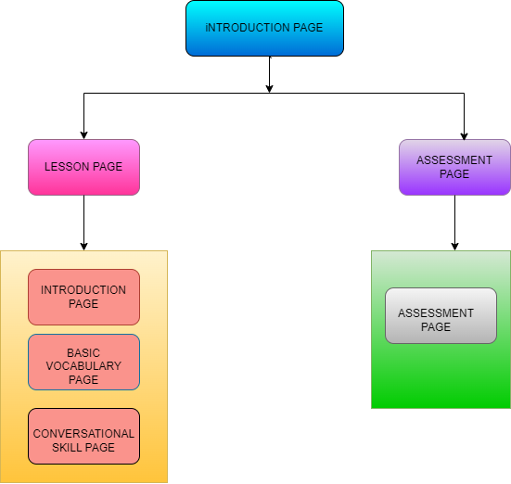
System Architecture
The two separate modules provide distinct functionalities for each module. The learning module allows an user to learn all the modules available in the website.
Once the learning module is completed , then it takes to the assessment module
The assessment module will allow learner to take up assessment and know their results.

Slide 6
List of Modules
HOME MODULE:
The home module enables easy access to the lesson module and the assessment module. The user can navigate to the other modules and can reach out the contact option from this page.
LESSON MODULE:
The Deaf Education Platform offers foundational lessons in sign language, covering basics like fingerspelling, vocabulary, grammar, and conversational skills. Illustrated images aid learning, while interactive assessments provide immediate feedback. Additional resources and community support ensure a comprehensive and engaging educational experience for beginners.
LESSON MODULE:

Slide 7
List of Modules
ADMIN MODULE:
The assessment module is designed to test learners’ knowledge and understanding of the content covered in previous modules. It includes multiple-choice questions that evaluate comprehension of grammar rules, vocabulary, and conversational skills. The interactive nature of the assessment, powered by JavaScript, provides immediate feedback on answers. Correct responses are reinforced, while incorrect ones are explained, helping learners understand their mistakes and improve. This module ensures that learners can self-assess their progress and identify areas needing further study.

Slide 8
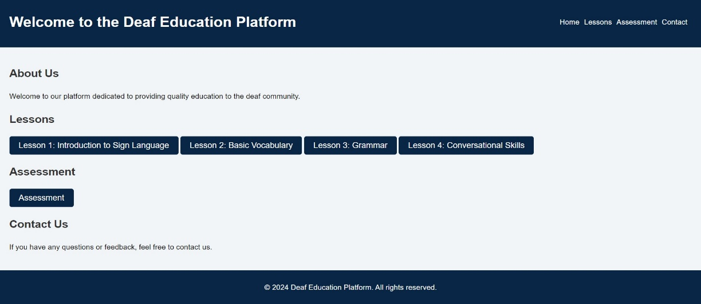
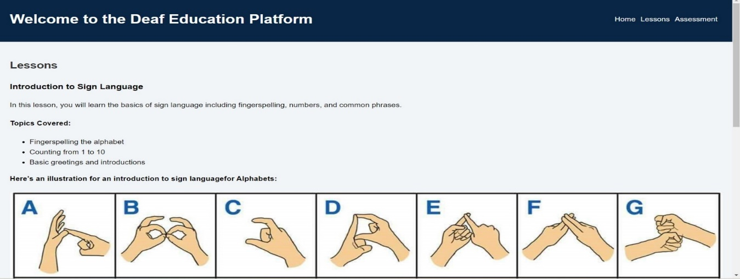
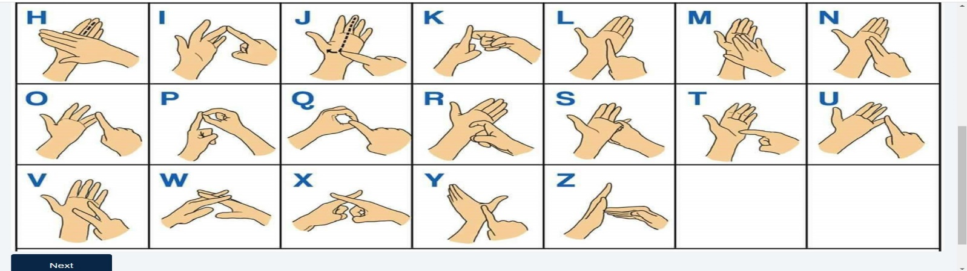
Implementation/Results of Module

Slide 9
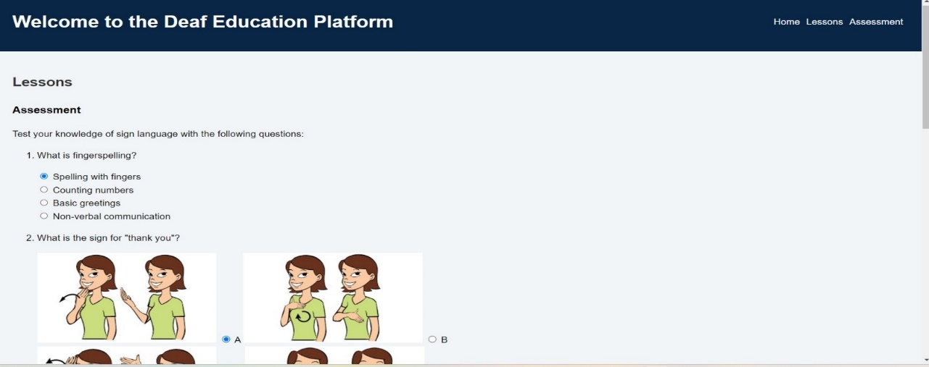
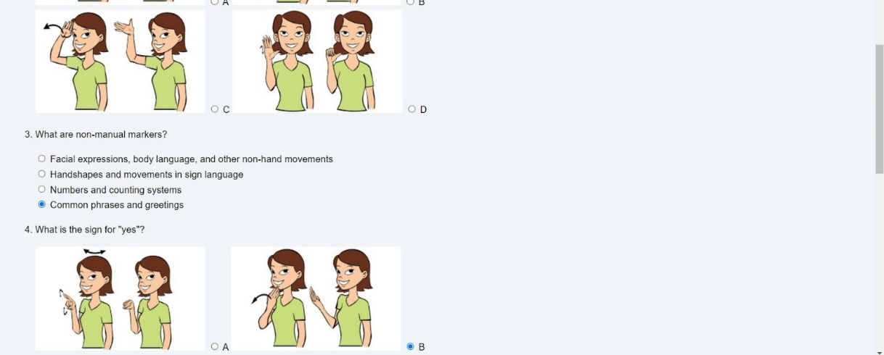
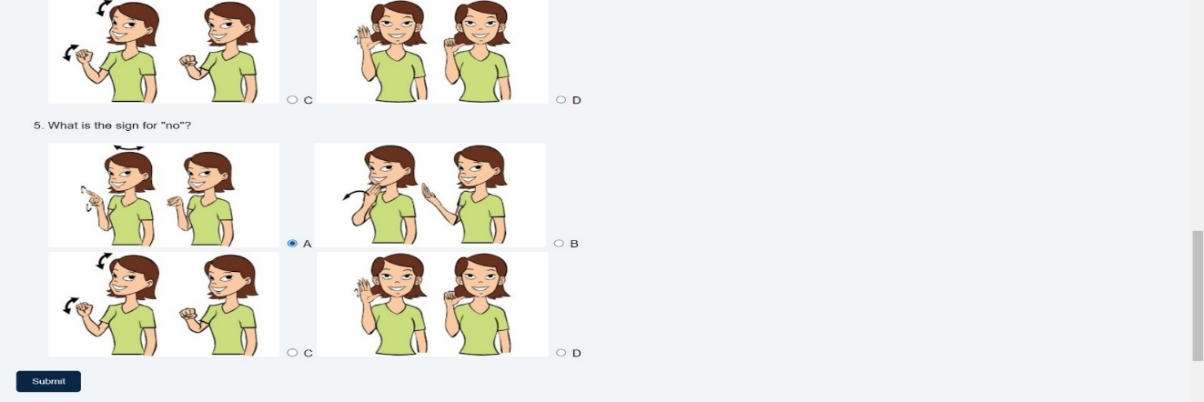
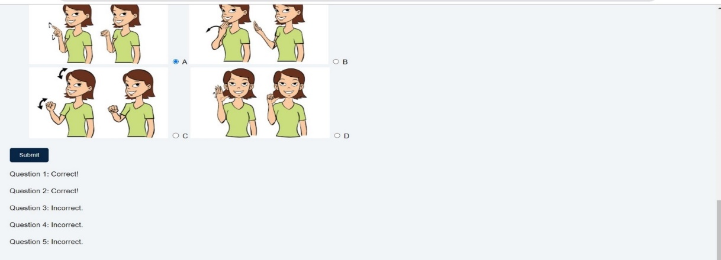
Implementation/Results of Module

Slide 10
Implementation/Results of Module
The Deaf Education Platform offers a robust and comprehensive introduction to sign language, targeting both grammar and conversational skills essential for beginners. The lesson covers crucial aspects such as fingerspelling the alphabet, counting from 1 to 10, and basic greetings, making it accessible and practical for new learners. Each topic is supported by clear illustrative images, which help in visual learning and retention. The grammar section delves into the intricacies of sign language structure, including word order, facial expressions, and non-manual markers, providing learners with a solid foundation in understanding and using sign language effectively.

Slide 11
Implementation/Results of Module
The platform's interactive assessment module stands out, featuring well-crafted multiple-choice questions that test learners' grasp of sign language concepts. Questions focus on practical grammar rules, the correct use of non-manual markers, and conversational skills such as starting and maintaining a conversation in sign language. The integrated JavaScript functionality provides immediate feedback, enabling learners to self-assess and identify areas needing improvement. This feedback mechanism enhances the learning experience by reinforcing correct answers and explaining mistakes. Overall, the Deaf Education Platform is a valuable educational tool, designed to be engaging and user-friendly. It effectively combines instructional content with interactive assessments, ensuring that learners acquire a comprehensive understanding of basic sign language and are well-prepared for real-world communication.

Slide 12
Conclusion
The website provides a user-friendly platform where learners can learn all the modules and take up assessment
The Home module plays a crucial role in emanaging the all the lessons and assessment,the Lesson module, listing available courses.

Slide 13
References
[1] Marschark, M., & Hauser, P. C. (2012). Deaf cognition: Foundations and outcomes. Oxford University Press.
[2] Antia, S., Reed, S., & Kreimeyer, K. H. (2009). Social outcomes of students who are deaf and hard of hearing in general education classrooms. Exceptional Children, 76(4), 489-504.
[3] Mitchell, R. E., & Karchmer, M. A. (2004). Chasing the mythical ten percent: Parental hearing status of deaf and hard of hearing students in the United States. Sign Language Studies,
[4] Moores, D. F. (2001). Educating the deaf: Psychology, principles, and practices. Cengage Learning.

Slide 14
Github Link
Github Link:
https://github.com/M-S-Harithaah/GE19612-PRIEE-079-129-078

Slide 15
Thank You

