Slide 1








FARMSMART
AI POWERED FARMING APPLICATION

Slide 2
ABSTRACT
FarmSmart is an AI-driven agricultural platform aimed at revolutionizing traditional farming practices through intelligent decision support. By integrating crop planning, fertilizer recommendations, seed purchasing, and disease detection into a single user-friendly system, FarmSmart empowers farmers with real-time, data-backed insights. An embedded AI chatbot enhances accessibility by delivering expert advice on demand. This unified solution addresses the fragmented nature of existing tools and promotes sustainable farming by maximizing yield, minimizing resource wastage, and improving overall farm profitability.

Slide 3
INTRODUCTION
Modern agriculture faces numerous challenges—from unpredictable weather and pest outbreaks to inefficient resource usage and lack of expert guidance. Traditional farming methods often rely on manual decision-making, which can lead to reduced yields and increased losses.
FarmSmart is an AI-powered platform designed to transform farming by offering intelligent, real-time assistance. It helps farmers with:
Crop selection based on season, soil, and location
Fertilizer recommendations for optimal growth
Plant disease detection using AI analysis
Seed purchasing through an integrated marketplace
AI chatbot support for on-demand expert advice

Slide 4
LITERATURE SURVEY
More than 50 per cent of marginal farmers reported losing at least half of their standing crops due to extreme weather conditions, according to a recent survey published in THE BUSINESS STANDARD.
The study published in THE ECONOMIC TIMES says that major causes of crop damage were drought (41%), irregular rainfall (32%), and monsoon delays (24%), with 43% of farmers losing over half of their standing crops.

Slide 5
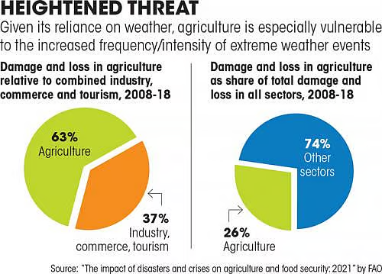
PIE CHART
.

Slide 6
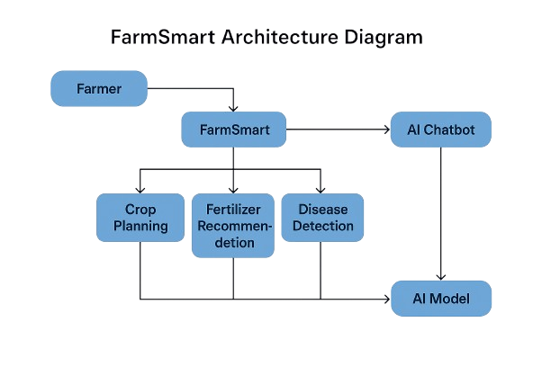
ARCHITECTURAL DIAGRAM
.

Slide 7
MODULE DESCRIPTION
Crop Recommendation Module: Uses soil data, climate, and season to suggest optimal crops.
Fertilizer Advisory Module: Recommends fertilizer type and quantity based on crop and soil.
Disease Detection Module: Uses image analysis to detect plant diseases and suggest treatments.
Seed Marketplace Module: Enables seed browsing and purchasing within the app.
AI Chatbot Module: Provides real-time support and answers to farmer queries.

Slide 8
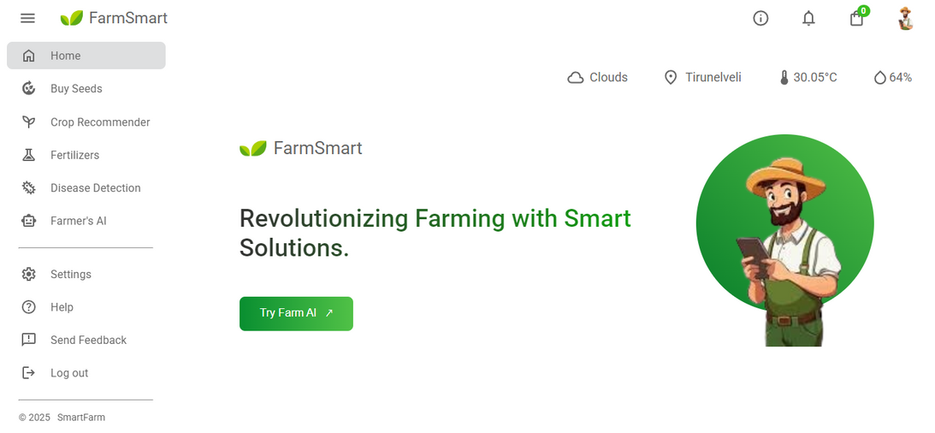
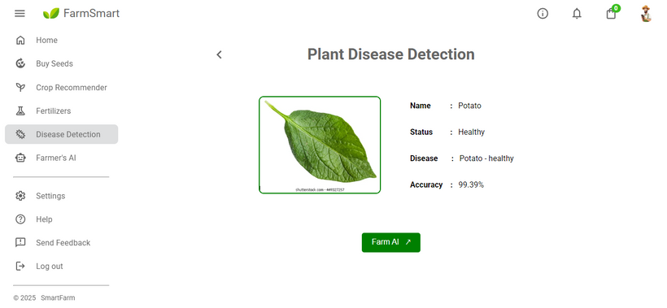
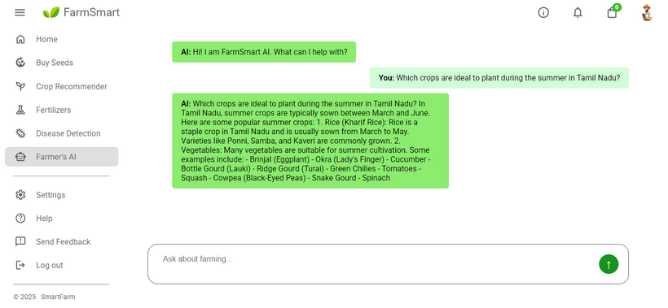
RESULTS/OUTPUT SCREEN

Slide 9
CONCLUSION & FUTURE SCOPE
Conclusion:
FarmSmart leverages AI to simplify farming by offering smart crop planning, fertilizer guidance, disease detection, and seed purchasing—all in one platform. It enhances productivity, supports sustainable practices, and empowers farmers with real-time, expert assistance.
Future Scope:
Add voice and regional language support
Integrate satellite and IoT data
Enable blockchain for supply chain transparency
Expand to weather prediction and livestock modules

Slide 10
REFERENCES
·Banerjee, S., & Mondal, A. C. (2020). "A region-wise weather data-based crop recommendation system using different machine learning algorithms." International Journal of Intelligent Systems and Applications in Engineering.
·Garg, D., & Alam, M. (2020). "An effective crop recommendation method using machine learning techniques." International Journal of Advanced Technology and Engineering Exploration.
·Hossain, S., Prova, N. N. I., Sadik, M. R., & Al Maruf, A. (2020). "Enhancing Crop Management: Ensemble Machine Learning for Real-Time Crop Recommendation System from Sensor Data."
·Sladojevic, S., Arsenovic, M., Anderla, A., Culibrk, D., & Stefanovic, D. (2016). "Deep neural networks based recognition of plant diseases by leaf image classification."
·Barbedo, J. G. A. (2019). "Plant disease identification from individual lesions and spots using deep learning." Biosystems Engineering, 180, 96-107.

Slide 11
THANK YOU

