Slide 1

FYP Progress Presentation Project Title: NextGen AI Healthcare: Symptoms-based Diagnosis and Medical Rentals Group Members: Muhammad Umar Jan - 21pwcse2000 Muhammad Saad - 21pwcse1997 Muhammad Zaid - 21pwcse1991 Muhammad Ilyas - 21pwcse2055
Department of Computer System Engineering, UET Peshawar

Slide 2
Problem Statement
Lack of access to medical advice in rural and under served areas
Difficulty obtaining medical equipment for short-term use
Delays in diagnosis and treatment recommendations
High cost of medical devices for temporary needs
Limited options for people to share unused medical equipment

Slide 3
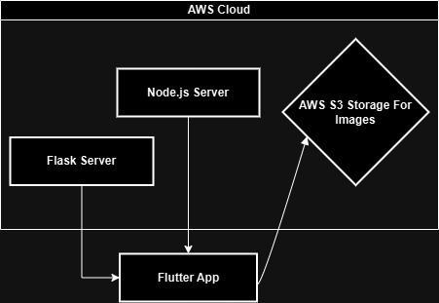
Methodology

Slide 4
Methodology (Cont.)
Flask Server: The Flask server handles AI diagnosis, running machine learning models or algorithms for medical diagnosis tasks.
Node.js Server: Node.js is used as the backend for managing the medical rental system, handling API requests, data management, and communication with MongoDB.
AWS S3 Storage:S3 is used to store medical tools’ images, and the generated links to these images are saved in MongoDB for easy access.
Flutter Application: The Flutter app serves as the client-side interface, interacting with both the Flask and Node.js servers, and fetching images stored in AWS S3.

Slide 5
Progress
70%
60%
10%

Slide 6
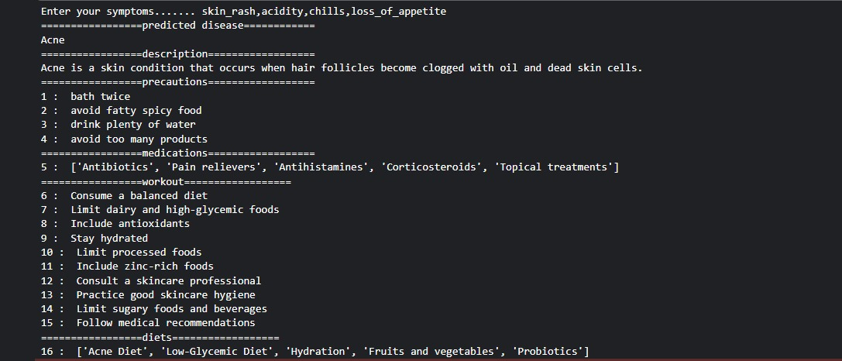
Progress (Cont) - AI

Slide 7
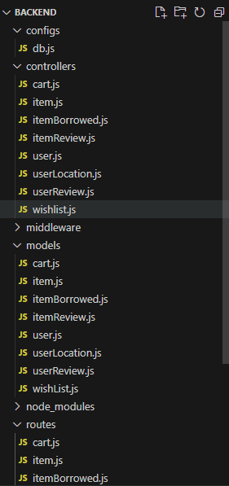
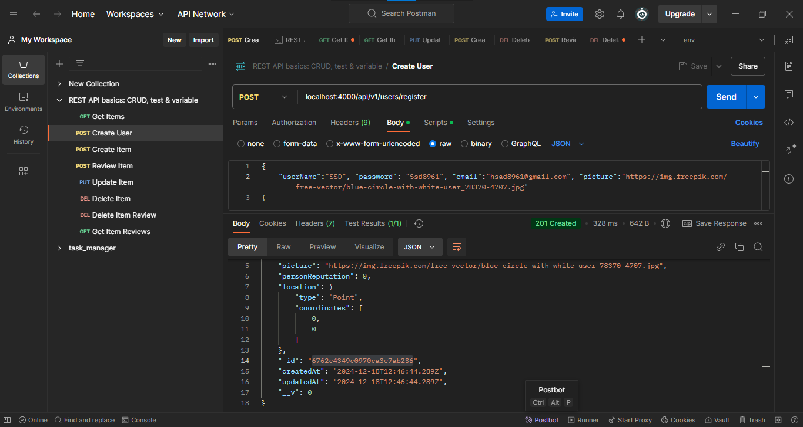
Progress (Cont) - Backend

Slide 8
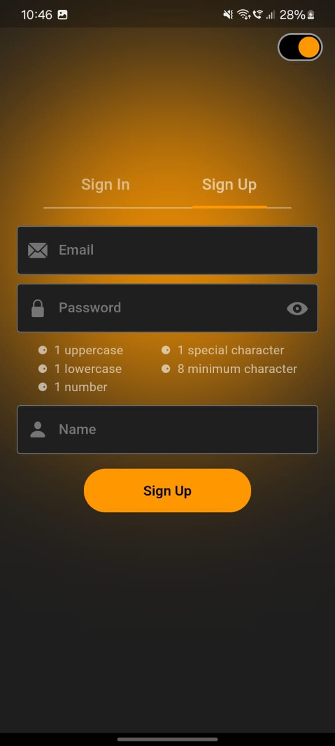
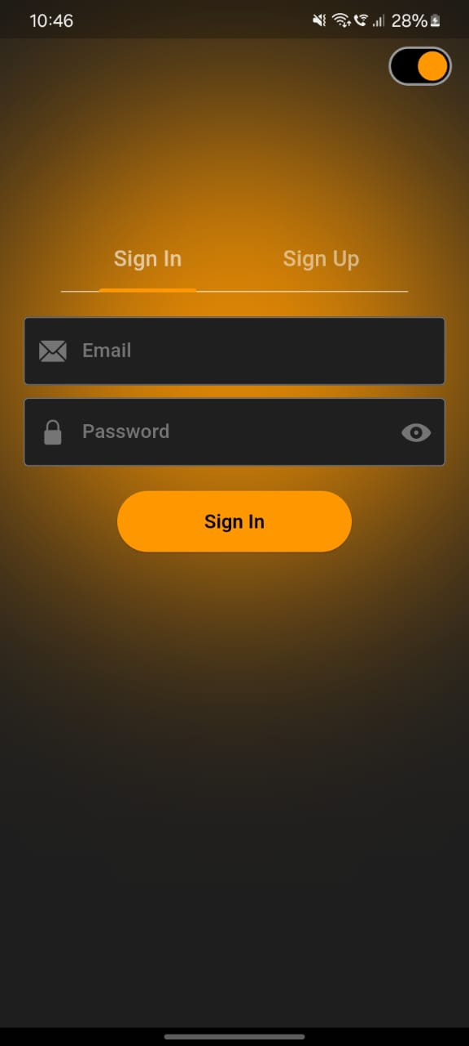
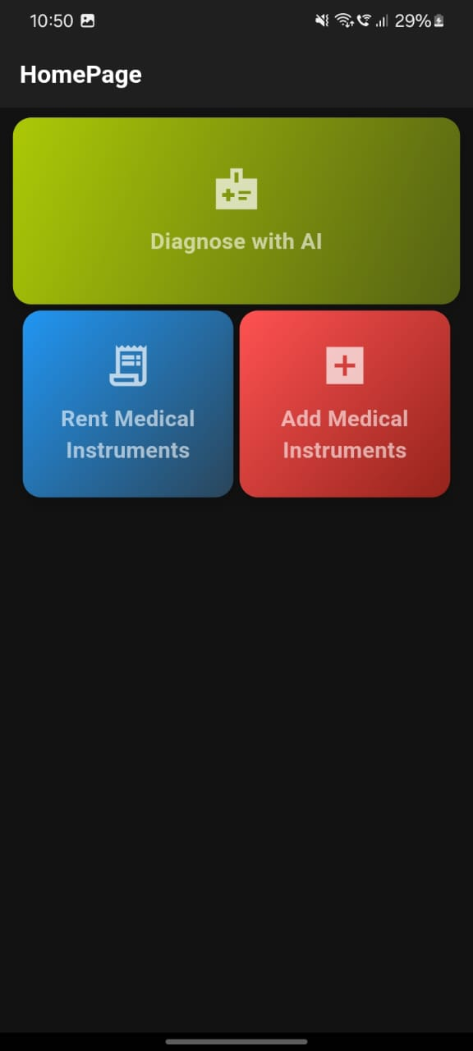
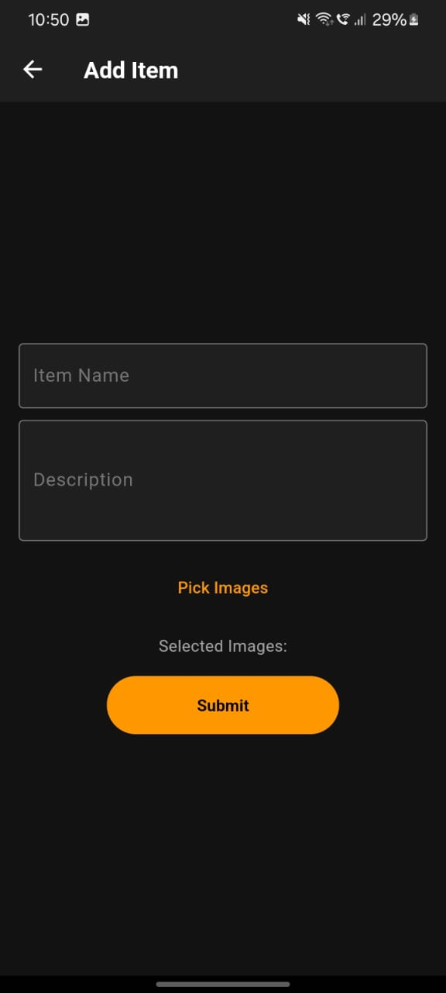
Progress (Cont) - Frontend

Slide 9
Progress (Cont.) To do Next
JWT and Google Authentication in Backend.
Start working more on our Frontend.
Flask server for AI Diagnosis.
Spelling Correction for symptoms (AI or other tool).

Slide 10
THANK YOU

