Slide 1

NextGen AI Healthcare: Symptoms-based Diagnosis and Medical Rentals
FYP Progress II Presentation
Supervised By: Dr. Nasru Minallah
UNIVERSITY OF ENGINEERING AND TECHNOLOGY PESHAWAR DEPARTMENT OF COMPUTER SYSTEM ENGINEERING

Slide 2
Group Members
Muhammad Umar Jan
21PWCSE2000
AI/ML
Muhammad Saad
21PWCSE1997
Flutter & Backend
Muhammad Zaid
21PWCSE1991
Flutter
Muhammad Ilyas
21PWCSE2055
Database & Backend

Slide 3
Important Links
Dataset
https://www.kaggle.com/datasets/noorsaeed/medicine-recommendation-system-dataset/data
AI Codebook
https://www.kaggle.com/code/muhammadumarjan/medical-recomendation
GitHub Repository
https://github.com/M-Saad-0/fyp_project
Data Profiling Report
https://m-saad-0.github.io/fyp_project/profiling-report

Slide 4
Problem Statement
Limited access to medical advice and timely diagnosis in rural and underserved areas.
Difficulty obtaining affordable medical equipment for short-term use.
Lack of platforms for sharing unused medical devices efficiently.

Slide 5
Platforms Of Our Project
AI Symptoms Diagnosis
Medical Rentals
This is an AI powered platform which diagnose your symptoms and predict your prognosis and on the basis of that prognosis, it recommend medications, diets and exercise etc.
This platform enables users to rent out their medical devices, providing essential equipment to those in need.

Slide 6
AI Symptoms Diagnosis -Flowchart
Data Loading And EDA
Feature Engineering
Model Building
Evaluation and Testing

Slide 7
Steps
Data Loading And Preprocessing:
The dataset Training.csv was loaded successfully using pandas.
The dataset was split into features (X) and the target variable (y), with prognosis as the target column.
Label encoding was applied to convert the target variable into numerical format.
Train-test split was performed, with 70% training and 30% test data.
Dataset

Slide 8
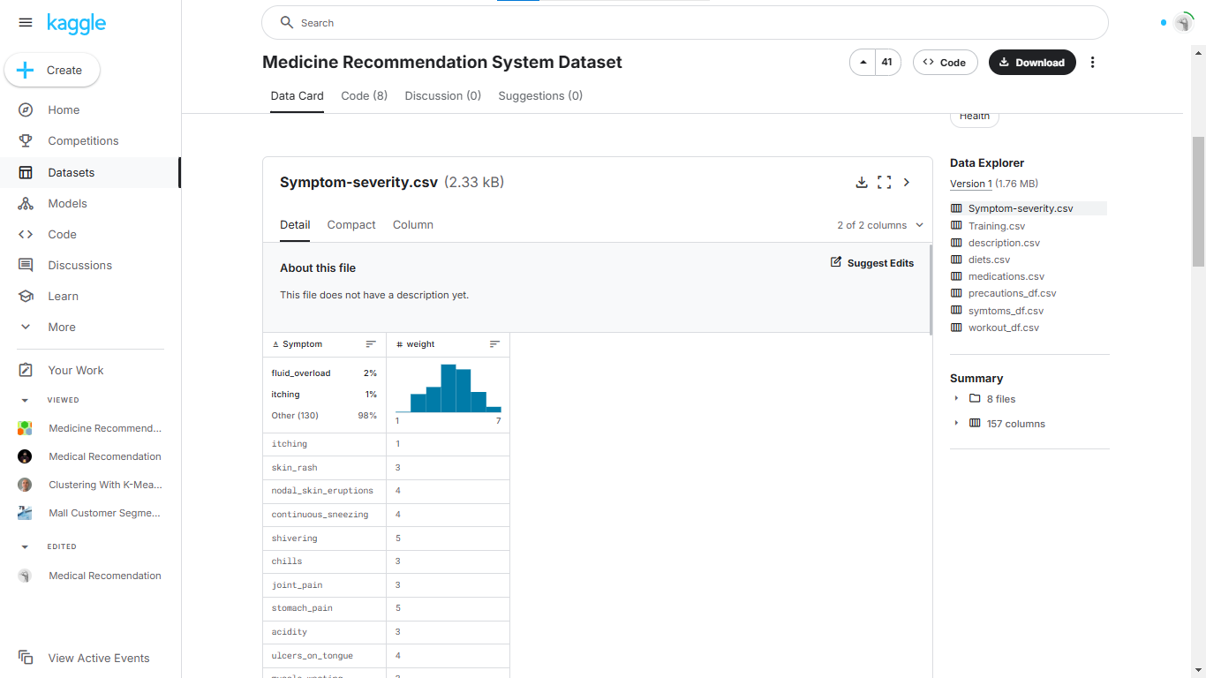
Dataset

Slide 9
Steps
Exploratory Data Analysis (EDA):
A profiling report was generated using ydata_profiling (formerly pandas-profiling), which provides a comprehensive summary of the dataset, including correlations, missing values, and feature distributions. Data Profiling
The profiling report likely revealed that several features in the dataset have high correlation with each other. This can lead to multicollinearity, making the model unstable and harder to interpret
Your dataset has an imbalance in the target variable (i.e., some diseases/prognoses are significantly more frequent than others). This can cause the model to favor the majority class and underperform on the minority classes.

Slide 10
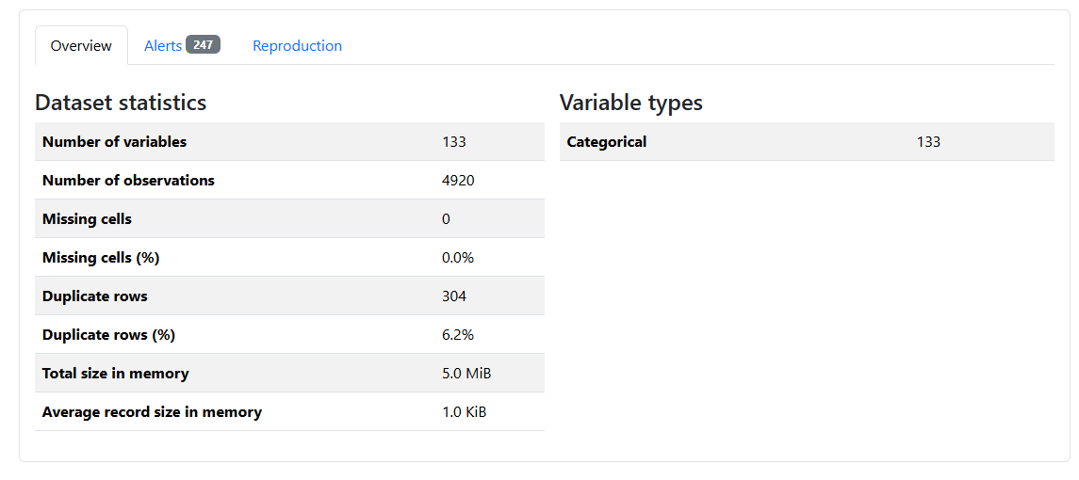
Y-Data Profiling Report - Overview

Slide 11
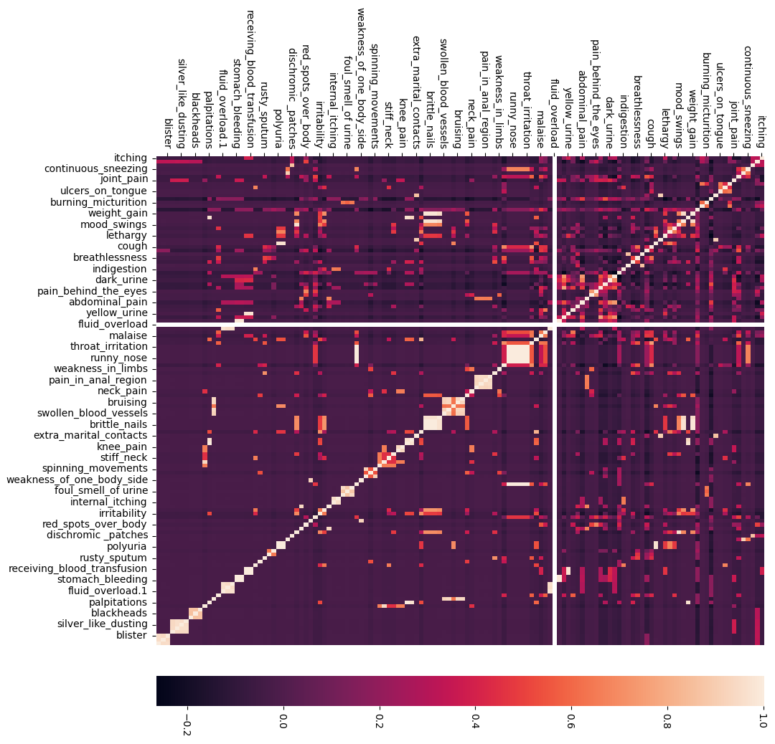
Correlation in-between features

Slide 12
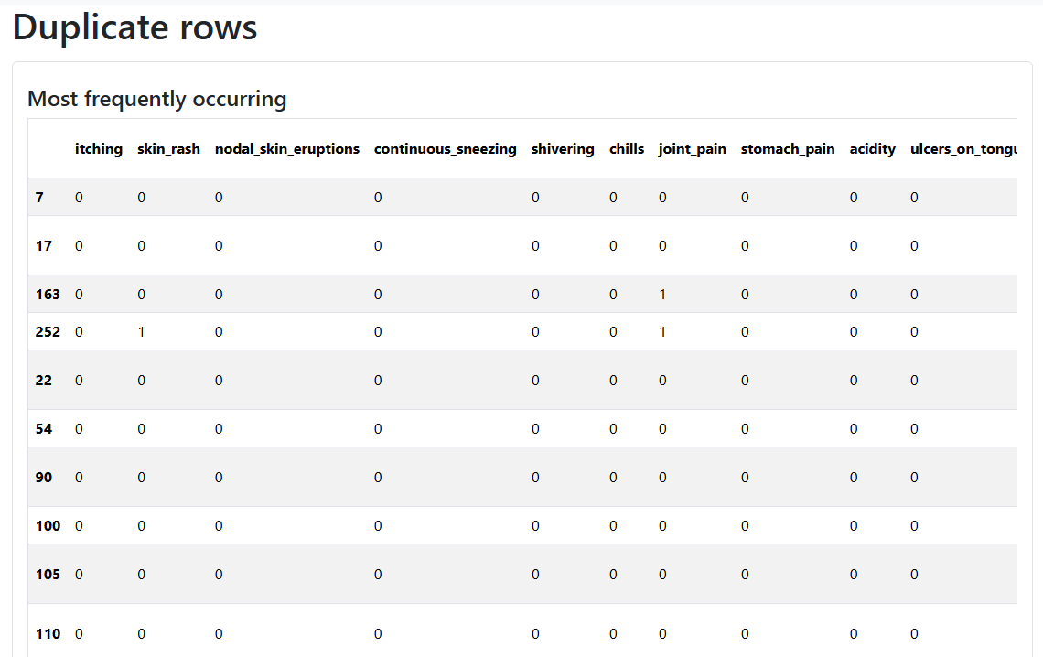
Y-Data Profiling – Duplicated Rows

Slide 13
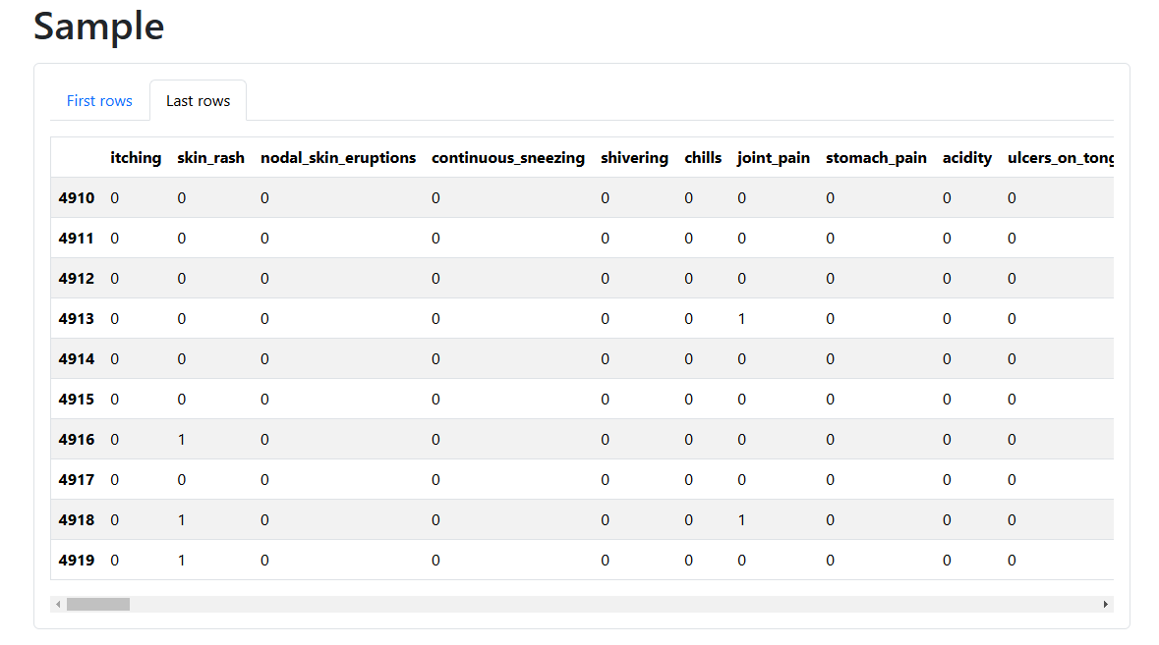
Y-Data Profiling – Samples

Slide 14
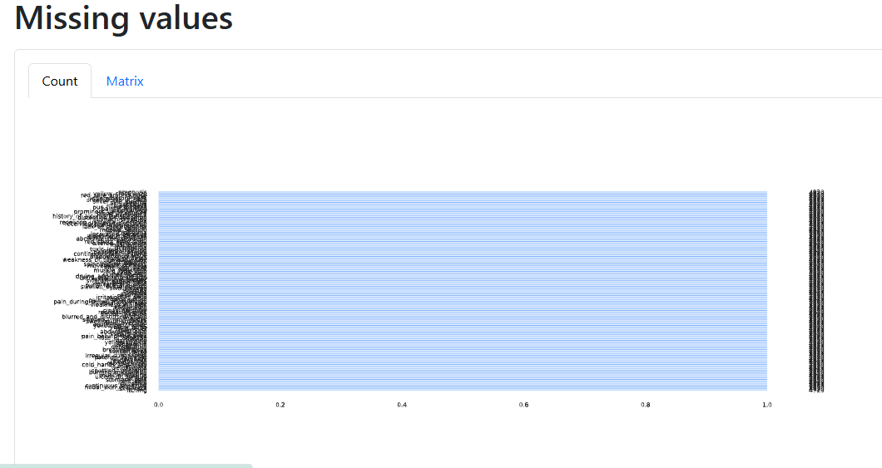
Y-Data Profiling – Missing Values

Slide 15
Steps
Feature Engineering:
To address the issue like correlation and unbalancing in data I used the feature engineering techniques.
Here I used the feature Engineering technique like feature selection and the specific technique that I were used is Mutual Information-based Feature Selection.
The Mutual Information Classifier was used to measure the dependency between each feature and the target variable.
Features were ranked based on their contribution to prognosis prediction.
Irrelevant and low-impact features were discarded to reduce dimensionality and prevent overfitting.

Slide 16
Steps
Model Building
Model Selection:
Executed machine learning models to identify the best-performing algorithm.
Considered models like Decision Trees, Random Forest, and SVM.
Training:
Trained the selected model(s) using X_train and y_train after feature selection.
Code: Code Notebook
Next Steps:
Hyper parameter tuning (e.g., Grid Search).
Explore ensemble methods (e.g., Random Forest, Gradient Boosting).
Consider class weights or resampling techniques for better minority class performance.
Model Building
Model Selection:
Executed machine learning models to identify the best-performing algorithm.
Considered models like Decision Trees, Random Forest, and SVM.
Training:
Trained the selected model(s) using X_train and y_train after feature selection.
Code: Code Notebook
Next Steps:
Hyper parameter tuning (e.g., Grid Search).
Explore ensemble methods (e.g., Random Forest, Gradient Boosting).
Consider class weights or resampling techniques for better minority class performance.

Slide 17
Steps
Evaluation:
The confusion matrix import suggests that evaluation metrics were planned or used for assessing model performance.
Challenges/Observations:
There are some redundant package installations and uninstallation commands (numba, ydata-profiling). These may slow down execution and should be cleaned up for production.
Profiling report is a great step for EDA, but ensure that insights from the report are incorporated into data preprocessing or feature engineering.

Slide 18
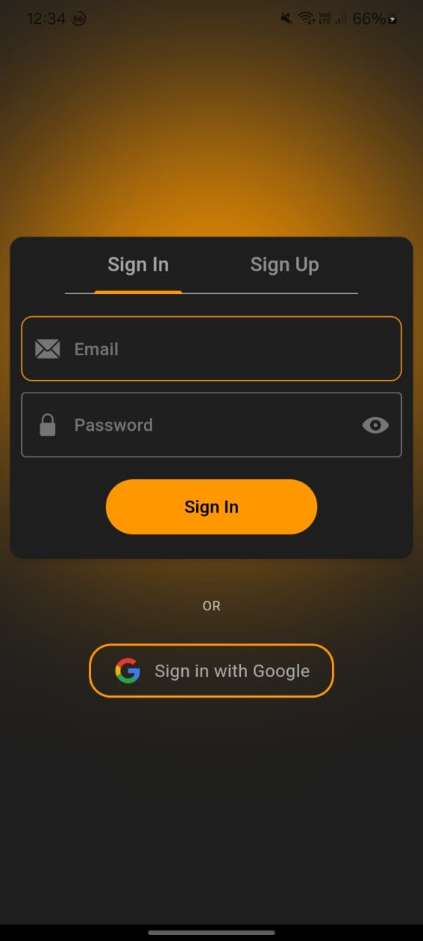
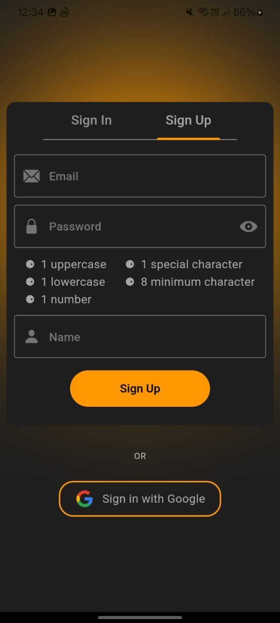
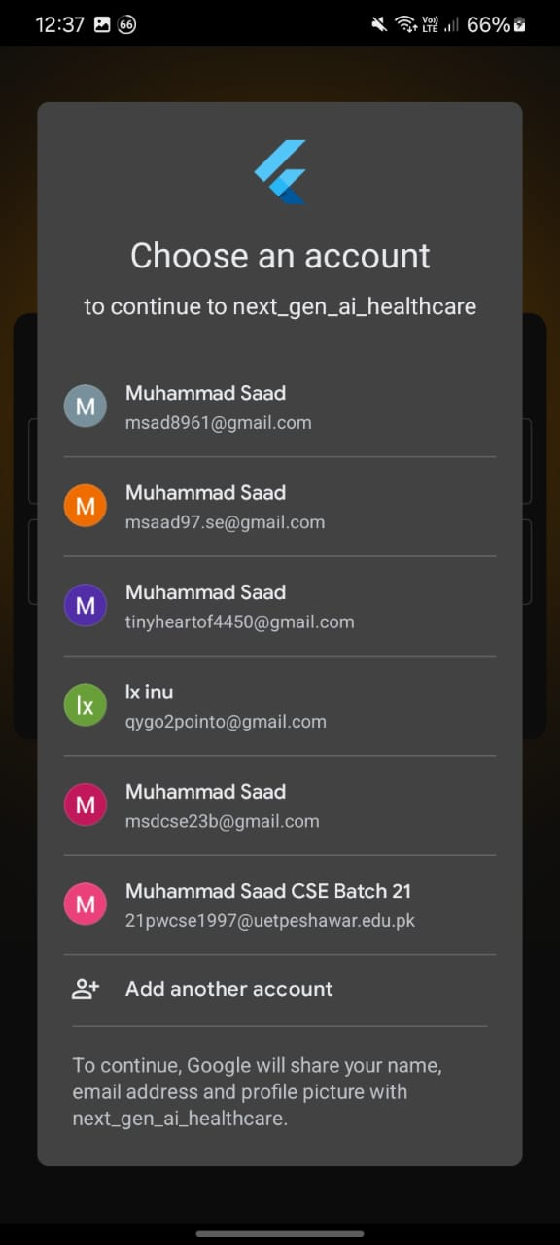
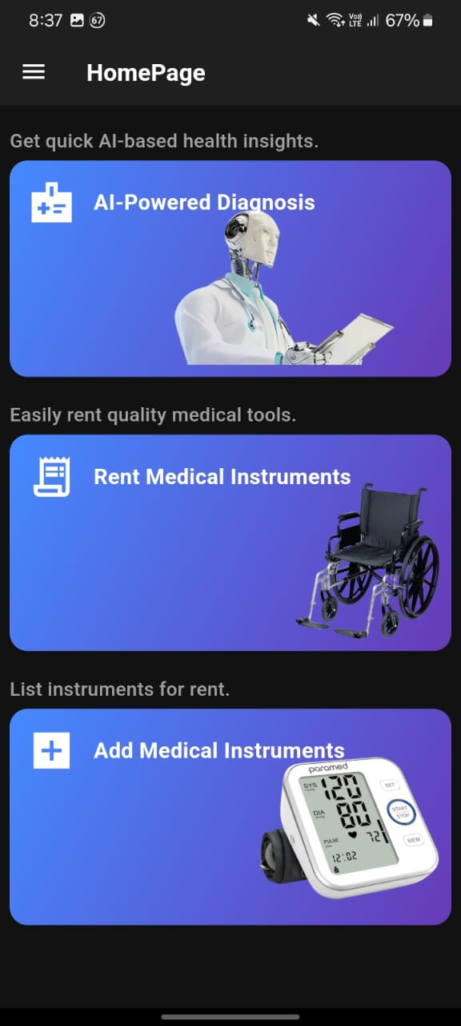
Medical Rentals (Frontend)
Sign In
Sign Up
Google Login
Homepage

Slide 19
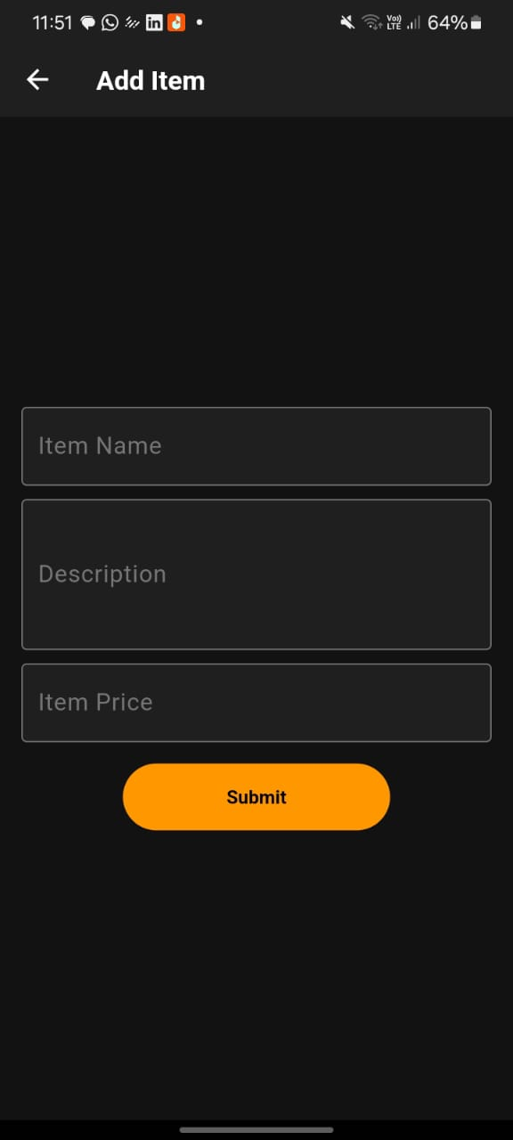
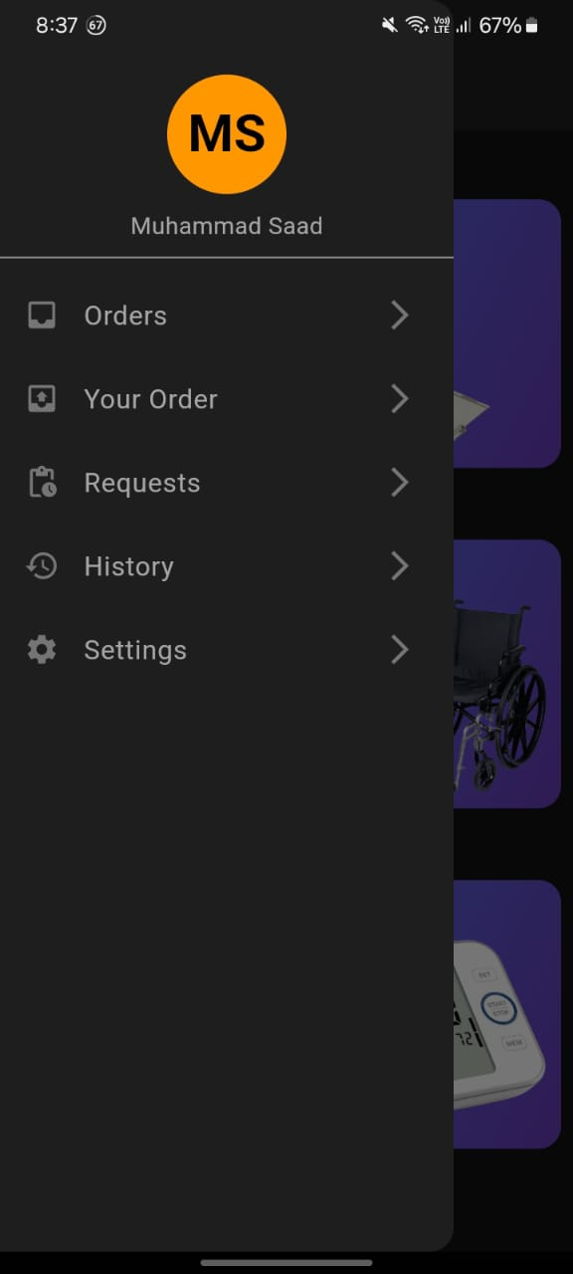
Medical Rentals (Frontend)
Sign In
Sign Up

Slide 20
Medical Rentals (Backned)
Progress
JWT Auth:
We implemented JWT authentication as a stateless and secure method to verify user identity by encoding user data into a token, ensuring seamless authentication for our web and mobile applications.
Google OAUTH 2.0:
We also integrated Google OAuth 2.0 for seamless third-party authentication in our web and mobile applications.

Slide 21
Research References
[1] T. Foley and F. Fairmichael, “The Potential of Learning Health Care Systems,” The Learning Healthcare Project, 2015. [Online]. Available: https://learninghealthcareproject.org/the-potential-of-learning-healthcare-systems/
[2] C. P. Friedman et al., “The science of learning health systems: foundations for a new journal,” Learning Health Systems, vol. 1, no. 1, 2017. [Online]. Available: https://onlinelibrary.wiley.com/doi/full/10.1002/lrh2.10020.
[3] D. A. Garwin. (1993) Building a Learning Organization. Harvard Business Review. 73-91. Available: https://hbr.org/1993/07/building-a-learning-organization
[4] J. M. McGinnis, D. Aisner, and L. O. Olsen, “The Learning Healthcare System,” National Academies Press, Washington (DC), USA, 2007. [Online]. Available: https://www.nap.edu/catalog/11903/the-learning-healthcare-system-workshop-summary
[6] J. Enticott, A. Johnson, and H. Teede, “Learning health systems using data to drive healthcare improvement and impact: a systematic review,” BMC health services research, vol. 21, no. 1, pp. 1-16, 2021. [Online]. Available: https://bmchealthservres.biomedcentral.com/articles/10.1186/s12913-021-06215-8#Tab3

Slide 22
Thanks!

