Slide 1
Feature Extraction
Combining CNN and RNN for Automatic Image Description

Slide 2
Introduction
• Feature Extraction automatically produces descriptive sentences for images.
• It uses Deep Learning techniques combining CNNs and RNNs.
• The model bridges the gap between computer vision and natural language processing.

Slide 3
Motivation
• Humans can easily describe what they see, but computers struggle with understanding visual scenes.
• Feature Extraction allows systems to explain images in words.
• Useful in accessibility, search, and automation.

Slide 4
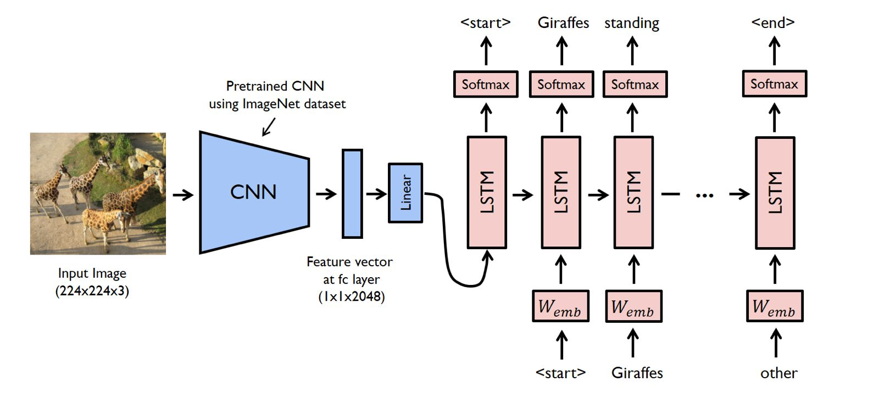
Architecture Overview

Slide 5
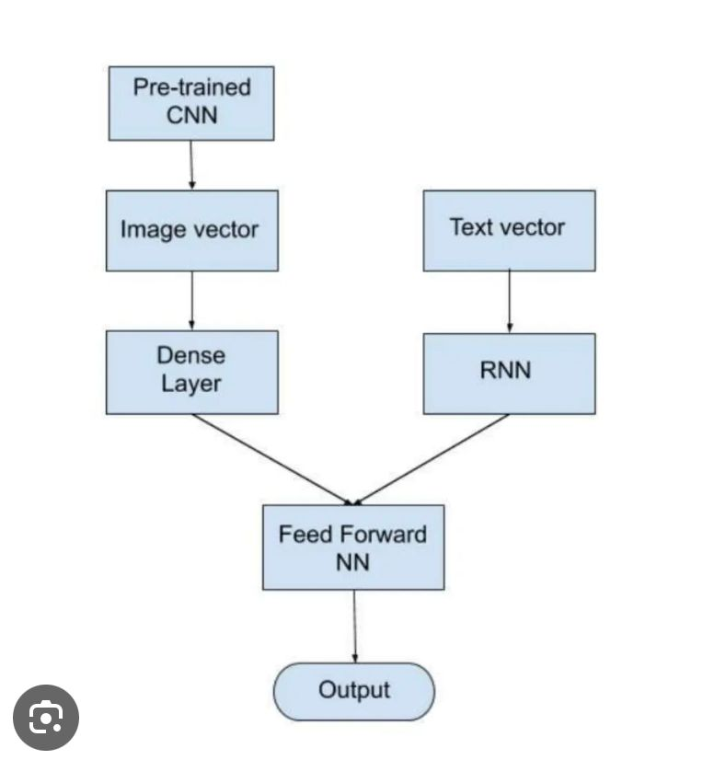
Simplified Model Flow

Slide 6
CNN Encoder
• Pre-trained CNN (e.g., ResNet, Inception) extracts visual features.
• Image is resized to 224x224x3 and passed through CNN layers.
• Output: 2048-dimensional feature vector representing visual semantics.

Slide 7
Feature Vector Transformation
• The CNN output is flattened and passed through a linear (Dense) layer.
• The dense layer reduces dimensionality and prepares the vector for LSTM input.
• This forms the connection between vision and language modules.

Slide 8
LSTM Decoder
• Long Short-Term Memory (LSTM) network generates captions word by word.
• Input: previous word and image feature vector.
• Output: next word prediction using softmax layer.
• Continues until <end> token is generated.

Slide 9
Embedding Layer
• Converts words into continuous vector representations.
• Helps LSTM understand semantic relationships between words.
• Example: 'cat' and 'dog' have closer embeddings than 'cat' and 'car'.

Slide 10
Training Process
• Dataset: typically MS COCO with thousands of image-caption pairs.
• Model learns to minimize cross-entropy loss between predicted and actual captions.
• Uses teacher forcing — feeding true words during training to stabilize learning.

Slide 11
Inference Process
• At test time, only the image is given.
• CNN extracts features → LSTM generates caption sequentially.
• Common decoding strategies:
- Greedy Search: picks most likely next word.
- Beam Search: explores multiple caption possibilities.

Slide 12
Applications
• Assistive technology for the visually impaired.
• Automated captioning for social media platforms.
• Enhancing image search engines.
• Video summarization and surveillance analysis.

Slide 13
Advantages
• Provides textual understanding of images.
• Combines strengths of computer vision and NLP.
• Can generalize across diverse image contexts.
• Useful for AI accessibility and automation.

Slide 14
Limitations
• Requires large, well-annotated datasets.
• May generate grammatically correct but semantically wrong captions.
• Computationally expensive to train.
• Struggles with abstract or unseen concepts.

Slide 15
Future Enhancements
• Integrate attention mechanisms to focus on image regions.
• Use transformer-based architectures (e.g., ViT + GPT models).
• Multi-modal training using both image and text embeddings.
• Real-time captioning for videos.

Slide 16
Conclusion
• Feature Extraction combines CNNs for image analysis and RNNs for sentence generation.
• Enables machines to understand and describe visual scenes.
• A key step toward human-like visual understanding and AI communication.

