Slide 1
EMPOWERING MUSLIM STUDENTS: Education Roadmap for the Community
Presented
by
Dr. Majid Jamil
Secretary, FAITH Social and Educational Welfare Society (Regd.)
&
Professor, Department of Electrical Engineering
Jamia Millia Islamia, New Delhi-110015
mjamil@jamiu.ac.in
Ph No 09313462108

Slide 2
Large dropped out of Muslim students
The children do not have proper facilities in their homes to study
Their parents are not educated and could not help them in basic studies.
General atmosphere in localities lack discipline and unless the children are given proper guidance, they fail in early classes and generally drop out of school.

Slide 3
Objectives of the project
The Project aimed to support the Children from economically and educationally poor families in socio economically backward localities in Saharanpur (U.P.) city.
The project helped in setting up the special classes at two locations, one in Mohalla Quazi and other in Nakhasa Bazar. The Children attended classes under supervision of two qualified teachers.
Most of the students belong to very poor families of house maids, rickshaw pullers, labourer’s etc. Students from slums are also attending this class.
Number of beneficiaries: 150 ( from class I to Class XII)
The classes under the project started initially at one place with around 50 children but now the number of students increased to more than 100 with two centres located at two different locations. These students belong to the poor families of neighbouring areas.

Slide 4
As per the All-India Survey on Higher Education (AISHE: 2020-21) conducted by the Ministry of Education, the number of Muslim students in Higher Education has decreased to 19.21 lakhs (4.6 per cent) in 2020-21 from 21 lakhs (5.5 per cent) in 2019-20.
The Muslim Community seems to be lagging behind all other Communities, including the OBCs (35.8%), Scheduled Castes (14.2% ) & Scheduled Tribes (5.8%).

Slide 5
AVERSION OF MUSLIMS TO SEND GIRL CHILDREN TO MODERN HIGHER EDUCATIONAL INSTITUTIONS
As reported by the All India Survey of Higher Education (AISHE) by Ministry of Education, Government of India, the participation of women in higher education compared to their male counterparts has persistently been rising.
Muslim women constituted 46% of the Muslim enrolment in higher education in 2012-13. Since then, their share has gone up to 50.32% in 2020-21, which is quite close to the national average for all sections of society.
Clearly, the decline in the enrollment of Muslims in higher education is in no way on account of the withdrawal of women from modern higher education.
In fact, in 2020-21, the enrolment of Muslim men declined more sharply than the number of Muslim women.
Muslim enrolment in Higher Education in 2020-21

Slide 6
BOTTLENECKS IN THE FEEDER CHANNEL
The bottleneck in the feeder channel appears quite plausible.
The UDISE+ data for 2019-20 reveals that Muslims constituted 9.89% of the total enrolment in the higher secondary level.
In the absence of precise information about Muslims on the dropouts, it can be proceeded on the basis of certain assumptions derived from the anecdotal evidence and some generalizations that the dropout rates amongst the Muslims are higher than the national average.
It may be assumed that no more than 40% of the Muslims in senior secondary schools would be in class 12th and no more than 80% (about 10% lower than the national average) of them would be appearing in the board examinations and that their success rate would be no more than 65% (12% lower than the national average).
This would indeed be regarded as very low in comparison to the size of the Muslim population in the country and would indeed be a major barrier to accessing higher education.

Slide 7
Percentage of Muslims enrolled in various Educational Institutions from 2019-21

Slide 8
Decline of Muslims Enrolment in Higher Education in India in different states during 2019-2021

Slide 9
Percentage Share of Muslims representation in various sectors in India in 2020-21

Slide 10
INITIATIVES FOR BETTERMENT

Slide 11
TALIMI MODEL
After the publication of the latest data released by Government of India regarding the gross enrolment of students in higher education, it came into the knowledge that the percentage of Muslims boys in higher education is decreasing from 2019 onwards, which was on rise from 2011 to 2018.
It was taken seriously by a group of educationalists from Saharanpur, U.P. and came forward to address the issue of dropped out students of Saharanpur city.
They decided to start a guidance centre for the students of XII class in a meeting held on 1st July 2023 at 4:00 pm at Brown Wood School, Saharanpur.

Slide 12
MINUTES OF THE MEETING HELD ON 1ST JULY 2023
A meeting of Talimi Bedari Committee was held on 1st July 2023 at 4:00 pm at Brown Wood School, Saharanpur.
The following persons were present:
Janab Zia Ansari Sahab
Dr. Qutsiya Sahiba
Mohtarma Sobohi Sahiba
Janab Jalal Umar Sahab
Janab Jameel Manvi Sahab
Professor Sirajuddin Ahmad Sahab
Professor Mohd. Kamil Sahab
Molana
Professor Majid Jamil
Dr. Shamshad Ali Sahab
Mr. Syed Hamza Sahab

Slide 13
CONCLUSION AND OUTCOME OF THE MEETING
Conclusions from the meeting:-
Special classes for students of Islamia Inter College (Boys) of class X and XII will be arranged from 30th July 2023.
Teachers development programmes to motivate teachers of Islamia Inter College will be arranged.
Outcome of the meeting:-
A reading room cum library facility was started from 30th July 2023 at Mohalla Qazi, Saharanpur.
Around 40 students joined the centre where they are asked to do self-study for at least 6-8 hours daily with the target of preparations for UG test of CUET-2024 for the admission in undergraduate programme-2024.
Facility of online teaching on You-Tube platform with Wi-Fi facility and two teachers to help them was provided.

Slide 14
IMESA SAHARANPUR PROJECT
The Project aimed to support the Children from economically and educationally poor families in socio economically backward localities in Saharanpur (U.P.) city.
The project helped in setting up the special classes at two locations, one in Mohalla Quazi and other in Nakhasa Bazar.
The Children attended classes under supervision of two qualified teachers.
Most of the students belong to very poor families of house maids, rickshaw pullers, labourer’s etc. Students from slums are also attending this class.

Slide 15
Number of beneficiaries:-
The classes under the project started initially at one place with around 50 children but now the number of students increased to more than 100 with two centres located at two different locations.
Capacity of beneficiaries before the project:
The children did not have proper facilities in their homes to study and do daily homework or prepare for exams at these two libraries.
Their parents are not educated and could not help their work in basic studies.
General atmosphere in these localities lack discipline and unless the children are given proper guidance, they fail in early classes and generally drop out of school.

Slide 16
Brief methodology:-
The Project began in 2015 as local team got together and held meetings to prepare and plan the project.
Campaign among local students and their parents began to join the free coaching and Guidance Centre.
It look couple of weeks to make necessary preparation. Registration of students began within a day 45 students enrolled. Interview were held to appoint teachers and support staff. Qualified teachers were selected.
Coaching classes run between 4pm -8pm, six days a week.
Hindi, Urdu, English, Mathematics Social Study Science and general knowledge are taught in the class. Homework is done by the students with the help of teacher.
Extra-curricular activities and regular games kept students engaged for overall development.

Slide 17
STAFF AT SAHARANPUR CENTRE
Name of the employee | Designation | Appointment date | Monthly salary
Mr. Mohd Saleem | Teacher | 01-01-2018 | Rs 5000/-
Ms. Baby Siora | Teacher | 01-06-2022 | Rs 3000/-
Ms. Aman | Trainer | 01-06-2022 | Rs 2000/-
Total Salary |  |  | Rs 10,000/-
Name of the employee | Designation | Appointment date | Monthly salary
Mr. Mohd Saleem | Teacher | 01-01-2018 | Rs 7500/-
Ms. Baby Siora | Teacher | 01-06-2022 | Rs 3000/-
Ms. Aman | Trainer | 01-06-2022 | Rs 3000/-
Ms. Alfiyya Omar | Teacher | 01-06-2023 | Rs. 7500/-
Mr. Mohd. Irfan Ansari | Coordinator | 01-06-2023 | Rs. 4000/
Total Salary |  |  | Rs 25,000/-
Staff at Saharanpur centre before 1 June 2023
Staff at Saharanpur centre after 1 June 2023

Slide 18
FREE READING ROOM CUM LIBRARY FACILITY MOHALLA QUAZI, SAHARANPUR
Aims and objectives :-
Creating and establishing educational environment among poor and educationally backward people in the neighboring localities of the premises.
Bringing awareness about importance of education in human society.
Restricting children to play in streets, watching excessive TV and wasting time without knowing their aims in life.
Creating moral values among youth.
Encouraging people to participate in social activities that benefit masses.
Outcome:-
By providing free reading room library with all facilities like proper sitting arrangement, power backup and a small collection of important books to all class students, improvement in the results is observed.
Students also became well behaved and confident with improvement not in academics but in cultural activities also.

Slide 19
Further needs:-
It is vital that the facility continues and students continue to get the support. Without such support, students’ performance will deteriorate sharply affecting their results. Some of them may thus drop out.
Such facilities should be multiplied and if possible, a mission should be started to extend maximum benefit to the needy people.
Data of dropped out students should be prepared in every mohalla as a large number of school going children discontinue their education after class VI onwards.
A help from university students during summer vacations may be taken to accomplish this task under the mentorship of one or two local seniors.

Slide 20
DR. A P J KALAM LIBRARY, SAHARANPUR
Objectives of the project:-
The Project aimed to support the Children at free of cost from economically and educationally poor families in socio economically backward localities in Saharanpur (U.P.) city.
The main aim is to provide an environment for self- study in the library to those children, who don’t have proper facilities to study and guidance at their homes as most of these students belong to very poor families of house maids, rickshaw pullers, labourer’s etc.
General atmosphere in their localities lack discipline and unless the children are given proper guidance, they fail in early classes and generally drop out of school.
The children attend library under supervision of qualified teachers, who teach them and help in completing home work.

Slide 21
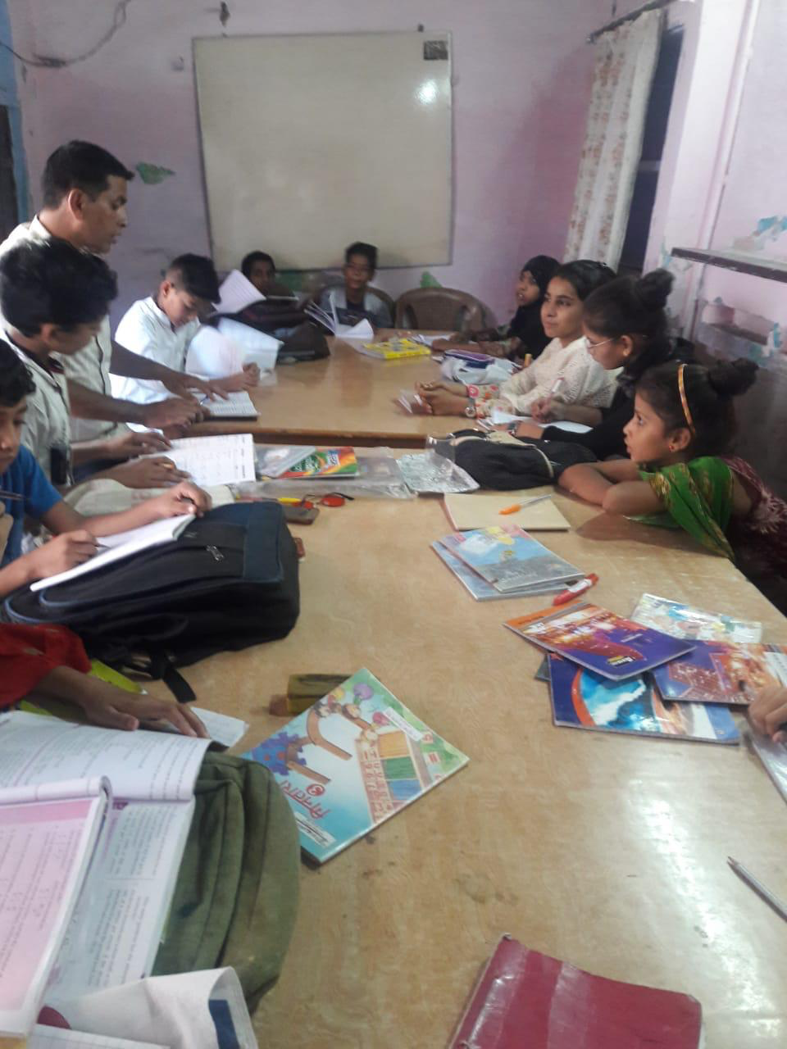
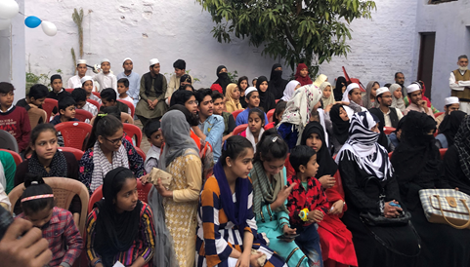
Recent photos from the Reading facilities in Saharanpur, UP

Slide 22
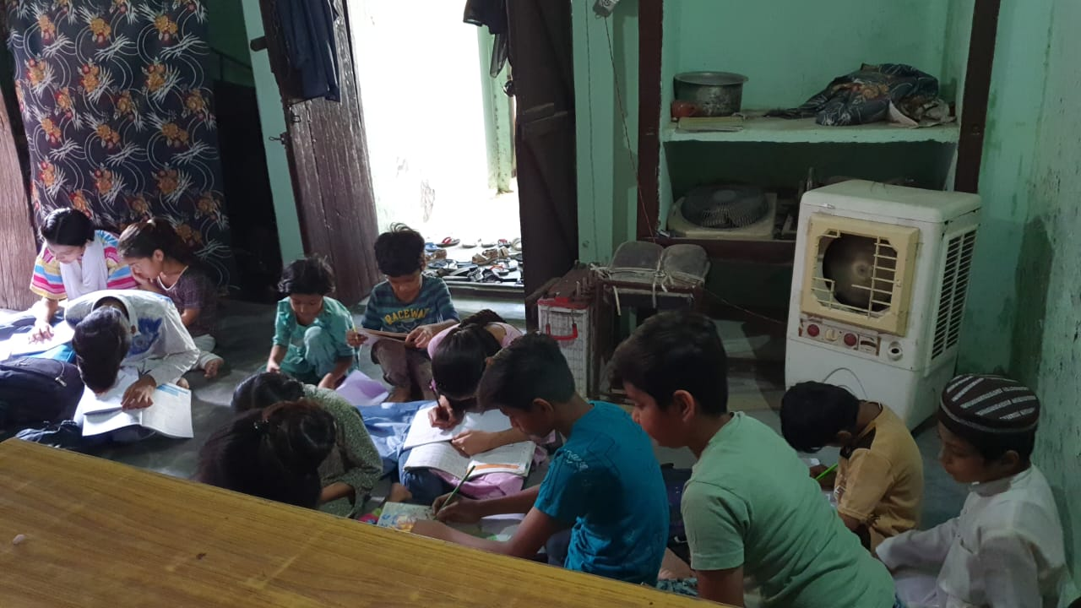
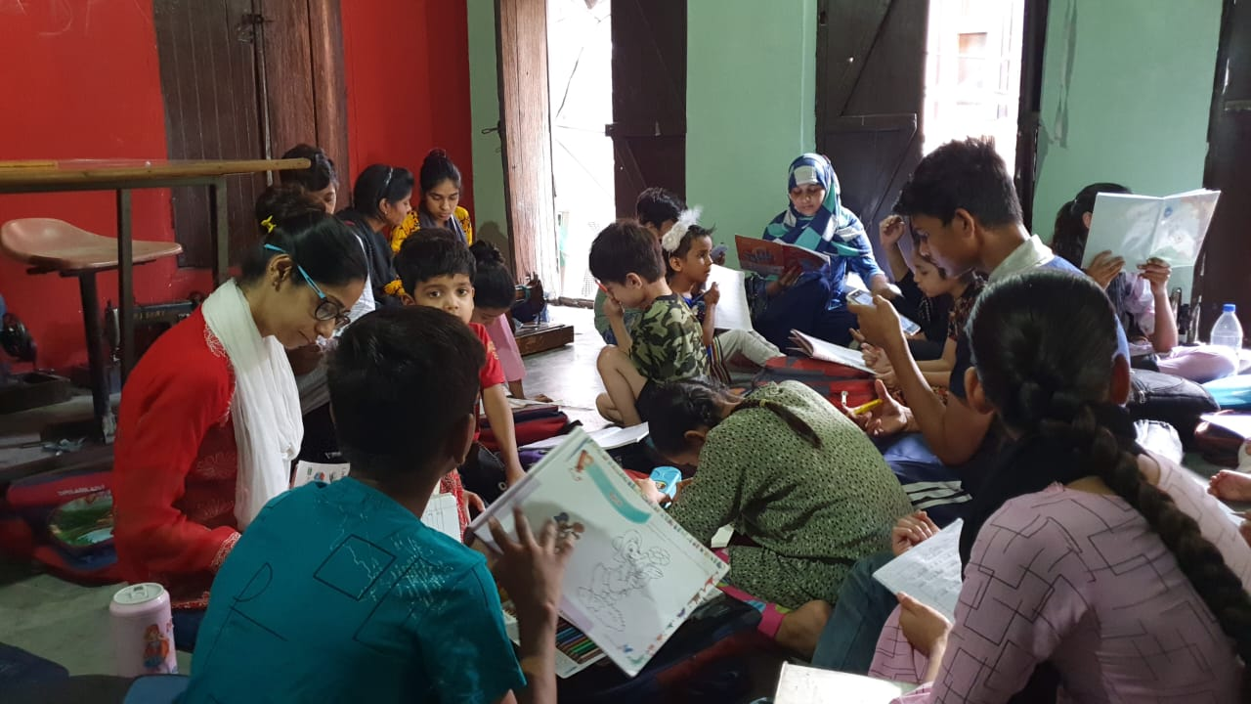
Recent photos from the Reading facilities in Saharanpur, UP

Slide 23
THANK-YOU

