Slide 1
Routing Architectures

Slide 2
Connection Blocks and Switch Blocks
LB
LB
Connection
Block
Switch
Block
Connection
Block
Switch
Block
LB
LB
Connection
Block
Switch
Block
Connection
Block
Switch
Block

Slide 3
Global vs. Detailed Routing View
Global (macroscopic) view:
Relative position of routing channels in relation to the positioning of logic blocks
How each channel connects to other channels
# of wires in each channel
LB
LB
Connection
Block
Switch
Block
Connection
Block
Switch
Block
LB
LB
Connection
Block
Switch
Block
Connection
Block
Switch
Block

Slide 4
Global vs. Detailed Routing View
Detailed (microscopic) view:
Lengths of the wires,
Specific switching quantity and patterns between and among wires and logic block pins
Single-driver vs. multiple-driver wires
→ wires that send signals in a specific direction
LB
LB
Connection
Block
Switch
Block
Connection
Block
Switch
Block
LB
LB
Connection
Block
Switch
Block
Connection
Block
Switch
Block

Slide 5
Global Routing Architecture
Global Routing Architectures:
Island-style
Hierarchical

Slide 6
Island-Style Architecture
Island-Style:
Logic blocks arranged in a 2D mesh with routing resources evenly distributed
Has routing channels on all four sides of the logic blocks
W: # of wires contained in a channel
pre-set during fabrication
one of the key choices made by the architect

Slide 7
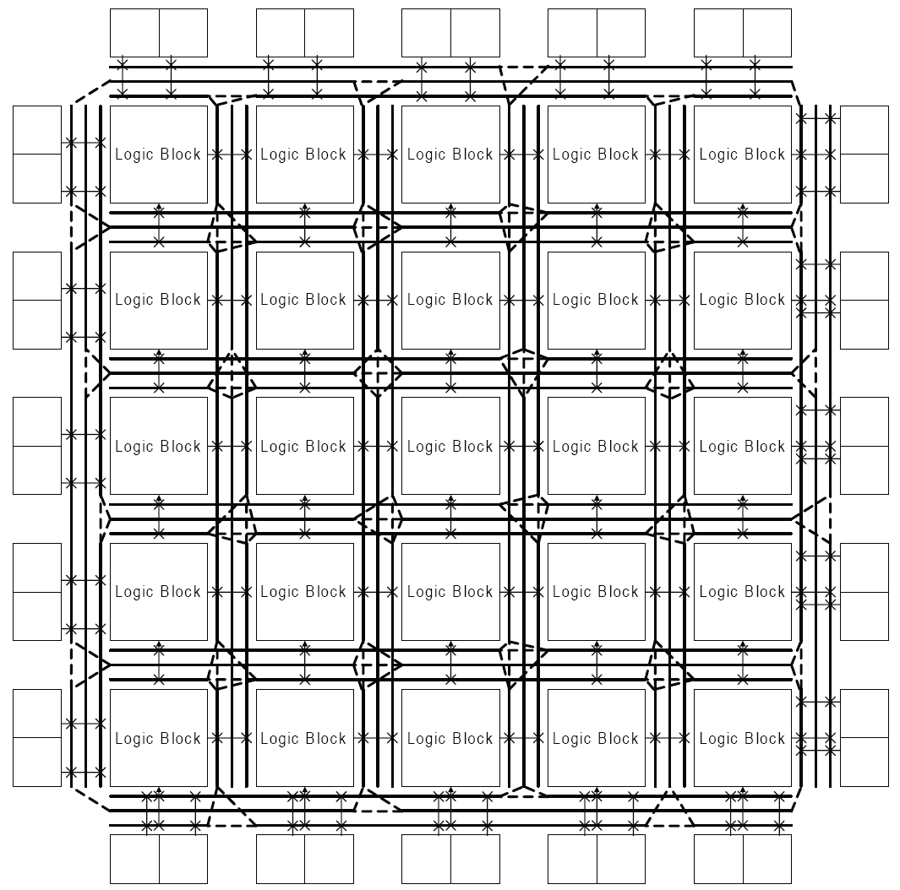
Island-Style Global Routing

Slide 8
Connection Blocks and Switch Blocks
LB
LB
Connection
Block
Switch
Block
Connection
Block
Switch
Block
LB
LB
Connection
Block
Switch
Block
Connection
Block
Switch
Block

Slide 9
Connection Architecture

Slide 10
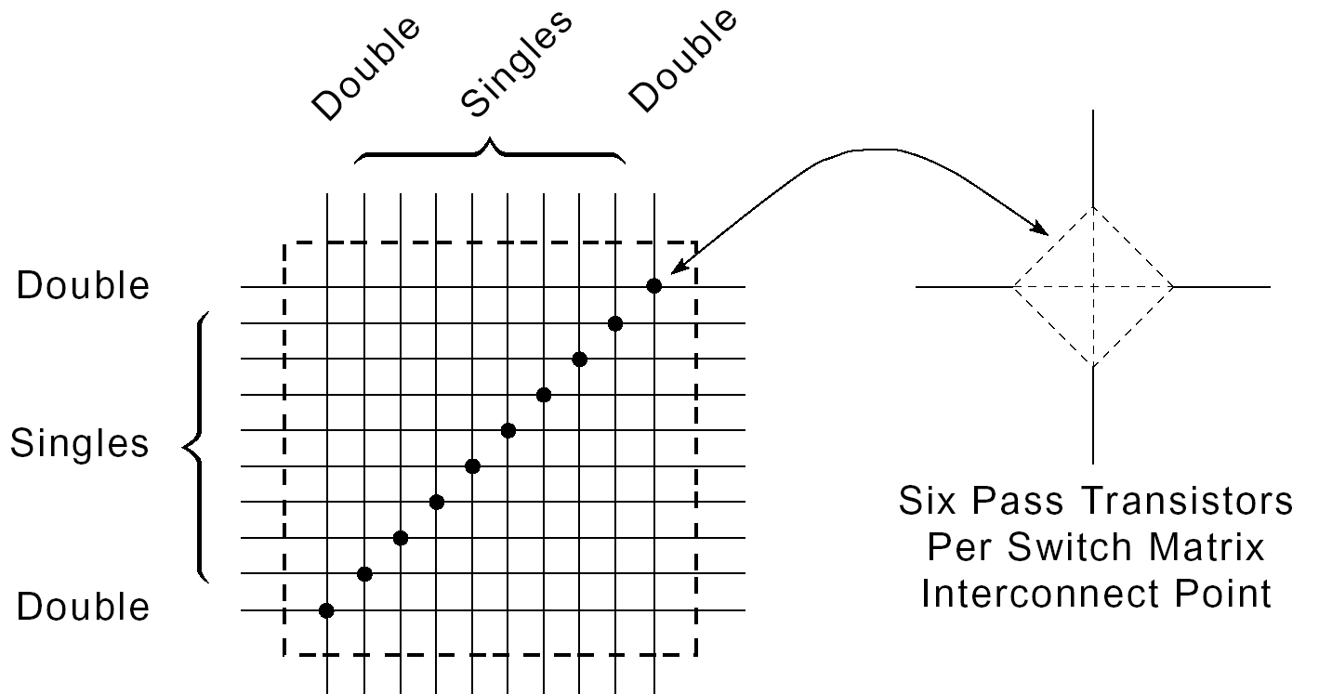
Programmable Switch Matrix (PSM)

Slide 11
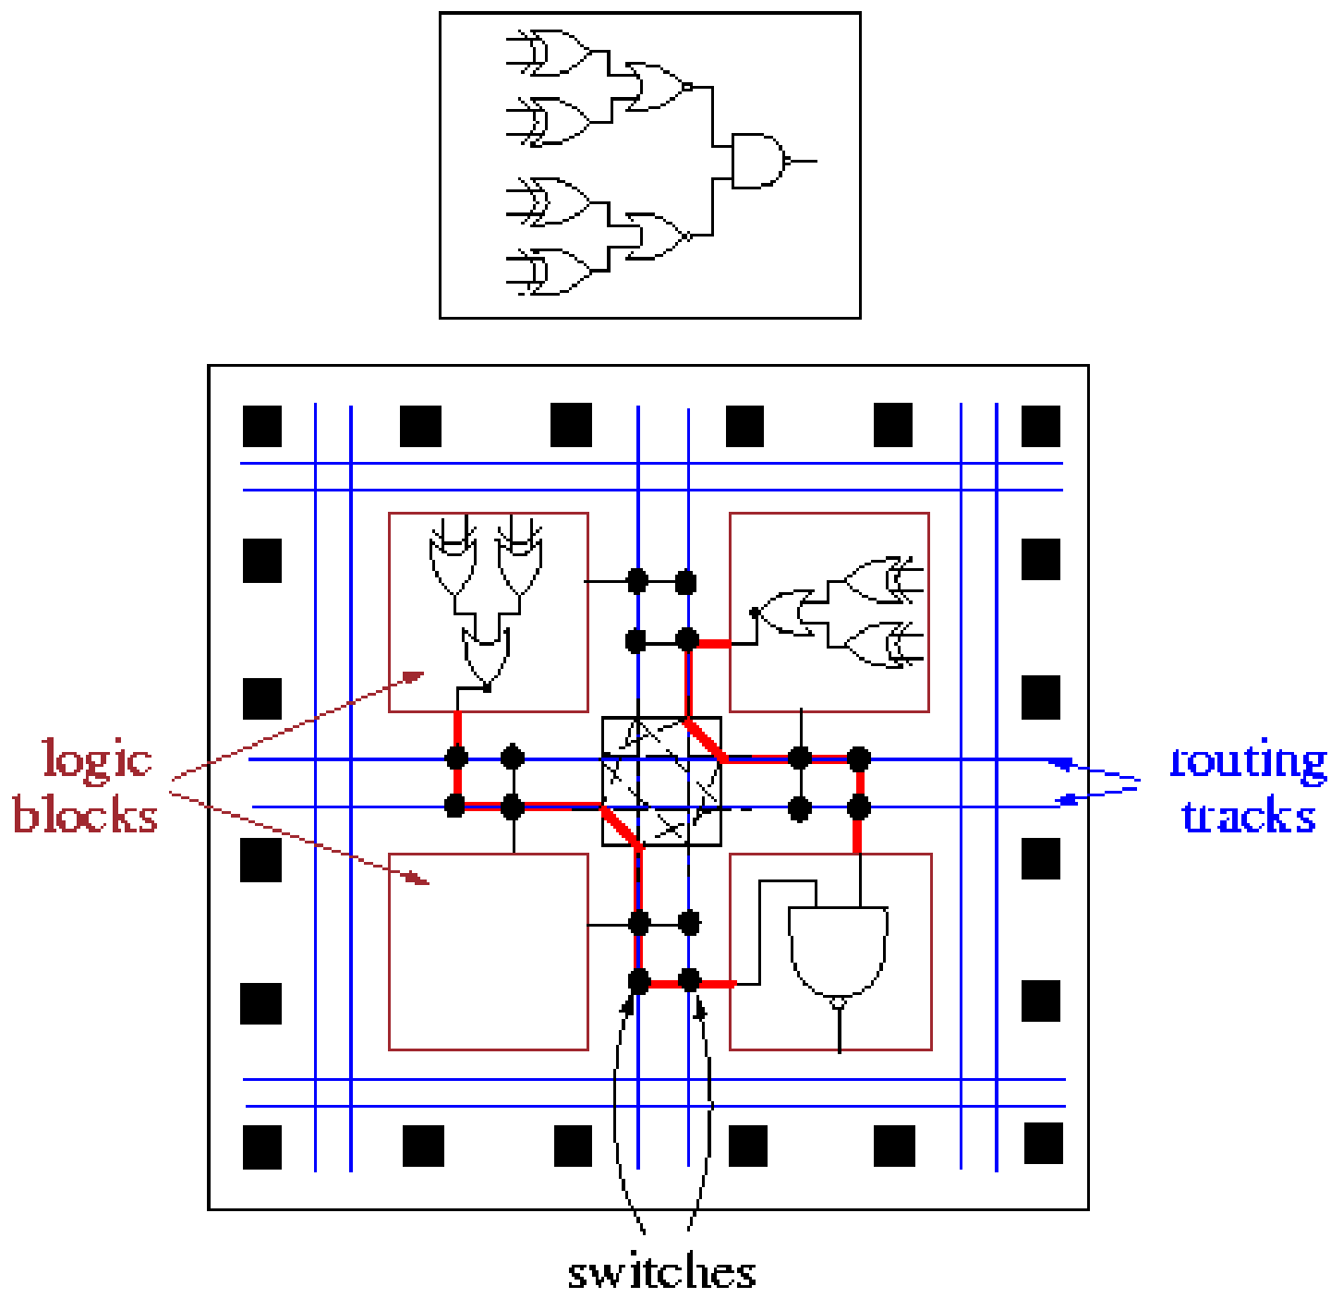
Field Programmable Gate Array (FPGA)

Slide 12
Global Routing Architecture
Hierarchical Architecture:
Logic blocks clustered in groups hierarchically
Connections between logic blocks within a group by wire segments at the lowest level
Connections between logic blocks in distant groups: traversal of one or more levels
Wider routing channels at levels furthest from the logic blocks
Like Freeways vs. streets

Slide 13
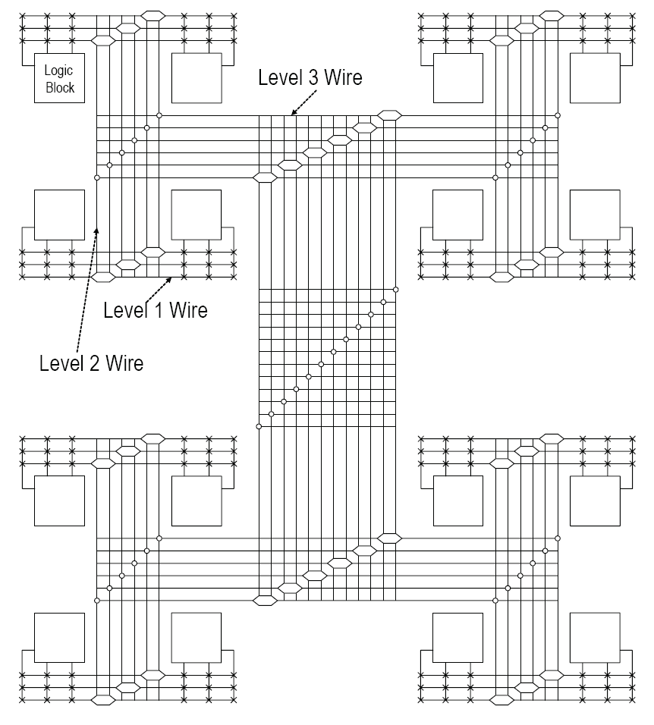
معماری اتصالات سلسله‌مراتبی
LB1
LB2
LB1.1
LB2.1
اتصال یک بلوک به بلوک دیگر:
عبور از حداکثر سه سطح سوییچ
ابزار جایابی LBهای متصل را در یک خوشه قرار می‌دهد
LB1.1.1
LB1.1.2
LB2.1.1
LB2.1.2
LB1.2
LB2.2
LB1.2.1
LB1.2.2
LB2.2.1
LB2.2.2
LB3
LB4
LB3.1
LB4.1
LB3.1.1
LB3.1.2
LB4.1.1
LB4.1.2
LB3.2
LB4.2
LB3.2.1
LB3.2.2
LB4.2.1
LB4.2.2

Slide 14
معماری اتصالات سلسله‌مراتبی
LB1
LB2
LB1.1
LB2.1
LB1.1.1
LB1.1.2
LB2.1.1
LB2.1.2
LB1.2
LB2.2
LB1.2.1
LB1.2.2
LB2.2.1
LB2.2.2
LB3
LB4
LB3.1
LB4.1
LB3.1.1
LB3.1.2
LB4.1.1
LB4.1.2
LB3.2
LB4.2
LB3.2.1
LB3.2.2
LB4.2.1
LB4.2.2
LB
LB1
LB1.1
LB1.2.1
LB2
LB2.1
LB3
LB3.1
LB3.2
LB4
LB4.1
LB4.1.1
LB1.2
LB1.1.1
LB1.1.2
LB1.2.2
LB2.1.1
LB2.1.2
LB3.1.1
LB3.1.2
LB3.2.1
LB2.2
LB2.2.1
LB2.2.2
LB3.2.2
LB4.1.2
LB4.2
LB4.2.1
LB4.2.2

Slide 15
Hierarchical Routing Architecture
Advantages:
More predictable inter-logic block delay following design placement
If interconnect delay is not significant, maximum delay is almost equal for all connections.
Superior performance for some logic designs
Disadvantages:
Each level of the hierarchy: a hard boundary
Once traversed → significant delay penalty
Physically close logic blocks but apart with respect to the hierarchy
In newer technologies, significant wire delay
→ Many recent commercial FPGAs: Two or three levels of hierarchy

Slide 16
Island-Style Architectures
Commercial FPGAs: Island-style with 2-level hierarchy (most new devices):
Lattice LatticeXP
Xilinx Spartan & Virtex family
Intel Stratix & Cyclone family

Slide 17
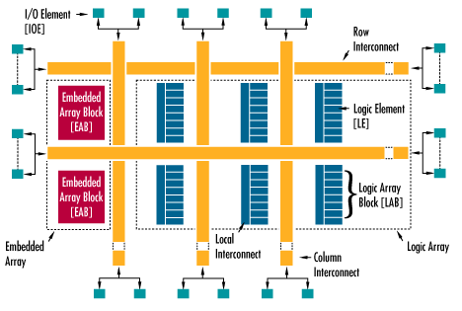
Intel Cyclone
M9K
Memory
M9K
Memory

Slide 18
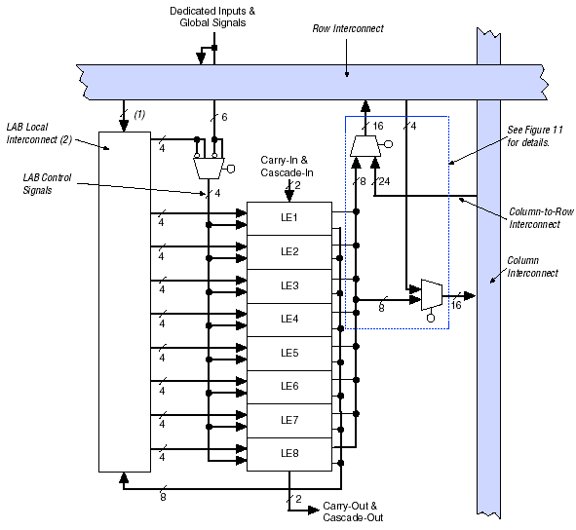
Intel Cyclone

Slide 19
Spartan CLB

Slide 20
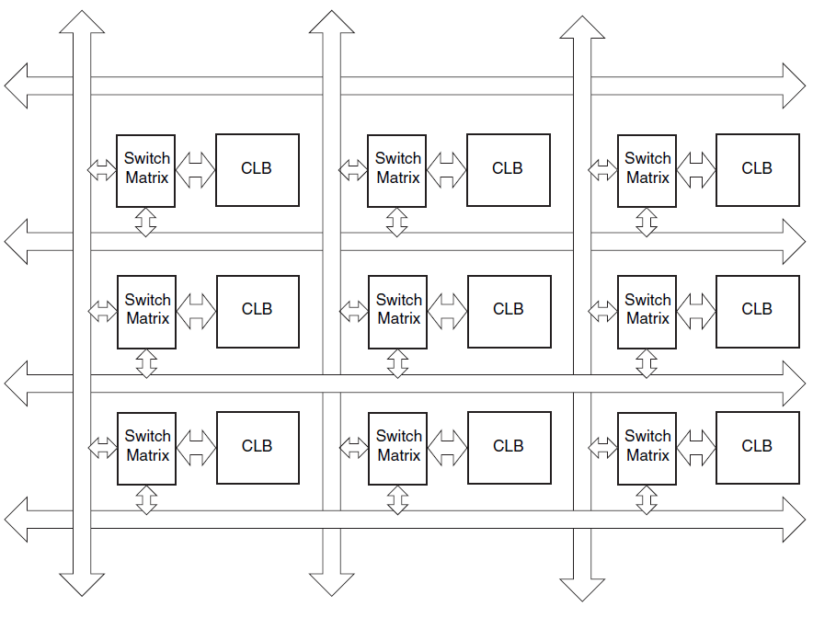
معماری اتصالات

Slide 21
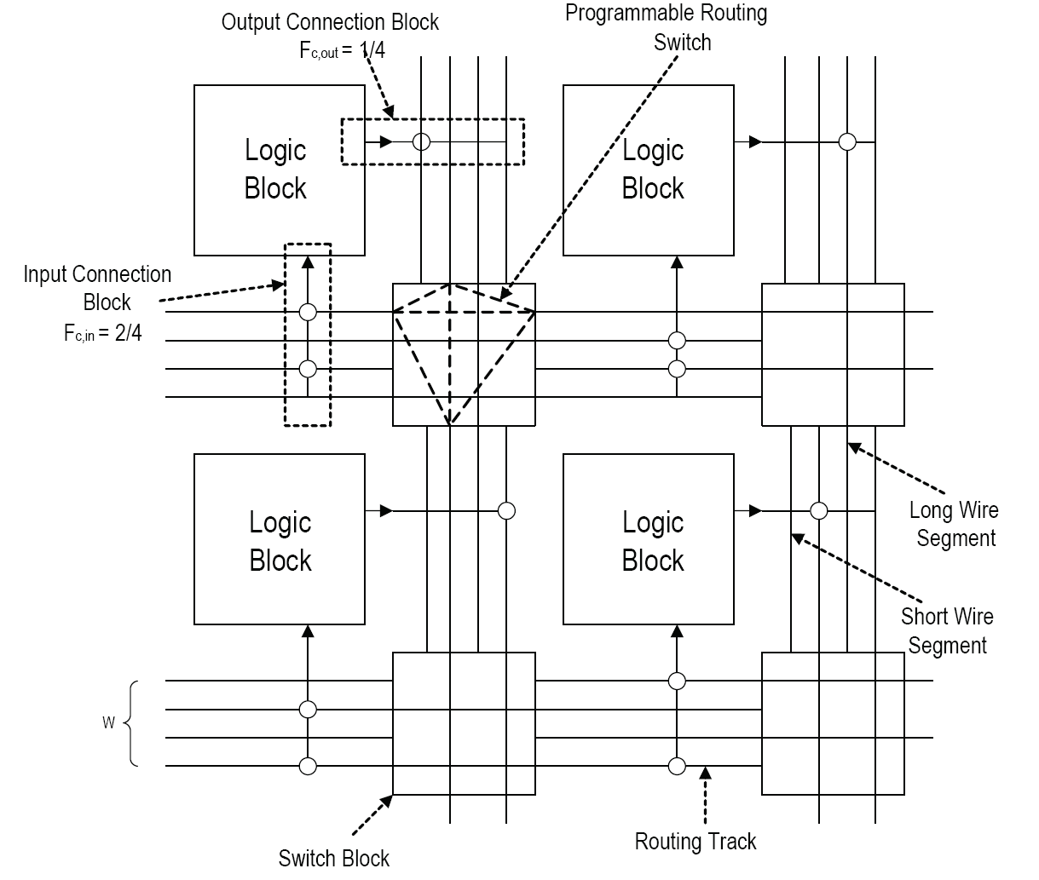
Connection Block
F_{c,in}
Input connection block flexibility
F_{c,out}
Output connection block flexibility

Slide 22
Connection Block
F_{c,in}
Input connection block flexibility
F_{c,out}
Output connection block flexibility

Slide 23
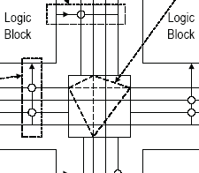
Switch Block
Switch Blocks:
Form connections between wire segments at intersections of a horizontal and vertical channel.
F_{s}:
Switch block flexibility:
# of possible connections a wire segment can make to other wire segments
F_{s} = ?

Slide 24
Programmable Switch Matrix (PSM)

Slide 25
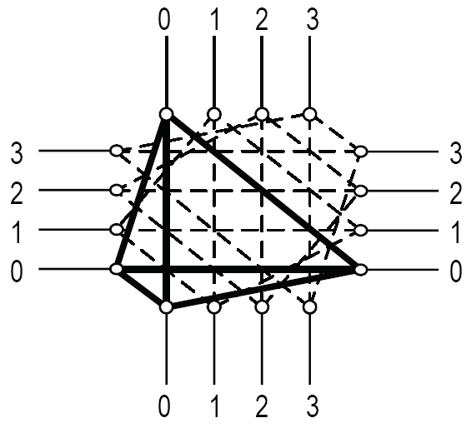
Disjoint vs. Wilton Switch Blocks
Disjoint:
A wire entering a disjoint switch block to other wires with the same number
→ Potential source–destination routes: isolated into distinct routing domains
→ limiting routing flexibility.

Slide 26
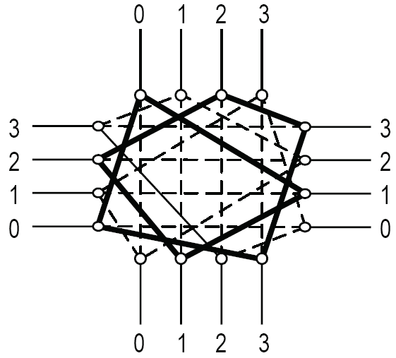
Disjoint vs. Wilton Switch Blocks
Wilton:
Uses the same number of routing switches
overcoming domain issue → can change domain
Greater diversity of routing paths from a net source to a destination

Slide 27
Multiple Block Length Wire Segments
A wire runs for L logic blocks:
LB
LB
LB
LB
switch
switch
switch
L=1
switch
switch
L=2
switch
switch
L=3

Slide 28
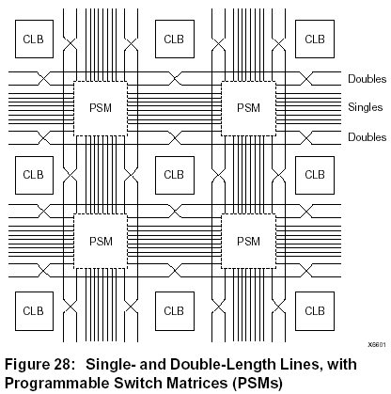
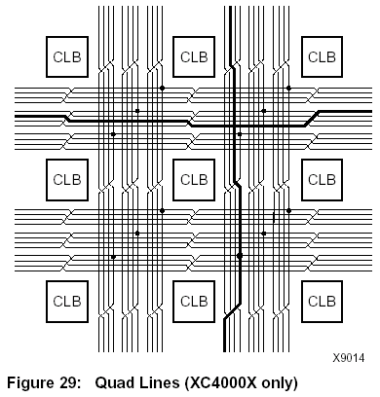
Multiple Block Length Wire Segments
Example:
40% of tracks: length 1
40%: length 2
20%: length 4

Slide 29
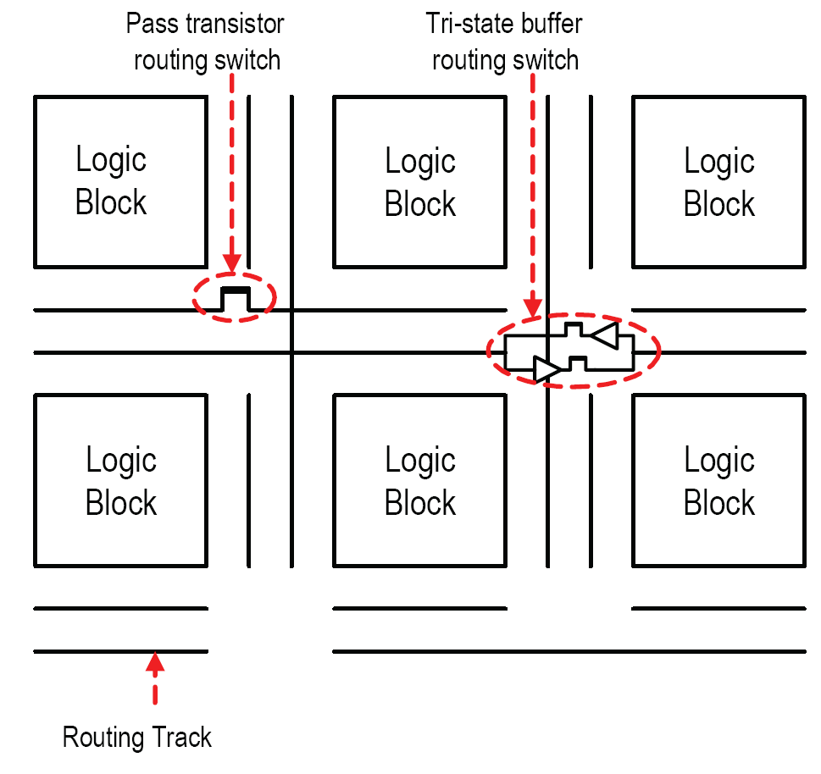
Routing Switches
Bidirectional switches:
Pass transistors:
Less area
Fast for short wiring paths (passing through a small number of switches)
Buffers:
Faster for connections passing through many switches
→ Mixed PT and tri-state buffers:
better delay characteristics with the same area

Slide 30
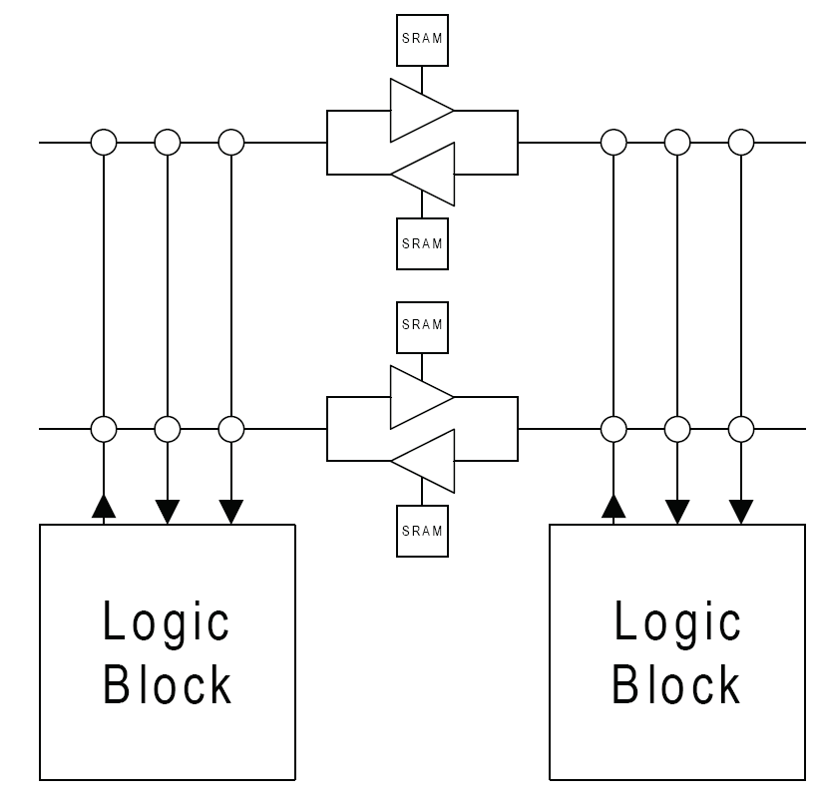
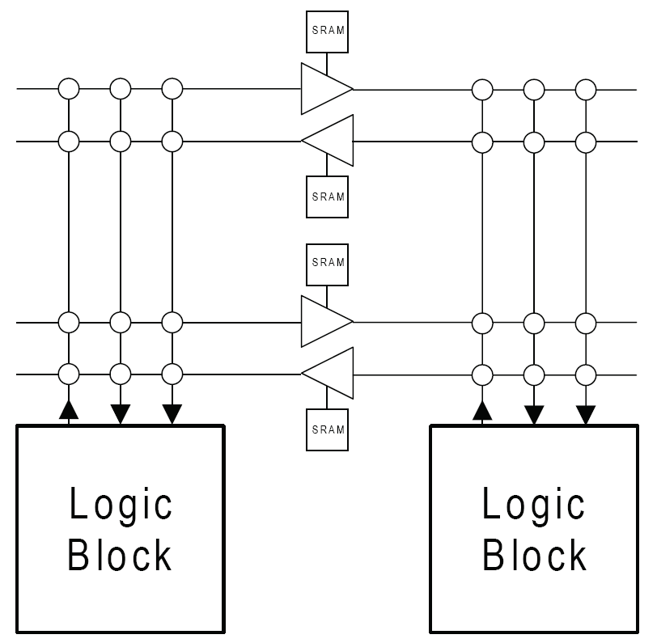
Unidirectional Switches
Bidirectional wire segments:
Can be driven by switch blocks on both ends.
[Lemieux04]: Once programmed, leaves 50% of switches inactive (unused)
Extra sinks → more capacitance → delay
Directional wire segments:
[Lemieux04]: halves the required tri-state buffers per switch

Slide 31

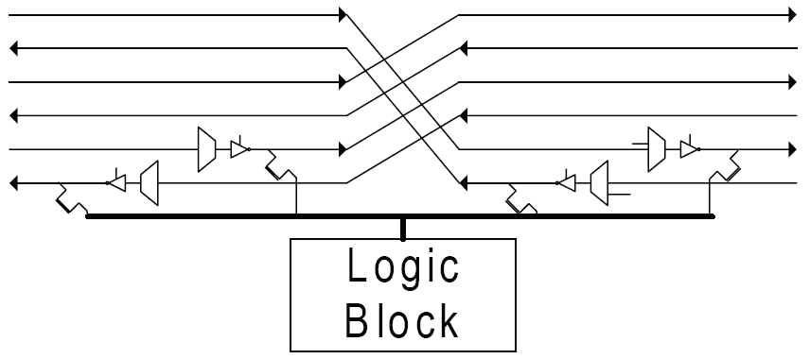
Unidirectional Switch Options
Directional tri-state (dir-tri):
Multiple driver:
Each wire segment is driven by:
adjacent wire segments
one or more LB output pins (via a PT)

Slide 32
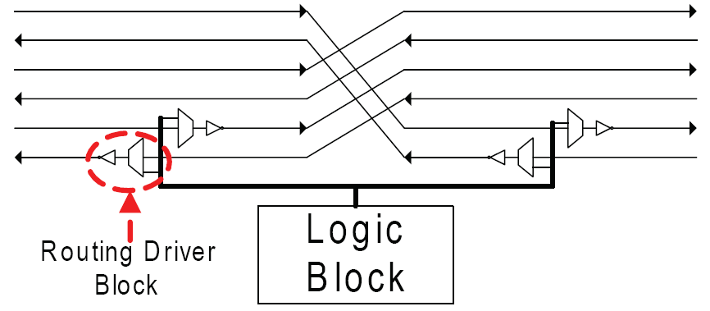
Unidirectional Switch Options
Single-driver:
A multiplexer selects inputs from both wire segment and logic block sources.
Each wire segment can be driven by a non-tri-state buffer
Improved drive strength
100% single-driver always gave the best results for area and delay.

Slide 33
Research in Routing Architecture Design

Slide 34
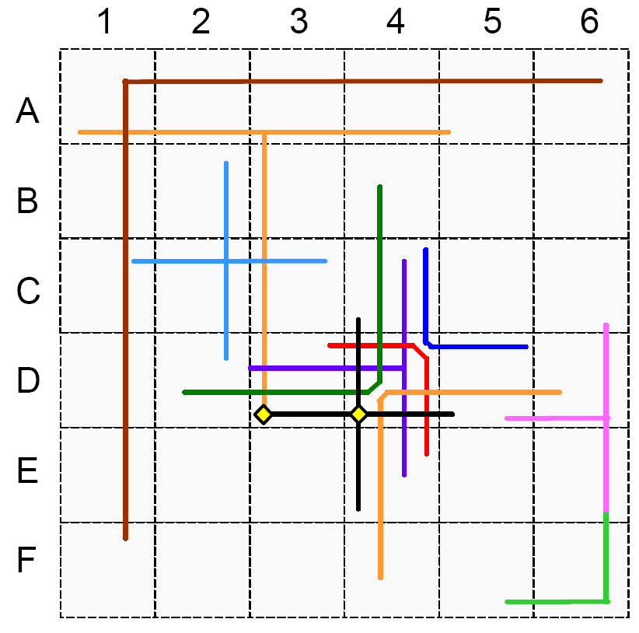
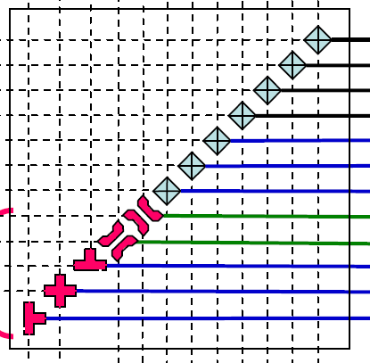
More Recent Routing Improvements
HARP: Hardwired Routing Patterns [Wang06]:
Junction patterns: L, T, +

Slide 35
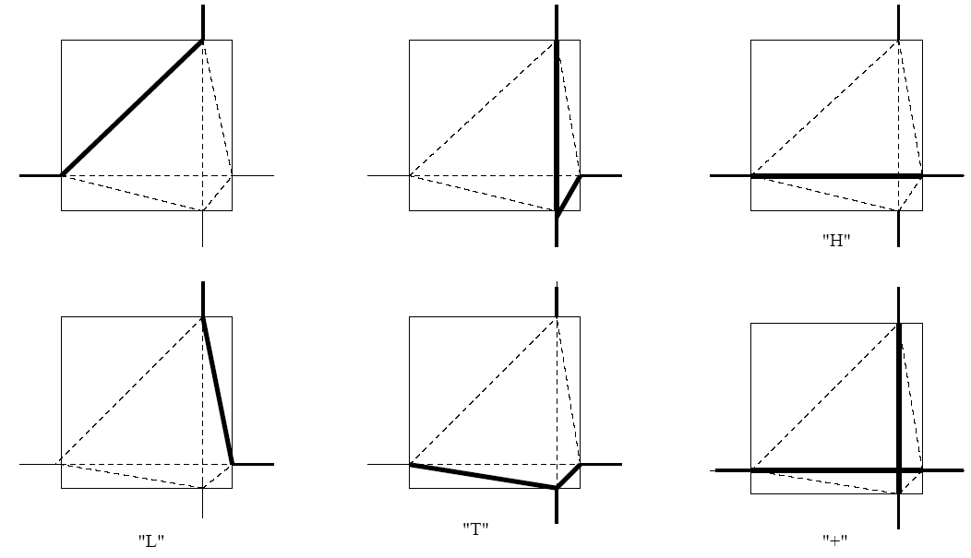
HARP Patterns
Some hard-wired patterns

Slide 36
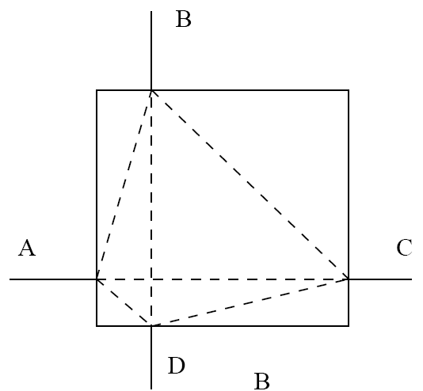
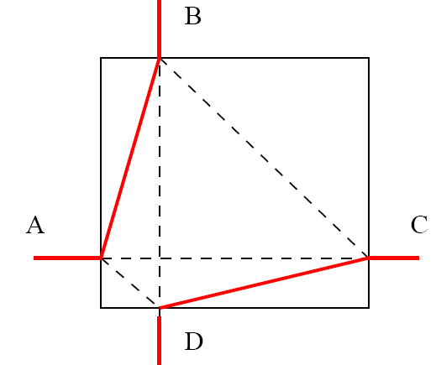
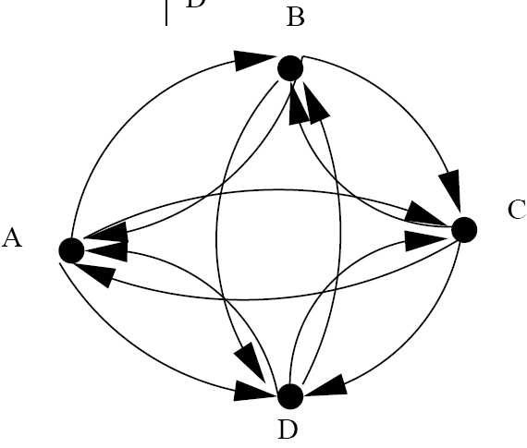
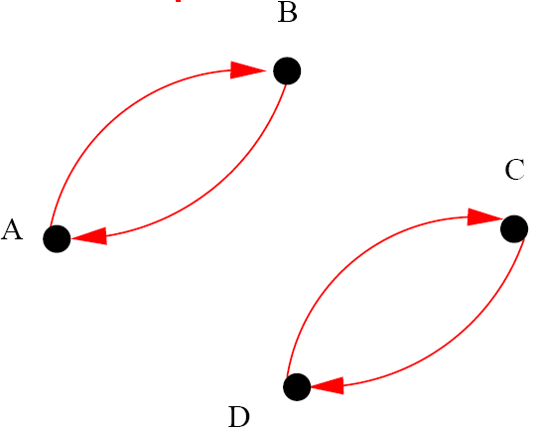
Routing Graphs
In Virtex 5, diagonal wires are used

Slide 37
HARP Research Procedure
Routing requirement analysis:
A number of circuits were placed and routed on traditional FPGA architectures,
Routing patterns that were formed in the switch boxes are analyzed.
HARP architecture generation:
Based on the frequencies of the patterns, HARP patterns were instantiated and replaced some switches.
Placement and routing with HARPs:
Place and route circuits on the new HARP architecture.

Slide 38
Performance Scaling
Effect of architectural innovations on performance:
Longer wires span multiple logic blocks
→ Making distant logic closer
HARP
Double/quad-length
2-level hierarchy
[Trimberger15]

Slide 39
Power Consumption

Slide 40
Power Consumption
Power Consumption:
Dynamic Power:
P_{d} = k.C_{L.}V_{dd}².f
Leakage Power:
Much of the interconnect resources within the FPGA are not actively used.
60%–70% of FPGA dynamic and static power consumption: in programmable interconnect

Slide 41
Power Consumption
Power Consumption:
Dynamic Power:
P_{d} = k.C_{L.}V_{dd}².f
Leakage Power:
Much of the interconnect resources within the FPGA are not actively used.
Components:
Source-to-drain subthreshold leakage
Gate-to-source gate oxide leakage
60%–70% of FPGA dynamic and static power consumption is located in the programmable interconnect.

Slide 42
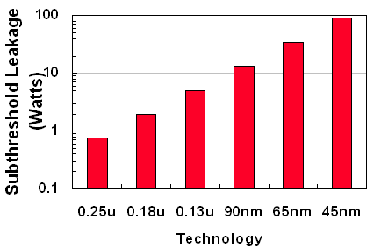
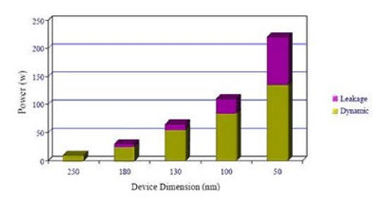
Leakage Power
Power Consumption:
Leakage Power

Slide 43
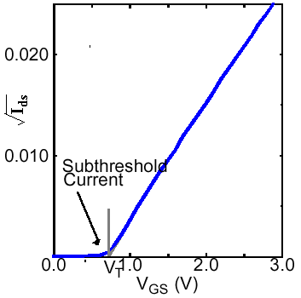
Sub-threshold Current
At V_{gs} = V_{t} (and a little before), I_{ds} > 0 (sunthreshold region)
Must reduce V_{gs} still more to cut-off the channel
I_{sub} ≈ 10⁻¹⁰ A @ V_{gs} = 0
I_{sub} ≈ 10⁻⁵ A @ V_{gs} = V_{t}
increases exponentially

Slide 44
Gate Oxide Leakage
Gate oxide leakage:
Electron tunneling as the transistor gate oxide is thinned
→ Leakage current increase exponentially with oxide thinning

Slide 45
Leakage Power
Reason for increase in Leakage:
V_{dd}: reduced with scaling
V_{th} must be lowered to recover switching speed
→ Subthreshold leakage current increases exponentially
Oxide thinning continued

Slide 46
Power Reduction
Power reduction techniques in general:
Removing V_{DD} from unused transistors:
→ Leakage power reduction
Reduce V_{DD} for some transistors:
→ Dynamic power reduced a lot
Multi-supply voltage (MSV) :
high voltage on critical paths to maintain performance
low voltage on non-critical paths to reduce power

Slide 47
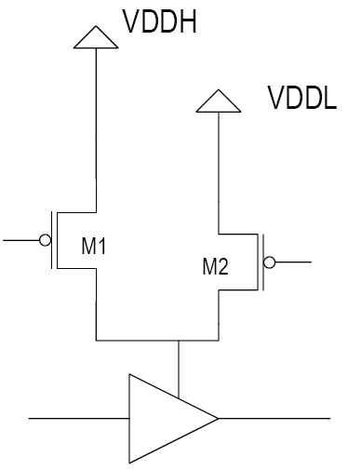
Power Reduction in FPGA
Power reduction techniques in FPGAs:
Drive each routing buffer by two separate sources [Li04]:
A full-rail V_{DD} (V_{DDH})
A reduced V_{DD} (V_{DDL}).
→ 3 cases:
high-performance (M1 active),
reduced performance (M2 active),
sleep mode (both shut off)

Slide 48
Power Reduction in FPGA
Experiments:
88% of interconnect buffers could be placed into sleep mode
85% of active routing buffers could be driven with V_{DDL} without increasing circuit delay.
→ 80% overall reduction in interconnect leakage
→38% reduction in interconnect dynamic power

Slide 49
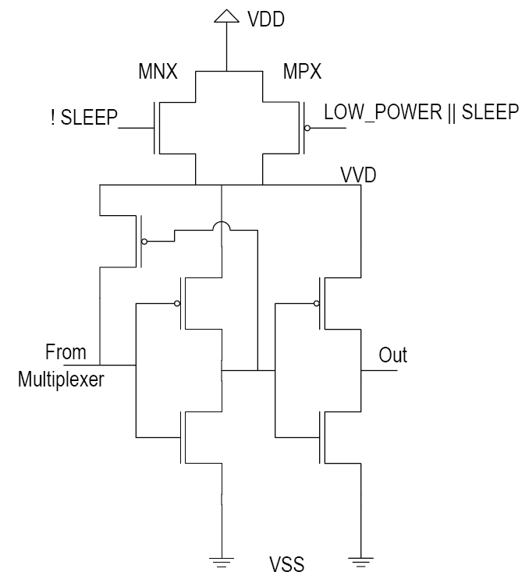
Power Reduction in FPGA
Problem:
requires the chip-wide distribution of multiple V_{DD} values
Solution:
V_{DD}-selection approach for routing buffers [Anderson04]
3 cases:
SLEEP = ‘1’, LOWPOWER = ‘0’
SLEEP = ‘0’; LOWPOWER = ‘1
SLEEP = ‘0’, LOWPOWER = ‘0’

Slide 50
Power Reduction in FPGA
Problem:
requires the chip-wide distribution of multiple V_{DD} values
Solution:
V_{DD}-selection approach for routing buffers [Anderson04]
3 cases:
SLEEP = ‘1’, LOWPOWER = ‘0’
Both off → sleep mode
SLEEP = ‘0’; LOWPOWER = ‘1
MNX on:
V_{VD} = V_{DD} – V_{t}
→ Weak supply
→ Low power mode
SLEEP = ‘0’, LOWPOWER = ‘0’
Both on:
V_{VD} = V_{DD}
→ Buffer in high-performance mode

Slide 51
Power Reduction in FPGA
Experiments:
75% of routing resources could tolerate a slowdown of 50% (70 nm process)
→ Leakage power reduction (including effects of the new transistors): about 35%
when operating in low-power mode (i.e., MPX off, MNX on)
Area increase: ~ 10%

Slide 52
MTCMOS in FPGAs
Dual Threshold Technique
Use low threshold transistor along critical paths
→ Optimize performance
Use high threshold transistor along non-critical paths
Minimize leakage
[Gayasen04],[Li04]
High V_{t} transistors to implement configuration SRAM bits
Not subsequently read
→ Performance: not an issue.

Slide 53
Power Reduction in FPGA
Body biasing for unused interconnect transistors:
→ Adaptive V_{t}
→ Reduce sub-threshold leakage
Disadvantages:
Needs multi-well process → area
Needs a circuit to control bias voltages
Experiments [Rahman04]:
Area increase: 1.6X to 2X,
Leakage current reduction: 1.7X to 2.5X

Slide 54
Power Reduction in FPGA
In commercial FPGAs:
High V_{t} transistors for configuration SRAM bits
Thicker oxides to reduce the leakage of the devices which are not performance critical
Xilinx, “Power consumption in 65 nm FPGAs, Xilinx White Paper WP246 (v1.2),”http://www.xilinx.com/support/documentation/white papers/wp246.pdf, February 2007.
Altera Corporation, “Stratix III FPGAs vs. Xilinx Virtex-5 devices: Architecture and performance comparison, Altera White Paper WP-01007-2.1,”http://www.altera.com/literature/wp/wp-01007.pdf, October 2007.

Slide 55
Power Reduction in FPGA
In commercial FPGAs:
Speed/power grades:
Kintex Ultrascale:
Grade -1, -1L:
lowest power, lowest speed
Can both work with 0.95 v
Grade -1: can work with 0.9 v
Grade -2, -3:
High performance (-3 highest)

Slide 56
References
م. صاحب‌الزمانی، طراحی کامپیوتری سیستم‌های دیجیتال، نشر شیخ بهایی، 1398
[Kuon07] I. Kuon, R. Tessier, “FPGA Architecture: Survey and Challenges,” Foundations and Trends in Electronic Design Automation, Vol. 2, No. 2 (2007) 135–253.
[Xilinx/AMD] www.xilinx.com – www.amd.com
[Altera/Intel] www.altera.com - www.intel.com
[Lemieux04] G. Lemieux, E. Lee, M. Tom, and A. Yu, “Directional and single-driver wires in FPGA interconnect,” in Proceedings: International Conference on Field-Programmable Technology, pp. 41–48, December 2004.
[Wang06] G. Wang, S. Sivaswamy, C. Ababei, K. Bazargan, R. Kastner, and E. Bozorgzadeh, “Statistical Analysis and Design of HARP Routing Pattern FPGAs,” Transactions on Computer-Aided Design of Integrated Circuits and Systems (TCAD), pp. 2088-2102, Vol. 25, No. 10, 2006.

Slide 57
References
[Li04] F. Li, Y. Lin, and L. He, “Vdd programmability to reduce FPGA interconnect power,” in IEEE/ACM International Conference on Computer Aided Design, 2004.
[Anderson04] J. Anderson and F. Najm, “A novel low-power FPGA routing switch,” in Proceedings of the IEEE Custom Integrated Circuits Conference, pp. 719–722, October 2004.
[Gayasen04] A. Gayasen, K. Lee, N. Vijaykrishnan, M. Kandemir, M. J. Irwin, and T. Tuan, “A dual-VDD low power FPGA architecture,” in Proceedings of the International Conference on Field-Programmable Logic and Applications, pp. 145–157, August 2004.

