Slide 1
Architecture Design Methodology

Slide 2
Aspects of an Experimental Flow
Design Entry
Verification & Analysis
Synthesis & Packing
Verification & Analysis
Placement
Verification & Analysis
Routing
Verification & Analysis
Configuration Bitstream

Slide 3
چرخة طراحی
سنتز:
تولید مدار
فلیپ فلاپ‌ها + معادلات بولین مدارهای ترکیبی
نگاشت فناوری (technology mapping)
تبدیل معادلات بولین به منابع سخت‌افزاری موجود در تکنولوژی (FPGA)
بهینه‌سازی مدار

Slide 4
سنتز و نگاشت فناوری
خروجی سنتز:
نت لیست مدار بر حسب اجزای موجود در تراشه
چه اجزایی و نحوة اتصال آنها (به هم و به پورت‌ها)

Slide 5
خروجی ابزار سنتز (مثال)
T₁ = 1
T₂ = z₁.z₄’
T₃ = z₁.z₂
T₄ = z₁.z₄ + z₁.z₂.z₃

Slide 6
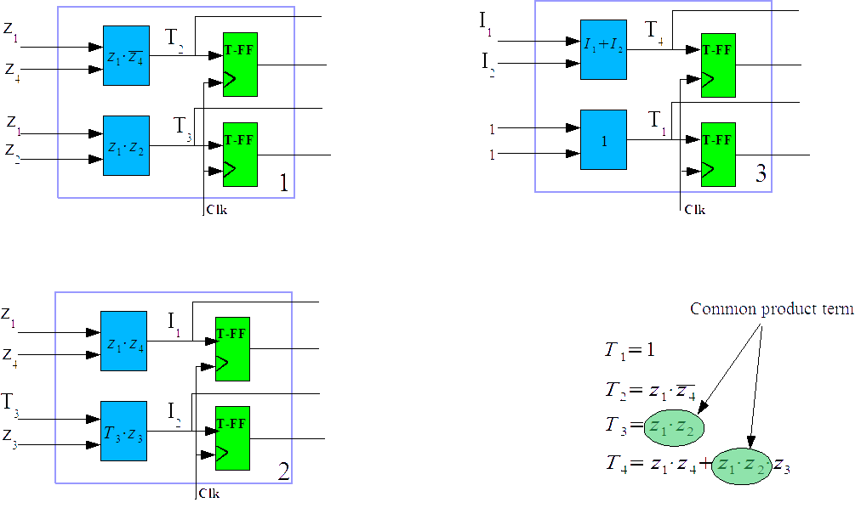
خروجی ابزار سنتز

Slide 7
چرخة طراحی
Design Entry
جایابی (placement):
اختصاص محل به اجزای مدار
تخصیص بلوک‌های منطقی به اجزای مدار
تلاش برای چیدمان بهینه
Simulation
Synthesis
Simulation
Place & Route
Simulation
Configuration Bitstream

Slide 8
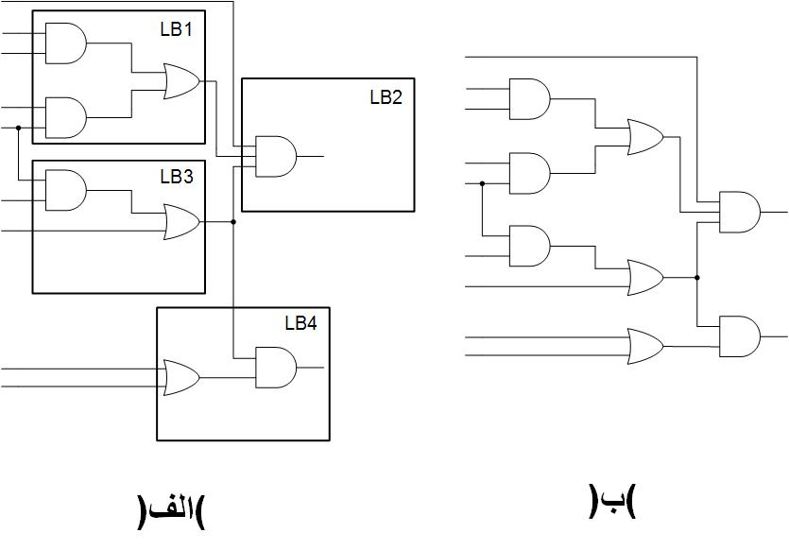
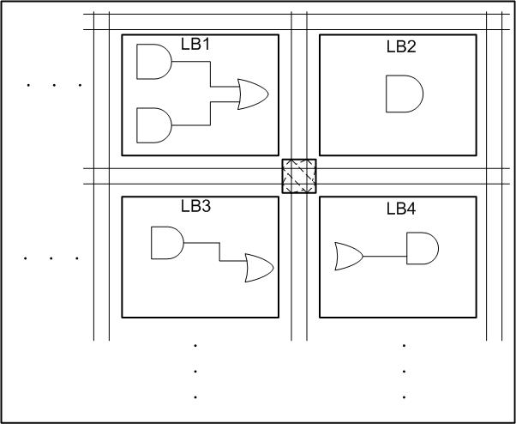
چرخة طراحی
جایابی (placement):

Slide 9
چرخة طراحی
مسیریابی (routing):
تعیین مسیر برای اتصالات
تعیین قطع یا وصل بودن سوییچ‌ها
تلاش برای تکمیل مسیریابی همة اتصالات

Slide 10
Architecture Design Methodology
The effects of architecture design on metrics:
Area (cost)
Performance
Power
Target market:
A set of application circuits to be attempted

Slide 11
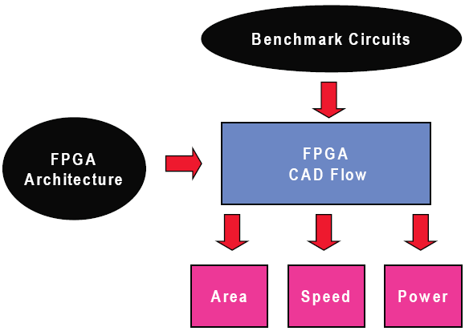
Methodology

Slide 12
Aspects of an Experimental Flow
The depth of the CAD flow:
The deeper the CAD flow, the more precise and believable the results.
More effort and computation time
The quality of the CAD tools used:
→Use the best tools
Low-quality tools → misleading architectural results
The set of benchmark circuits used:
How representative the benchmark circuits are w.r.t. typical circuits.
The quality of the models and algorithms in analysis tools:
Simple or accurate models/algorithms?

Slide 13
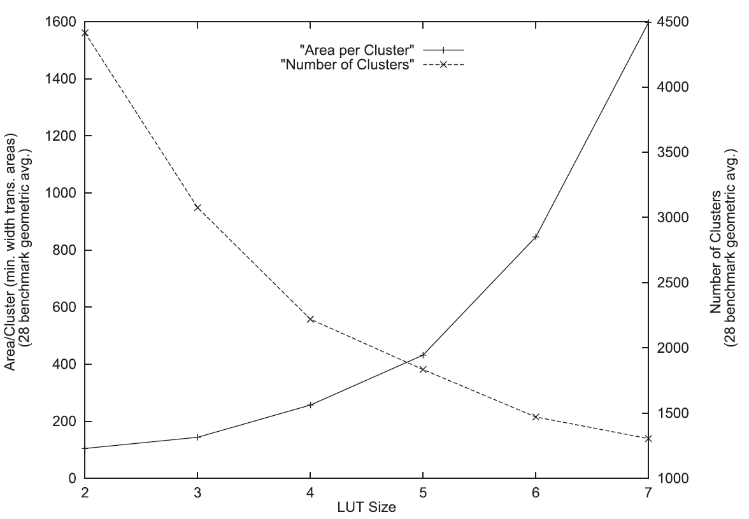
Example
Area-granularity experiment:

Slide 14
Example
Observations:
As the LUT size (K) increases, the number of LUTs required to implement the circuits significantly decreases.
The area required for each block increases significantly.
Justification for area increase:
# of transistors in the LUT increases.
# of programming bits in a K-input lookup table is 2^{K}.
# of pins connecting into the logic block increases.
→ # of routing tracks surrounding the logic required for successful routing increases.

Slide 15
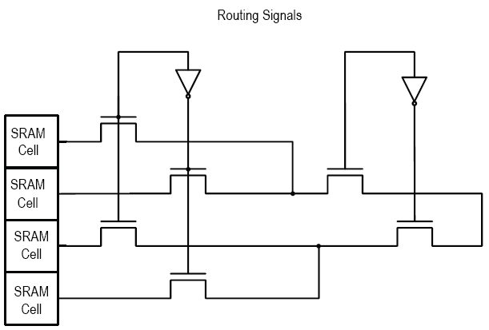
LUT Structure

Slide 16
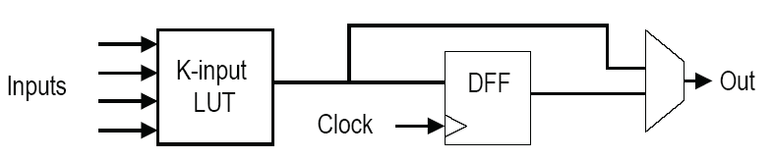
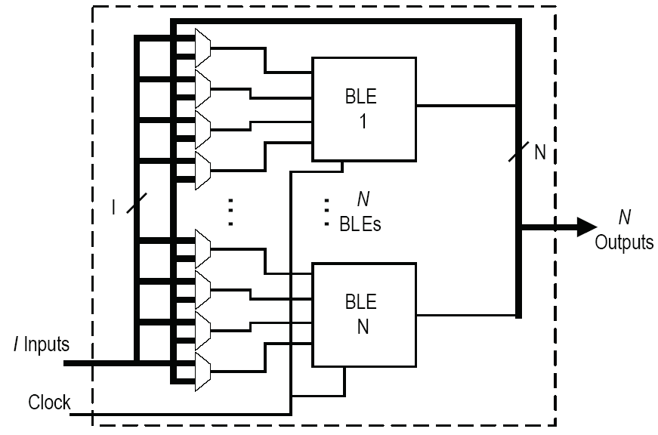
Hierarchical Structure
- Instead of growing LUT size: Hierarchical
- Commonly used in most industrial FPGAs
Basic Logic Element (BLE)
Local interconnect
Logic Cluster

Slide 17
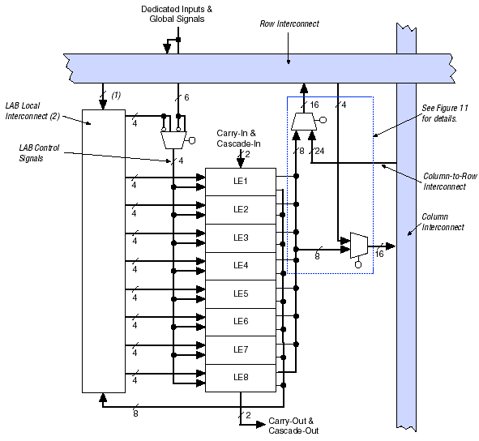
Intel Cyclone

Slide 18
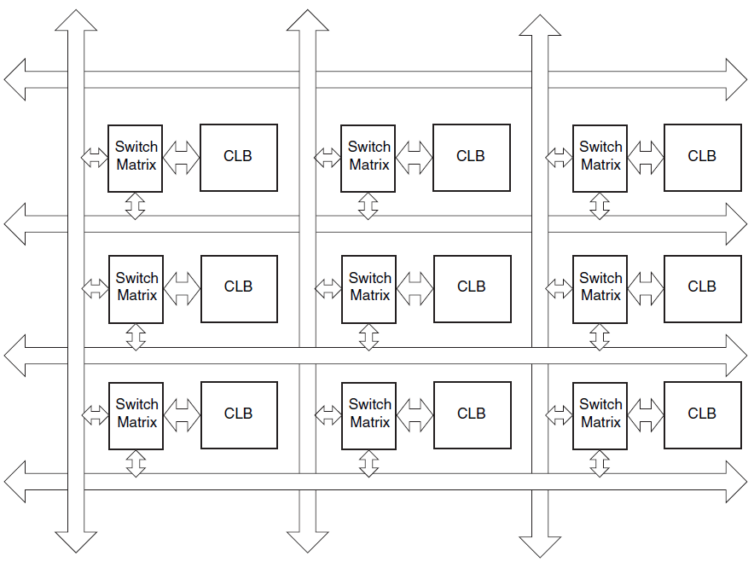
معماری اتصالات

Slide 19
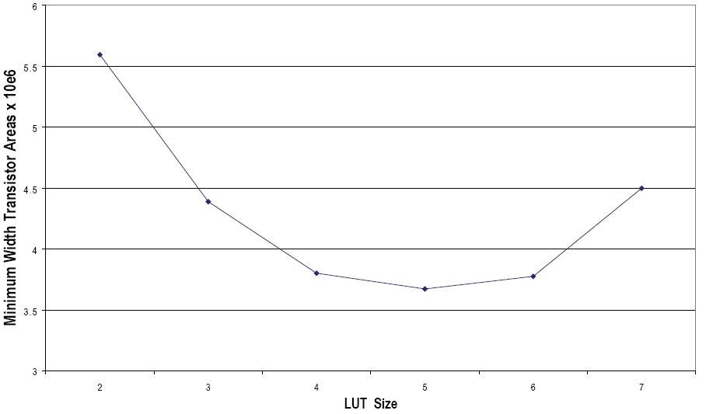
Example
Product of two curves:
Total area.

Slide 20
Speed Trade-Offs
Increase in functionality of the logic block
→ Its internal delay increases
→Fewer logic blocks are used on the critical path
→ Fewer logic levels needed
→ Higher overall speed

Slide 21
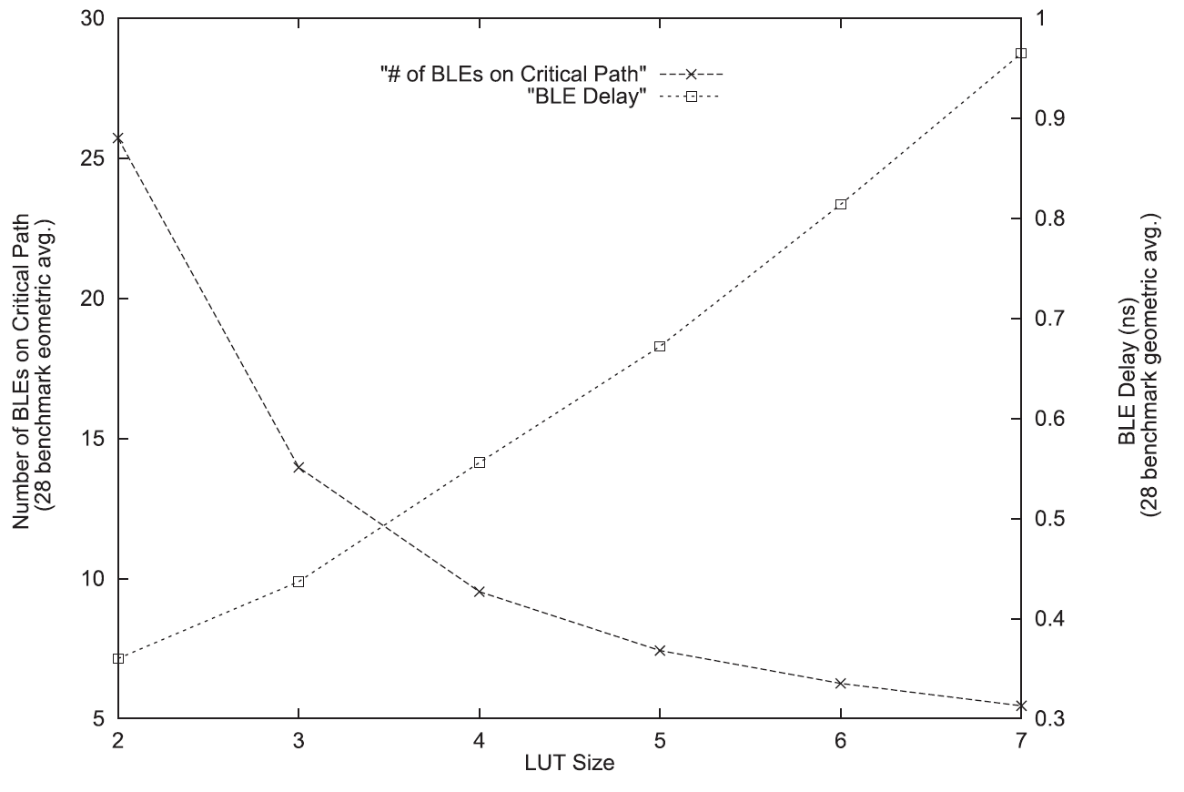
Speed Trade-Offs
[Ahmed06]
BLE = LUT in this figure

Slide 22
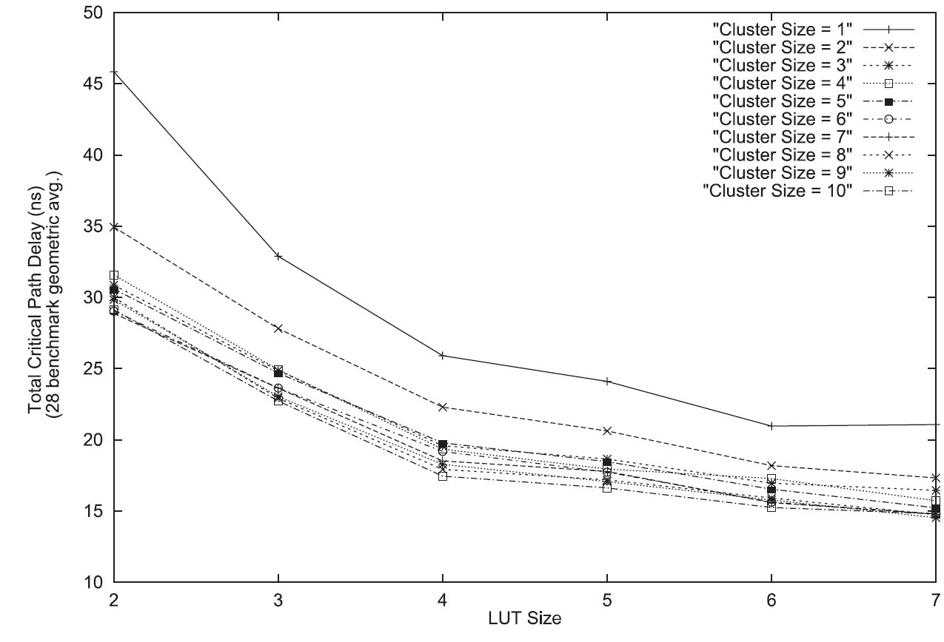
Speed Trade-Offs
Total FPGA delay as a function of LUT size includes the routing delay
Recent trends in commercial architectures: larger LUT sizes to capture these gains:
Intel Stratix III, IV, V, 10
Xilinx Virtex 5, 6, 7

Slide 23
Virtex 5, Virtex 6

Slide 24
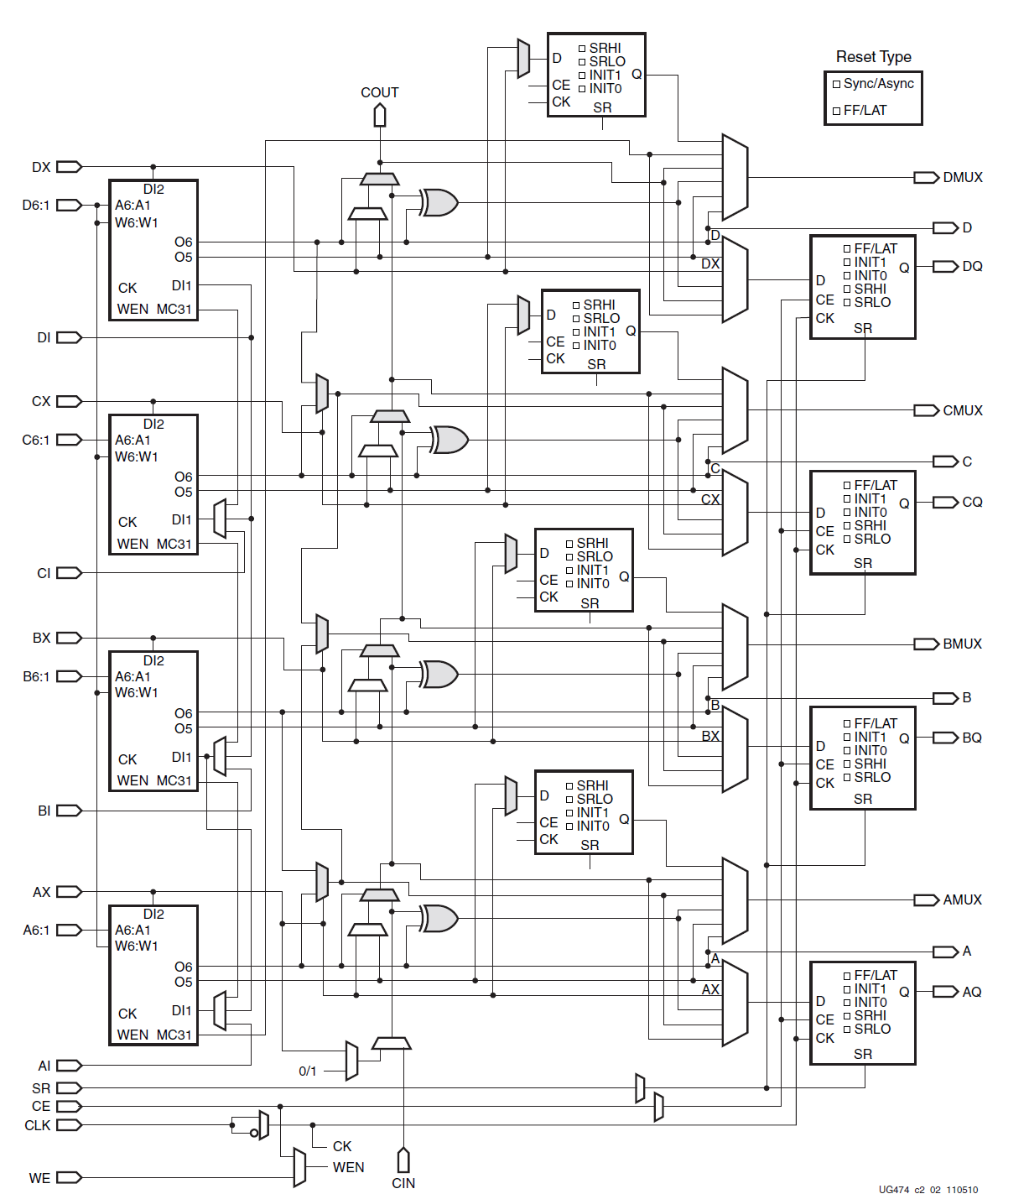
Virtex 7

Slide 25
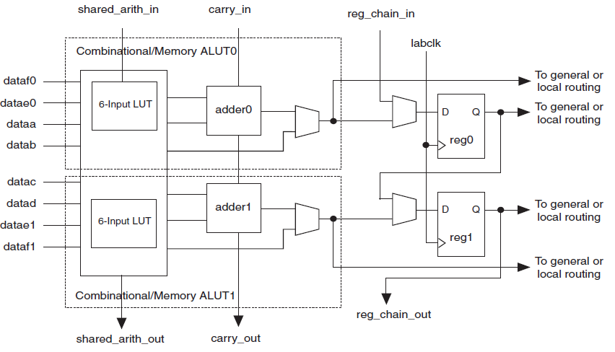
Stratix/Cyclone

Slide 26
Power Trade-Offs
Experiments:
Best logic block architectures for area → Best for power consumption
For a fixed, standard logic block architecture:
Sleep transistors and threshold voltage settings achieve significant power consumption reductions.

Slide 27
PLA/PAL-Style Logic Blocks
[Cong05]:
Fairly small PAL-like structure:
With 7–10 inputs
10–13 product terms
Performance gains (up to 33%)
Excessive area (27%)
Excessive power

Slide 28
PLA/PAL-Style Logic Blocks
Another routing architecture:
RA1:
Only buffer switched wires of length 1
RA2:
50% buffer switched wires of length 4 + 50% pass transistor switched wires of length 4
Performance gains (up to 27%)
Area reduction (17%), excessive power

Slide 29
References
[Kuon07] I. Kuon and J. Rose, “Measuring the gap between FPGAs and ASICs,” IEEE Transactions on Computer-Aided Design of Integrated Circuits and Systems, vol. 26, no. 2, pp. 203–215, 2007.
[Ahmed01] E. Ahmed, The Effect of Logic Block Granularity on Deep-Submicron FPGA Performance and Density. Master’s thesis, University of Toronto, Department of Electrical and Computer Engineering, 2001.
[Xilinx] www.xilinx.com
[Altera] www.intel.com
م. صاحب‌الزمانی، طراحی کامپیوتری سیستم‌های دیجیتال، نشر شیخ بهایی، 1398
[Cong05] J. Cong, H. Huang, and X. Yuan, “Technology mapping and architecture evaluation for k/m-macrocell-based FPGAs,” TODAES, vol. 10, pp. 3–23, January 2005.

