Slide 1
FPGA Technology Mapping

Slide 2
Research Topic
Choose a topic for presentation
Oral presentation
Written report
Either a research paper or a practical topic
Scehdule:
Topic selection: 30 Aban
Oral presentations: 15-17 min.
29 Azar
1 Dey
6 Dey
Written reports
6 Dey

Slide 3
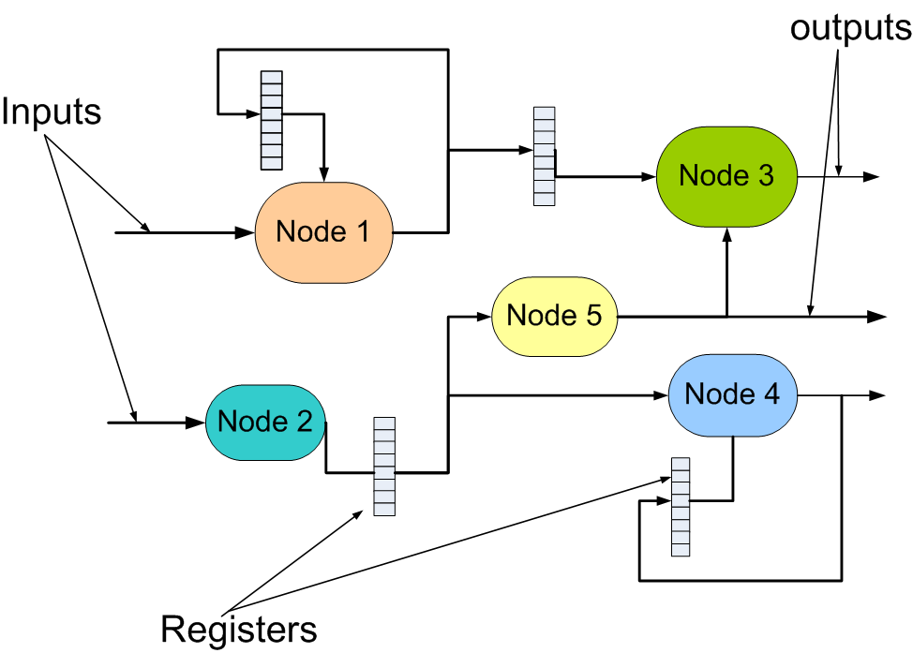
Types of Algorithms
Input to technology mapping:
Netlist of flip flops
Nodes with Boolean functions
[Special-purpose blocks (preserved by synthesis)]
Multipliers
Memory blocks
Adders

Slide 4
LUT-Technology Mapping
Technology mapping:
Implements the optimized nodes of the Boolean network to the target device library.
For FPGA, library elements = LUT
→ LUT-based technology mapping (LUT mapping)
Objectives:
Number of LUTs (area)
Signal delay (speed)
Routability
Power (few publications)

Slide 5
Types of Algorithms
Classification:
Based on objective functions:
Area-driven
Performance-driven
Routability-driven
Power-driven
Based on input network:
Combinational
Assumes fixed positions for sequential elements
Only considers the combinational logic between sequential elements
Sequential
May relocate FFs during mapping (retiming)
Can explore a much larger solution space (better quality)

Slide 6
Types of Algorithms
Structural TM:
Does not modify the input netlist (except logic duplication).
Covers a netlist with logic cells (e.g., K-LUTs)
Efficient for large designs
Most algorithms are structural.
Functional TM:
Mixes Boolean optimization with covering
Can potentially explore a larger solution space than structural mapping
Time-consuming
→ Restricted to small designs (or small portions of a large design)

Slide 7
FPGAs vs. Custom Logic
Cost metric for custom static gates:
Literal
ax + bx’ has four literals: 8 transistors
Cost metric for FPGAs:
Logic element
All functions that fit in an LE: same cost

Slide 8
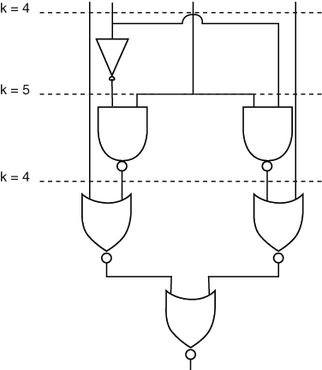
FPGA Tech Mapping
Cost (number of inputs) doesn’t always increase with added functions

Slide 9
LUT-Technology Mapping
LUT-technology mapping problem:
Covering a Boolean network with a set of K-feasible cones.
The Boolean network is usually 2-bounded (if not, it is converted to 2-bounded)
Example:
K = 4

Slide 10
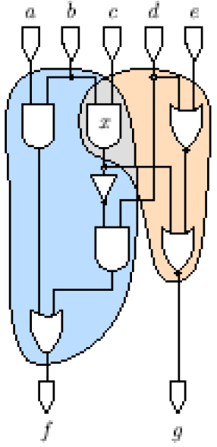
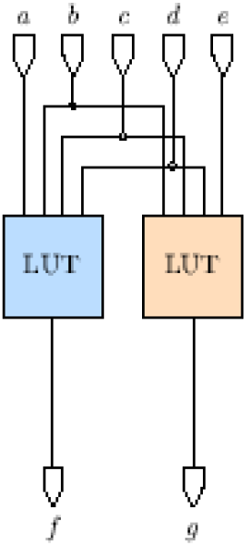
LUT-Technology Mapping
[Chen06]
Graph covering with cones
LUT Mapping

Slide 11
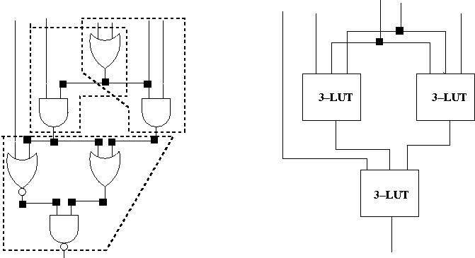
LUT-Technology Mapping
LUT-technology mapping problem:
Covering a Boolean network with a set of K-feasible cones.
Graph covering with cones
LUT Mapping

Slide 12
LUT-Technology Mapping
Find the largest logic cone that will fit into the LUT:
d = a + b
s = d’
q = g’ + h
r = q + s’

Slide 13
How much fits in an LUT?
One 2-input NAND gate frequently used for comparison.
Approximately 12 ~ 15 gates per 4-input LUT
20 ~ 30 gates per 6-input LUT
Number of different functions for a 4- input LUT:
2¹⁶ functions -> 80 after IO swapping
14 after IO inversion
A
A
B
B
C
C
D
D

Slide 14
LUT-Technology Mapping
LUT-technology mapping problem:
For a combinational logic network, find an equivalent logic network, such that
each vertex is associated with a function implementable by a LUT.
Objective:
Min. # vertices or
Min. critical path delay

