Slide 1
FPGA Technology Mapping Algorithms
Chortle

Slide 2
Chortle Algorithm
Chortle [Francis90]:
Developed by Francis et al, University of Toronto in 1990
Optimal i.t.o. area
Inputs:
Fanout-free tree of combinational network
n-input LUTs
Procedure:
Dynamic programming:
Computes and records solutions to all sub-problems proceeding from smallest to largest sub-problem.
Recording the solution to each sub-problem eliminates the need to recalculate it as part of the solution of any larger sub-problem.

Slide 3
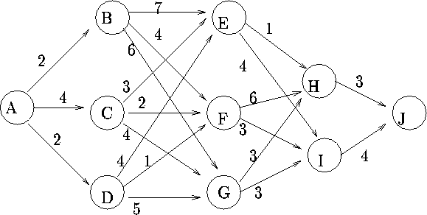
Dynamic Programming
Example:
Shortest path problem
From A to J
Levelized network:
A
B, C, D
E, F, G
H, I
J
[Trick]

Slide 4
Dynamic Programming
Shortest distance from node S to the destination J

Slide 5
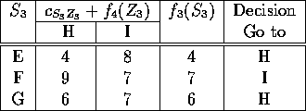
Dynamic Programming
4,H
Stage 4:
F₄(H) = 3
F₄(I) = 4
Stage 3:
3
7,I
4
6,H

Slide 6
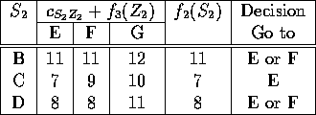

Dynamic Programming
11,E
4,H
Stage 2:
Stage 1:
3
7,E
7,I
4
8,F
6,H

Slide 7
Chortle Algorithm
Input DAG:
Assumption: A tree
If not:
Convert to a forest of maximal fanout-free tree
n
n
n_{a}
n_{b}
n_{c}
a
c
a
b
b
c

Slide 8
Chortle Algorithm
Input DAG:
Assumption: Fanin of any node <= K
If > K, then decomposition algorithm:
Considers all possible decompositions of every node
K = 3
8
Notes:
8

Slide 9
Chortle Algorithm
Post-Order Tree Traversal
Visit Left subtree
Visit Right subtree
Visit Root
Utilization of LUT at root of subtree (node n):
The number of inputs, out of K inputs, that are actually used in the circuit.
U ∈ { 2..K }
U=K for fully utilized LUT
Minimum Cost of sub-circuit rooted at n
MinMap(n,U_{n}):
Optimal solution for node n for U ∈ { 2..K }
[Lockwood06]
9
Notes:
9

Slide 10
Chortle Algorithm
Utilization Division of an LUT:
Node n has fanin nodes n₁, n₂, …, n_{f}
LUT of n includes all fanin edges of n and some subtrees S_{i} rooted at n_{i}
Utilization Division:
Distribution of inputs to the LUT among the subtrees
U(u₁, u₂, … u_{f})
UD: How the inputs of this LUT are divided among the fanin edges of node n
n₁
n₂
n_{f}
(1,1,2)
n
10
Notes:
10

Slide 11
Chortle Algorithm
Can show:
For any node n, with fanin nodes n₁, …, n_{f}, if we have previously calculated minMap(n_{i}, U_{i}) for all U_{i} from 2 to K for every node n_{i}, then we can calculate minMap(n, U) for all U from 2 to K.
n₂
minMap(n₂, 2)
n₁
minMap(n₂, 3)
n_{f}
minMap(n_{f}, 2)
minMap(n₂, 4)
minMap(n_{f}, 3)
minMap(n₁, 2)
minMap(n_{f}, 4)
minMap(n₁, 3)
minMap(n₁, 4)
n
minMap(n, 2)
minMap(n, 3)
minMap(n, 4)

Slide 12
Chortle Algorithm
MapTree(T,K)
For each node (n) in postorder traversal of Tree (T)
For each utilization (U) = 2 to K of node n {
CurrentBestCost = ∞
CurrentBestMap = Ø
For each Utilization Division (μ (left,right)) such that left+right=U {
Construct minimum-cost mapping, M, from min maps of fanin nodes computed previously
Calculate cost (M)
If Cost (M) < CurrentBestCost (M)
CurrentBestMap = M
CurrentBestCost = Cost (M)
} /* next Utilization Division μ */
MinMap (n,U) = CurrentBestMap
} /* next utilization U */
} /* next node n */
Return MinMap (root,K)

Slide 13
Chortle Algorithm
Construct minMap:
Combine constructed root LUT with the mapping minMap(n_{i}, u_{i}) which have been previously computed
If u_{i} = 1, minMap(n_{i},K) must be used instead of minMap(n_{i}, 1)
The root LUT of minMap(n_{i}, u_{i}) is eliminted because it is within the constructed LUT.

Slide 14
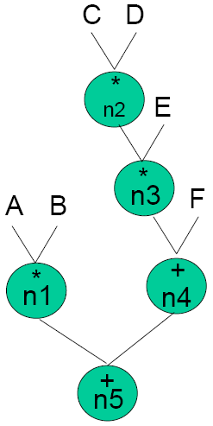
Chortle: Example
Given:
F = A*B + (C*D*E) + F
Decompose
F = (A*B) + (C*D) * E) + F
Given
K=4
Find Optimal Implementation
Maptree(n5,2)
Maptree(n5,3)
Maptree(n5,4)

Slide 15
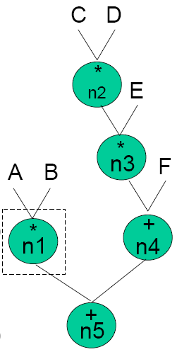
Chortle: Example
For n=n1
For U=2
For μ_{n1}(1,1)
CurrentBestMap=n1(A,B)
CurrentBestCost(M) = 1 LUT
→ MinMap(n1,2) = n1(A,B)
MinCost = 1 LUT
For U=3 : Same as U=2
→ MinMap(n1,3) = MinMap(n1,2)=n1(A,B)
MinCost = 1 LUT
For U=4 : Same as U=2
→ MinMap(n1,4) = MinMap(n1,2)=n1(A,B)
MinCost = 1 LUT

Slide 16
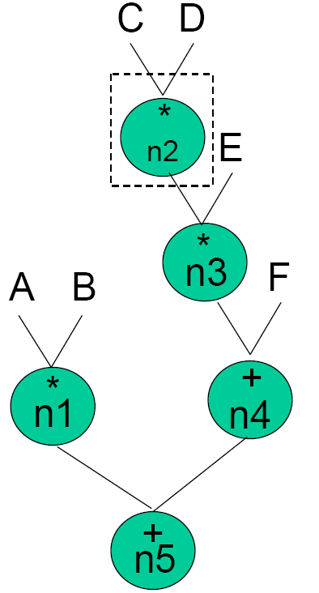
Chortle: Example
For n=n2
For U=2
For μ_{n2}(1,1)
CurrentBestMap=n2(C,D)
CurrentBestCost(M) = 1 LUT
→ MinMap(n2,2) = n2(C,D)
MinCost = 1 LUT
For U=3 : Same as U=2
→ MinMap(n2,3) = MinMap(n2,2)=n2(C,D)
MinCost = 1 LUT
For U=4 : Same as U=2
→ MinMap(n2,4) = MinMap(n2,2)=n2(C,D)
MinCost = 1 LUT

Slide 17
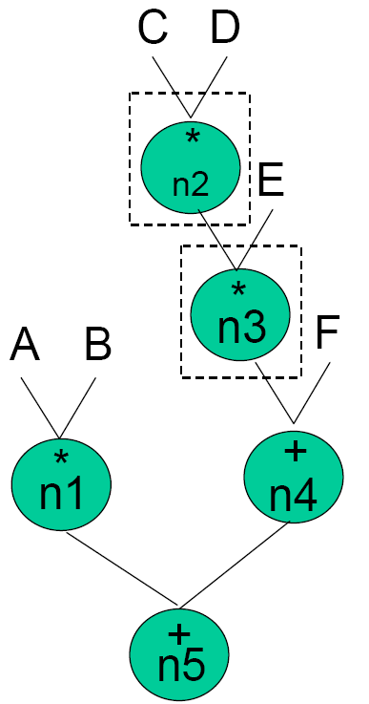
Chortle: Example
For n=n3
For U=2
For μ_{n3}(1,1)
CurrentBestMap
=n3(MinMap(n2,K=4),E)
=n3(n2(C,D),E)
CurrentBestCost(M)
=MinCost(n2) + 1=2 LUTs
→ MinMap(n3,2) = n3(n2(C,D),E)
MinCost = 2 LUTs

Slide 18
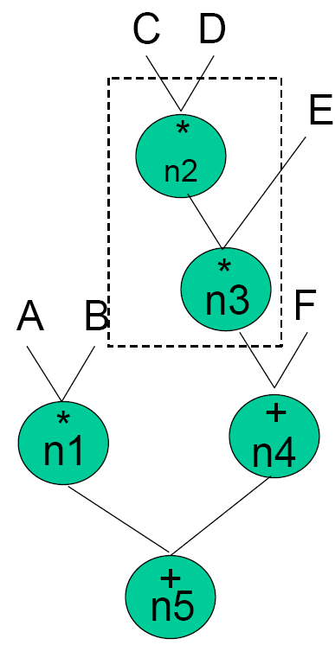
Chortle: Example
For n=n3 (continued)
For U=3
For μ_{n3}(2,1)
CurrentBestMap
=n3(MinMap(n2,2),E)
=n3(C,D,E)
CurrentBestCost(M) = 1 LUT
For: μ_{n3}(1,2): Same as μ_{n3}(1,1)
→ MinMap(n3,3) = n3(C,D,E)
MinCost = 1 LUT
For U=4 : Same as U=3

Slide 19
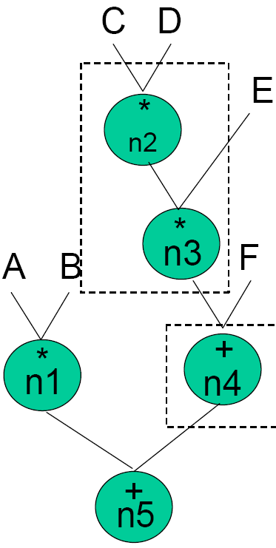
Chortle: Example
For n=n4
For U=2
For μ(left,right)=μ(1,1)
CurrentBestMap
=n4(MinMap(n3,K=4),F)
=n4(n3(C,D,E),F)
CurrentBestCost(M) = 2 LUTs
→ MinMap(n4,2) = n4(n3(C,D,E),F)
MinCost = 2 LUTs

Slide 20
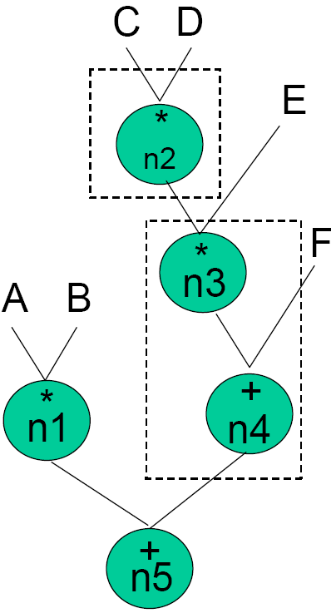
Chortle: Example
For n=n4 (continued)
For U=3
For μ_{n4}(2,1):
CurrentBestMap
=n4(MinMap(n3,2),F)
=n4(n2(C,D),E,F)
CurrentBestCost(M) = 2 LUTs
For: μ_{n4}(1,2): Same as μ_{n4}(1,1)
Cost = 2 LUTs (tie)
→ MinMap(n4,3) = n4(n2(C,D),E,F)
MinCost = 2 LUTs

Slide 21
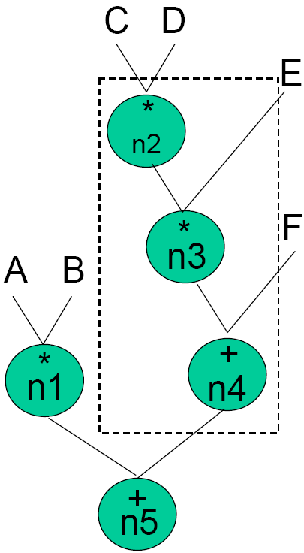
Chortle: Example
For n=n4 (continued)
For U=4

Slide 22
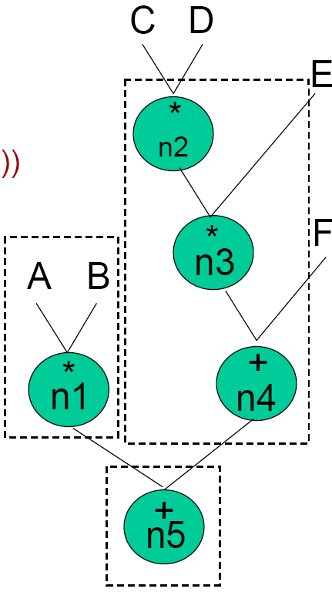
Chortle: Example

Slide 23
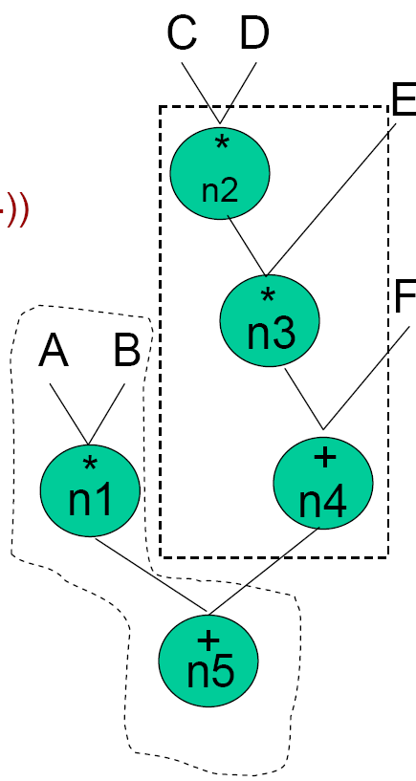
Chortle: Example

Slide 24
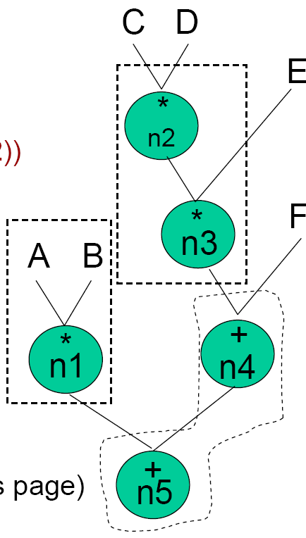
Chortle: Example

Slide 25
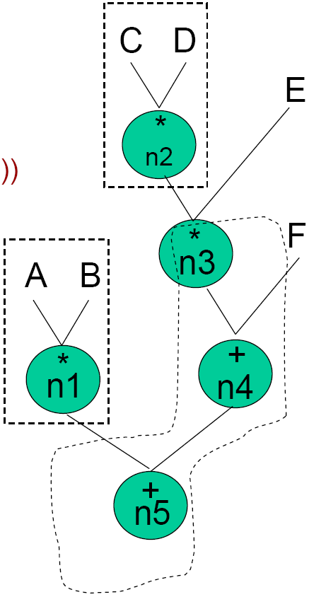
Chortle: Example

Slide 26
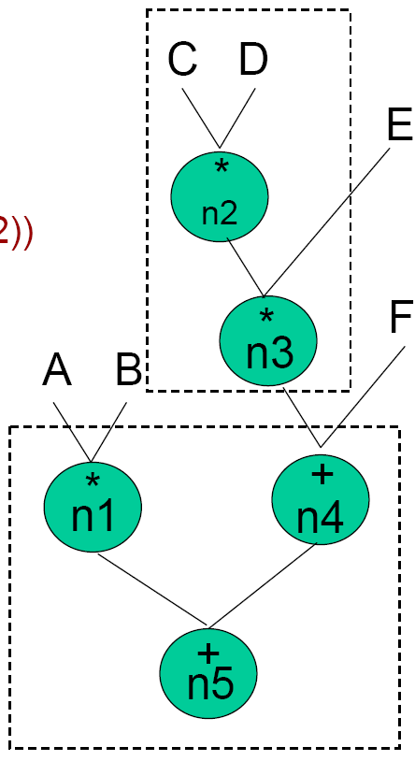
Chortle: Example

Slide 27
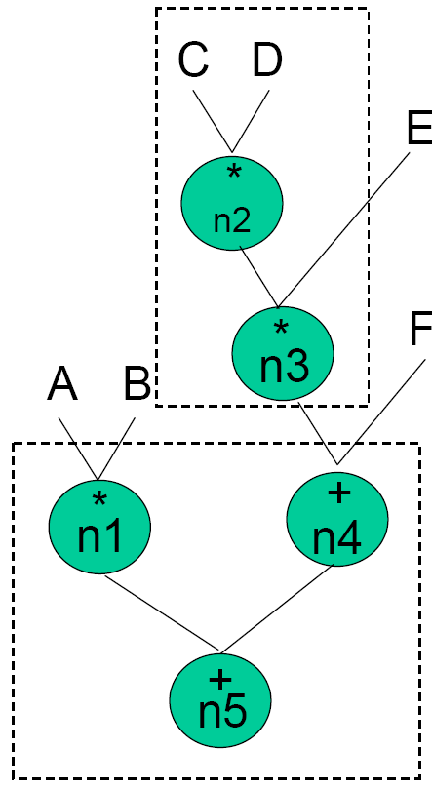
Chortle: Example
MinMap(n5,4)
= n5(A,B,n3(C,D,E),F)
MinCost = 2 LUTs

Slide 28
Chortle-crf Algorithm
Chortle-crf [Francis91]:
Developed by Francis et al, University of Toronto in 1991
Inputs:
SOP representation of a single output function
K-input LUTs
Procedure:
Bin packing and dynamic programming
x28 faster

Slide 29
Bin Packing Problem
Obj (j):
Bin
Bin
Bin
Bin (i):
Bin packing problem:
Placing n objects into a number of bins (at most n bins).
Each object has a weight (Wj > 0)
Each bin has a limited capacity (Ci > 0)
Find the best assignment of objects to bins such that
The total weight of the objects in each bin does not exceed its capacity
The number of bins used is minimized

Slide 30
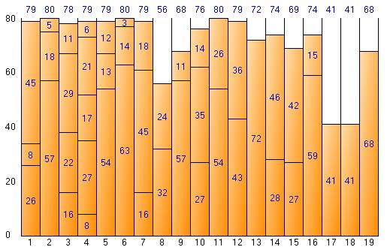
1-D Bin Packing

Slide 31
Bin Packing : Formulation
Obj (j):
Bin
Bin
Bin
Bin (i):
Y_{i} = 1 if bin_{i} is used
X_{ij} = 1 if object_{j} is assigned to bin_{i}

Slide 32
Chortle-crf Algorithm
Example:
K = 3
f = ab + cd
→ # of inputs = 4 > K
Cannot use a single LUT.
Decomposition:
f₁ = ab,
f₂ = cd,
f = f₁ + f₂
Alternative decomposition:
f₁ = ab,
f = f₁ + cd

Slide 33
Chortle-crf Algorithm
Map the trees:
Traverse the network from inputs to output.
At each node v, a circuit implementing the cone (from v to PIs) is constructed.
The circuit is called Best Circuit (BC) at v.
Objectives in constructing BC:
Minimize number of LUTs (area)
Maximize number of unused inputs at the output LUTs
Allows subsequent nodes to be implemented without extra LUTs.

Slide 34
Chortle-crf Algorithm
Example:
K = 5
An OR node and its fanin LUTs
f
g
h
i
j

Slide 35
Chortle-crf Algorithm: Decomposition
Decomposition:
Goal:
To construct a tree of LUTs that implements
both the functions of fanin LUTs and
a decomposition of the node.
Two Steps:
Two-level decomposition
Convert it to multi-level decomposition

Slide 36
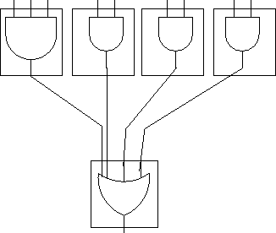
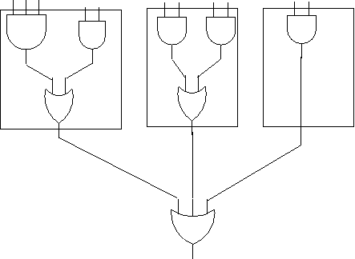
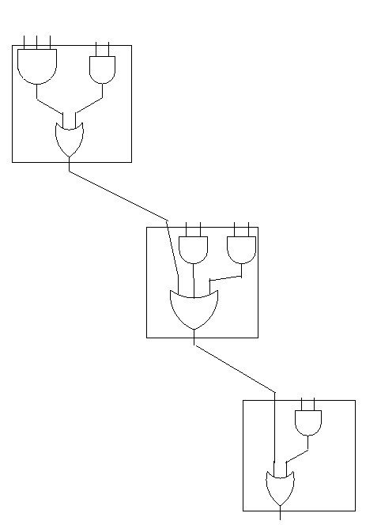
Chortle-crf Algorithm: Decomposition
Two-level
Multi-level

Slide 37
Step 1: Two-Level Decomposition
Packing:
Combining two LUTs LUT₁ (implementing f₁) and LUT₂ (implementing f₂) into a new LUT_{r} that implements the function f = f₁ Ø f₂, where Ø is the function implemented in the fan-out node (e.g. OR)
Uses first-fit decreasing (FFD) method
Can use best-fit (BFD)

Slide 38
Two-Level Decomposition
Bin packing:
Bins:
Combined lookup tables
Objects:
Fanin lookup tables
The capacity of each bin:
K
Size of each object:
Number of used inputs of fanin LUT
Example (K=5):
sizes
3, 2, 2, 2, 2
Final contents of the packed bins:
5, 4, 2

Slide 39
Chortle-crf: Multi-Level Decomposition
Multi-level Decomposition
The first-level node is implemented with a tree of LUTs:
Inputs to the LUT of the 1st-level tree = outputs of the 2nd-level LUTs of two-level decomposition
Reduction of the number of LUTs:
by using unused pins of the 2nd-level LUTs to implement a portion of the 1st -level LUTs.
2nd level
X
1st level
Algorithm MultiLevel
{
while there are more than one unconnected LUT do
{
if there are no free inputs among
the remaining unconnected LUT
{
create an empty LUT and add
it to the end of the LUT list
}
connect the most filled unconnected LUT
to the next unconnected LUT with a free input
}
}

Slide 40
Chortle-crf: Reconvergent Paths
Exploiting reconvergent paths (RP)
If two boxes share the same input, there is a pair of RPs
If # of distinct inputs to these two boxes <= K
➔ can pack into one bin.
Y
Y
Y
f
g
h
i
j

Slide 41
Chortle-crf: Reconvergent Paths
K = 3
bin
boxes

Slide 42
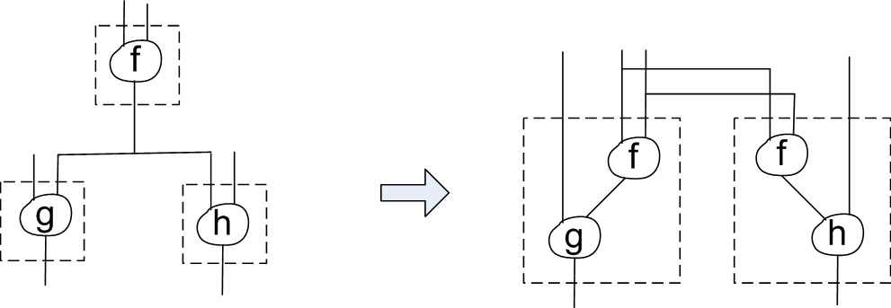
Chortle-crf: Logic Replication
Improvement
Logic replication at fan-out nodes reduces the number of LUTs
Previous version of Chortle partitioned the circuit into fanout-free trees.

Slide 43
Chortle-d
Chortle-d:
Considers delay as objective
FlowMap solves it optimally.

Slide 44
References
[Bobda07] C. Bobda, “Introduction to Reconfigurable Computing: Architectures, Algorithms and Applications,” Springer, 2007.
[Francis90] R. Francis, J. Rose, K. Chung, “Chortle: A Technology Mapping Program for Lookup Table-Based Field-Programmable Gate Arrays,” DAC 1990.
[Francis91] R. Francis, J. Rose, Z. Vranesic, “Chortle-crf: Fast technology mapping for lookup table-based FPGAs,” DAC, 1991.

Slide 45
Reconfigurable Computing, lecture slides, lect05-ece697f.ppt
[Lockwood06] J. Lockwood, “Switching Theory,” Lecture slides, Washington University, http://www.arl.wustl.edu/~lockwood/class/cse460/ 2006.
[Sedgewick83] R. Sedgewick, Algorithms, Addison-Wesley, 1983.
[Lim08] S. Lim, “Practical Problems in VLSI Physical Design Automation,” Springer, 2008.
[Trick] Michael A. Trick, “A Tutorial on Dynamic Programming”, http://mat.gsia.cmu.edu/classes/dynamic/dynamic.html

