Slide 1
FPGA Technology Mapping Algorithms
FlowMap

Slide 2
FlowMap
Objective:
Minimizing signal delays of mapped designs
First polynomial-time depth-optimal algorithm
Real signal delay:
Delay in the LUTs
Interconnection delay
LUT placement is not known
→ Only LUT delay is considered
→ Interconnection delay:
Assumed to be the same for all signals
→ The delay of a signal = the number of LUTs that the signal traverses on a path from input to output
→ Minimization of the depth of the DAG
Two Steps:
Node labelling
Node mapping

Slide 3
Mapping for Area
Optimizing for area vs. optimizing for delay
Reducing LUTs (area) may increase delay
Based on network flow problem
4-LUTs

Slide 4
Mapping for Area
Optimizing for area vs. optimizing for delay
Reducing LUTs (area) may increase delay
Based on network flow problem
4-LUTs
Area = 3
Delay = 3
Area = 4
Delay =2

Slide 5
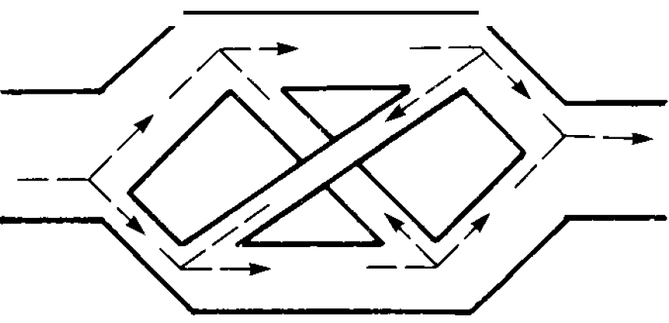
Network Flow Problem
Input:
A network with a single source (say, an oil field) and a single destination (say, a large refinery)
All of the pipes ultimately connected to them
Problem:
What switch settings will maximize the amount of oil flowing from source to destination?

Slide 6
Network Flow Problem
Assumptions:
Pipes: fixed capacity (proportional to their size)
Oil can flow: only in the direction indicated
Switches at each junction: control how much oil goes in each direction.
The system reaches a state of equilibrium
Oil flowing in = Oil flowing out
No matter how the switches are set

Slide 7
Network Flow Problem
Goal:
Maximize this amount of flow

Slide 8
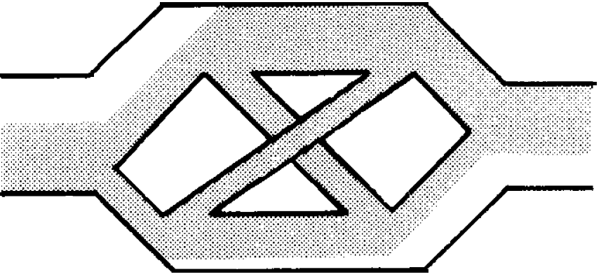
Network Flow Problem
How can switch settings affect the total flow?
Suppose all switches are open.
→ Diagonal pipes are full
~ half of the input pipe capacity is used

Slide 9
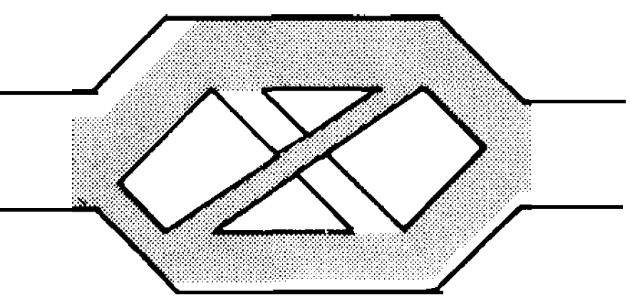
Network Flow Problem
How can switch settings affect the total flow?
Suppose upward pipe is shut-off
Substantial Increase in total flow into and out of the network.

Slide 10

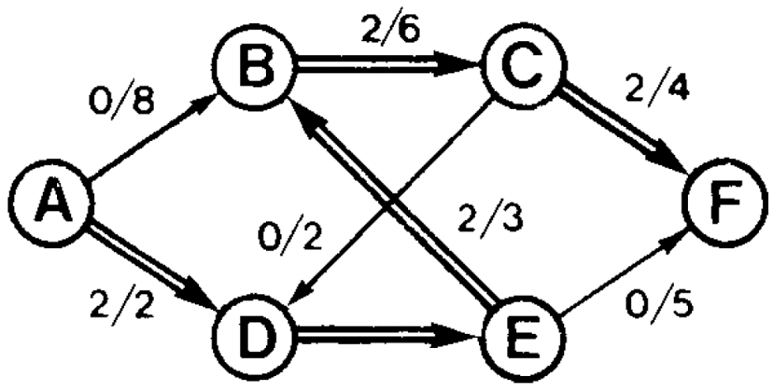
Graph Model of Network Flow
Graph model:
Weighted directed graph
Nodes:
Source (with no input edge)
Sink (with no output edge)
Pipe junctions
Edges:
Pipes
Directions: oil flow
Weights:
flow on edge / pipe capacities
Flow in a node = Flow out of it
Network flow problem:
Maximize flow out of the output node

Slide 11
Graph Model of Network Flow
Graph model:
Edges can be viewed in both directions:
(x → y), capacity s, flow f =
(y → x), capacity -s, flow -f
2/5

Slide 12

Ford-Fulkerson Method
FF Algorithm:
Start with a zero flow
Try to increase flow repeatedly
Repeat until no increase possible
→ Maximum flow found
0/6
0/4
0/3
0/2
0/5
2/5
Increase flow along the path ADEBCF

Slide 13
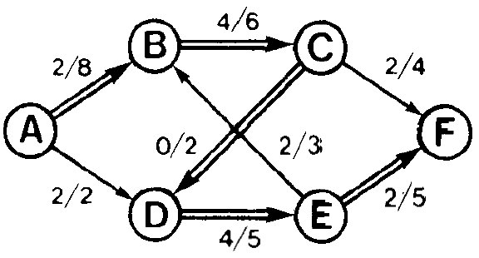
Ford-Fulkerson Method
Increase flow along the path ABCDEF
2/2
2/5

Slide 14
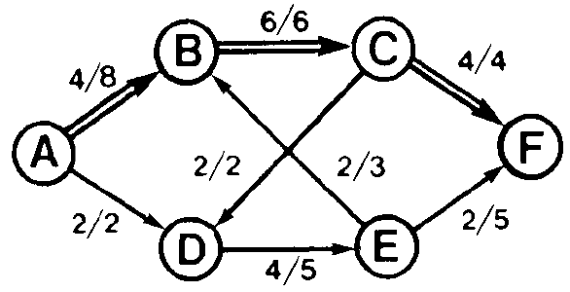
Ford-Fulkerson Method
Increase flow along the path ABCF
2/2

Slide 15
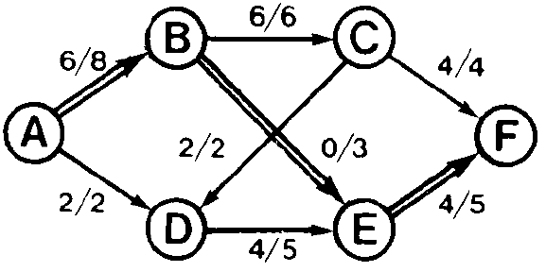
Ford-Fulkerson Method
Increase flow along the path ABEF
Condition to stop:
For all paths from source to destination:
at least one of the forward edges becomes full or
at least one of the backward edges becomes empty

Slide 16
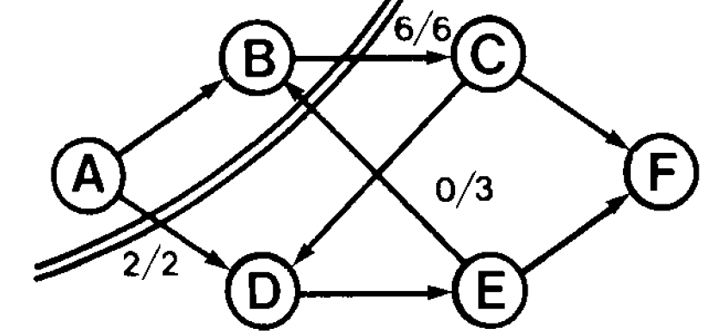
Maxflow-Mincut Theorem
Cut:
Go through the network (from source to sink) and find the first full forward edge or empty backward edge on every path.
6
8
4
2
3
2
5
5
Maxflow-Mincut Theorem:
Whenever the cut flow equals the total flow, we know not only that the flow is maximal, but also that the cut is minimal.
Count only the forward edges in cut.

Slide 17
Dynamic Programming

Slide 18
Dynamic Programming
Optimization Technique:
Procedure:
Computes and records solutions to all sub-problems proceeding from smallest to largest sub-problem.
Recording the solution to each sub-problem eliminates the need to recalculate it as part of the solution of any larger sub-problem.

Slide 19
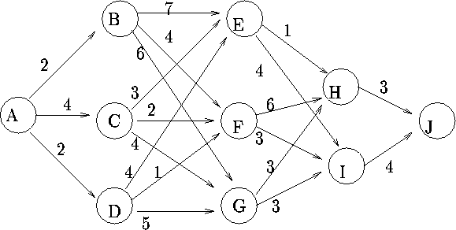
Dynamic Programming
Example:
Shortest path problem
From A to J
Levelized network:
A
B, C, D
E, F, G
H, I
J
[Trick]

Slide 20
Dynamic Programming
Shortest distance from node S to the destination J

Slide 21
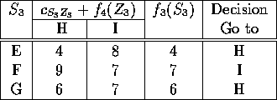
Dynamic Programming
4,H
Stage 4:
F₄(H) = 3
F₄(I) = 4
Stage 3:
3
7,I
4
6,H

Slide 22
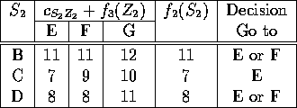

Dynamic Programming
11,E
4,H
Stage 2:
Stage 1:
3
7,E
7,I
4
8,F
6,H
10
10

Slide 23
Definitions
Fan-in of v: input(v):
The set of nodes whose outputs are inputs of v
Fan-out of v: output(v):
The set of nodes which use the output of v as inputs
Primary Input:
A node with no predecessor
Primary output:
A node with no successor
Level of a node:
The length of the longest path from PI to that node
Depth of a graph:
The largest level of any node in the graph
K-bounded Boolean network:
if |input(v)|≤ K for all nodes in the graph

Slide 24
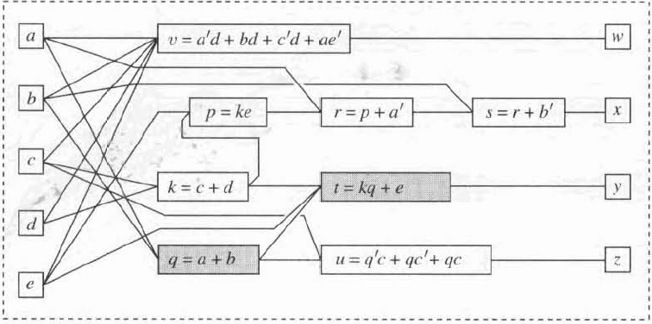
Definitions
Fanin/fanout
PI/PO
Node level, graph depth
4-bounded?

Slide 25
Definitions
Tree (fanout-free circuit):
∀node v, max(fanout(v)) =1
Forest:
An independent set of trees

Slide 26
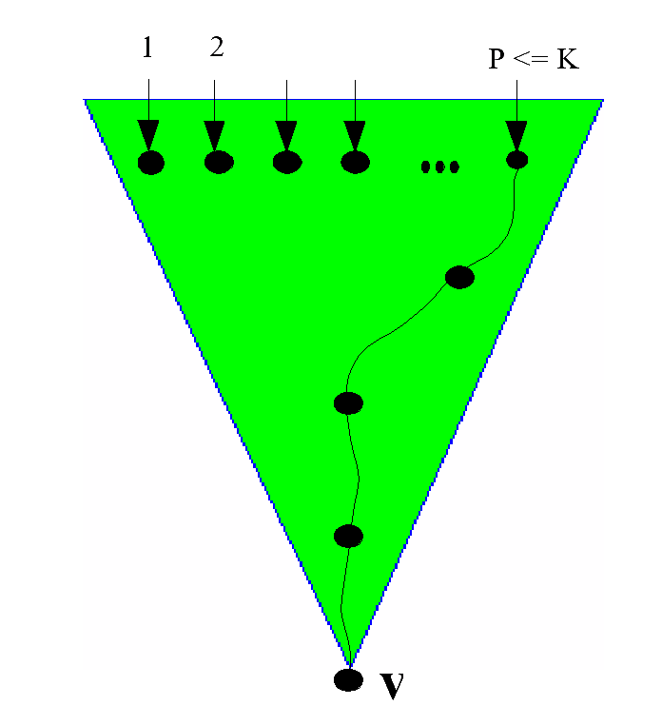
Definitions
Cone C_{v} at node v:
The tree (better to say DAG) with root v which spans from v to a set of inputs: input(C_{v})
K-feasible cone :
C_{v} is K-feasible at node v if:
|input(C_{v})| ≤ K and
any path connecting a node in C_{v} and v lies entirely in C_{v}
Fanout-free cone:
Fanouts of every node (other than the root) are inside the cone
A K-feasible Cone at v
For each node ν, there is a unique maximum fanout-free cone (MFFCv)
i.e. contains every fanout-free cone rooted at ν
Spans to PIs

Slide 27
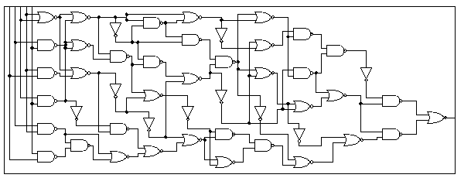

Slide 28
Basics of Network Flow
FlowMap: a network flow-based method.
Basics of network flow:
Given a network N = (V, E) (a graph) with a source s and target t
Cut: a partition (X,X_{b}) of N with s∈ X and t ∈ X_{b}
Edge cut-size e(X,X_{b}): weighted sum of crossing edges
Node cut-size n(X,X_{b}) of a cut (X,X_{b}): # of nodes in X adjacent to some nodes in X_{b}
K-feasible cut: iff n(X,X_{b}) ≤ K
input(C_{v}):
Set of distinct nodes outside of
C_{ν} supplying inputs to gates in C_{ν}.
PIs
a
b
c
d
e
v

Slide 29
Basics of Network Flow
PIs
a
F_{v}
b
c
3-feasible cut
d
e
v
3-feasible cone C_{v}
[Chen04]
29
→ C_{ν} is K-feasible if |input(C_{ν})| ≤ K.
Notes:
29

Slide 30
Basics of Network Flow
K-LUT:
X_{b} is a K-LUT that implements ν with the inputs to the cone.
We use cuts, cones, and LUTs interchangeably
t-bounded Boolean network:
if |input(ν)| ≤ t for each node ν
For Flowmap, the input network must be 2-bounded
Otherwise, it should be decomposed before Flowmap

Slide 31
Basics of Network Flow: Example
PIs
a
b
c
d
e
v
3-feasible cone C_{v}
Delay of 2

Slide 32
FlowMap: Basic Approach
Node labelling:
Labels every node in a topological order
Each node is processed after all its predecessors
Label:
Minimum possible depth of the node in any mapping solution
Dynamic Programming:
Starting from PI nodes, compute node labels in topological order:
Compute the label of a node based on labels of its predecessors
Labels of PO nodes:
Depth of the optimal mapping solution

Slide 33
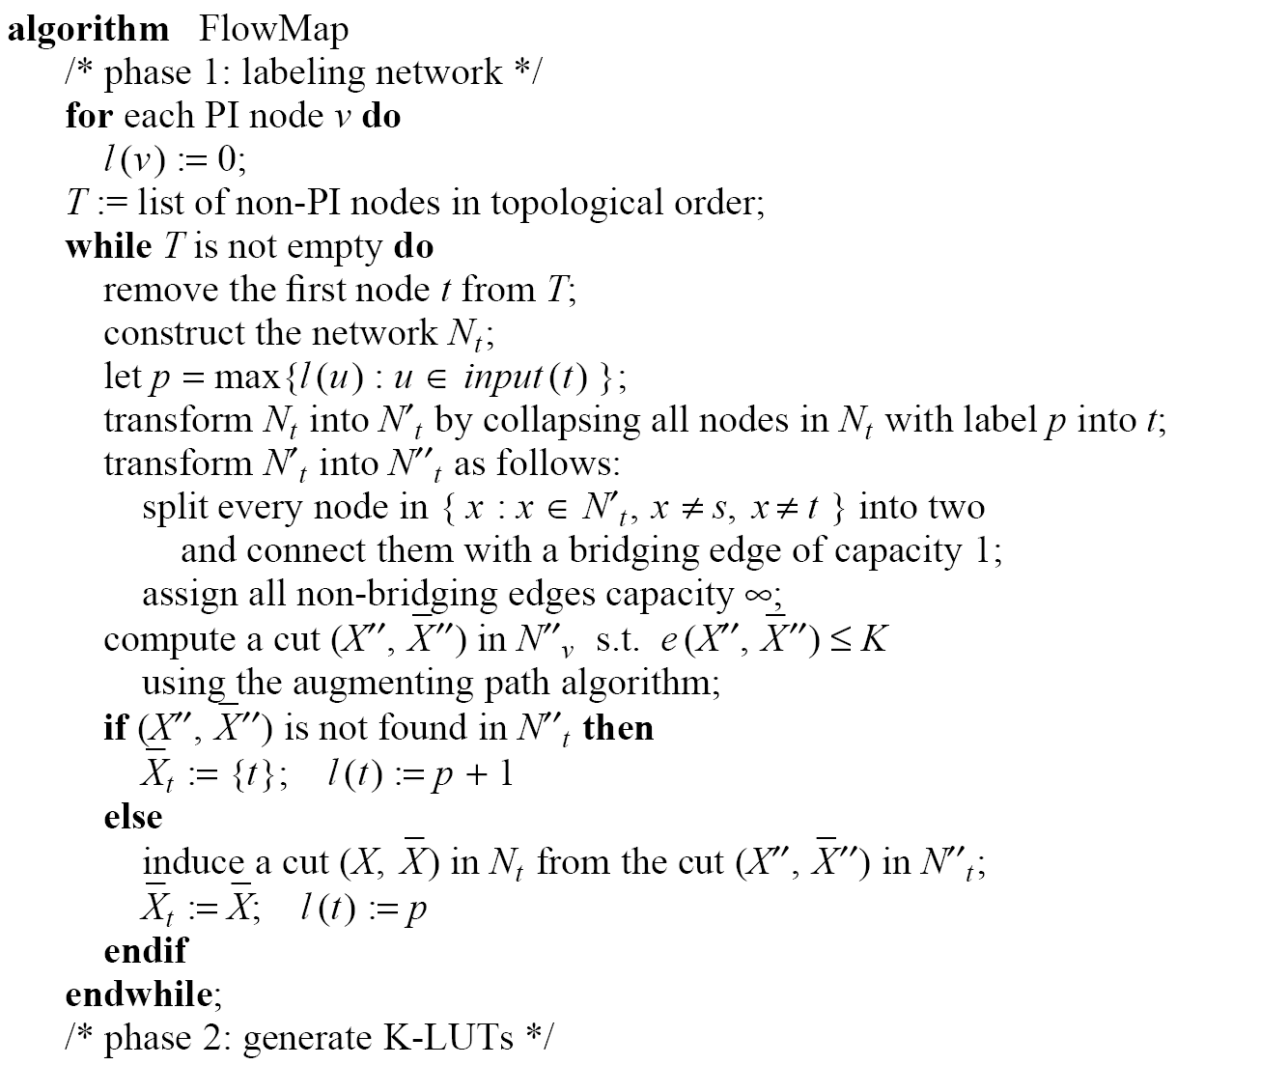
FlowMap Algorithm

Slide 34
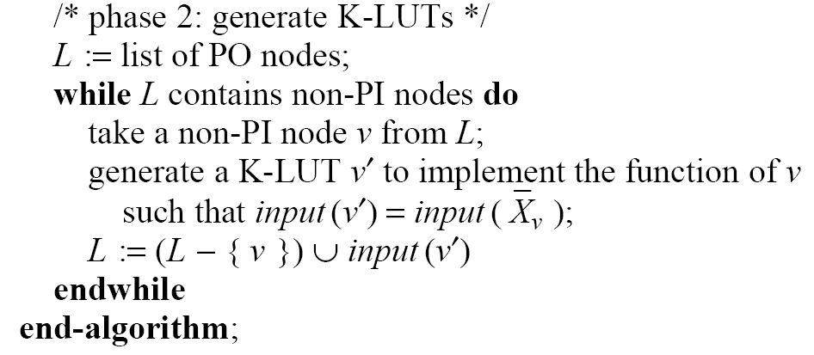
FlowMap Algorithm

Slide 35
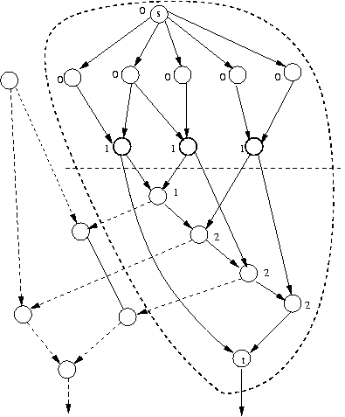
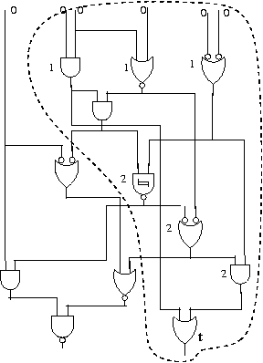
FlowMap: Node Labelling
Node labelling:
Steps:
For a given node t, the cone C_{t} is transformed into a network N_{t} :
Inserting a source node s whose output is connected to all inputs of N_{t}.
l(primary input) = 0
Other nodes’ labels: ?
Network transformation

Slide 36
FlowMap: LUT Mapping
Lemma:
If p is the maximum label in input(t), then
l(t) = p OR
l(t) = p+1
Algorithm:
Check whether there is a K-feasible cut (X,X_{b}) of height p−1 in N_{t}.
If yes, then
l(t) ← p and the node t will be packed (in the second phase) in a common LUT with the nodes in X_{b}.
If no, then
the minimum height of the K-feasible cuts in N_{t} is p and
N_{t} − {t} , {t} is such a cut.
l(t) ← p + 1 and
a new LUT will be used for t.
New Problem:
How to find out if a network has a K-feasible cut with a given height h.

Slide 37
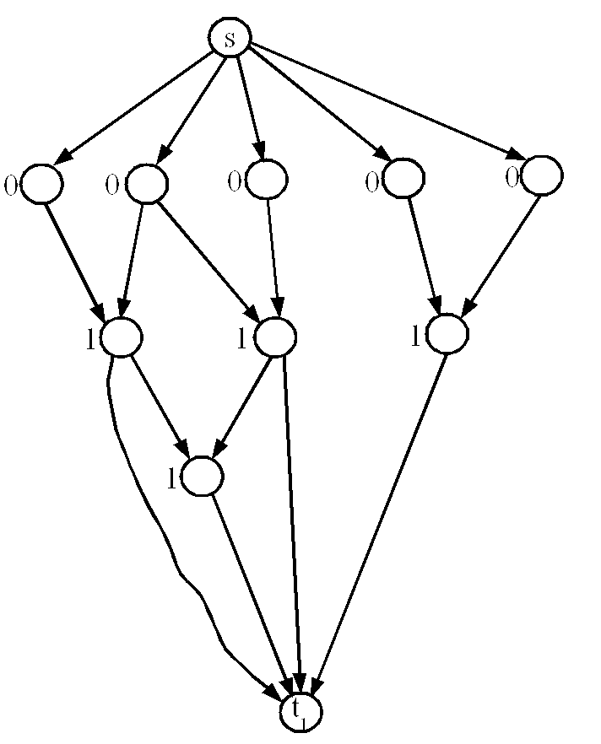
Network Collapsing
Network Collapsing:
Collapses all the nodes in N_{t} with max-label = p together with t in a new node t’.
Lemma:
If N’_{t} has a K-feasible cut, N_{t} has a K-feasible cut of height p − 1
Network collapsing
N_{t}
N’_{t}

Slide 38
Node Splitting
Finding min height K-feasible cut (in N_{t}) → finding K-feasible cut in N’_{t}
Question:
How to know if there is a K-feasible cut in N’_{t}?
Answer:
Network flow algorithms
Problem:
They use edge cut optimization
Solution:
→ Node splitting

Slide 39
Node Splitting
u
v
Transform N’_{t} to N’’_{t}:
For each node v in N’_{t} (except s and t’)
Introduce v₁ and v₂
Connect them by bridging edge (v₁, v₂)
s and t’ appear in N’’_{t} too.
For each (s, v), create a (s, v₁)
For each (v, t’), create a (v₂ ,t’)
For each (u, v) in N’_{t} (u ≠ s and v ≠ t’),
Create (u₂, v₁)
Set capacity:
1 for bridging edges
∞ for non-bridging edges
u₂
∞
v₁
1
v₂
∞
∞

Slide 40
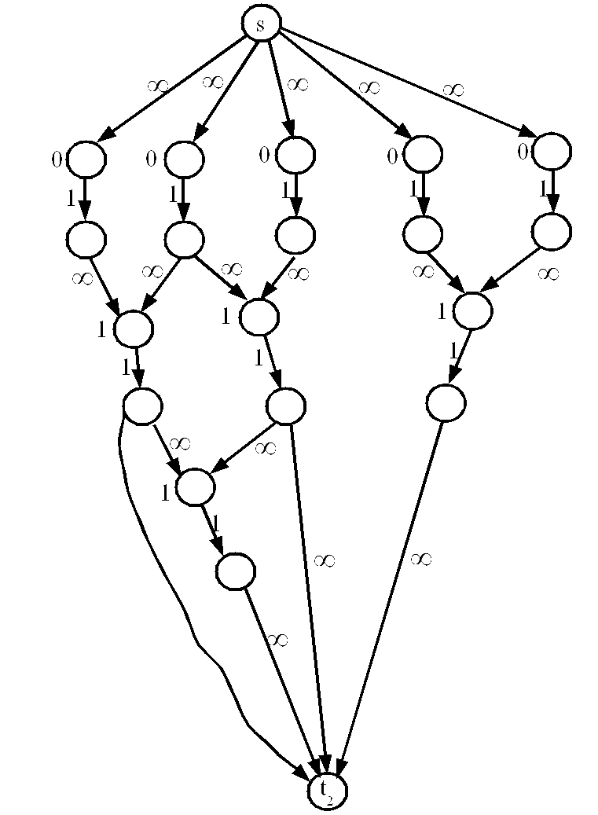
Node Splitting
Second
transformation

Slide 41
Node Splitting
N’_{t} to N’’_{t} transformation:
Ensures that if a cut exists in N’’_{t} with capacity < K, then no edge with infinite capacity will be a crossing one.
Only bridging edges are crossing the cut
A LUT may have fanout > 1
→ Min-cut in N’_{t} may not work properly
Lemma:
If N’’_{t} has a cut with edge cut size ≤ K, N’_{t} has a K-feasible cut.

Slide 42
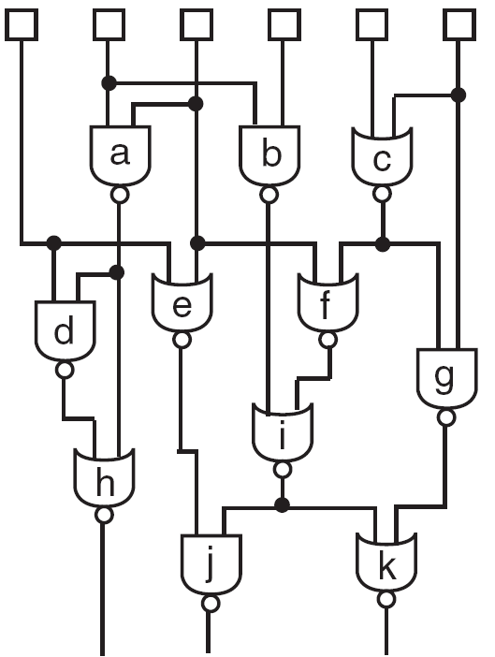
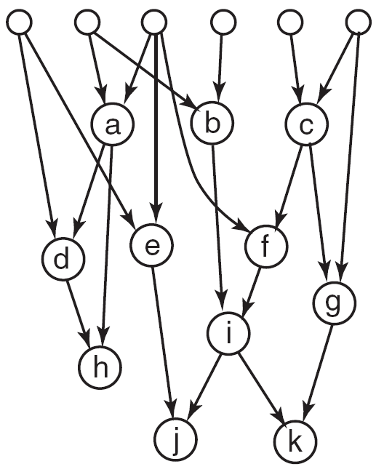
Example
Example:
K = 3

Slide 43

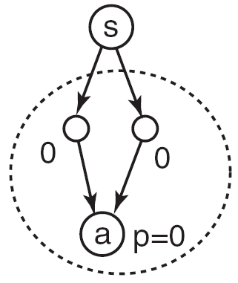

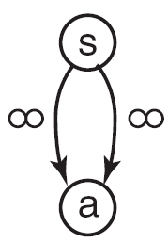
Example
l(i) = 0 for all PIs
p = 0
Topological order: {a, b, c, d, e, f, g, h, i, j, k}
Not possible to find a cut in N’’_{a} with a cutsize smaller or equal to K = 3
➔ X_{b} = {a}
l(a) = p + 1 = 1.

Slide 44
Example
Nodes b and c:
Similar to the case for node a,
Node b:
X_{b} = {b},
l(b) = 1
Node c:
X_{b} = {c}
l(c) = 1

Slide 45
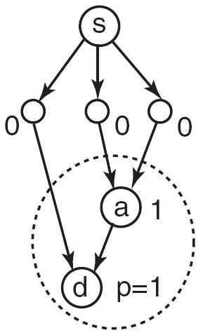
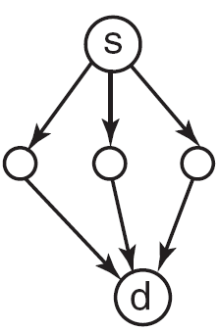
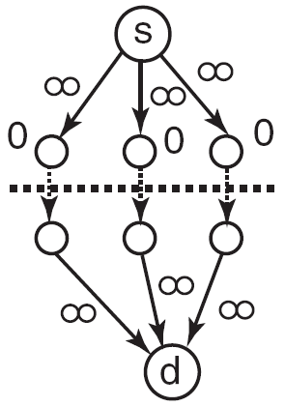
Example
Node d:
p = 1
Max flow (min-cut) = 3
X_{b} = {a, d}
l(d) = p = 1

Slide 46
Example
Node e:
Similar to a
X_{b} = {e}
l(e) = 1
Node f:
similar to d
X_{b} = {c, f}
l(f) = 1

Slide 47
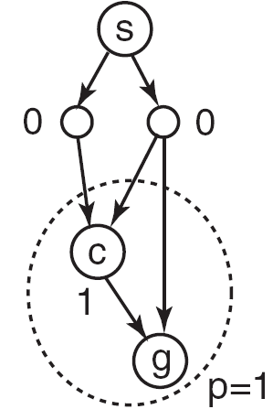
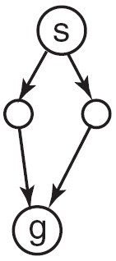
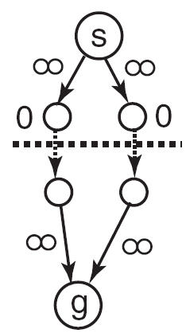
Example
Node g:
X_{b} = {c, g}
l(g) = p = 1

Slide 48
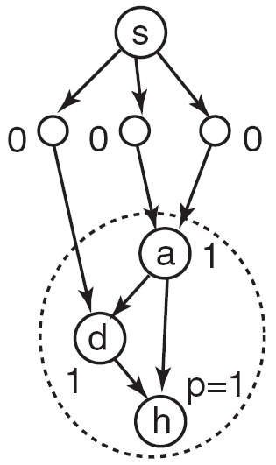
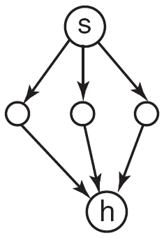
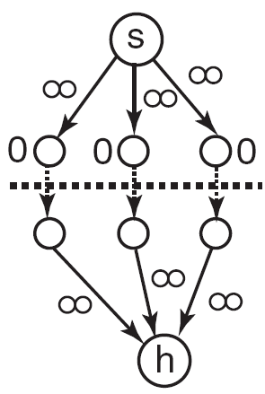
Example
Node h:
X_{b} = {a, d, h}
l(h) = l(d) = 1

Slide 49
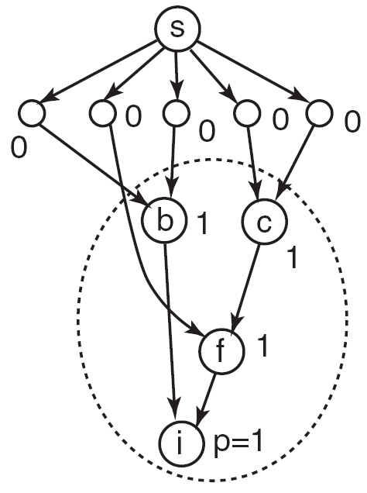
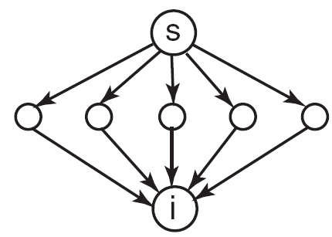
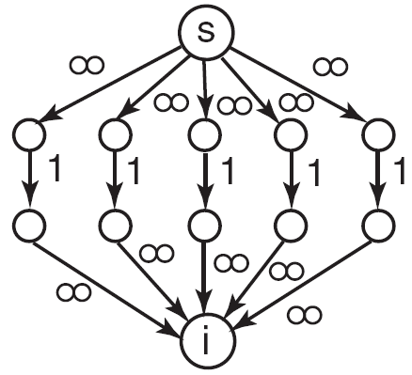
Example
Node i:
N’’_{i} does not contain a K-feasible cut.
X_{b} = {i}
l(i) = p + 1 = 2

Slide 50
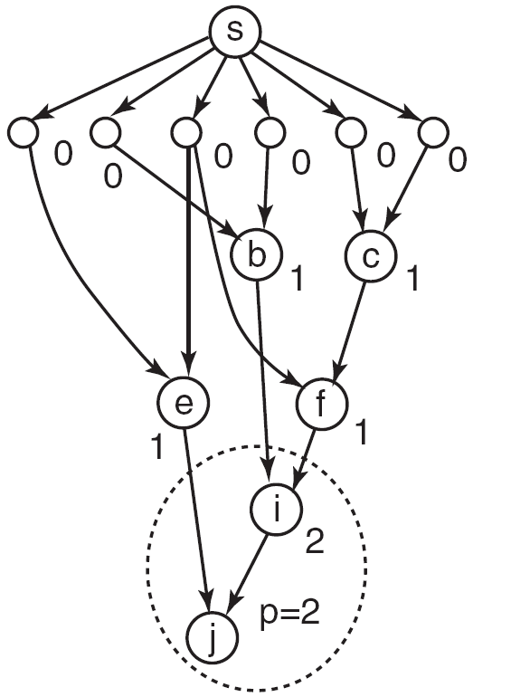
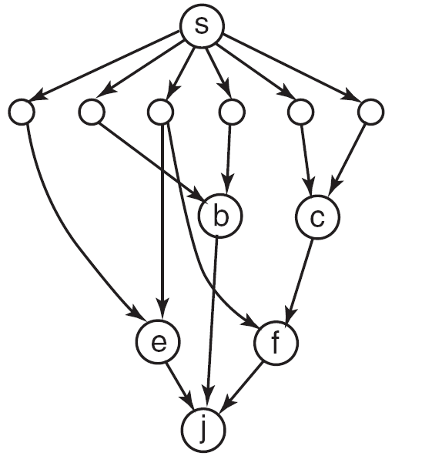
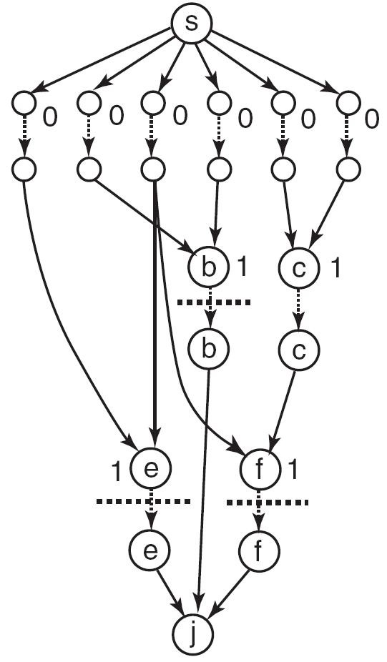
Example
Node j:
Only one K-feasible cut in N’’_{j}
Its height is 1.
X_{b} = {i, j}
l(j) = p = 2

Slide 51
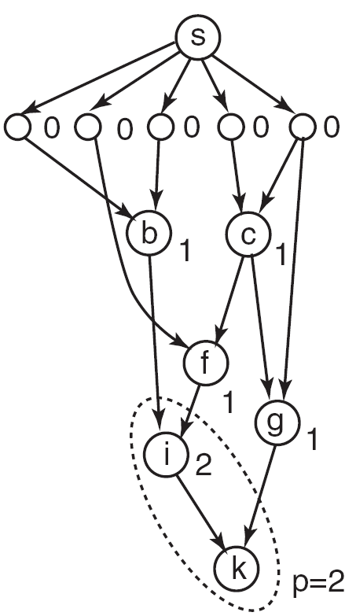
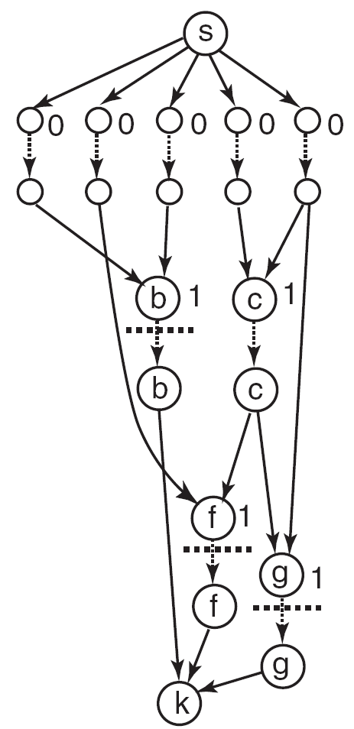
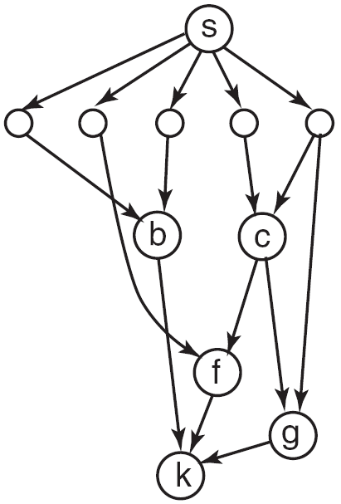
Example
Node k:
Only one K-feasible cut in N’’_{k}
Its height is 1.
X_{b} = {i, k}
l(k) = p = 2

Slide 52
FlowMap Algorithm

Slide 53
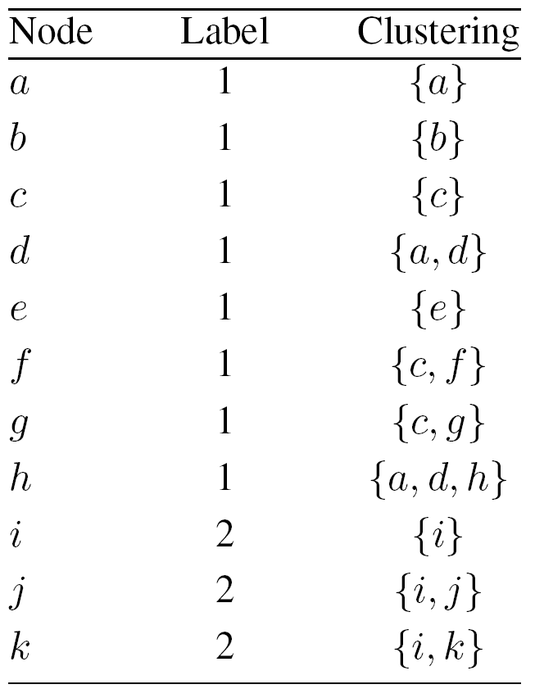
Example
Labels and clusters →
L = {h, j, k}

Slide 54
Example
Remove h from L
h’ = K-LUT implementation of h
Table: h’ contains {a, d, h}

Slide 55
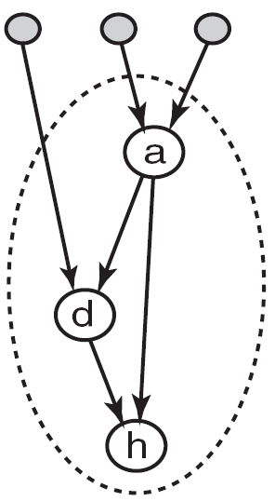
Example
input(h’) contains three PI nodes
We do not add PI nodes into L
→ L = {j, k}

Slide 56
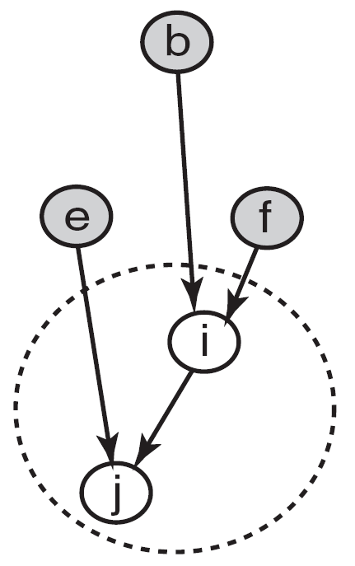
Example
Remove j from L
Table: j’ contains {i, j}
input(j’) = {e, b, f}
→ L = {k} ∪ {e, b, f} = {k, e, b, f}

Slide 57

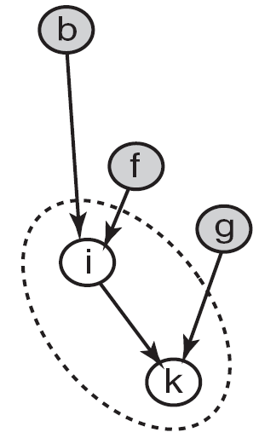
Example
Remove k from L
Table: k’ contains {i, k}
input(k’) = {b, f, g}
→ L = {e, b, f} ∪ {b, f, g} = {e, b, f, g}

Slide 58
Example
Remove e from L
Table: e’ contains {e}
input(e’) = PI nodes
→ L = {b, f, g}

Slide 59
Example
Remove b from L
Table: b’ contains {b}
input(b’) = PI nodes
→ L = {f, g}

Slide 60
Example
Remove f from L
Table: f’ contains {c, f}
input(f’) = PI nodes
→ L = {g}

Slide 61
Example
Remove g from L
Table: g’ contains {c, g}
input(g’) = PI nodes
→ L = Ø

Slide 62

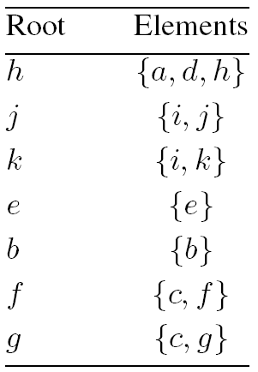
Example
7 K-LUTs generated

Slide 63
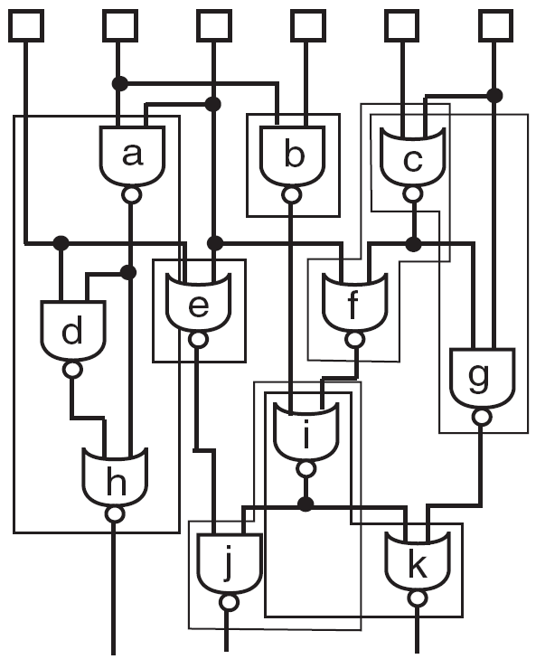
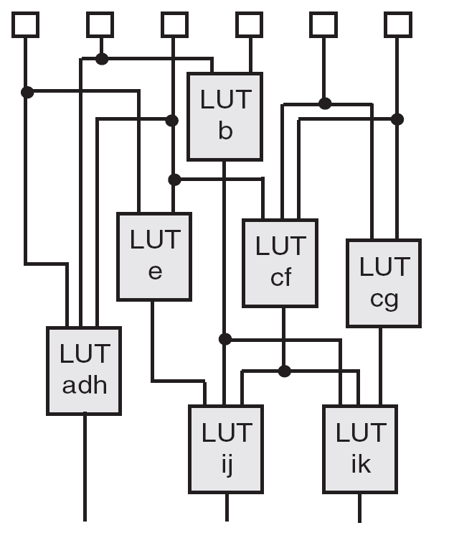
Example
Max label = 2
→ Max delay = 2

Slide 64
References
[Cong94] J. Cong and Y. Ding, “Flowmap: an optimal technology mapping algorithm for delay optimization in lookup-table based fpga designs,” IEEE Trans. on CAD of Integrated Circuits and Systems, vol. 13, no. 1, pp. 1–12, 1994.
[Sedgewick83] R. Sedgewick, Algorithms, Addison-Wesley, 1983.
[Lim08] S. Lim, “Practical Problems in VLSI Physical Design Automation,” Springer, 2008.

