Slide 1
FPGA Technology Mapping Algorithms
ABC

Slide 2
ABC LUT Mapping
VTR (Verilog to Routing):
AIG (And-Inverter Graph)
Boolean network composed of two-input ANDs and inverters
F(a,b,c,d) = ab + d(ac’+bc)
6 nodes
4 levels
a
b
d
F(a,b,c,d) = ac’(b’d’)’ + c(a’d’)’ = ac’(b+d) + bc(a+d)
a
c
b
c
7 nodes
3 levels
2-input AND
a
c
b
d
b
c
a
d
NOT

Slide 3
Structural Cuts in AIG
n
Cut of a node n:
A set of nodes in transitive fan-in such that
every path from the node to PIs is blocked by nodes in the cut.
k-feasible cut:
size of the cut ≤ k
p
q
a
b
c
{p, b, c}: 3-feasible cut of node n (also a 4-feasible cut)
k-feasible cut can be replaced by a k-LUT.

Slide 4
Cut Enumeration
Different cuts for the same node
f
f
a
b
c
d
e
a
b
c
d
e
The mapped netlist
Dotted lines: NOT

Slide 5
Cut Enumeration
For each node, tries all possible cuts.
Finds the best.
Nodes processed in topological order (from inputs)

Slide 6
Cut Computation
Set of cuts of a node: ‘cross product’ of the sets of cuts of its children
Any cut that is of size greater than k is discarded.
Best cut (area, delay, power) is selected.
{ {n}, {p, q}, {p, b, c}, {a, b, q}, {a, b, c} }
n
{ {p}, {a, b} }
{ {q}, {b, c} }
Computation is done bottom-up
p
q
{ {a} }
{ {b} }
{ {c} }
a
b
c

Slide 7
Later Problems/Issues
Area optimization while maintaining performance
DAOmap [Chen04] guarantees optimal delay, reducing area significantly
Integrated approaches:
with retiming
with synthesis
with clustering and placement
More area/delay reduction heuristics
Improvements on delay and area as well as the runtime and memory requirements
Power minimization techniques [Cheng07]
TM for dual supply voltages
TM for reliability
Parallel algorithms for TM
Notes:
dp9D_2.ppt:
Power Minimization
PowerMinMap, [Li, et al, ASPDAC’03]
Emap, [Lamoureux, et al, ICCAD’03]
DVmap, [Chen, et al, FPGA’04]

Slide 8
Later Problems/Issues
Mapping for FPGAs with heterogeneous resources:
FPGAs with different LUT sizes
Stratix-5:
Virtex-7:
FLUT (Fracturable LUT) Mapping [Dickin11]
Mapping with embedded memory blocks (not so recent):
Unused EMBs can be used to implement logic.
Large multi-input/multi-output LUTs
Mapping DSP blocks [Smith24]
Notes:
dp9D_2.ppt:
Power Minimization
PowerMinMap, [Li, et al, ASPDAC’03]
Emap, [Lamoureux, et al, ICCAD’03]
DVmap, [Chen, et al, FPGA’04]

Slide 9
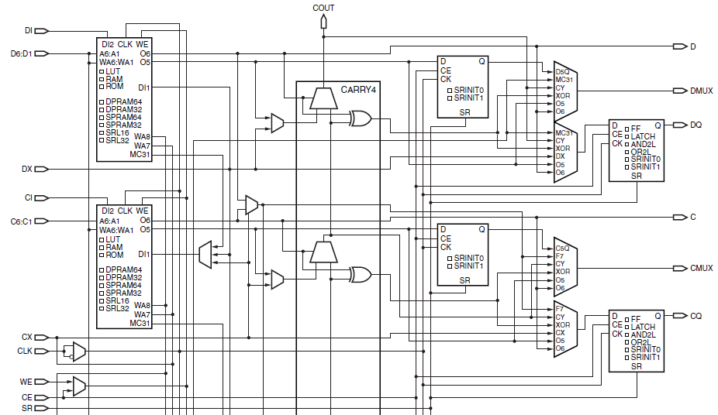
SliceM

Slide 10
SliceM
LUT:
Can implement one 6-input function
Only O6 can be used
Can implement two 5-inout functions with common inputs (A1-A5)
O5 and O6 are used

Slide 11
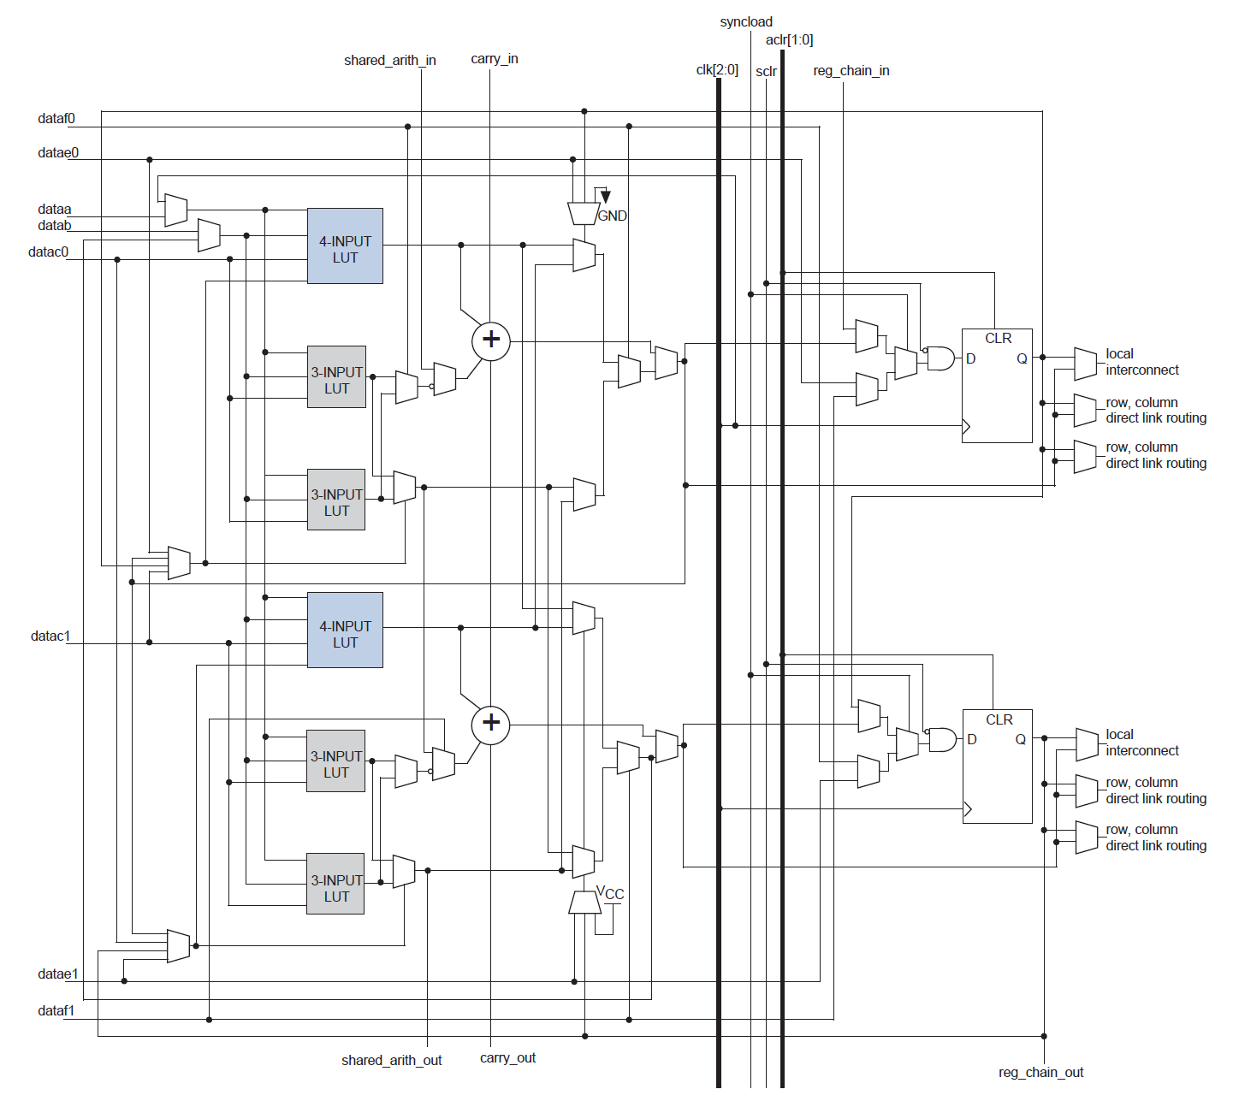
Altera Stratix Logic Element

Slide 12
Adaptive Logic Module
ALM:
An 8-input structure that can implement many combinations of logic functions, including:
One 6-input logic function
Two 4-input logic functions
One 5-input and one 3-input function
Two 6-input functions that share the same logic function and 4 inputs

Slide 13
Optimality Study of TM Algorithms

Slide 14
Potential Success of TM Algorithms
Area-optimal LUT mapping is NP-complete.
Optimality study of LUT-based TM [Cong06]:
LEKO examples:
Logic synthesis Examples with Known Optimal
No optimization done
Existing academic LUT-mapping algorithms and commercial tools:
Gap: 5% to 23% (average 15%):
Quartus: 5% (Commercial) (does logic optimization too)
DAOmap: 23% (Academic)

Slide 15
LEKO Construction
Constructing a network Gn of an arbitrarily large size that has a known optimal technology mapping solution.
n inputs and outputs
G is constructed in a special way by replicating a small circuit with a known optimal mapping solution into a circuit of any size that also has a known optimal mapping solution.
The building block of our construction is a “hard graph” named G5, with the following properties:
1. It has five inputs and five outputs.
2. Every output is a function of all five inputs.
3. Each internal node of G5 has exactly two inputs.
4. There exists an optimal (in terms of area/depth) mapping of G5 into a 4-LUT mapping solution, denoted M5, such that M5 only has 4-LUTs (no 3-LUTs or 2-LUTs).

Slide 16
Potential Success of TM Algorithms
LEKU examples:
Logic synthesis Examples with Known Upper bounds (on area)
LEKUs require logic restructuring/optimization to achieve the optimal mapping solutions.
Average optimality gap: from x70 to x504 over known upper bounds (average: x172)
→ Poor performance of logic optimization + technology mapping algorithms

Slide 17
References
[Mishchenko] A. Mishchenko, Introduction to Logic Synthesis with ABC.ppt.
[Brayton] R. Brayton, and A. Mishchenko, “ABC: An Academic Industrial-Strength Verification Tool. In: T. Touili, B. Cook, P. Jackson, (eds) Computer Aided Verification. CAV 2010. Lecture Notes in Computer Science, vol 6174. Springer, Berlin, Heidelberg.
VPR 5.0, http://www.eecg.utoronto.ca/vpr.
VPR 6.0, Beta Release, May 30, 2011
Now: VTR 8, March 2020.
Murray, et al. "VTR 8: High Performance CAD and Customizable FPGA Architecture Modelling". ACM Transactions on Reconfigurable Technology and Systems, Vol. 13, No. 2, 2020, pp. 1-55.

Slide 18
References
[Chen04] Chen, Deming, and Jason Cong. "DAOmap: A depth-optimal area optimization mapping algorithm for FPGA designs." In IEEE/ACM International Conference on Computer Aided Design, ICCAD, pp. 752-759, 2004.
[Smith24] Smith, et al. "FPGA Technology Mapping Using Sketch-Guided Program Synthesis." In Proceedings of the 29th ACM International Conference on Architectural Support for Programming Languages and Operating Systems, pp. 416-432. 2024.

