Slide 1
Placement and Routing Algorithms

Slide 2
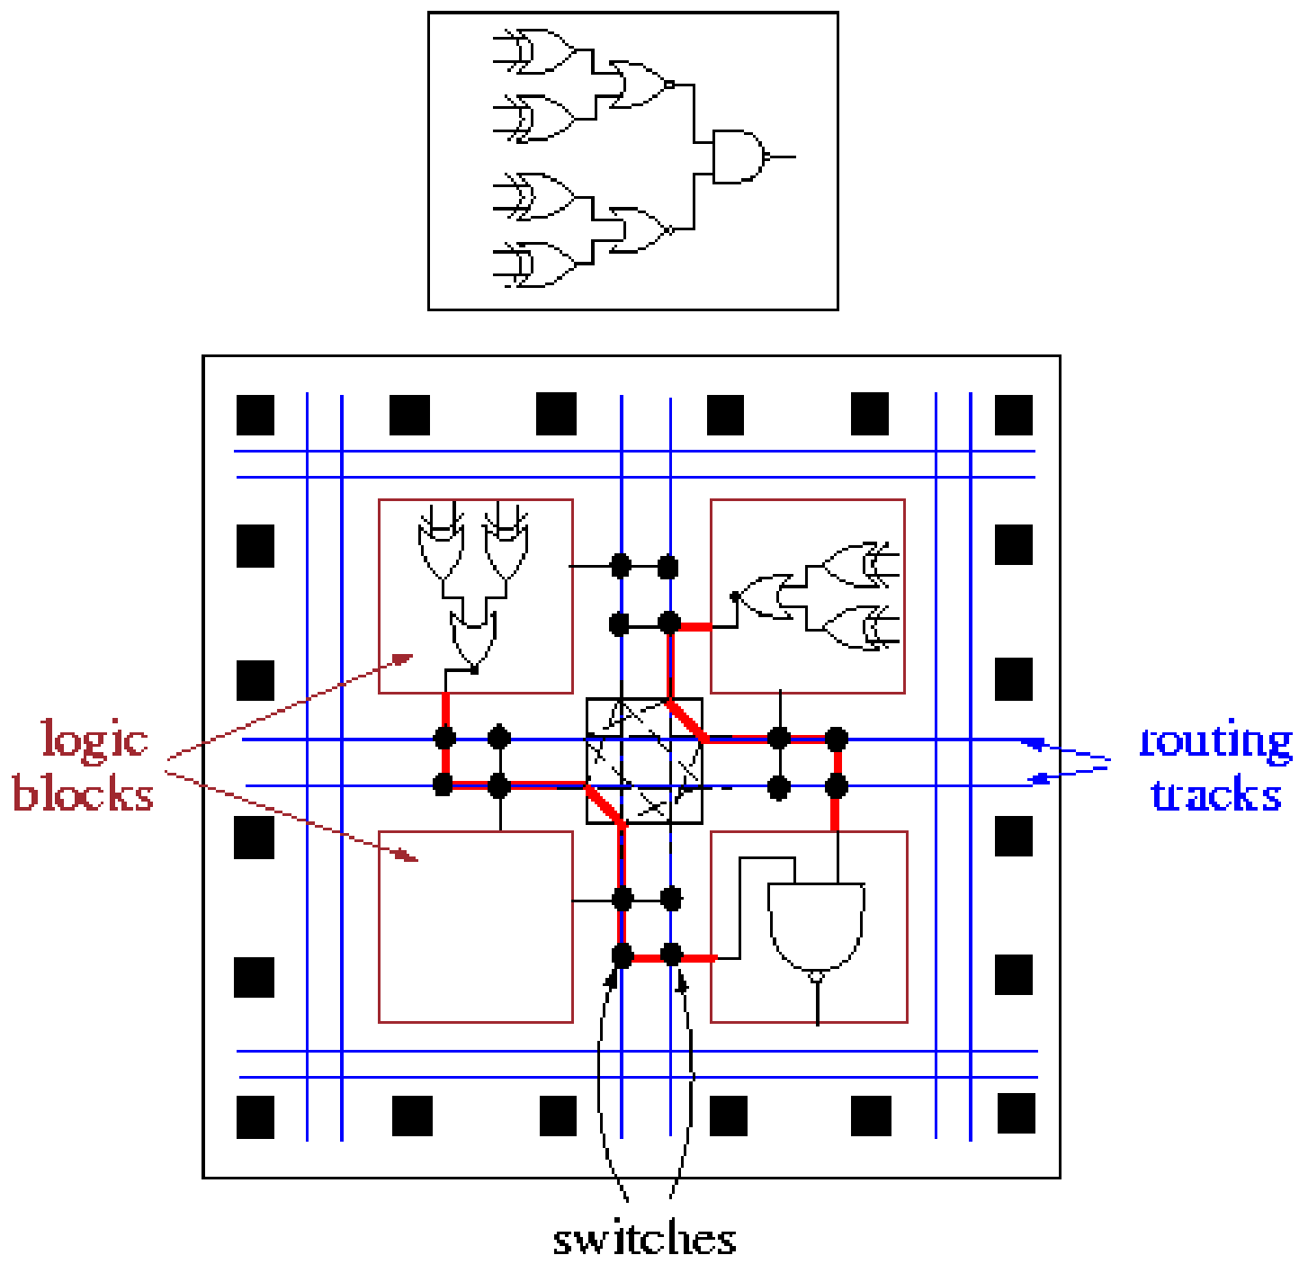
FPGA Placement & Routing

Slide 3
Placement
Placement:
Defines the amount of interconnect in the design
Large impact on performance and routability
Even worse in FPGA due to switches

Slide 4
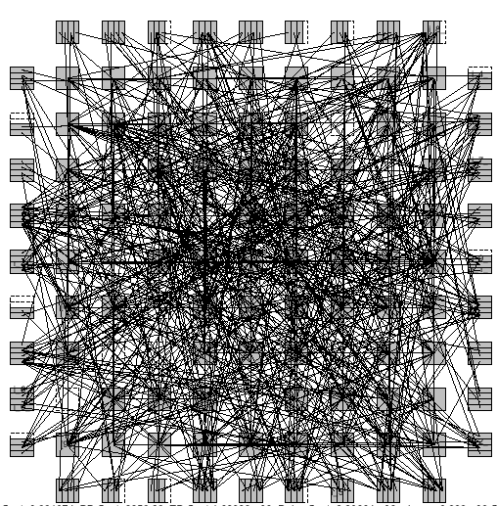
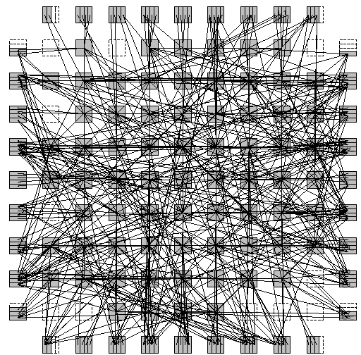
Placement Impact on Routing

Slide 5
Simulated Annealing
Annealing process for crystals
At high temperature
Molecules move freely
Get into and out of minimum energy state due to high speed
At low temperature
Molecules move slowly
If freezed fast, trap to local minimum energy state
→ fragie crystal
If cooling slowly enough, minimum energy state
Probability of getting out of minimum energy state decreases
→ solid crystal

Slide 6
Simulated Annealing
Simulates annealing process for placement
Initial placement
Random positions
Perturb by block exchanging
If Δcost < 0, → accept
otherwise, may still accept if const increase is not too much
Too much increase?
Depends on the algorithm stage

Slide 7
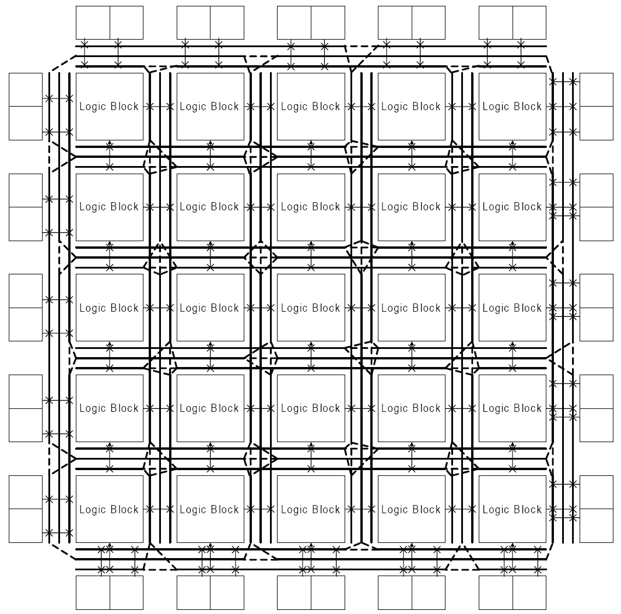
Island-Style Global Routing

Slide 8
Search Space
Avoids getting trapped in local minimum
Cost

Slide 9
Simulated Annealing Algorithm
Input: initial solution init_sol
Output: optimized new solution curr_sol
T = T₀ // initialization
i = 0
curr_sol = init_sol
curr_cost = COST(curr_sol)
while (T > T_{min})
while (stopping criterion is not met)
i = i + 1
trial_sol = TRY_MOVE(curr_sol) // try small local change
trial_cost = COST(trial_sol)
Δcost = trial_cost – curr_cost
if (Δcost < 0) // if there is improvement,
curr_cost = trial_cost // update the cost and
curr_sol = MOVE(curr_sol) // execute the move
else
r = RANDOM(0,1) // random number [0,1]
if (r < e ^{–Δcost/T}) // if it meets threshold,
curr_cost = trial_cost // update the cost and
curr_sol = MOVE(curr_sol) // execute the move
T = α ∙ T // 0 < α < 1, T reduction

Slide 10
Temperature Reduction Function
iteration

Slide 11
Cost Decrease
iteration
Cost of current placement

Slide 12
Accepted Moves
iteration

Slide 13
SA Paramters
The quality of results is highly dependent on parameters:
Initial Temperature
Final Temperature
Inner Loop Criterion
Cooling Schedule
Move Function
Cost Function

Slide 14
Range Limit
Range Limiter:
Defines maximum Δx and Δy accepted

Slide 15
Placement Algorithm: VPR
VPR:
Based on simulated annealing
Temperature updating:
T_{new}=T_{old}×γ
Idea:
If α too large due to high temperature
Decrease temperature faster
If α too small due to no significant improvement
Decrease temperature faster
Spend more time in good α range with more productive perturbs.
Cost:
Total wire length (Bounding box)
Congestion
acceptance rate

Slide 16
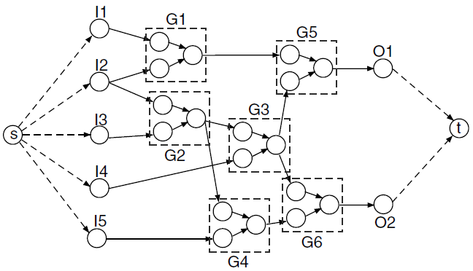
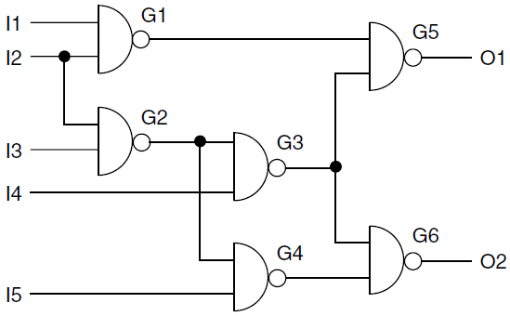
STA

Slide 17
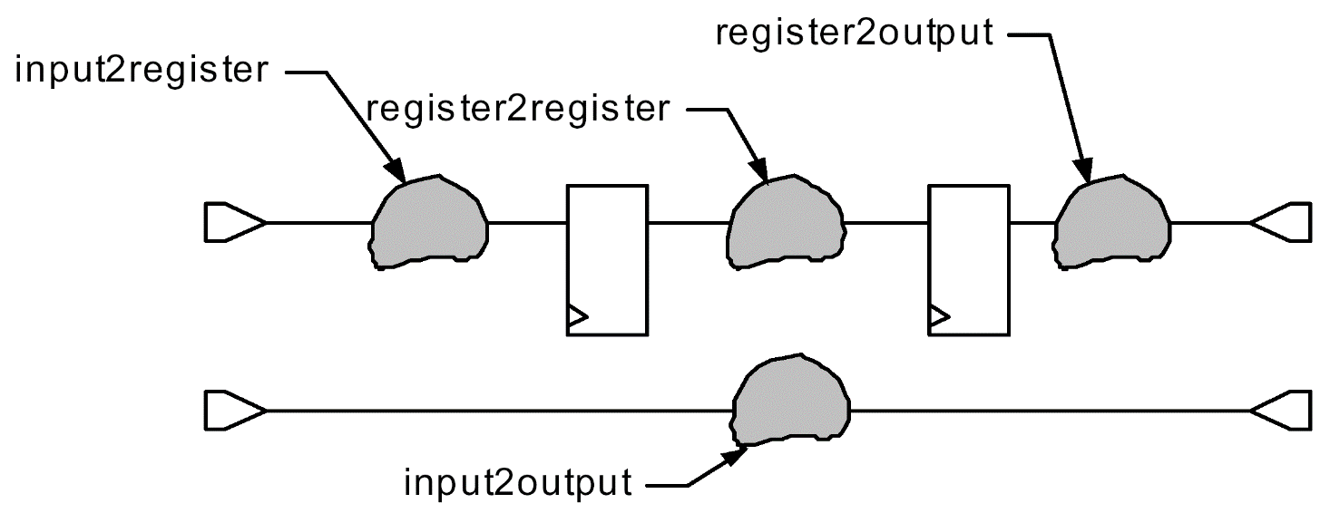
Sequential Circuits
Represented as:
a set of combinational blocks that lie between latches.
A timing graph may be constructed for each of these blocks
Inputs of graph: PIs + FF outputs
Outputs of graph: POs + FF inputs

Slide 18
STA Algorithm
Traverse in topological order
Apply:
18

Slide 19
STA Algorithm
0
2
2
13
0
3
0
6
6
0
10
17
4
2
0
2
2
0
15
0
5
3
3
0
Wire delays integrated

Slide 20
STA: Critical Path
Critical path:
Trace back from the PO with largest arrival time
This is the output of last block on critical path
Identify the latest arriving input of the block
Identify the block that causes this transition
Repeat

Slide 21
Critical Path: Example
0
2
2
13
0
3
0
6
6
0
10
17
4
2
0
2
2
0
15
0
5
3
3
0

Slide 22
Required Arrival Times
If timing constraints are specified:
For each node, must check if met or not
Useful to know which parts should be sped up
If AT_{node} > RT_{node}, ➔ the path that the node lies on must be sped up

Slide 23
Required Arrival Times
13
15
0
2
18
13
2
3
0
9
13
3
6
6
0
20
3
Min(15,13) = 13
4
2
0
10
17
7
9
2
0
2
7
18
0
5
10
13
15
0
3
10
3
0
Consider delays as –ve
Apply the same procedure from output to inputs
Arrow directions reversed

Slide 24
Slack
Slack of a node:
RT_{node} – AT_{node}
+ve slack s:
➔ Arrival time of that node can be increased by s w/o affecting the overall delay of circuit
→ Potential to optimize power/area/….
In FPGAs, >75% of nodes have > 50% slack [Anderson04]

Slide 25
Timing-Driven VPR
Timing-driven VPR:
Adds timing cost term to the objective function
Timing cost = summation of the delay times and the timing criticality over all connections in the design
Criticality of a net:
depends on its timing slack.
Every accepted move may change delays in a number of connections
→Change the slack distribution
→Static timing analysis is required to recompute all the slacks after each accepted move
→ Too costly (i.t.o. run time)
Update slacks after a number of moves (typically at the end of each temperature iteration)

Slide 26
Timing-Driven VPR
Timing-driven VPR:
Two terms in objective function → Careful scaling
Self-normalization:
Changes of timing cost and wirelength of a move are scaled by the total timing cost and total wirelength at the end of the previous temperature iteration
Very good results
Problem:
TD VPR minimizes the weighted delays of ALL connections where the weight of a connection depends on its slack.
→ Ignores important path sharing:
A connection appearing in many critical paths should be given a higher weight.
Difficult to capture:
An exponential number of paths going through a connection, each with a different timing criticality

Slide 27
PathFinder/VPR
A recent enhancement:
Ken Eguro Scott Hauck, “Enhancing Timing-Driven FPGA Placement for Pipelined Netlists,” DAC, 2008.

Slide 28
A Novel Net Weighting Algorithm for Timing-Driven Placement
Tim (Tianming) Kong, ICCAD 2002

Slide 29
Net-Weighting Approaches
Net weighting for timing-driven placement
Very popular in industry and academia
Advantages:
Low complexity
High flexibility
Ease of implementation

Slide 30
Net-Weighting Approaches
Basic idea:
Put a higher weight for nets that are more timing critical
A good net weighting algorithm should assign net weights based on path analysis.
Can be used with any length-based placement algorithm

Slide 31
Net-Weighting Approaches
Timing-driven placement:
A static timing analysis engine computes delay of longest path
Results are then used by the placement optimization engine to minimize longest path delay.
Longest path delay:
by computing the arrival time, iteratively:
s1
s2
t
s3
s4

Slide 32
Net-Weighting Approaches
Main Idea:
If two critical paths share a common segment, the edges in the common segment should receive higher weights.
Path counting is a general way to assign net weights with consideration of such effect.
Two path counting algorithm:
Critical Path Counting
Accurate All Path Counting

Slide 33
Critical Path Counting
After timing analysis:
Compute the total number of critical paths passing each edge
For each pin, define two variables:
F(p): the number of different critical paths starting from PI elements, terminating at p.
B(p): the number of different critical paths starting from PO elements, terminating at p, (if all signal flow directions are reversed).

Slide 34
Critical Path Counting
The number of different critical paths passing through an edge (s,t) :
GP(s,t) = F(s) * B(t)
Weights are assigned to nets proportional to GP(s,t).

Slide 35
Critical Path Counting Example
F(t) computations:
0
2
2
0
0
0
0
0
0
0
2
1
1
2
2
2
1
0
0
0
0
0
PI
PO

Slide 36
Critical Path Counting Example
B(t) computations:
0
1
1
0
0
0
0
0
0
0
2
2
2
2
1
1
2
0
0
0
0
0
PI
PO

Slide 37
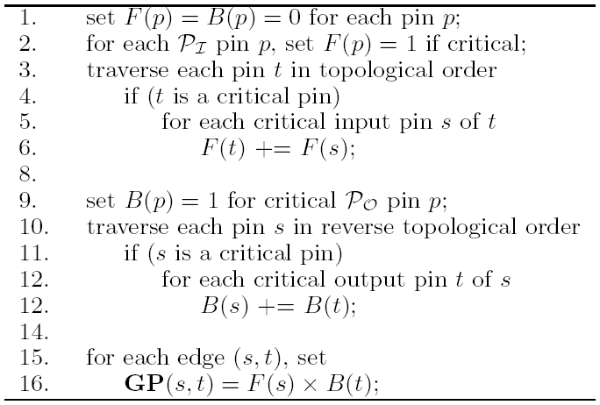
Pseudo code

Slide 38
Critical Path Counting Example
Selected edge share with 2 path
→ GP(s,t) = F(s) * B(t) = 2*2=4
t
s
PI
PO

Slide 39
Accurate All Path Counting
Define two variables:
Forward local slack for edge e(s,t):
Backward local slack for edge e(s,t):
Define a discount function:
a is a constant.

Slide 40
Example
0
0
80
0
20
50
110
0
0
PI

Slide 41
Discount function
D
1
1/a
x
Objective: put smaller weight on path with larger slack

Slide 42
Accurate All Path Counting
F(t) computations:
Assume:
a=2
T=10
D = a^{-Fs/T}
Fs (s1,t) = 2.8-1.2-1=0.6
D1=0.959
Fs (s2,t) = 2.8-1.4-1=0.4
D2=0.972
ARR=1.2
Fs (s3,t) = 2.8-1.3-1.5=0
D3=1
s1
Fs (s1,t) is larger, thus D1 is lower
Fs (s4,t) = 2.8-1.4-1.4=0
D4=1
1
ARR=1.4
s2
1
ARR=2.8
t
1.5
F(t) =D1*F(s1)+
D2*F(s2)+
D3*F(s3)+
D4*F(s4)
ARR=1.3
s3
1.4
s4
ARR=1.4

Slide 43
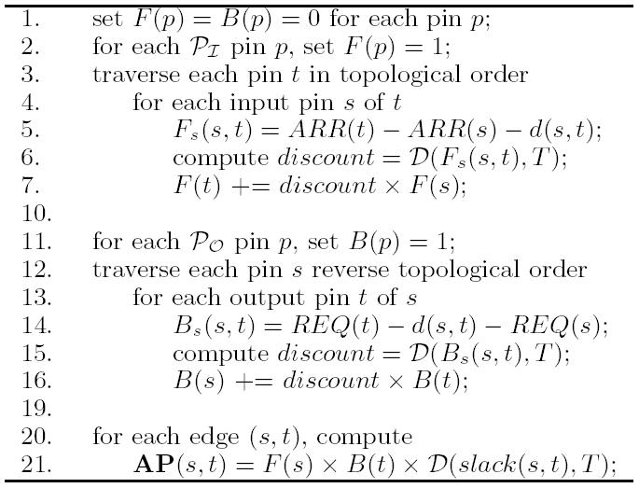
Pseudo code:

Slide 44
References
[Chen06] D. Chen, J. Cong and P. Pan, “FPGA Design Automation: A Survey,” Foundations and Trends in Electronic Design Automation, Vol. 1, No. 3, 2006, pp. 195–330.
Kong, “A Novel Net Weighting Algorithm for Timing-Driven Placement,” ICCAD 2002.
J. Luu, et al, “VPR 5.0: FPGA CAD and Architecture Exploration Tools with Single-Driver Routing, Heterogeneity and Process Scaling,” FPGA 2009.
VPR 5.0, http://www.eecg.utoronto.ca/vpr.
VPR 6.0, Beta Release, May 30, 2011
Now: as part of VTR 8, March 2020.
Murray, et al. "VTR 8: High Performance CAD and Customizable FPGA Architecture Modelling". ACM Transactions on Reconfigurable Technology and Systems, Vol. 13, No. 2, 2020, pp. 1-55.

