Slide 1
Routing Algorithms

Slide 2
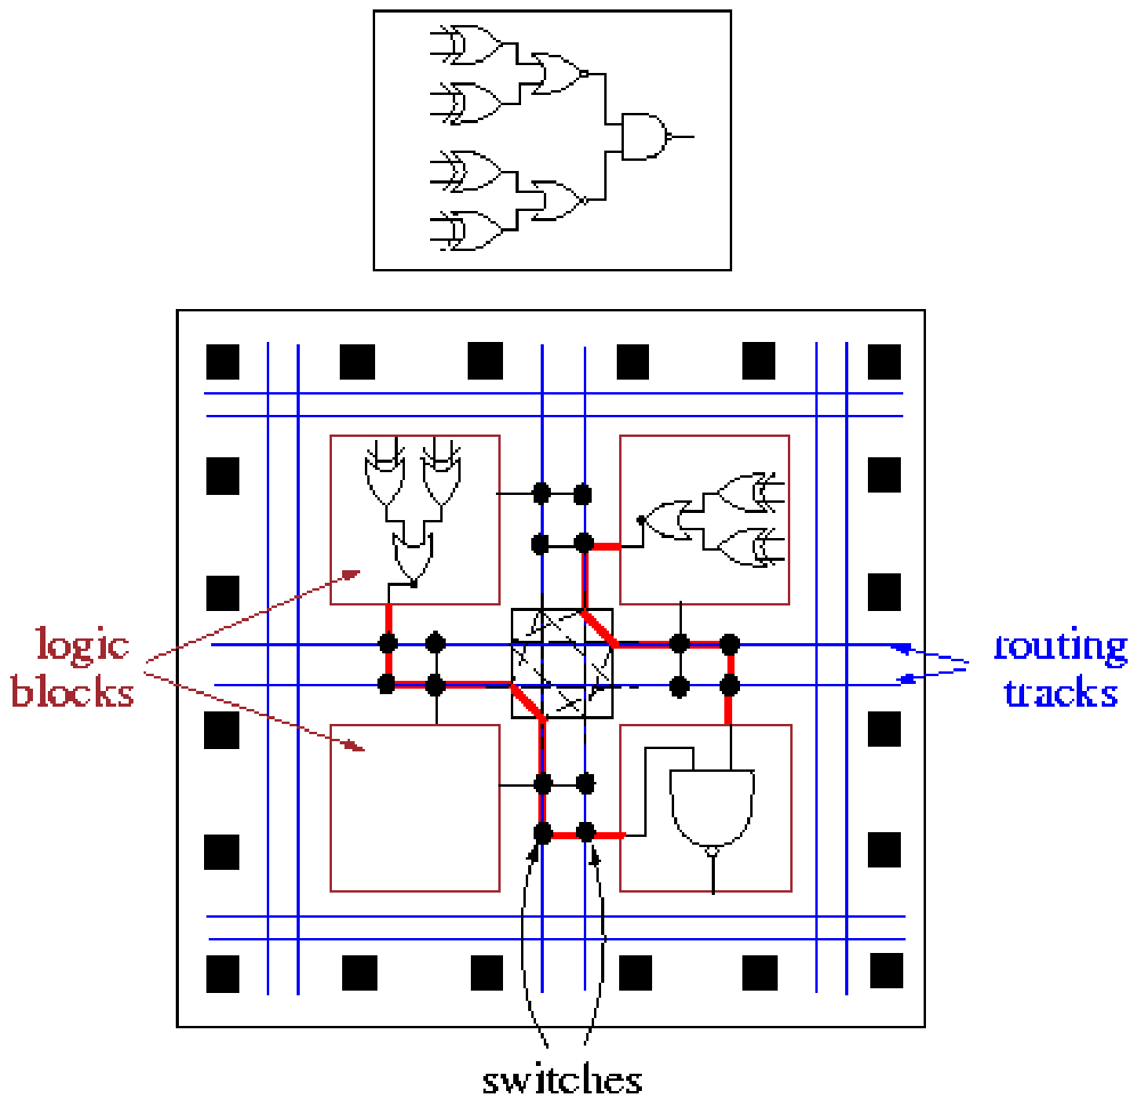
FPGA Placement & Routing

Slide 3
Routing
Routing:
  One of the most basic, tedious, yet important steps in FPGA designs
  Last step in the design flow → bit-stream
Definition:
  Successfully connect all signal nets subject to timing (and power) constraints
Compared to ASIC routing:
  More restricted: it can use only the prefabricated routing resources
    → 100% routability is more challenging

Slide 4
Routing Steps
Steps:
  Routing-resource graph generation
  Global routing (optional)
  Detailed routing

Slide 5
Routing Resource Graph
Routing resource graph:
  Models routing resources
  An abstract data representation
    Used by global and detailed routers
Vertices:
  Wire segments in the routing channels
  I/O pins of the logic blocks
Edges:
  Programmable switches that connect two vertices
    Unidirectional switch (e.g. buffer): directed edge
    Bi-directional switch, (e.g. pass transistor): a pair of directed edges

Slide 6
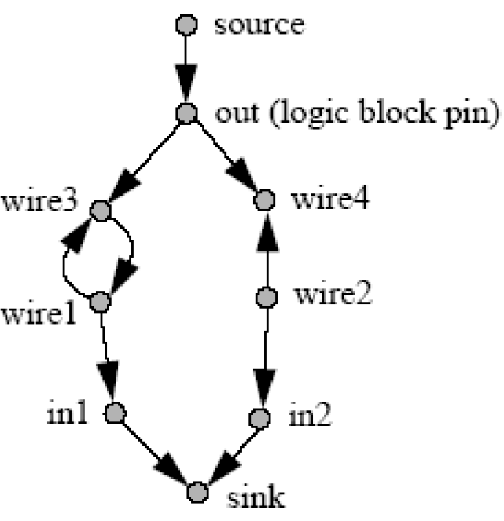
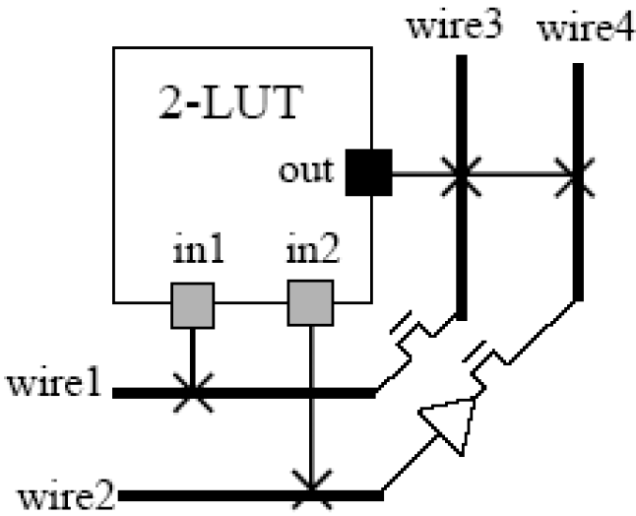
Routing Resource Graph
Modeling equivalent pins:
  A source vertex connects to all the logically equivalent output pins of a logic block,
  A sink vertex connects from all the logically equivalent input pins of a logic block

Slide 7


Routing Resource Graph
Vertex capacity:
  Maximum number of nets that can use this vertex in a legal routing.
Example:
  Source node capacity = 1
  Sink node capacity = 2
Routing resource graph is usually very large.
  → Tool generates it for a basic tile and replicates and stitches together.

Slide 8
Routing Steps in FPGA
Global routing:
  Divides the available routing area into channels or routing regions
  Determines the coarse routing topology of each net
    in terms of channels or routing regions that the net passes through
  Minimizes overall congestion
  Satisfies timing constraints of critical nets
Detailed routing:
  Generates detailed routing paths to implement every net in each routing channel or region

Slide 9
Global Routing
Coarse routing-resource graph (routing graph):
Vertices:
  Each routing channel (as opposed to each wire segment)
    Capacity:
      # of tracks in the channel.
  Each pin in a logic block
  Source and sink (for logically equivalent pins)
Edges:
  Available connections from logic block I/O pins to channels
  Available connections between adjacent channels

Slide 10
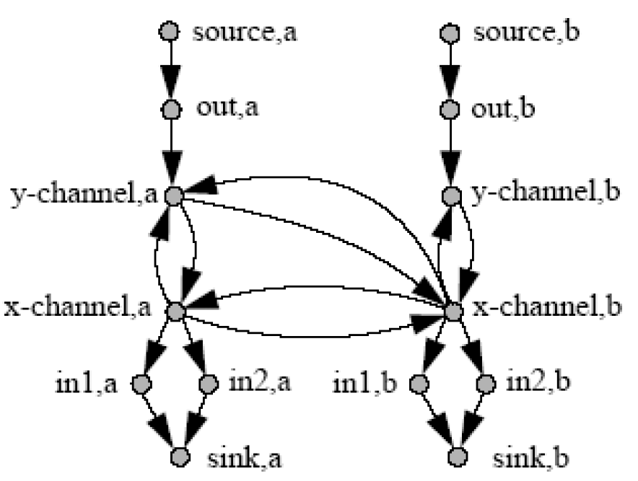
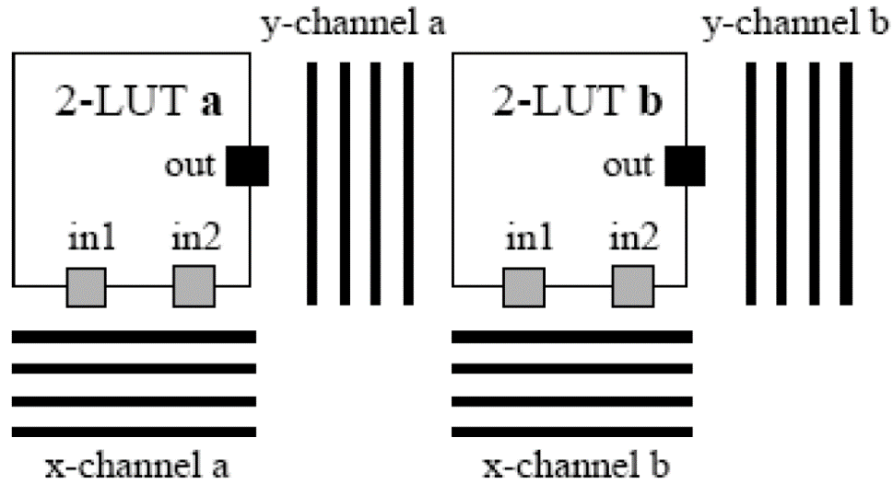
Coarse Routing Graph

Slide 11
Global Routing
Advantage:
  Reduce complexity
Disadvantage:
  GR has to use a rough model for available routing resources in each channel or routing region,
  GR doesn’t see the details of routing resource architecture:
    Distribution of different types of wire segments (single/double-length)
    Single/double driver
    ….
      → May greatly affect the success of DR, but is hard to model during GR.
Solution:
  Single-step routing

Slide 12
Global Routing
Global routing problem:
Input:
  Coarse routing-resource graph G
Output:
  Routing of each net on G such that
    all the channel capacity constraints are satisfied
    signal timing constraints on all the nets are satisfied
Challenge:
  Order dependency
  Timing consideration
  Focus on routability issues for now

Slide 13
GR Algorithms
GR problem very similar to ASIC:
  → May use many ASIC GR algorithms/techniques
Most successful FPGA GR:
  VPR/PathFinder:
    Negotiation-based GR

Slide 14
PathFinder/VPR
Negotiation-based router:
  Each net negotiates the use of shared resources with other nets until none of the resources are shared
At each iteration:
  All nets are routed each using the minimum cost even though leading to over-congestion.
    Costs: associated with the vertices in the routing graph in some routing channels
  Re-adjust each vertex cost based on whether the corresponding channel has overflowed in the current iteration (and previous iterations).
  Route all nets based on this new cost
  Repeat until all congestion is removed (or some pre-defined stopping criteria is met:
    e.g., maximum number of iterations

Slide 15
PathFinder/VPR
VPR cost function [Betz99]:
  For using routing resource n (node) when it is reached from routing resource m:
    Cost(n) = (b(n) + h(n)) . p(n) + BendCost(n,m)
  b(n): base cost:
    Delay of using node n (e.g., wire segment length or delay)
    Unchanged throughout the routing process
  p(n): present congestion penalty
    Depends on the amount of overflow at resource n
  h(n): historical penalty term
    Accumulates the congestion penalty in the previous iterations
  BendCost(n,m):
    Discourages bends in the routing solution

Slide 16
PathFinder/VPR
S₁
S₂
S₃
Edge labels:
  Cost of using the edges (switches)
Node capacities = 1
Problem:
  Signals to be routed from S_{i}’s to D_{i}’s
2
3
1
3
1
1
4
A
B
C
3
1
1
4
2
1
3
D₁
D₂
D₃
    Cost(n) = (b(n) + h(n)) . p(n) + BendCost(n,m)
Route ignoring congestion:
  Minimum cost path for each signal: through B!
First order congestion (h(n) = 0):
  For 1st iteration: p(n) = 1
    → No penalty for use of n regardless of how many signals occupy n
  Subsequent iterations:
    p(n) is increased gradually depending on how many signals share n.

Slide 17
PathFinder/VPR
S₁
S₂
S₃
2
3
1
3
1
1
4
A
B
C
3
1
1
4
2
1
3
D₁
D₂
D₃
1st iteration:
  All signals use B
Later iterations:
  Signal 1 finds that a route through A gives lower cost than congested node B.
Later:
  Signal 3 finds a better route through C.
Abrupt increase in p(n):
  → Oscillation

Slide 18
PathFinder/VPR
2nd order congestion:
S₁
S₂
S₃
2
1
2
1
1
A
B
C
2
  1
2
1
1
D₁
D₂
D₃
Sequential rip-up & re-route:
  Signal 1 uses B, Signal 2 and Signal 3 share C
    To succeed, both Signals 1 and 2 should be rerouted.
    Signal 2 must be re-routed first.
    Signal 1 does not use congested node
      → Difficult to determine that it should be rerouted first
→ Cannot be solved by p(n) alone

Slide 19
PathFinder/VPR
2nd order congestion:
S₁
S₂
S₃
2
1
2
1
1
A
B
C
2
  1
2
1
1
D₁
D₂
D₃
h(n) (history):
  Increased slightly each iteration that C is shared
  After some iterations, C becomes more expensive than B
  If Signal 2 uses B, B is shared by Signal 1 and Signal 2
    → Signal 1 uses A later.

Slide 20
PathFinder/VPR
Routing of each net:
  Maze routing

Slide 21
Grid Graph
Routing of each net:
  Maze routing
S
S
S
X
X
T
T
X
X
T
Area Routing
Grid Graph
(Maze)
Simplified
Representation

Slide 22
Basic Idea
Maze Routing:
  A Breadth-First Search (BFS) of the grid graph.
  Always find the shortest path possible.
Consists of 2 phases:
  Wave Propagation
  Retrace

Slide 23
An Illustration
S
0
1
2
3
1
2
3
3
4
5
5
4
5
T
6

Slide 24
Wave Propagation
Wave propagation:
  At step i, all vertices at Manhattan-distance i from S are labeled with i.
  A Propagation List (FIFO) is used to keep track of the vertices to consider in next step.
S
S
S
0
1
2
3
0
0
1
2
3
1
2
3
1
2
3
3
3
4
5
T
T
5
4
5
T
6
After Step 0
After Step 3
After Step 6

Slide 25
Retrace
Retrace:
  Trace back the actual route.
  Starting from T.
  At vertex with i, go to any vertex with label i-1.
S
0
1
2
3
1
2
3
3
4
5
5
4
5
T
6
Final Labeling

Slide 26
Example
2
A
1
2
2
B

Slide 27
Example (continued)
7
6
5
4
3
4
5
6
7
8
9
10
11
12
6
5
4
3
2
3
4
5
6
7
8
9
10
11
12
7
6
A
1
2
3
4
5
6
7
8
9
10
11
8
7
2
3
11
12
9
8
3
4
12
10
9
4
5
6
7
8
9
10
11
12
11
10
5
6
7
8
9
10
11
10
9
8
7
6
7
8
9
10
11
12
B
11
10
9
8
7
8
9
10
11
12

Slide 28
Retrace the Path
7
6
5
4
3
4
5
6
7
8
9
10
11
12
6
5
4
3
2
3
4
5
6
7
8
9
10
11
12
7
1
6
A
1
2
3
4
5
6
7
8
9
10
11
2
8
7
2
3
11
12
3
4
12
9
8
3
10
9
4
6
10
4
5
7
8
9
11
12
5
6
9
11
11
10
5
7
8
10
6
7
8
9
10
11
12
10
9
8
7
6
7
8
9
10
11
12
B
11
10
9
8
7
8
9
10
11
12

Slide 29
Alternative Paths
7
6
5
4
3
4
5
6
7
8
9
10
11
12
6
5
4
3
2
3
4
5
6
7
8
9
10
11
12
7
6
A
1
2
3
4
5
6
7
8
9
10
11
8
7
2
3
11
12
9
8
3
4
12
10
9
4
5
6
7
8
9
10
11
12
11
10
5
6
7
8
9
10
11
10
9
8
7
6
7
8
9
10
11
12
B
11
10
9
8
7
8
9
10
11
12
Guideline: do not change direction unless you must

Slide 30
Connecting Multipoint Nets
One point is selected as the source and all the other points are the target
  Propagate from the source until one target is reached
  Find the path from the source to that target
  All the cells on the path are labeled as source cells and the remaining unconnected pins are targets
  Repeat the steps

Slide 31
Example
2
1
4
3
2
1
1
4
3
2
1
2
5
4
3
3
4
3
2
1
S
1
2
2
3
2
1
3
3
4
1
4
5
4
3
3
T
4
3
1
4
1
2
2
5
3
4
2
1
2
1
4
1
4
2
5
3
2
1
3
4
5
3
3
4
2
3
1
5
2
5
4
1
4
4
3
3
4
2
1
T
2
4
5
2
5
1
4
3
4
3
4
5
4
3
2
1
2
3
Start at the source and run the maze router until you hit a target
Every cell on the path is a source – run the maze router

Slide 32
Global Routing
Similarity with standard-cell global routing problem:
  → Recent advances in std-cell algorithm:
    BoxRouter, … can be employed

Slide 33
Detailed Routing

Slide 34
Detailed Routing
Detailed routing:
  Implements each route in the coarse routing-resource graph in the detailed routing-resource graph so that there is no resource conflict
  There are different types of wire segments and programmable switches in a channel
    → # of possible ways to implement each route in the coarse routing graph is still quite large.

Slide 35
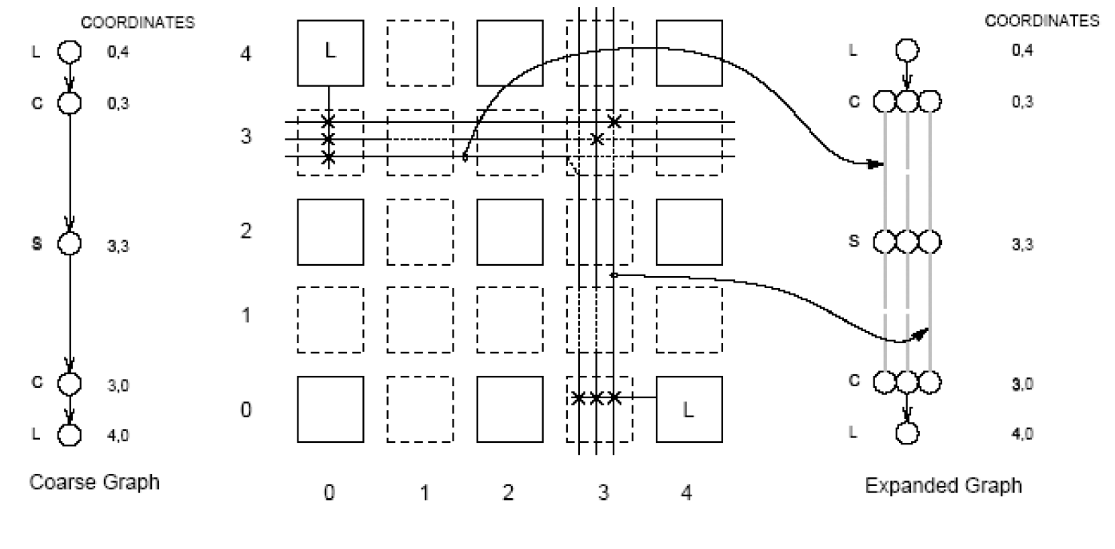
Expansion Graph
Expansion graph generation:
  For each global route, enumerate all possible detailed routes in the routing-resource graph that go through the same set of channels.

Slide 36
Expansion Graph
Cost:
  For each detailed route p, a cost is associated in the expansion graph based on:
    # of segments used
    waste of long segments by short connections,
    # of alternative paths to p
      Identify paths that are essential for a connection.
    impact that the selection of p has on other paths in the expansion graph
      Select paths that have fewest negative effects on others

Slide 37
Combined GR/DR
VPR router:
  Uses the negotiation-based approach
  Applies exactly the same GR engine for combined GR/DR on the detailed routing-resource graph

Slide 38
Timing Optimization in Routing
Timing optimization is important
  since routing delays in FPGA designs are significant
    largely due to the extensive use of programmable switches
Timing analysis:
  Given a mapped and placed circuit, one can perform STA to compute the signal arrival/required times at every pin.
    → Compute slacks
Levels of optimization techniques:
  Routing order optimization
  Routing tree topology optimization
  Slack distribution (not discussed)
  Net weighting (not discussed)

Slide 39
Timing Optimization in Routing
Routing order optimization:
  Order nets based on their slacks
  Timing-critical nets (i.e., small slacks) are routed first to avoid long detours.
    Almost all timing-driven routers do this
Optimize routing tree topologies of timing-critical nets:
  Routes a timing-critical net by an arborescence
    A routing tree with the shortest path from the source to every sink in the routing graph
  and also tries to minimize the total routing cost of the arborescence

Slide 40
Arborescence
Steiner Minimum Tree
Arborescence
Arborescence with reduced length

Slide 41
Timing Optimization in Routing
PathFinder and VPR:
  Use a delay penalty term in the routing cost function
    Balances the delay and congestion optimization
    Cost(n)=Crit(i, j) . delay(n,topology) + [1 − Crit(i, j)] . b(n) . h(n) . p(n)
  Crit(i, j): Shows criticality of sink j of net i (in [0,0.99])
    0.99 avoids ignoring congestion for the most timing critical nets
  delay(n, topology): Elmore delay at the vertex n given the partial routing topology constructed so far

Slide 42
References
  [Chen06] D. Chen, J. Cong and P. Pan, “FPGA Design Automation: A Survey,” Foundations and Trends in Electronic Design Automation, Vol. 1, No. 3 (2006) 195–330.
  [Betz99] V. Betz, J. Rose, and A. Marquardt. Architecture and CAD for Deep-Submicron FPGAs. Kluwer Academic Publishers, 1999.
  [Mcmurchie95] L. Mcmurchie and C. Ebeling. PathFinder: A negotiation-based performance-driven router for FPGAs. In Proceedings of International Symposium on Field-Programmable Gate Arrays, February 1995.

