Slide 1
In-System Integration

Slide 2
Types of Using Reconfigurable Devices
Reconfigurable devices (RD) are usually used in three different ways:
Rapid prototyping
Non-frequently reconfigurable systems
Frequently reconfigurable systems

Slide 3
1. Rapid Prototyping
The RD is used as emulator for a circuit to be produced later as ASIC.
The emulation process allows for testing the correctness of the circuit, before production.
Reconfiguration only when a new implementation of ASIC is needed.

Slide 4
2. Non-Frequent Reconfiguration
The RD is used as application specific device similar to ASIC.
Possibility of upgrading the system by means of reconfiguration.
Configuration usually in EEPROM/flash.
No reconfiguration during operation.

Slide 5
3. Frequent Reconfiguration
Usually coupled with a processor
RD is used as an accelerator for time-critical parts of applications.
The processor accesses the RD using function calls.
More and more stand-alone frequently reconfigurable systems are appearing.

Slide 6
Classification: Proximity
Degree of Coupling with CPU:
Reconfigurable fabric as a standalone device
Communication by existing CPU I/O mechanism.
Slow data transfer
→ Applications in which a significant amount of processing can be done by the fabric without processor intervention.
E.g. emulation systems: (Cadence Palladium, Mentor’s Vstation Pro)
[Todman05]
[Compton02]

Slide 7
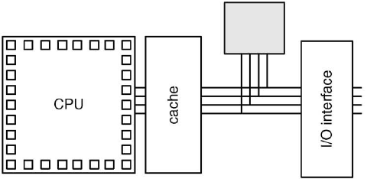
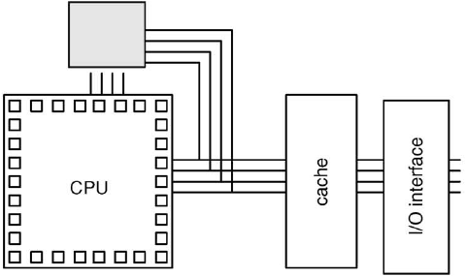
Classification: Proximity
Degree of Coupling with CPU:
As an attached processing unit/co-processor
Acts as an extra processor in a multi-processor system/co-processor.
Host and the reconfigurable logic can execute simultaneously.
Cost of communication is lower
Cannot/can see the host’s Cache
Examples:
PipeRench
Garp
MorphoSys
PAM
OneChip

Slide 8
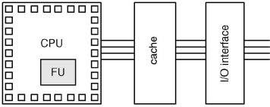
Classification: Proximity
Degree of Coupling with CPU:
As a functional unit
Very tightly-coupled
RFUs execute as functional units on the main microprocessor datapath,
Registers used to hold the input and output operands
RFU allows custom instructions (may change over time)
Examples:
MATRIX
RAW

Slide 9
Classification: Proximity
Degree of Coupling with CPU:
CPU embedded in reconf fabric
Hard core
Soft core

Slide 10
Proximity: Summary
Tighter Coupling:
Lower communication overhead
→Reconf. h/w can be used more frequently within an application.
Reconf. h/w is unable to operate for significant portions of time without intervention of host.
Amount of reconfigurable logic available often limited.
Looser Coupling:
Greater parallelism in program execution,
Higher communications overhead.

Slide 11
Classification: Proximity

Slide 12
Terminology

Slide 13
Static and Dynamic Reconfiguration
Offline Reconfigurable System
(static)
Run-time reconfigurable systems
Static
Dynamic

Slide 14
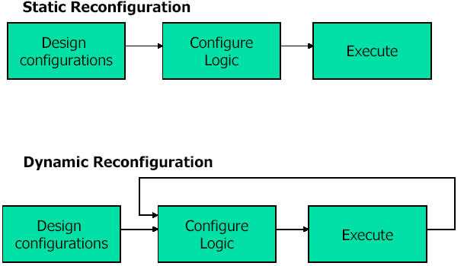
Offline vs. Run-Time Reconfiguration

Slide 15
Static and Dynamic Reconfiguration
Off-line static reconfigurable systems
The computation and reconfiguration is defined once at compile time.
No reconfiguration during run-time

Slide 16
Static and Dynamic Reconfiguration
Run-time static reconfigurable systems
The computation and reconfiguration is defined once at compile time
The computation and reconfiguration sequences are known at compile-time
Reconfiguration during run-time

Slide 17
Static and Dynamic Reconfiguration
Run-time dynamic reconfigurable systems
The computation and reconfiguration sequences are not known at compile-time.
The system reacts dynamically at run-time to computation.

Slide 18
References
[Bobda07] C. Bobda, “Introduction to Reconfigurable Computing: Architectures, Algorithms and Applications,” Springer, 2007.
[Todman05] T.J. Todman, G.A. Constantinides, S.J.E. Wilton, O. Mencer, W. Luk and P.Y.K. Cheung, “Reconfigurable computing: architectures and design methods,” IEE Proceedings, 2005.
[Compton02] K. Compton, S. Hauck, “Reconfigurable Computing: A Survey of Systems and Software, ACM Computing Surveys,” Vol. 34, No. 2, June 2002, pp. 171–210.

