Slide 1
Iteration

Slide 2
Iteration and Loop
Iteration is the process of repeating a set of instructions multiple times, either for a fixed number of times or until a certain condition is met.
A loop is a programming tool that repeats a block of code as long as a condition is true or for a set number of times.
There are two main types of loops:
while loop – repeats while a condition is true.
for loop – repeats a set number of times or through a list.
For example, if you want to print "Hello" five times, you can use a loop instead of writing the same line five times.

Slide 3
Why iteration
We use iteration to avoid writing repetitive code. It helps:
Save time and effort: You don’t have to write the same line many times.
Make programs shorter and easier to read.
Handle large tasks: Like processing every item in a list or printing something 1000 times.
Update values automatically: Such as
counting,
checking conditions,
running a program until something changes.

Slide 4
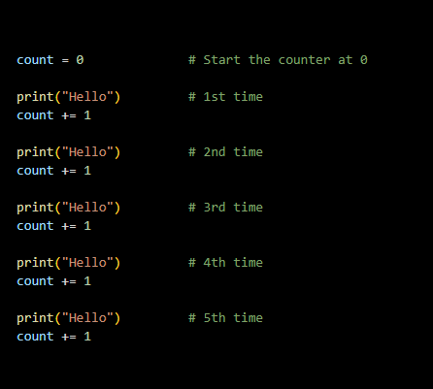
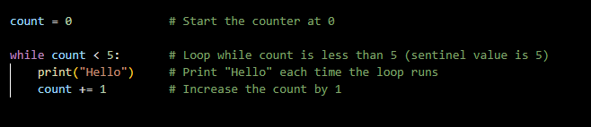

Slide 5
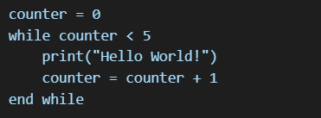
Pseudocode and Flowchart
Pseudocode: A way of writing the steps of a program in plain English-like language, without following the exact syntax of a programming language.
Example:

Slide 6
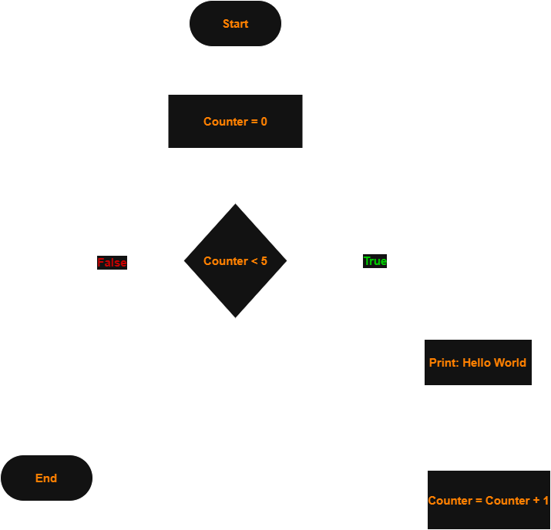
Pseudocode and Flowchart continue
Flowchart: A visual diagram that shows the steps and decision points in a process or program using arrows and shapes like rectangles (for actions) and diamonds (for decisions).

Slide 7
While loop
A control structure that repeats a block of code as long as a given condition is true. It checks the condition before each repetition.
Syntax of While Loop
while condition:
# code to repeat
Example
count = 0
while count < 5:
print("Hello")
count += 1

Slide 8
Infinite Loop
An infinite loop is a loop that never ends because its condition is always true, or the condition never becomes false.
Why it happens:
Using a condition that is always true, like while True: without a break.
Solution:
Make sure the loop condition will eventually become false.
Use Ctrl + C to stop it in the terminal if it runs by mistake.
Example
counter = 0
while counter < 5:
print(counter)
# Missing: counter += 1

