Slide 1
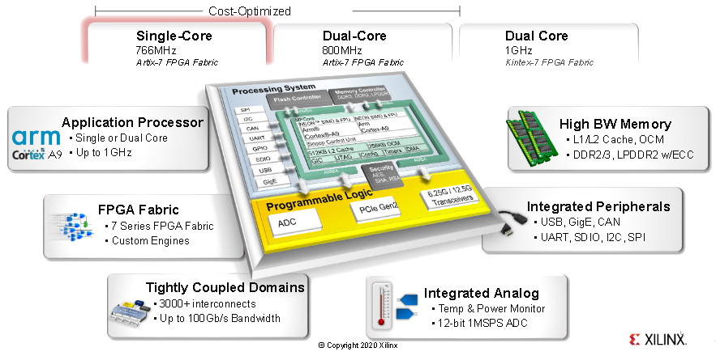
Zynq 7000: Analog Devices FMCOMMS1 module integration
Aleksei Rostov, PhD,
Senior R&D Engineer,
FPGA/Embedded Linux Developer,
aleksei.rostov@protonmail.com

Slide 2
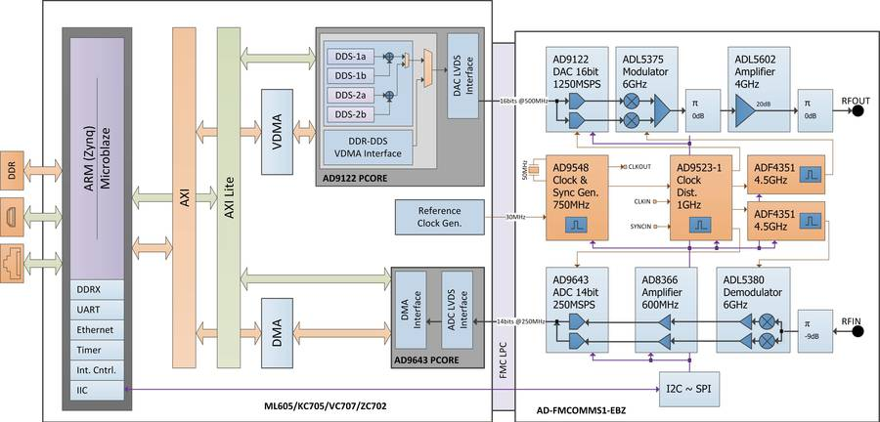
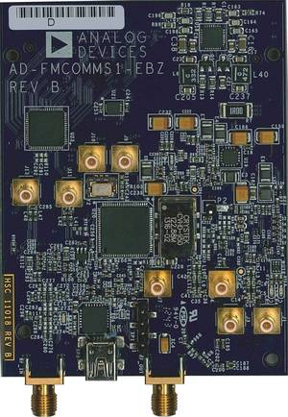
FMCOMMS1 functional scheme

Slide 3
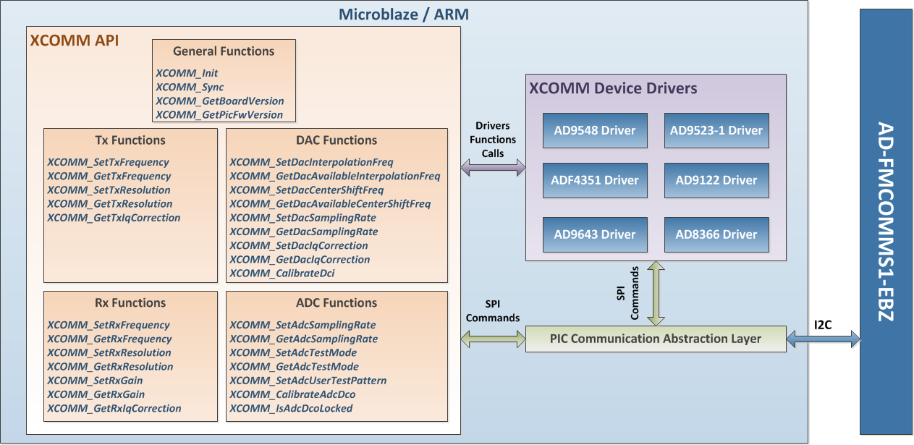
FMCOMMS1 THIRD-PARTY API

Slide 4
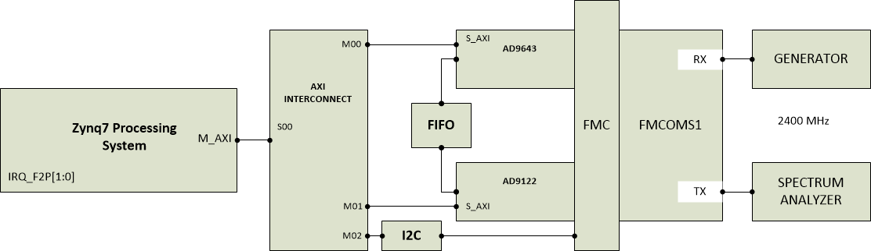
HARDWARE DESIGN
aleksei.rostov@protonmail.com

