Slide 1
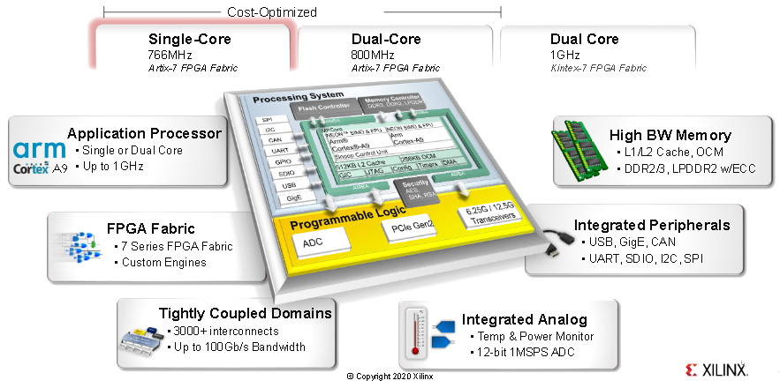
Zynq 7000: digital signal processing with FMCOMMS1 module
Aleksei Rostov, PhD,
Senior R&D Engineer,
FPGA/Embedded Linux Developer,
aleksei.rostov@protonmail.com

Slide 2
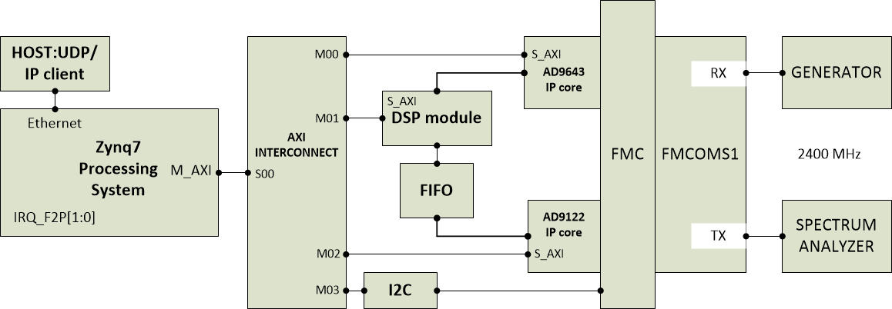
HARDWARE DESIGN
aleksei.rostov@protonmail.com

Slide 3
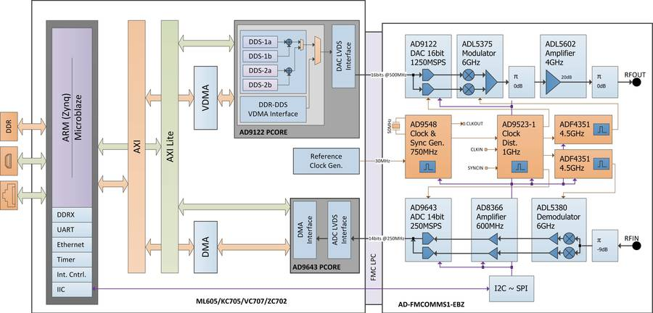
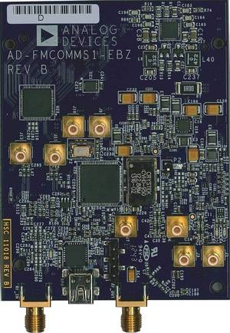
FMCOMMS1 functional scheme

Slide 4
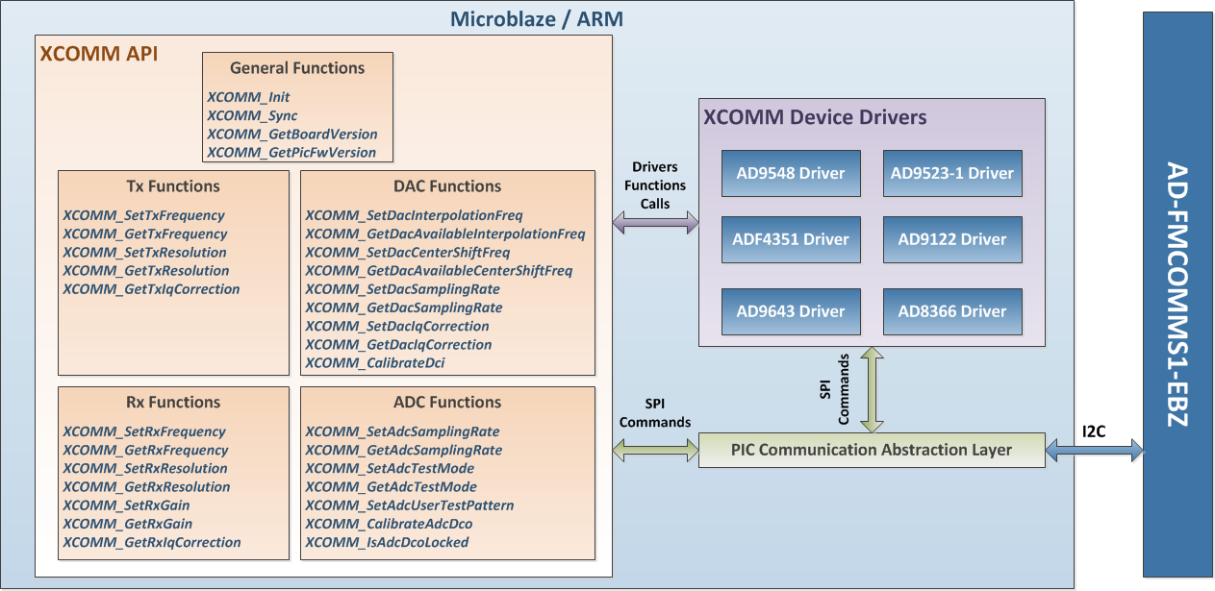
FMCOMMS1 THIRD-PARTY API

