Slide 1
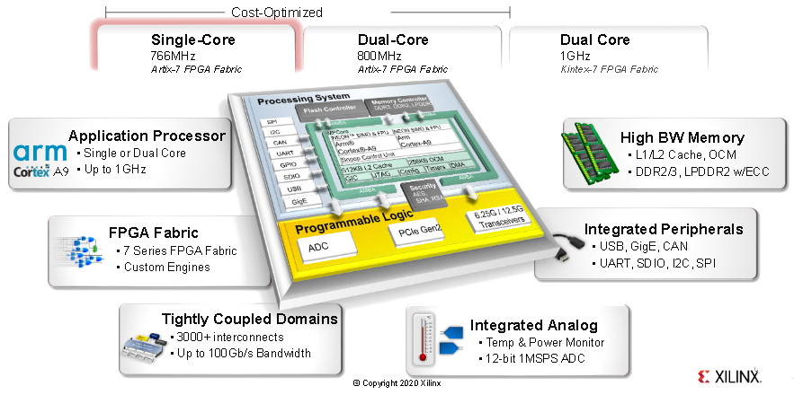
Zynq 7000: Linux start guide, AXI GPIO example
Aleksei Rostov, PhD,
Senior R&D Engineer,
FPGA/Embedded Linux Developer,
aleksei.rostov@protonmail.com

Slide 2
sudo apt-get install -y gcc git make net-tools libncurses5-dev tftpd zlib1g-dev libssl-dev flex bison libselinux1 gnupg wget diffstat chrpath socat xterm autoconf libtool tar unzip texinfo zlib1g-dev gcc-multilib build-essential libsdl1.2-dev libglib2.0-dev zlib1g:i386 screen pax gzip gawk
sudo -s
mkdir -p /opt/pkg/petalinux
chown <your_user_name> /opt/pkg/
chgrp <your_user_name> /opt/pkg/
chgrp <your_user_name> /opt/pkg/petalinux/
chown <your_user_name> /opt/pkg/petalinux/
exit
cd ~/Downloads
./petalinux-v2017.4-final-installer.run /opt/pkg/petalinux
source /opt/pkg/petalinux/settings.sh
petalinux-create --template zynq --type project --name test
cd test
petalinux-config --get-hw-description=project_vivado.sdk
petalinux-build
petalinux-package --boot --format BIN --fsbl ./images/linux/zynq_fsbl.elf --fpga ./images/linux/design_1_wrapper.bit --u-boot

Slide 3
