Slide 1
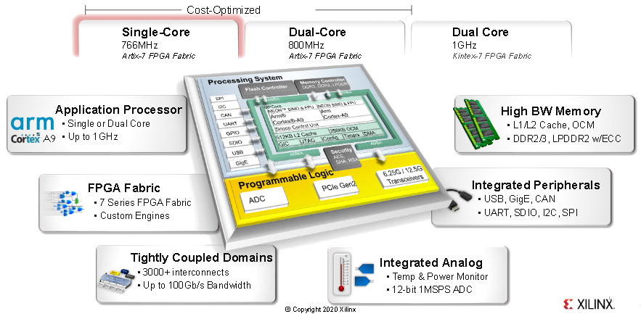
Zynq 7000: Overview, GPIOs, Interrupt Controller
Aleksei Rostov, PhD,
Senior R&D Engineer,
FPGA/Embedded Linux Developer,
aleksei.rostov@protonmail.com

Slide 2
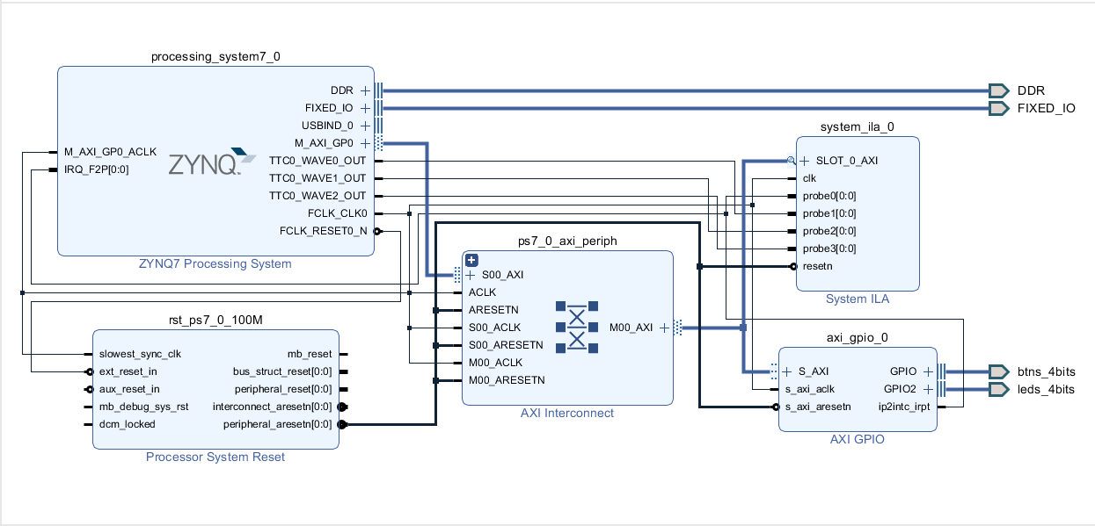
AGENTA
Zynq 7000 overview
Implementation AXI GPIO and interrupt
aleksei.rostov@protonmail.com

Slide 3
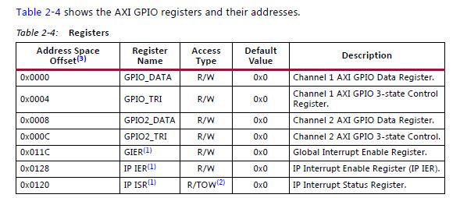
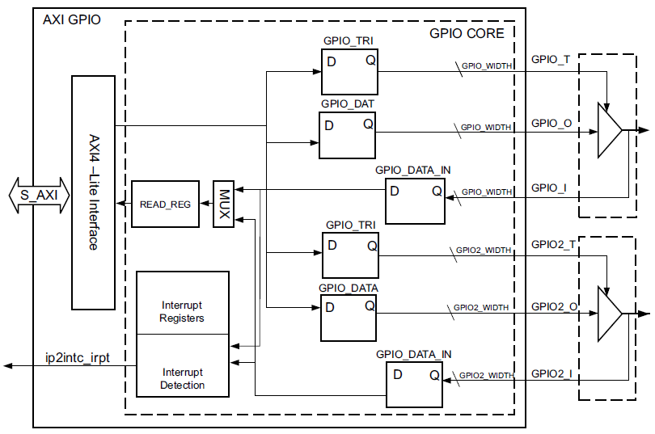
AXI GPIO
AXI GPIO MODULE
aleksei.rostov@protonmail.com

Slide 4
Hardware design with Vivado HLS IP cores integrated
aleksei.rostov@protonmail.com

