Slide 1
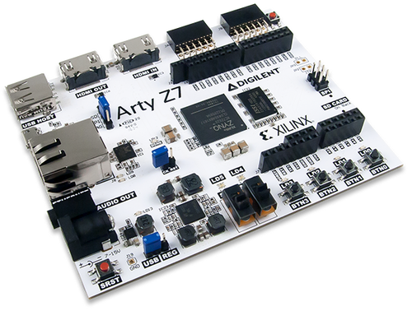
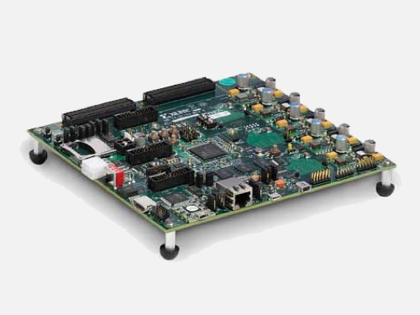
IQ demodulator: FIR FILTER – hardware design and implementation
Aleksei Rostov, PhD,
Senior R&D Engineer,
FPGA/Embedded Linux Developer,
aleksei.rostov@protonmail.com

Slide 2
DESIGN FLOW
MATLAB model
Functional simulation (Testbench)
Synthesis, implementation and bitstream generating
Debugging using logic analyzer and VIO IP core
FIR filters in IQ demodulator
aleksei.rostov@protonmail.com

Slide 3
PROJECT MODULES and hardware design
Virtual IO
Lowpass FIR
Controller DDS
DDS compiler
Bandpass FIR
System ILA
Highpass FIR
Hardware design for FPGA
freq_0
control_dds.v
Timer process
dfreq
phase_data
t_mod
phase_vld
turn_on
Phase computing process
sync
sin2lfm
Controller for DDS
aleksei.rostov@protonmail.com

