Slide 1
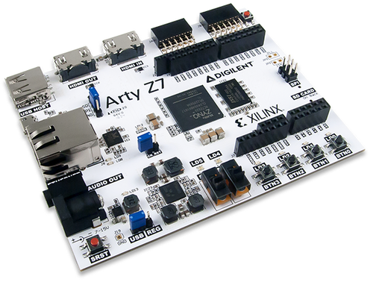
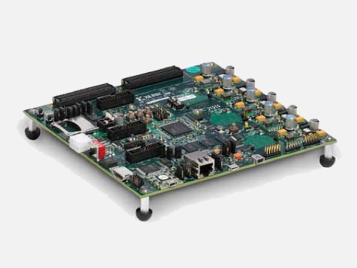
IQ demodulator: FIR FILTER – hardware design and implementation
Aleksei Rostov, PhD,
Senior R&D Engineer,
FPGA/Embedded Linux Developer,
aleksei.rostov@protonmail.com

Slide 2
DESIGN FLOW and hardware design
MATLAB model
Functional simulation (Testbench)
Synthesis, implementation and bitstream generating
Debugging using logic analyzer and VIO IP core
Virtual IO
Lowpass FIR
Controller DDS
DDS compiler
Bandpass FIR
System ILA
FIR filters in IQ demodulator
freq_0
control_dds.v
Timer process
Highpass FIR
dfreq
phase_data
t_mod
phase_vld
turn_on
Phase computing process
sync
sin2lfm
Hardware design for FPGA
Controller for DDS
aleksei.rostov@protonmail.com

