Slide 1
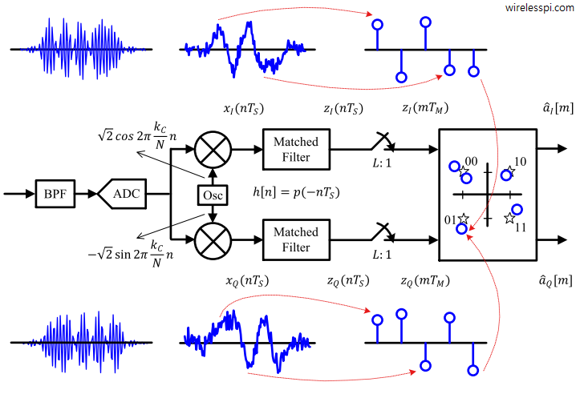
Frequency and Phase modulation (HDL design)
Aleksei Rostov, PhD,
Senior R&D Engineer,
FPGA/Embedded Linux Developer,
aleksei.rostov@protonmail.com

Slide 2
DESIGN FLOW
AGENTA
Digital system MATLAB model with modulation subsystem
HDL design and implementation (Verilog) of digital system
MATLAB model
Functional simulation (Testbench)
Synthesis, implementation and bitstream generating
Debugging using logic analyzer and VIO IP core
aleksei.rostov@protonmail.com

