Slide 1
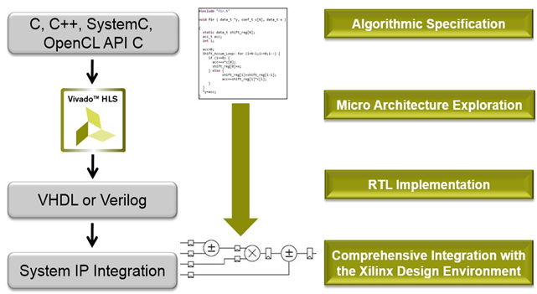
Vivado HLS: up/down converters, IQ frequency and phase modulation
Aleksei Rostov, PhD,
Senior R&D Engineer,
FPGA/Embedded Linux Developer,
aleksei.rostov@protonmail.com

Slide 2
DESIGN FLOW
AGENTA
Vivado HLS: up/down converter, frequency/phase modulator
HDL design and implementation (Verilog) of digital system
Vivado HLS
Functional simulation (Testbench)
Synthesis, implementation and bitstream generating
Debugging using logic analyzer and VIO IP core
aleksei.rostov@protonmail.com

Slide 3
Vivado HLS modules: simulation, optimization, IP exporting
IQ demodulator
IQ modulator
Frequency, Phase modulator
aleksei.rostov@protonmail.com

Slide 4
Hardware design with Vivado HLS IP cores
Hardware design with Vivado HLS IP cores integrated
aleksei.rostov@protonmail.com

