Slide 1
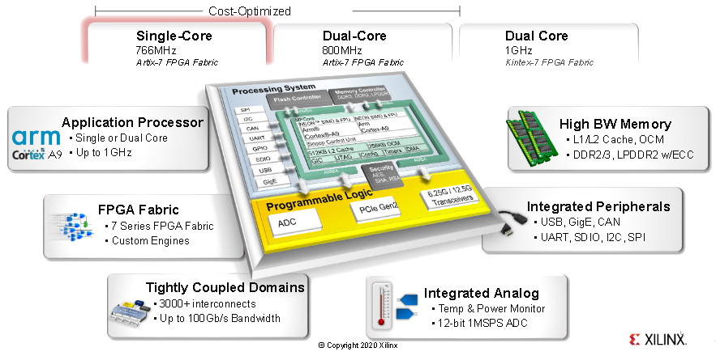
Zynq 7000: Lightweight IP, FSBL
Aleksei Rostov, PhD,
Senior R&D Engineer,
FPGA/Embedded Linux Developer,
aleksei.rostov@protonmail.com

Slide 2
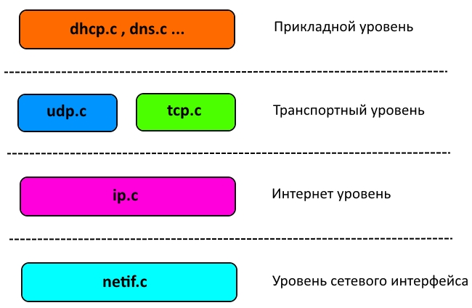
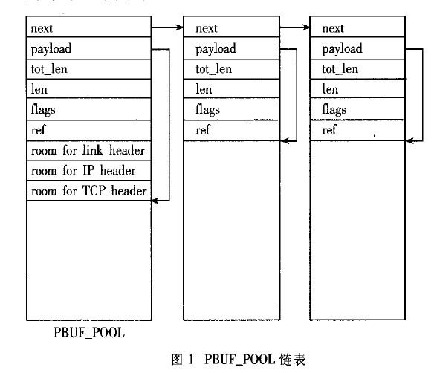
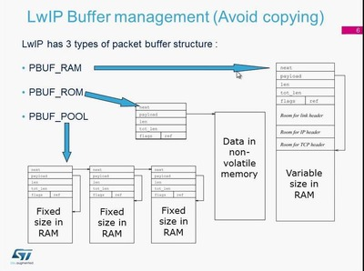

Slide 3
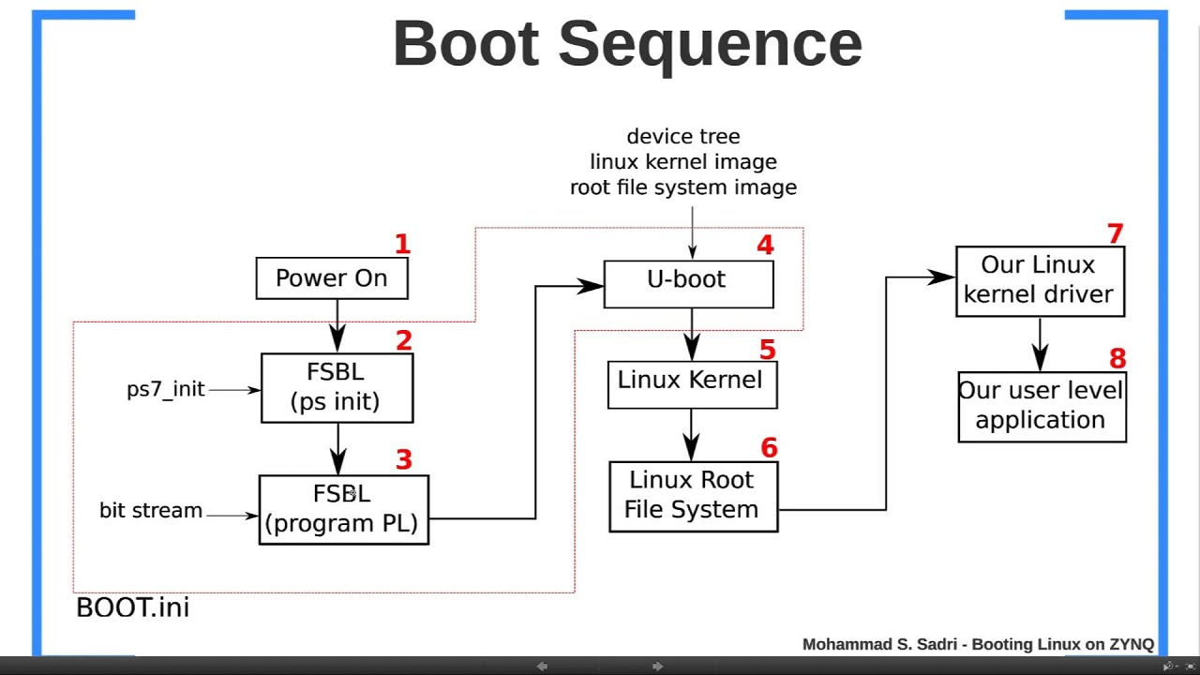
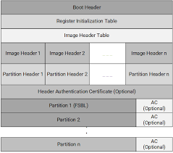
aleksei.rostov@protonmail.com

