Slide 1
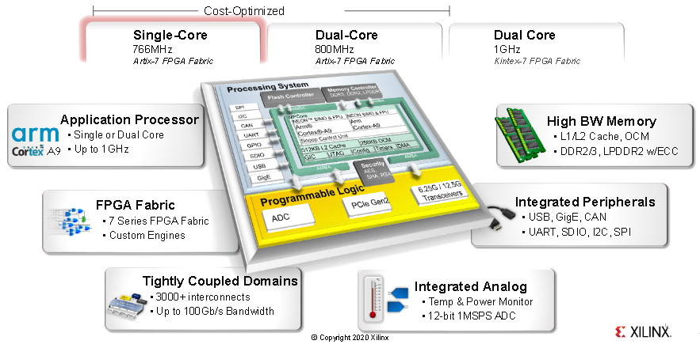
Zynq 7000: AXI DMA Networking
Aleksei Rostov, PhD,
Senior R&D Engineer,
FPGA/Embedded Linux Developer,
aleksei.rostov@protonmail.com

Slide 2
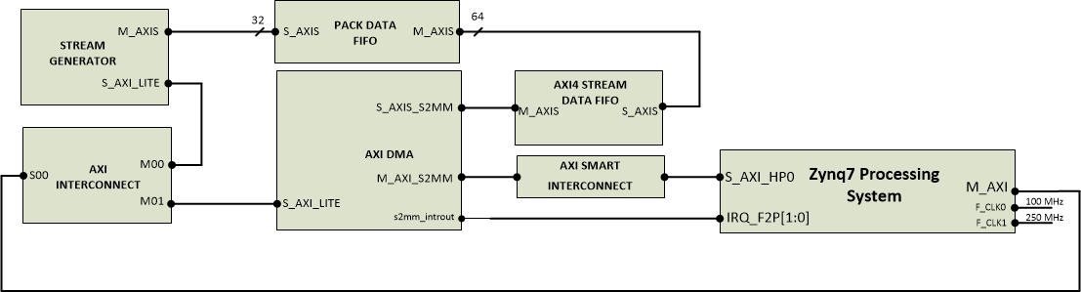
HARDWARE DESIGN
AGENTA
Memory mapped IP core creation
LWIP networking with AXI DMA using UDP/IP
aleksei.rostov@protonmail.com

