Slide 1
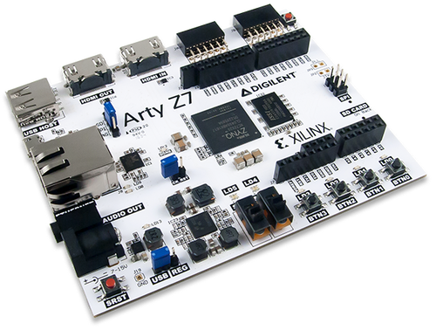
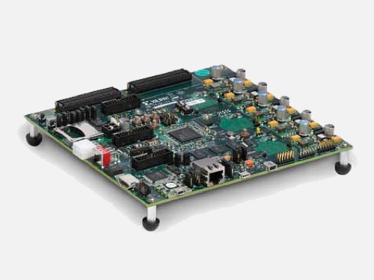
IQ demodulator: NCO – numerically controlled oscillator
Aleksei Rostov, PhD,
Senior R&D Engineer,
FPGA/Embedded Linux Developer,
aleksei.rostov@protonmail.com

Slide 2
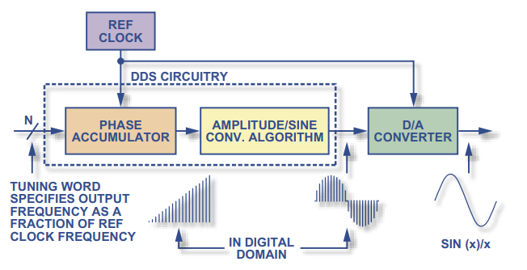
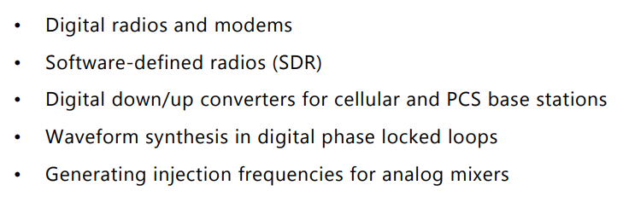
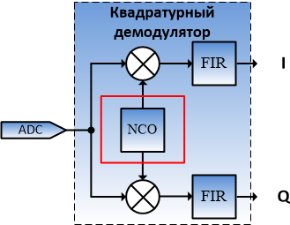
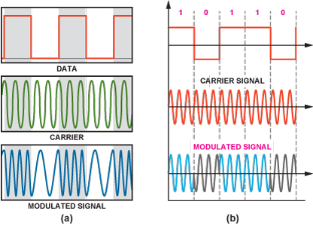
DDS direct digital synthesizer
Implementation
Application
NCO in IQ demodulator
Frequency shift and phase shift keying (FSK and PSK signals)

Slide 3
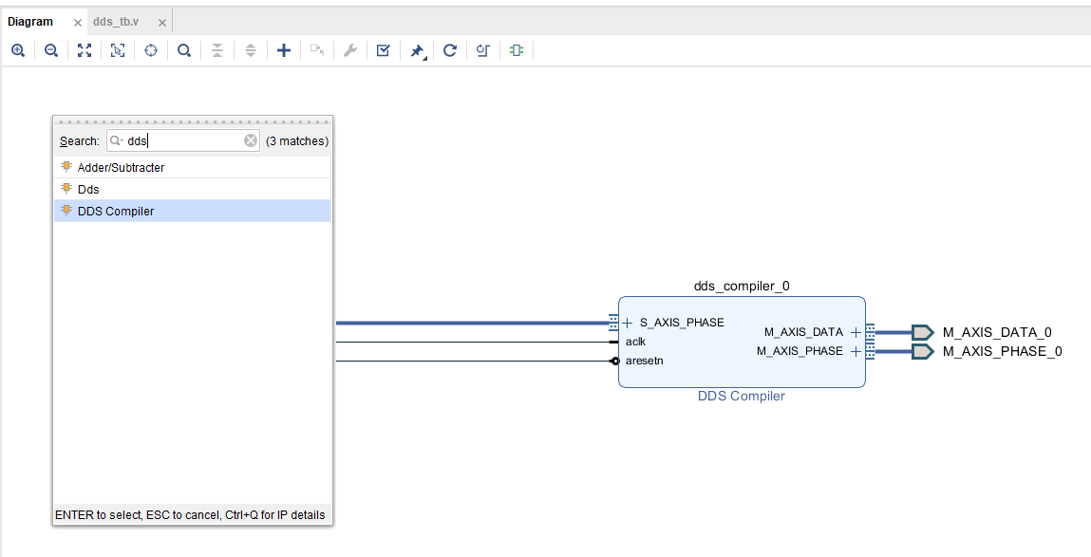
DESIGN FLOW
MATLAB model
Functional simulation (Testbench)
Synthesis, implementation and bitstream generating
Debugging using logic analyzer and VIO IP core
DDS signals
Sin/Cos
LFM
PSK / FSK
DDS compiler IP core
pg141-dds-compiler.pdf
aleksei.rostov@protonmail.com

Slide 4
PROJECT MODULES
dds_tb.v
Virtual IO
System ILA
clk
rstn
DDS compiler
Controller DDS
DDS compiler
phase_data
dds_wrapper.v
dds_data
phase_vld
dds_vld
Clock generator
Modules for functional simulation
Hardware design for FPGA
freq_0
control_dds.v
Timer process
dfreq
phase_data
t_mod
phase_vld
turn_on
Phase computing process
sync
sin2lfm
Controller for DDS
aleksei.rostov@protonmail.com

