Slide 1
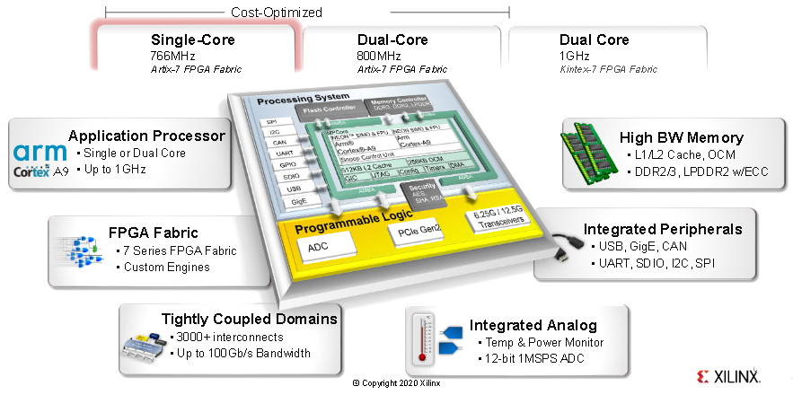
Zynq 7000: AXI DMA in Direct Register Mode
Aleksei Rostov, PhD,
Senior R&D Engineer,
FPGA/Embedded Linux Developer,
aleksei.rostov@protonmail.com

Slide 2
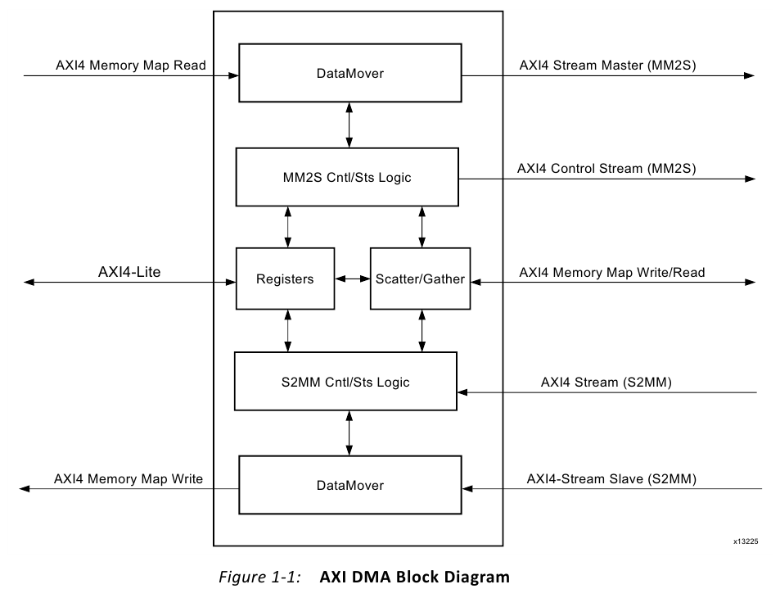
HARDWARE DESIGN
aleksei.rostov@protonmail.com

Slide 3
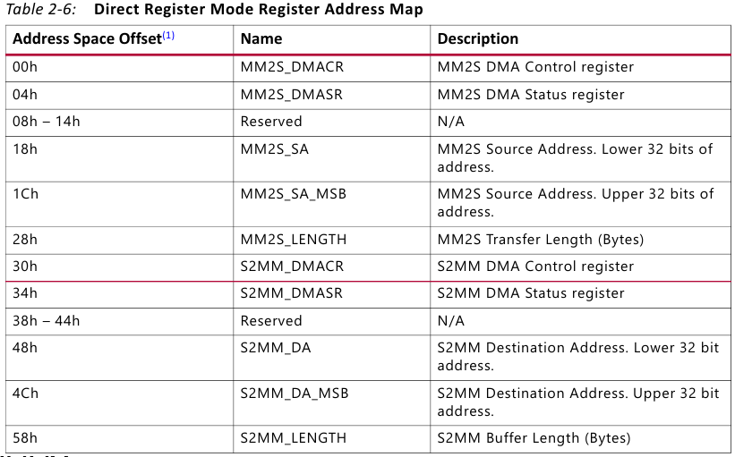
AXI DMA
aleksei.rostov@protonmail.com

Slide 4

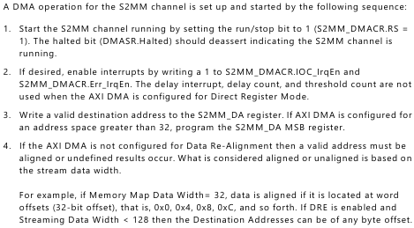
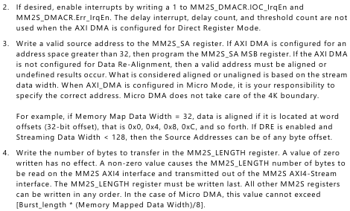
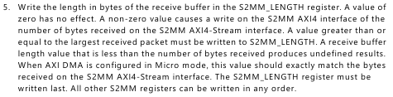
AXI DMA PROGRAMMING SEQUENCE
aleksei.rostov@protonmail.com

