Slide 1
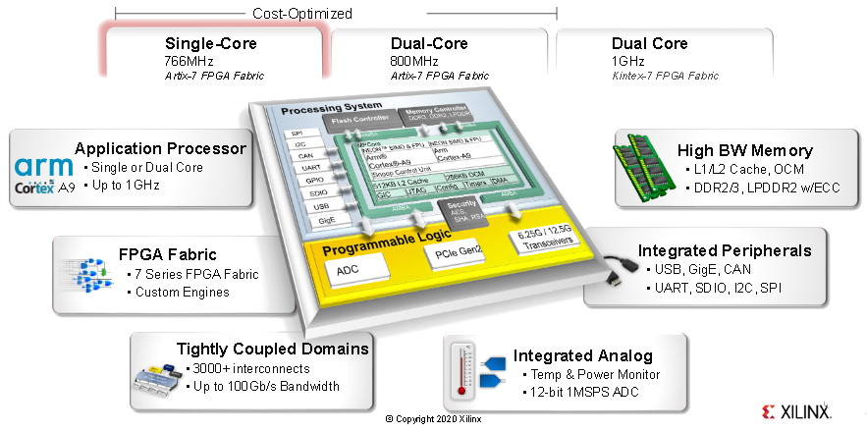
Zynq 7000: AXI DMA in Scatter Gather Mode
Aleksei Rostov, PhD,
Senior R&D Engineer,
FPGA/Embedded Linux Developer,
aleksei.rostov@protonmail.com

Slide 2
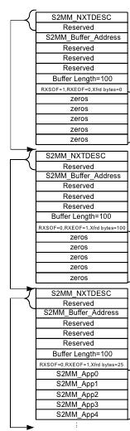
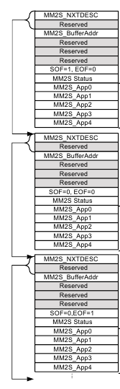
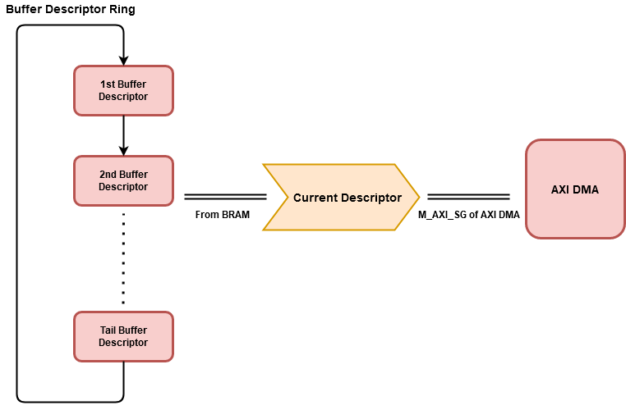
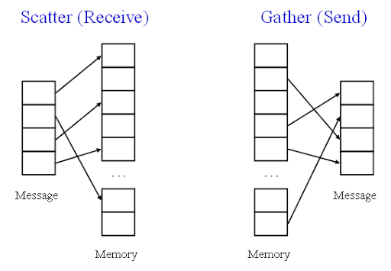

Slide 3
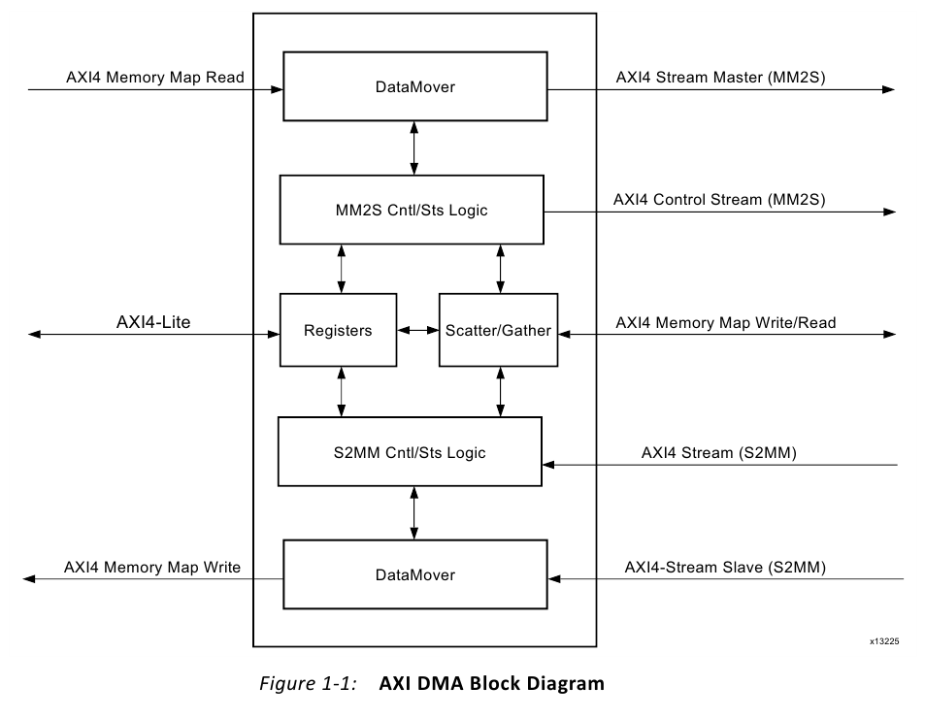
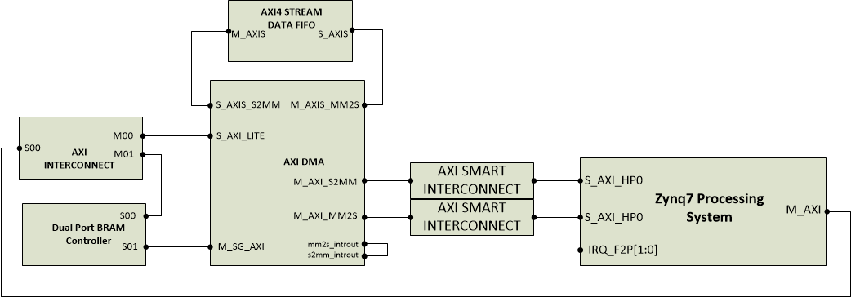
HARDWARE DESIGN
aleksei.rostov@protonmail.com

Slide 4
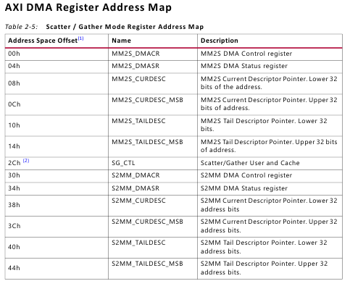
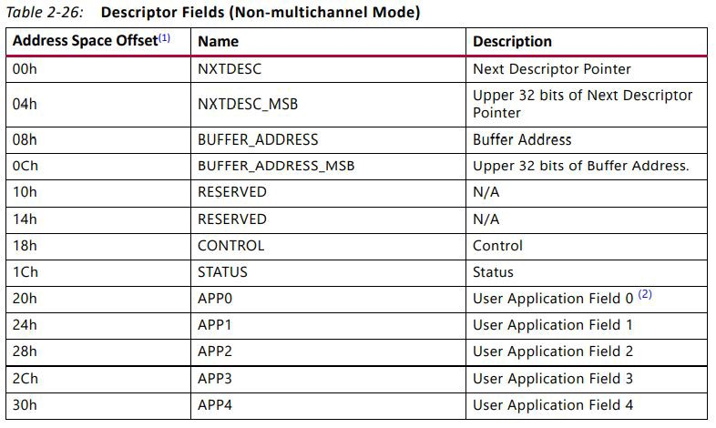
AXI DMA SCATTER GATHER MODE
aleksei.rostov@protonmail.com

Slide 5
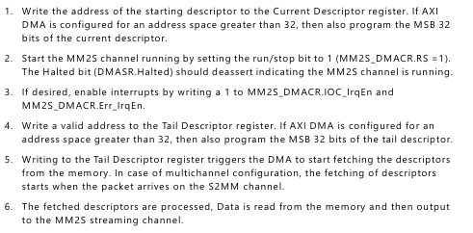
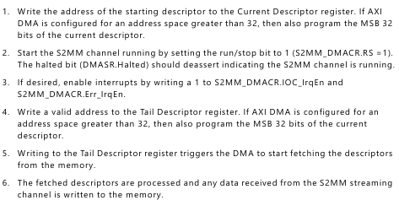
AXI DMA PROGRAMMING SEQUENCE
aleksei.rostov@protonmail.com

