Slide 1
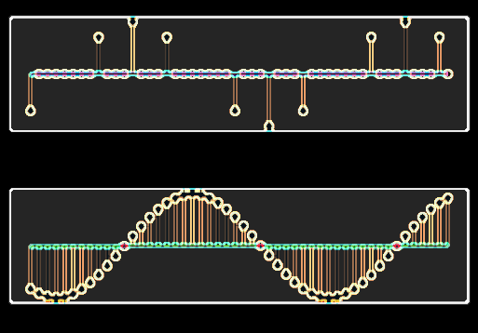
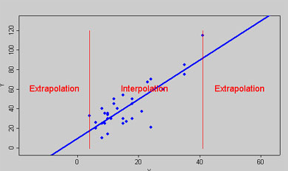
IQ MODULATOR and INTERPOLATION (HDL design)
Aleksei Rostov, PhD,
Senior R&D Engineer,
FPGA/Embedded Linux Developer,
aleksei.rostov@protonmail.com

Slide 2
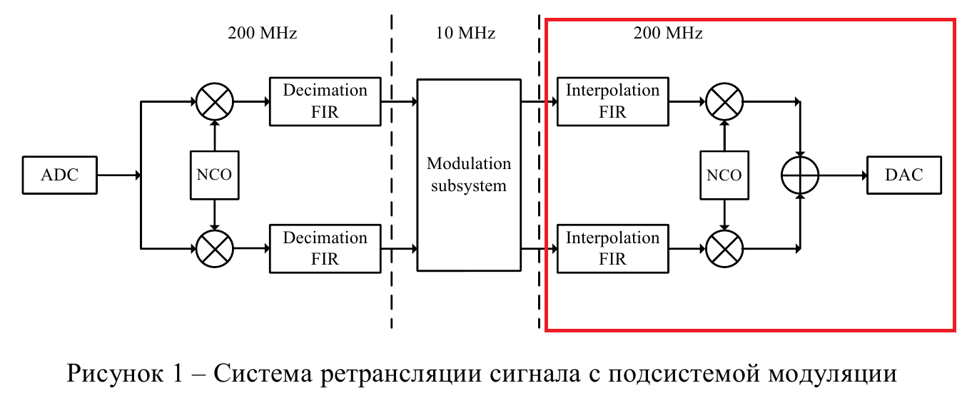
DESIGN FLOW
AGENTA
IQ modulator and interpolation filter MATLAB model
HDL design and implementation (Verilog) of Interpolation FIR filter and IQ modulator
MATLAB model
Functional simulation (Testbench)
Synthesis, implementation and bitstream generating
Debugging using logic analyzer and VIO IP core
aleksei.rostov@protonmail.com

Slide 3
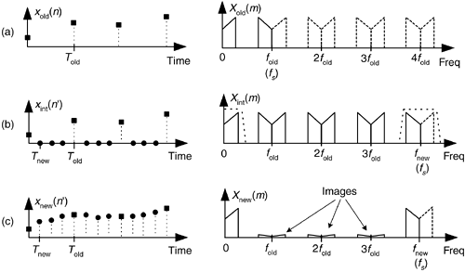
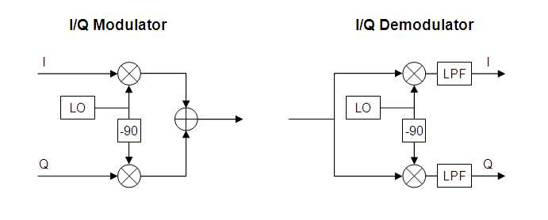
MATLAB model
Model structure
IQ LFM input signal 0…4 MHz
Filling by zeros
Low Pass FIR
UP converter
Interpolation of input signal
IQ modulator and demodulator

Slide 4
Interpolation FIR filter and IQ modulator: hardware design
Clock generator
clk25
clk250
clk25
clk250
System testbench
AXIS Data FIFO
adding zeros
Low Pass FIR
Multiplier
System ILA
Controller DDS
DDS compiler
add zeros testbench
Interpolator testbench
DDS compiler
adder
AXIS Data FIFO
adding zeros
Low Pass FIR
Multiplier
IQ modulator and interpolator by 10
aleksei.rostov@protonmail.com

