Slide 1
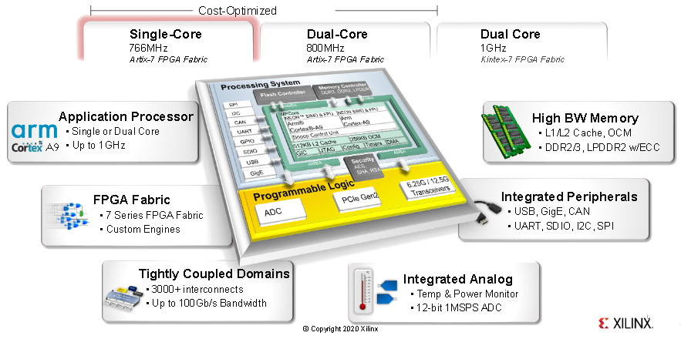
Zynq 7000: Overview, GPIOs, Interrupt Controller
Aleksei Rostov, PhD,
Senior R&D Engineer,
FPGA/Embedded Linux Developer,
aleksei.rostov@protonmail.com

Slide 2
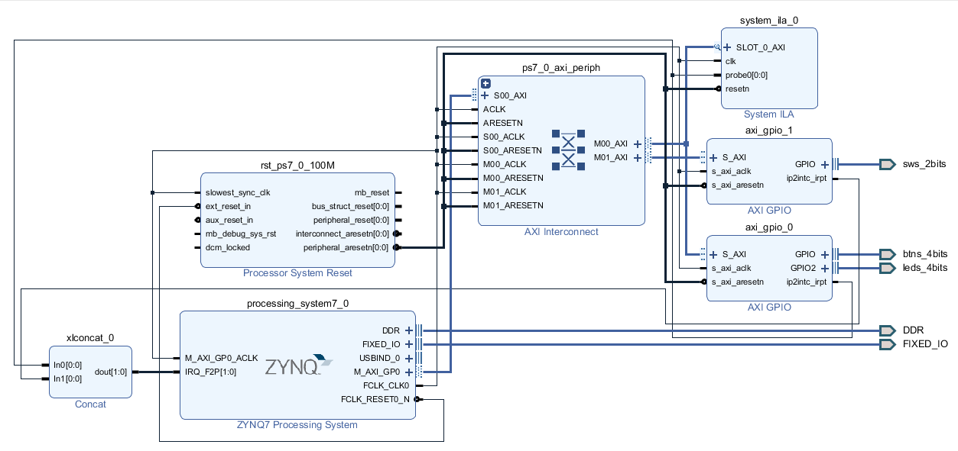
AGENTA
Zynq 7000 overview
Working with AXI GPIO and Generic Interrupt Controller (GIC)
aleksei.rostov@protonmail.com

Slide 3
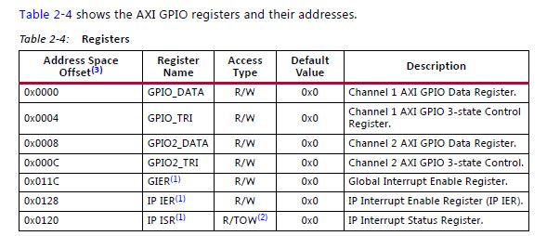
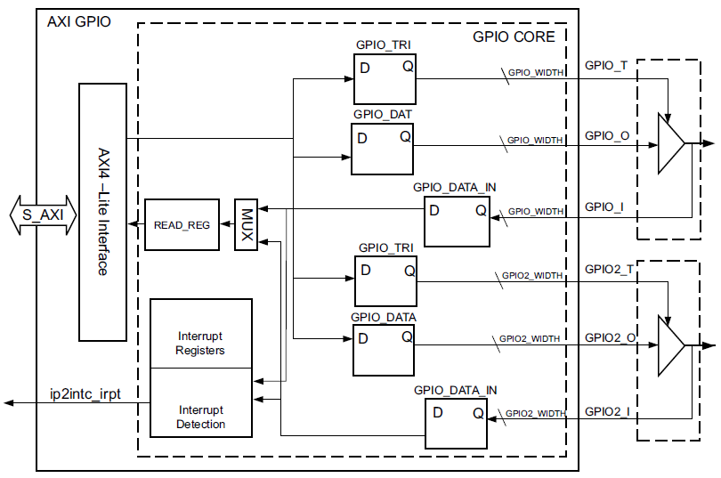
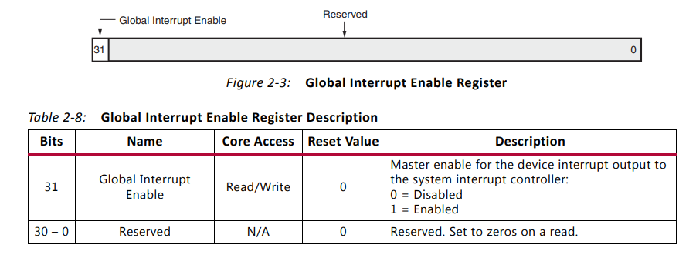
AXI GPIO
AXI GPIO Block Diagram
aleksei.rostov@protonmail.com

Slide 4
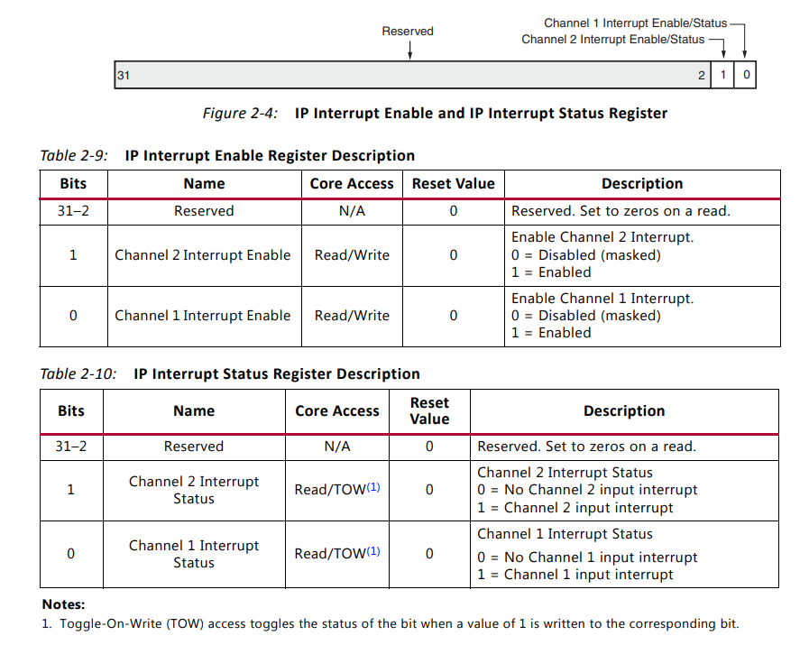
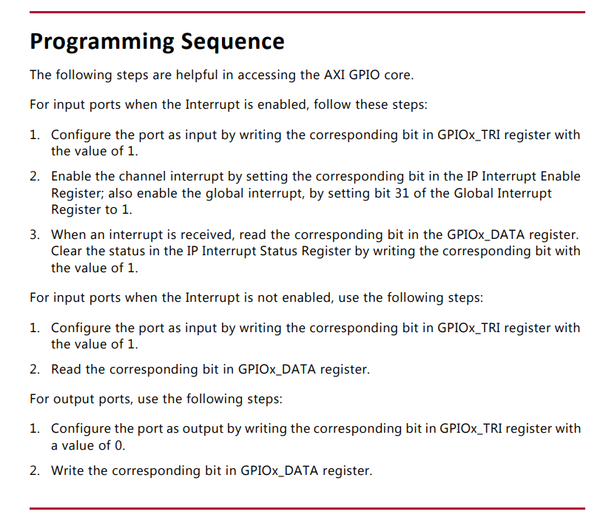
AXI GPIO
aleksei.rostov@protonmail.com

Slide 5
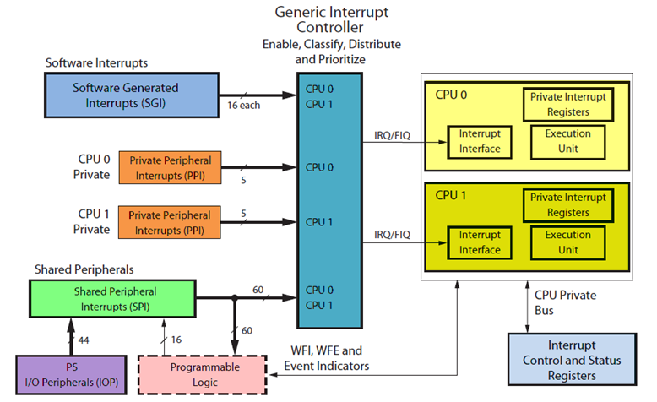
Interrupt Controller
aleksei.rostov@protonmail.com

