Slide 1
Digital System processing and embedded design for Xilinx SoC Zynq 7000/ MpSoC Zynq Ultrascale+
Aleksei Rostov, PhD,
Senior R&D Engineer,
FPGA/Embedded Linux Developer,
aleksei.rostov@protonmail.com

Slide 2
Instruments and Structure of course
Vivado 2019
Vivado IDE
Vivado HLS
MATLAB 2019b
Petalinux 2019
Xilinx SDK 2019
Github
VMware Workstation
IDEs/Instruments
Course structure
Programmable logic
RTL design for DSP
Vivado HLS for DSP
Processing systems
(Zynq 7000 ZynqMP Ultrascale+)
Standalone / RTOS
Linux OS
aleksei.rostov@protonmail.com

Slide 3
HARDWARE DESIGN EXAMPLES
Processing system with integrated programmable logic
Example of DSP digital system for RTL design
aleksei.rostov@protonmail.com

Slide 4
GIT structure with folders
Presentation
Introduction.pptx
Others
scripts
Vivado
vivado.sdk
vivado.runs
vivado.sim
MATLAB
dsp.m
AnyFile.bin
aleksei.rostov@protonmail.com

Slide 5
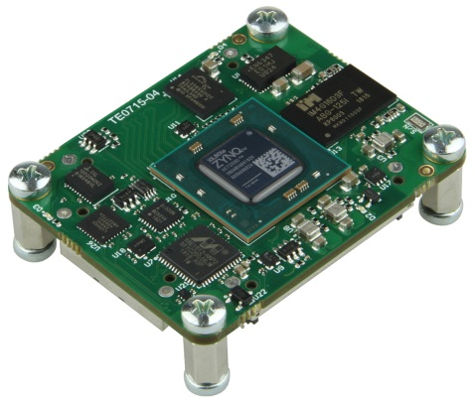
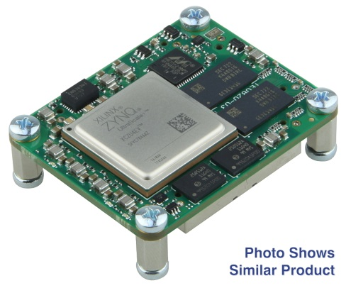
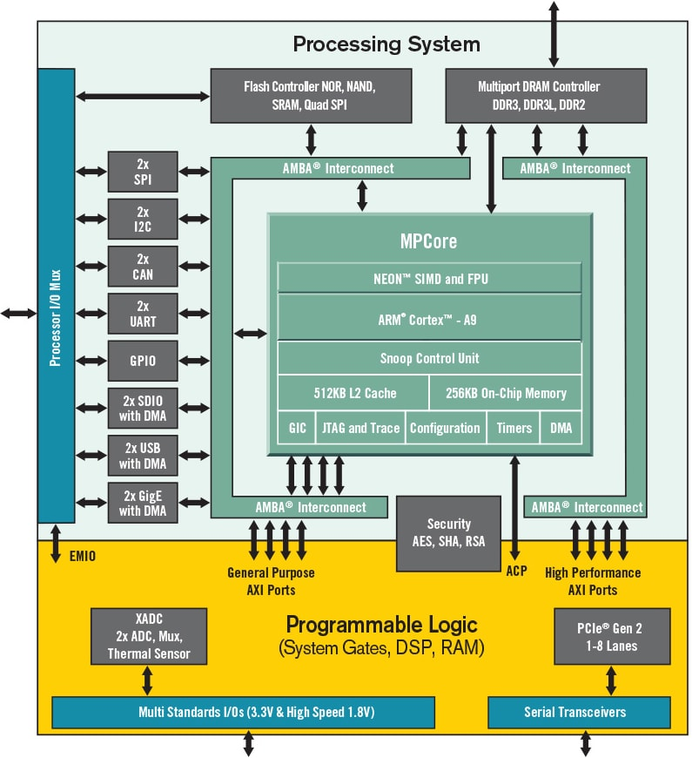
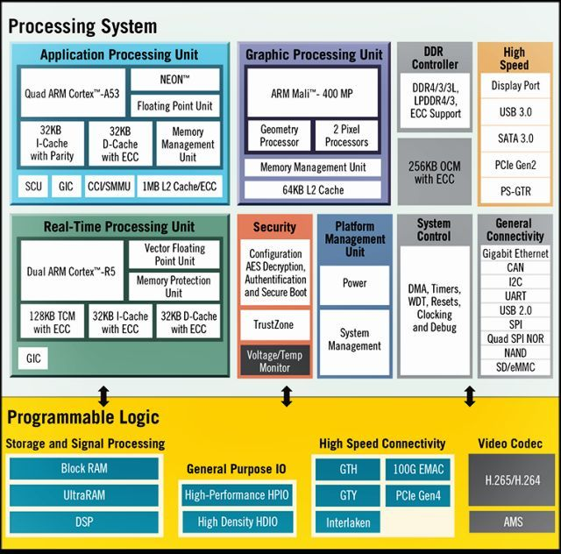
Xilinx SoC Zynq 7000
Xilinx MpSoC Zynq Ultrascale+
aleksei.rostov@protonmail.com

