Slide 1
IQ demodulator: NCO – numerically controlled oscillator
Aleksei Rostov, PhD,
Senior R&D Engineer,
FPGA/Embedded Linux Developer,
aleksei.rostov@protonmail.com

Slide 2
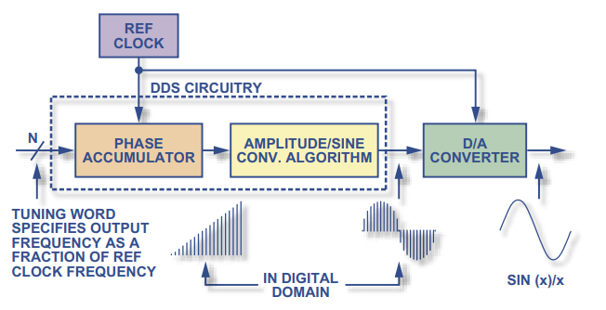
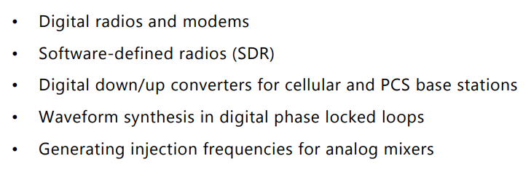
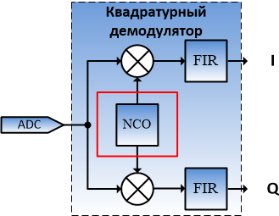
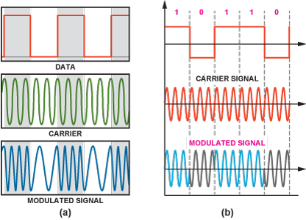
DDS direct digital synthesizer
Implementation
Application
NCO in IQ demodulator
Frequency shift and phase shift keying (FSK and PSK signals)

Slide 3
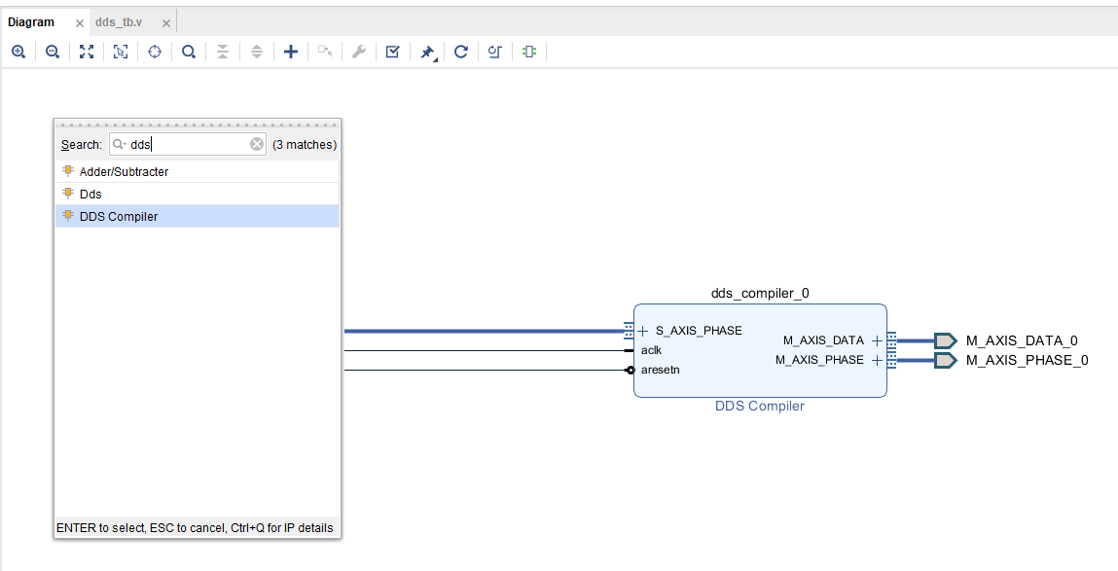
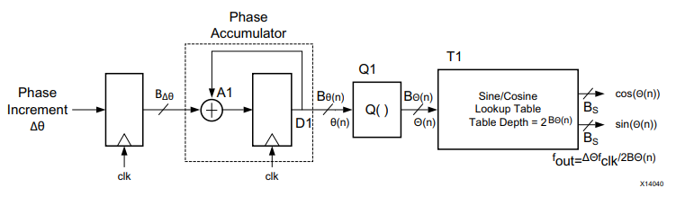
Xiilinx implementation
dds compiler IP core implementation
dds compiler IP core
DDS signals
Sin/Cos
LFM
PSK / FSK
aleksei.rostov@protonmail.com

