Slide 1
Vivado High Level Synthesis Tutorial
Aleksei Rostov, PhD,
Senior R&D Engineer,
FPGA/Embedded Linux Developer,
aleksei.rostov@protonmail.com

Slide 2
Agenda
Introduction to Vivado HLS
Role for FPGA design
C/C++ language usage
Optimization strategies, RTL interfaces
Design flow
Case: FIR filter development
aleksei.rostov@protonmail.com

Slide 3
High-Level Synthesis (HLS)
HLS is an automated design process that transforms a high-level functional specification to a [optimized] register-transfer level (RTL) description suitable for hardware implementation
HLS tools are widely used for complex ASIC and FPGA design
Main benefits
Productivity: lower design complexity and faster simulation speed
Portability: single source → multiple implementations
Permutability: rapid design space exploration → higher quality of result (QoR)
aleksei.rostov@protonmail.com

Slide 4
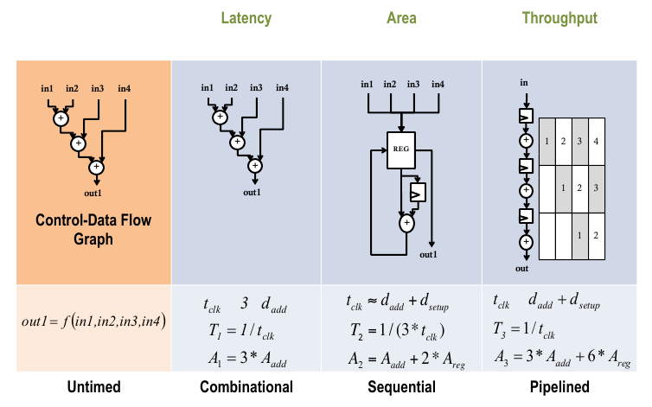
Permutability: Faster Design Space Exploration
aleksei.rostov@protonmail.com

Slide 5
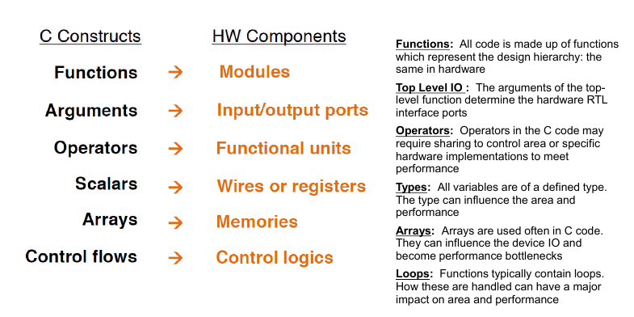
Mapping of C/C++ constructs to RTL
aleksei.rostov@protonmail.com

Slide 6
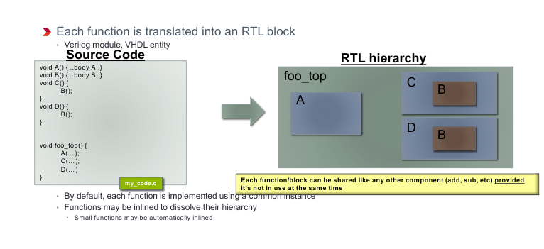
Functions & RTL hierarchy
aleksei.rostov@protonmail.com

Slide 7
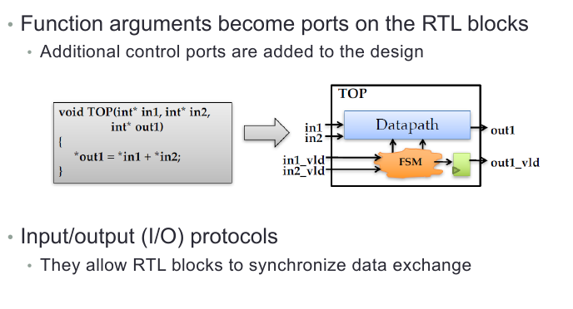
Function arguments
aleksei.rostov@protonmail.com

Slide 8
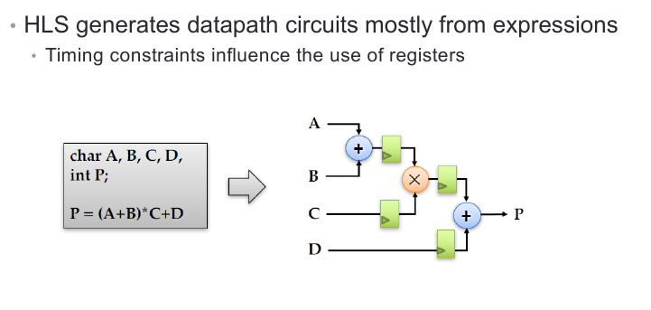
Expressions
aleksei.rostov@protonmail.com

Slide 9
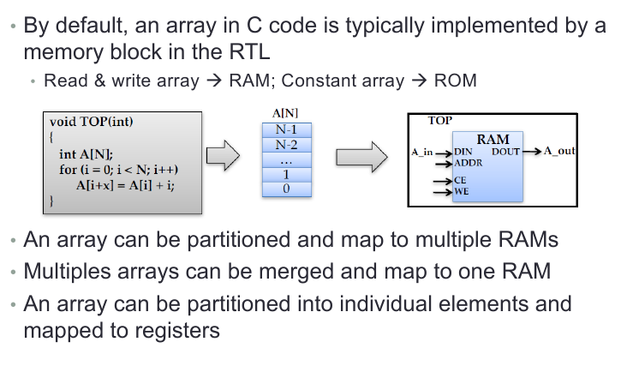
Arrays
aleksei.rostov@protonmail.com

Slide 10
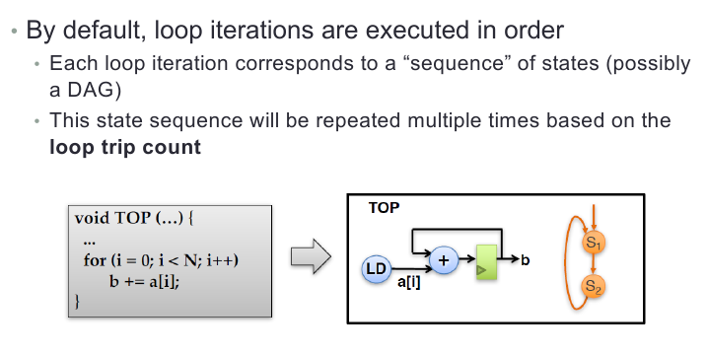
Loops
aleksei.rostov@protonmail.com

Slide 11
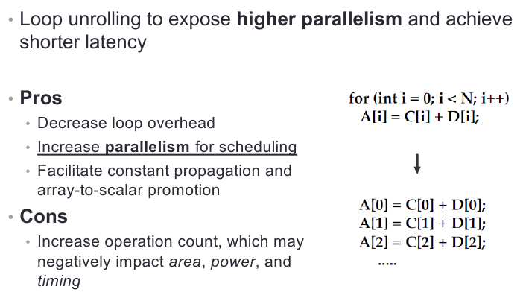
Loop unrolling
aleksei.rostov@protonmail.com

Slide 12
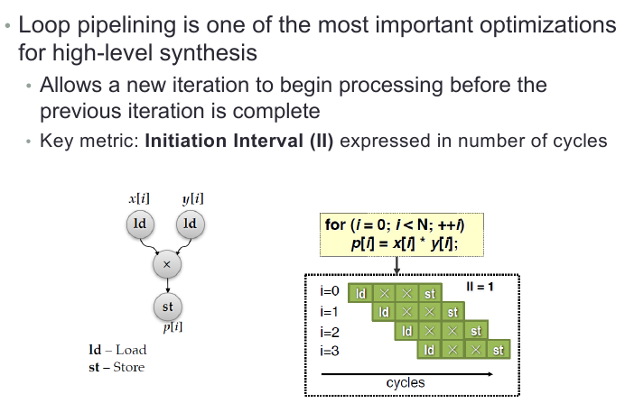
Loop pipelining
aleksei.rostov@protonmail.com

Slide 13
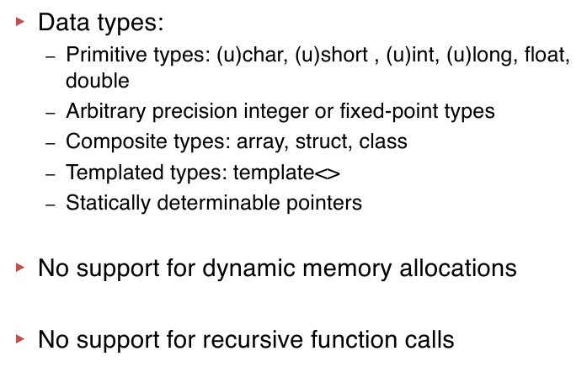
Typical C/C++ Synthesizable Subset
aleksei.rostov@protonmail.com

