Slide 1
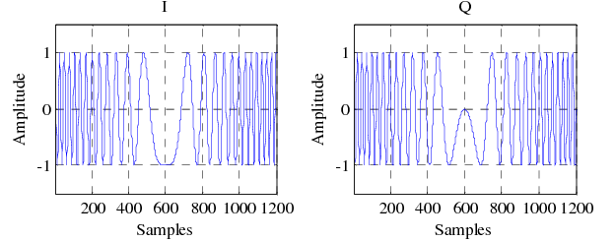
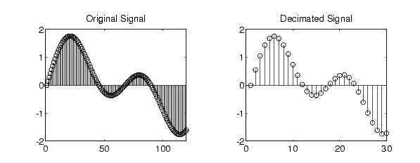
IQ demodulator and decimation (HDL design)
Aleksei Rostov, PhD,
Senior R&D Engineer,
FPGA/Embedded Linux Developer,
aleksei.rostov@protonmail.com

Slide 2
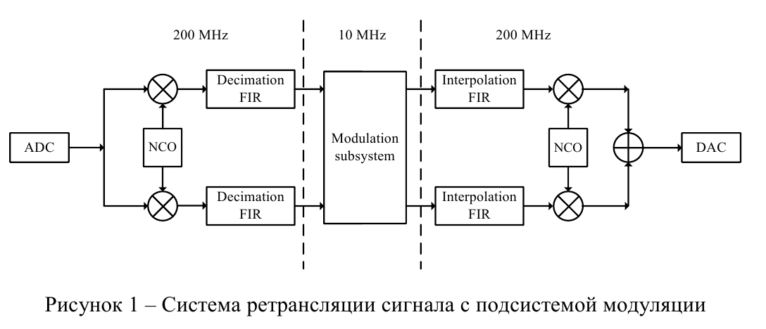
DESIGN FLOW
AGENTA
IQ demodulator and decimation filter MATLAB model
HDL design and implementation (Verilog) of Decimation FIR filter
Decimation FIR filter AXIS IP core creation
MATLAB model
Functional simulation (Testbench)
Synthesis, implementation and bitstream generating
Debugging using logic analyzer and VIO IP core
aleksei.rostov@protonmail.com

Slide 3
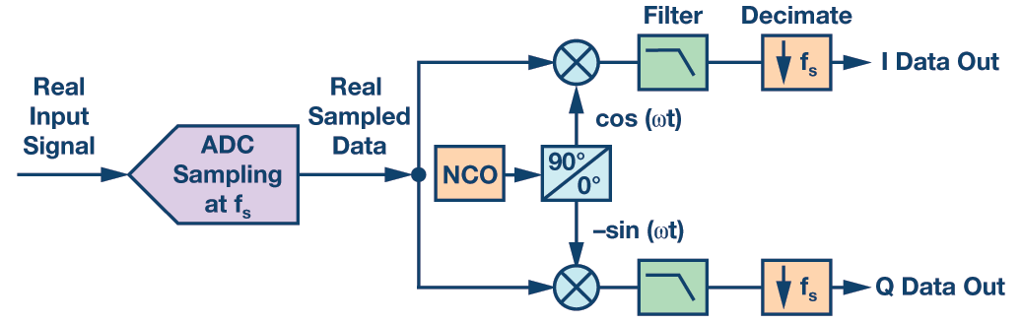
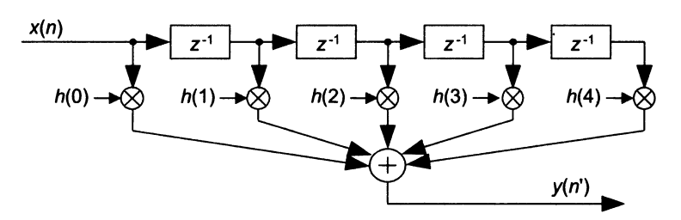
MATLAB model
Model structure
Real LFM input signal 28…32 MHz
COS and SIN Multipliers
Low Pass FIR (anti-aliasing)
Down sampling
IQ demodulator with decimation
FIR filter with multiplexed output

Slide 4
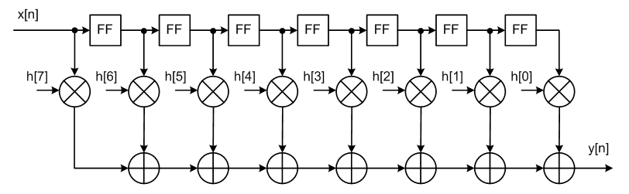
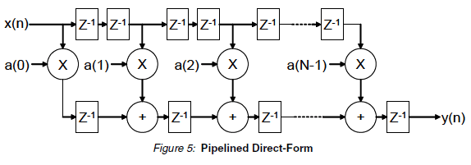
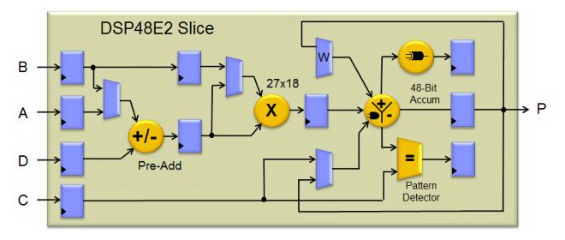
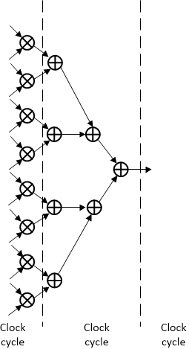
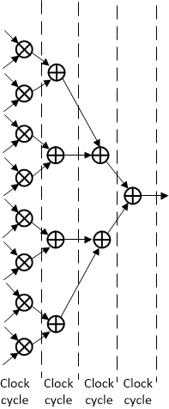
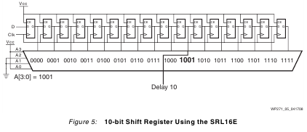
FIR filter hardware design and implementation
FIR filter direct form

Slide 5
PROJECT MODULES
fir_dec_tb.v
Controller DDS
System ILA
clk
rstn
Mem file
TAPS
Width
DDS compiler
FIR decimator
in_data
fir_dec.v
fir_data
in_vld
fir_vld
Clock generator
Modules for functional simulation
Hardware design for FPGA
freq_0
control_dds.v
Timer process
dfreq
phase_data
t_mod
phase_vld
turn_on
Phase computing process
sync
sin2lfm
Controller for DDS
aleksei.rostov@protonmail.com

