Slide 1
BERT Model

Slide 2
BERT
BERT stands for Bidirectional Encoder Representations from Transformers
It was introduced by Google AI in 2018 (by Jacob Devlin et al.) and revolutionized Natural Language Processing (NLP).

Slide 3
The Problem Before BERT
Earlier models like Word2Vec and GloVe created static embeddings — the word “bank” always had one vector, whether in:
“river bank” or
“bank account”
These models didn’t understand context.
Then came Transformers (by Vaswani et al., 2017) — which use self-attention to understand context globally.

Slide 4
Basic Definition - Transformer Architecture
When we say Transformer, we’re referring to a specific neural network design introduced by Vaswani et al. (2017) in “Attention Is All You Need.”
That paper introduced two key ideas:
The self-attention mechanism
The stacked layer architecture (multi-head attention + feedforward layers + residual connections + layer normalization)
Those architectural principles are what make a model a Transformer — not necessarily the presence of both encoder and decoder.

Slide 5
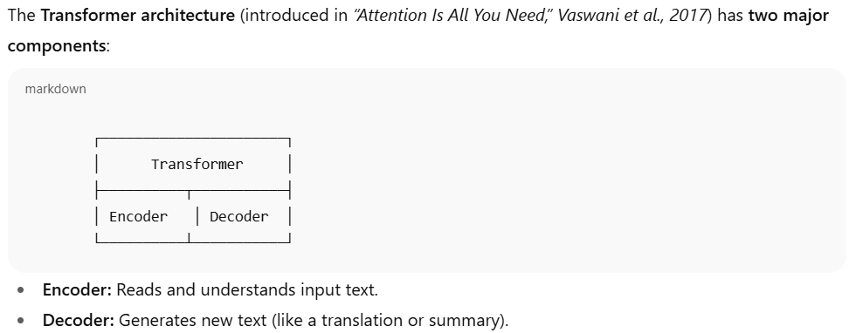
Transformer Architecture
The Transformer model has two main parts:
Encoder — reads input text and creates contextual representations
Decoder — generates text (used in translation, GPT, etc.)
“Transformer” = a neural network built using self-attention layers (not necessarily both encoder and decoder blocks).
BERT only uses the Encoder part of the Transformer — that’s why it’s great for understanding text, not generating it.

Slide 6
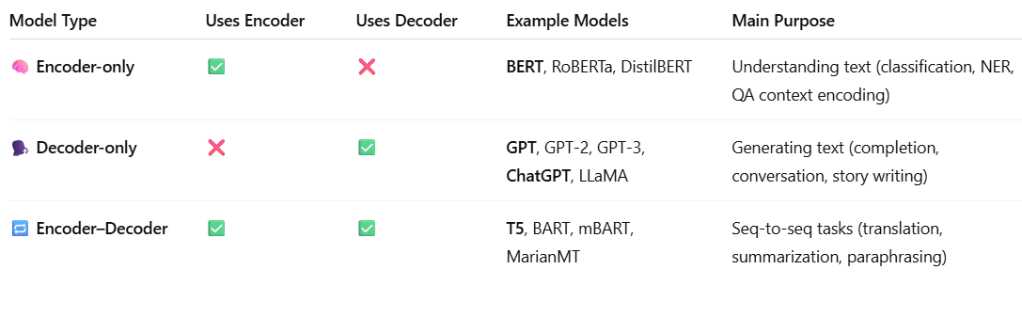
Comparison between BERT and GPT
BERT use only encoder part of transformers
GPT use only decoder part of transformers
*you can use GPT (decoder-only models) for classification — but it’s not what it was originally designed for.

Slide 7
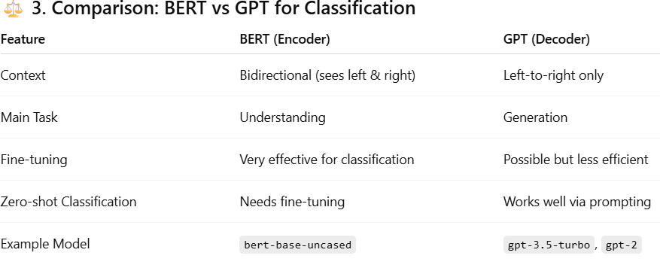
BERT Vs GPT

Slide 8
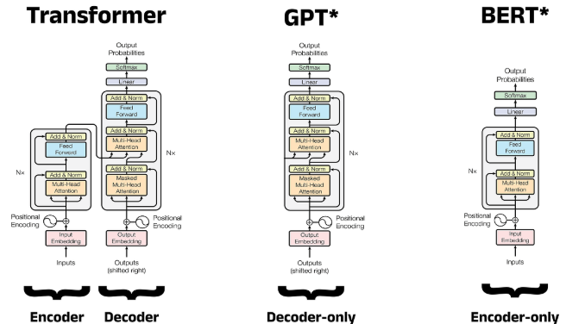
Three important architectures

Slide 9
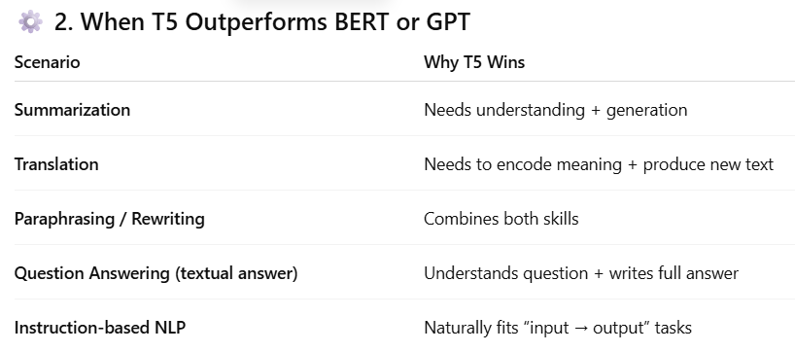
T5 model
T5 = Full Transformer (Encoder + Decoder)
T5 (Text-to-Text Transfer Transformer) combines:
🧠 Encoder: understands input deeply (like BERT)
🗣️ Decoder: generates output text (like GPT)
So T5 can understand and generate at the same time.

Slide 10
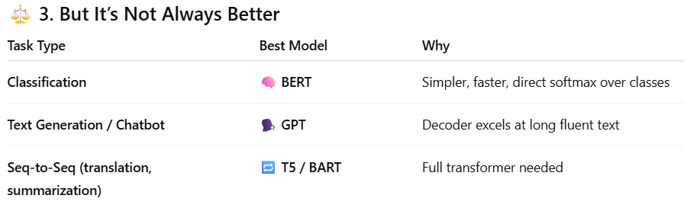
T5 not always better

Slide 11
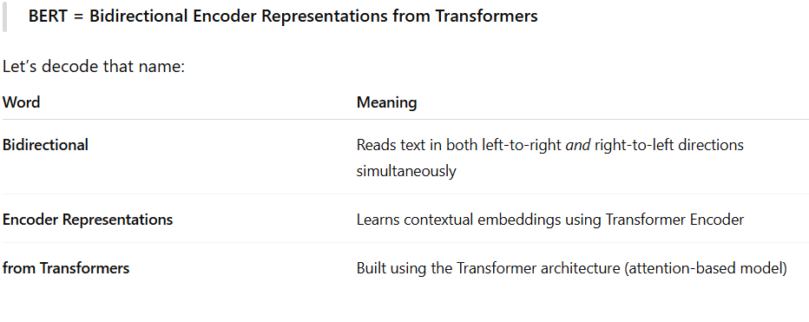
BERT
*GPT or LSTMs read text in one direction (left-to-right or right-to-left).

Slide 12
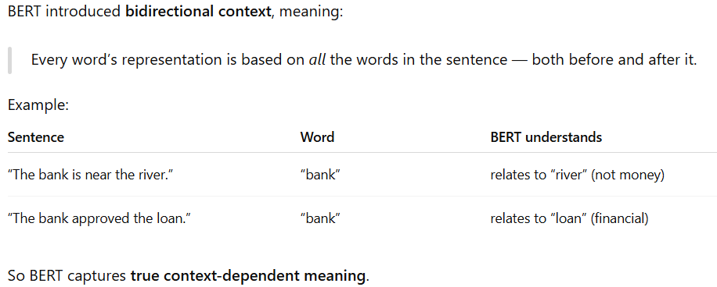
Benefit of bi-direction

Slide 13
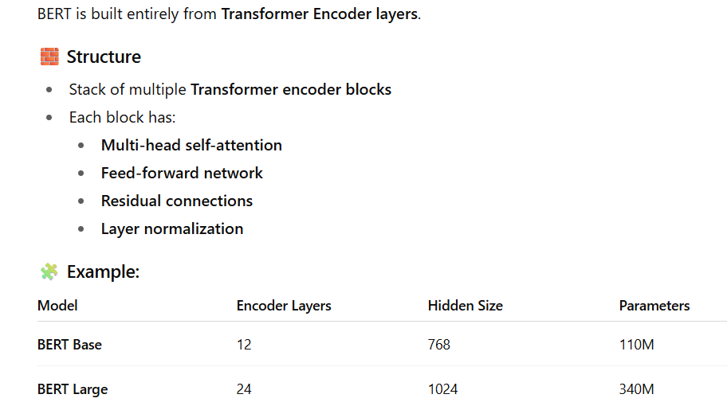
BERT Architecture

Slide 14
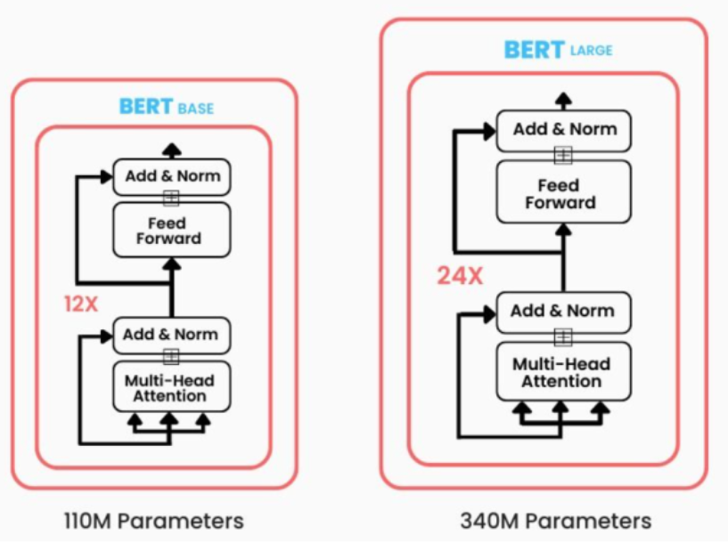
BERT Architecture

Slide 15
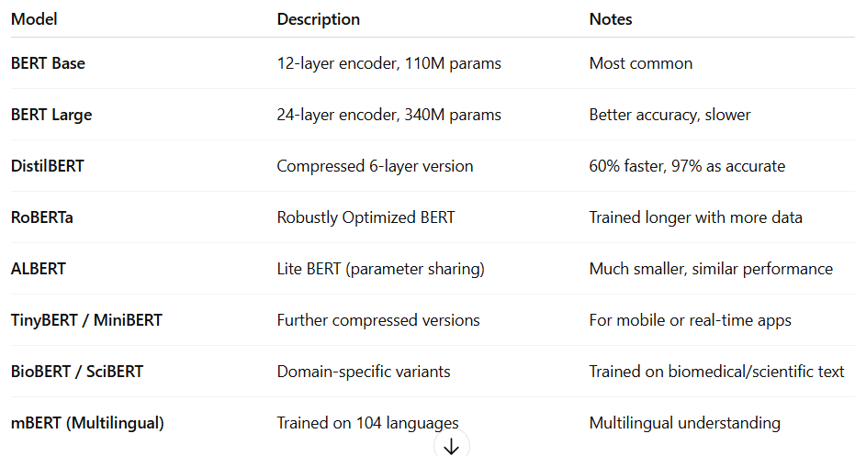
Types of Bert Model

Slide 16
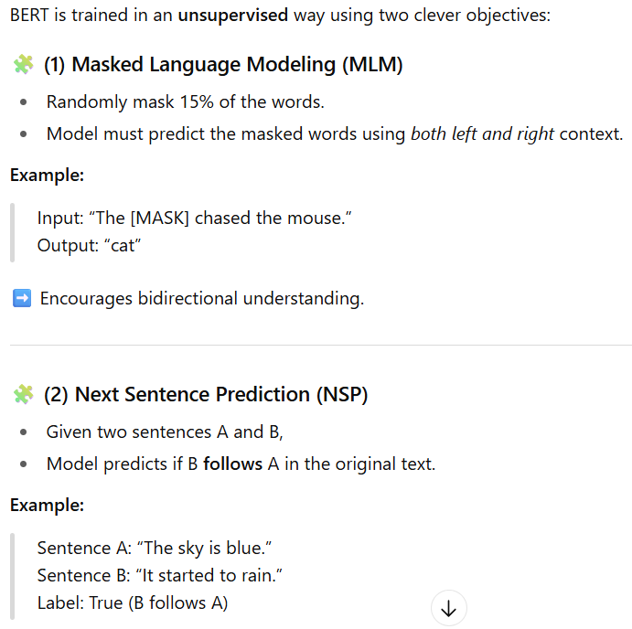
Bert Pretraining tasks 2 Tasks →

Slide 17
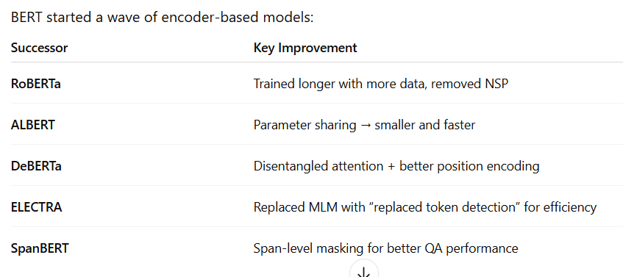
Successor inspired by BERT

Slide 18
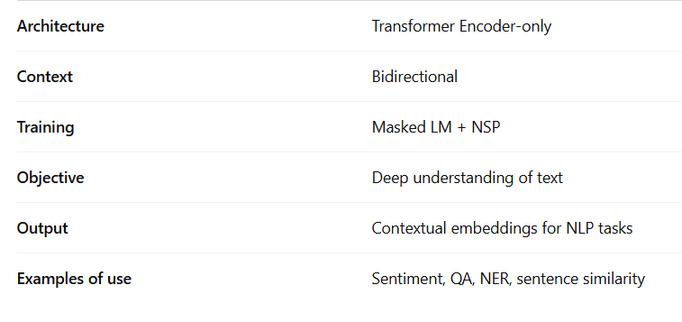
Summery

