Slide 1
Fine-Grained Car Classification: SVM vs CNN
Manu Thomas and Jesse Hao

Slide 2
Problem
Problem: classify car images across 196 make/model/year classes.
Why it is hard: many classes differ only by subtle visual details such as trim, headlights, grille shape, or model year.
Research question: how much do we gain by moving from classical SVM pipelines to transfer-learned CNNs on the same split?
Dataset: Stanford Cars, 16,185 images, 196 classes, real-world variation in lighting, angle, and background.
Why this task matters: it is a strong fine-grained vision benchmark for comparing hand-crafted and learned features.

Slide 3
Dataset and Preprocessing
Dataset: Stanford Cars, 16,185 images, 196 classes, re-split to 70/15/15 train/val/test.
Data challenges: subtle inter-class differences, real-world pose/background variation, and mild class imbalance.
HOG + SVM: resize to 128x128, grayscale, extract HOG descriptors with pixels_per_cell=(16,16).
Raw-pixel + SVM: resize to 64x64, grayscale, flatten, then standardize and apply PCA.
CNNs: RGB input, resize/crop, ImageNet normalization; improved CNN also uses stronger augmentation.
Reason for these choices: keep the classical pipelines tractable while giving the CNNs enough visual detail to learn fine-grained cues.

Slide 4
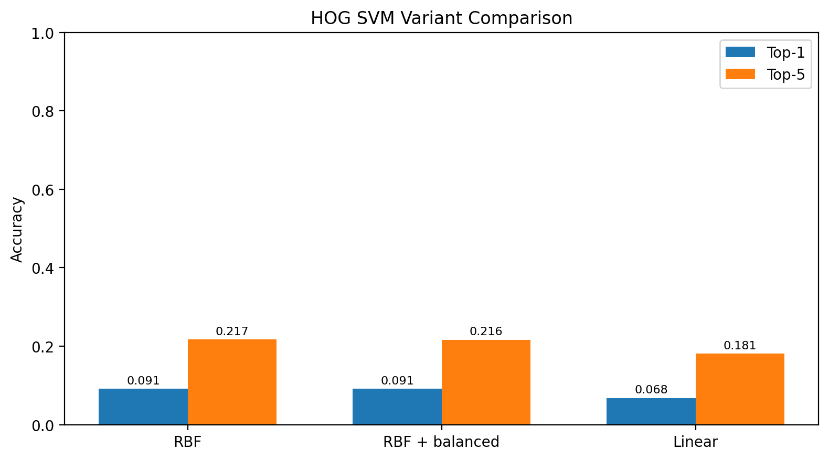
HOG SVM Variant Comparison

Slide 5
Classical ML Methods - SVM
HOG + SVM (RBF): strongest classical baseline; best test Top-1 = 0.0910, Top-5 = 0.2171.
HOG + SVM (RBF, balanced): nearly identical to standard RBF; Top-1 = 0.0914, Top-5 = 0.2162.
HOG + SVM (linear): weaker than RBF; Top-1 = 0.0680, Top-5 = 0.1808.
Raw pixels + SVM: worst classical result even after PCA; Top-1 = 0.0313, Top-5 = 0.0840.
Takeaway: HOG helps a classical model more than raw pixels do, and nonlinear decision boundaries matter more than class reweighting on this dataset.

Slide 6
Deep Learning Methods - CNN
Baseline CNN: pretrained ResNet18, 10 epochs, best test Top-1 = 0.8262, Top-5 = 0.9650.
Improved CNN: pretrained ResNet34, stronger augmentation, AdamW, cosine LR schedule, label smoothing, full fine-tuning.
Improved CNN test result: Top-1 = 0.8929, Top-5 = 0.9835.
Why CNNs work here: they learn fine-grained texture, edge, and semantic cues directly from the images instead of relying on hand-crafted descriptors.

Slide 7
Why These Methods?
The project compares two paradigms on exactly the same split:
1. classical feature engineering: HOG or raw pixels + SVM
2. learned visual representations: transfer-learned CNNs
Within the SVM family we also compare kernel choice and class weighting.
Within the CNN family we compare a simpler baseline against a stronger training recipe.
This makes the final performance gap easier to interpret than a single baseline-vs-model comparison.

Slide 8
Evaluation Setup
Split: 70/15/15 train/validation/test, identical across all models.
Metrics: Top-1 accuracy and Top-5 accuracy.
Model selection: validation used to choose hyperparameters and checkpoints.
Final reporting: test-set results for all six models.
Comparisons: RBF vs linear, balanced vs unbalanced HOG SVM, HOG vs raw pixels, baseline CNN vs improved CNN, and SVMs vs CNNs overall.

Slide 9
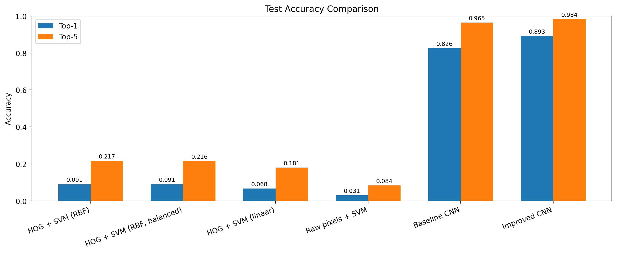
Results
Test-set comparison across all six models. The chart shows both Top-1 and Top-5 accuracy.

Slide 10
Interpretation
Main result: both CNNs massively outperform all SVM baselines on this fine-grained task.
Best classical model: HOG + SVM (RBF).
Balanced class weights had almost no effect, so class imbalance was not the main bottleneck.
Linear HOG SVM underperformed RBF, suggesting the class boundaries are meaningfully nonlinear.
Improved CNN beat the baseline CNN by about 6.7 points in Top-1 accuracy and about 1.9 points in Top-5 accuracy on test.

Slide 11
Error Analysis
Likely failure modes to discuss:
SVMs often confuse cars with similar silhouettes but different trims or model years because HOG drops color and fine texture.
Raw-pixel SVM is especially weak because flattened pixels are a poor representation for a classical classifier.
CNNs still likely fail on unusual viewpoints, occlusion, or visually near-duplicate classes.
Good final slide addition: include 2-3 example mistakes once representative prediction images are selected.

Slide 12
Limitations and Next Steps
Limitations: we tested a limited family of classical and deep models rather than an exhaustive benchmark.
HOG 8x8 was too expensive on the available hardware, so the final HOG pipeline uses 16x16 cells.
Raw-pixel SVM required PCA and a lower 64x64 input size just to be practical.
Next steps: add qualitative failure cases, try larger pretrained backbones or ensembles, and investigate why balanced weights barely changed the HOG + RBF result.

Slide 13
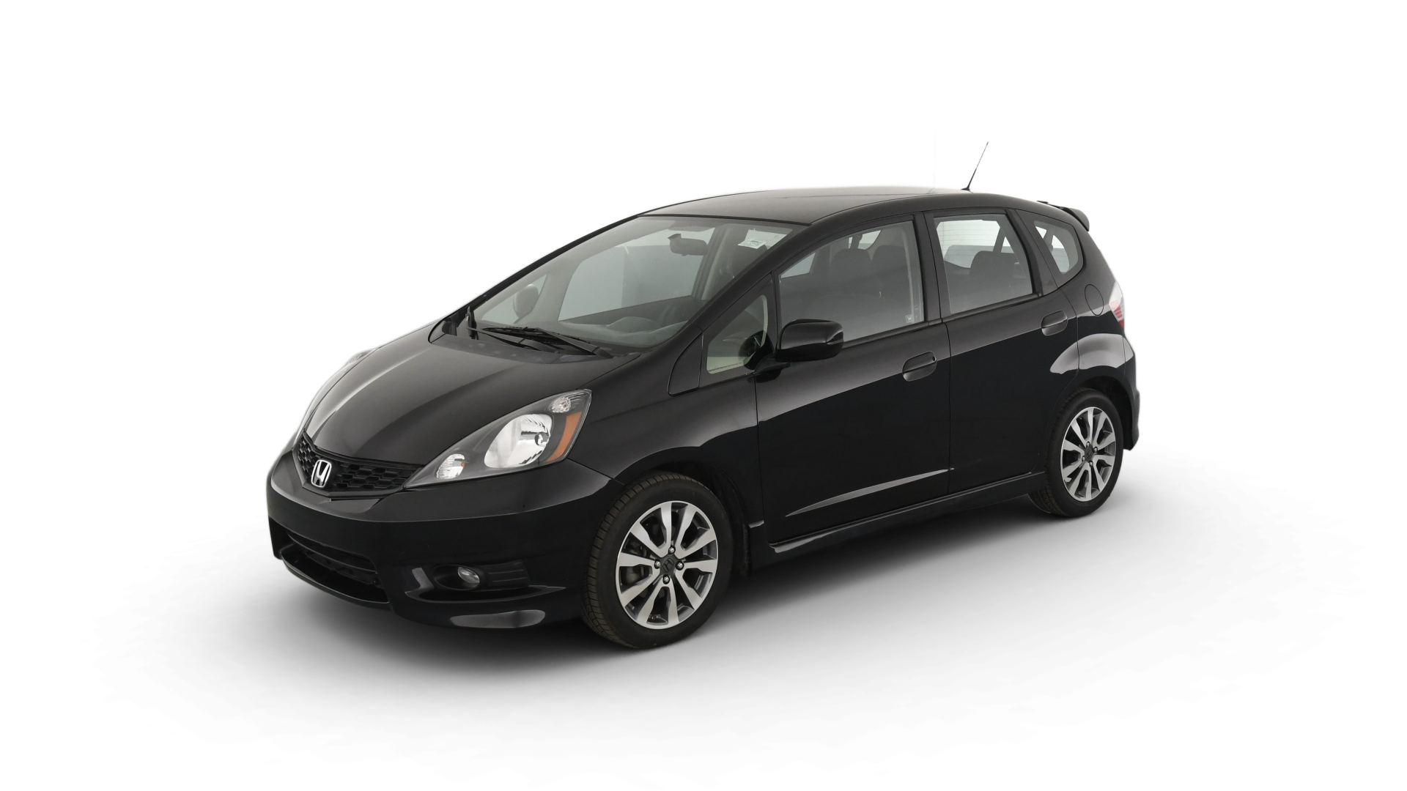
Thank You
Questions?
Quick audience prompt: if you had to guess this car with 100% Top-1 accuracy, what visual details would you use?

